Slide 1
CSSE 132
Arithmetic Logic Unit
Tuesday, March 17, 2020
Adapted from CMU 15-213/18-213/15-513

Slide 2
Questions
ALU is an "all-in-one" circuit that perform multiple operations.
  It can do AND, OR, ADD and more
How to select an operation?
  Multiplex
How to build an arithmetic logic unit?
  AND, OR, ADD, SUB, SLT, etc.
How to extend to multi-bit?
Notes:
Do a quick recap on the top-down view.

Slide 3
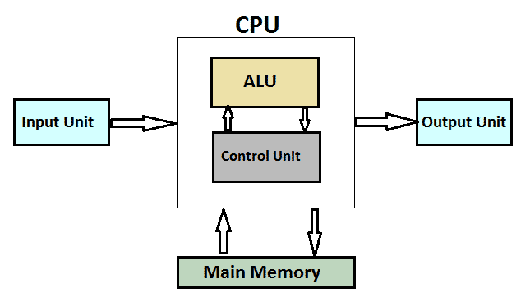
Introduce ALU (Arithmetic Logic Unit)
The “brawn” of the computer

Slide 4
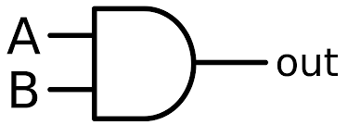
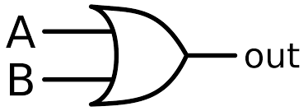
Mutiplexer
Given inputs A and B, we also need a “selector” to choose what we want to perform

Slide 5
Multiplexer

Slide 6
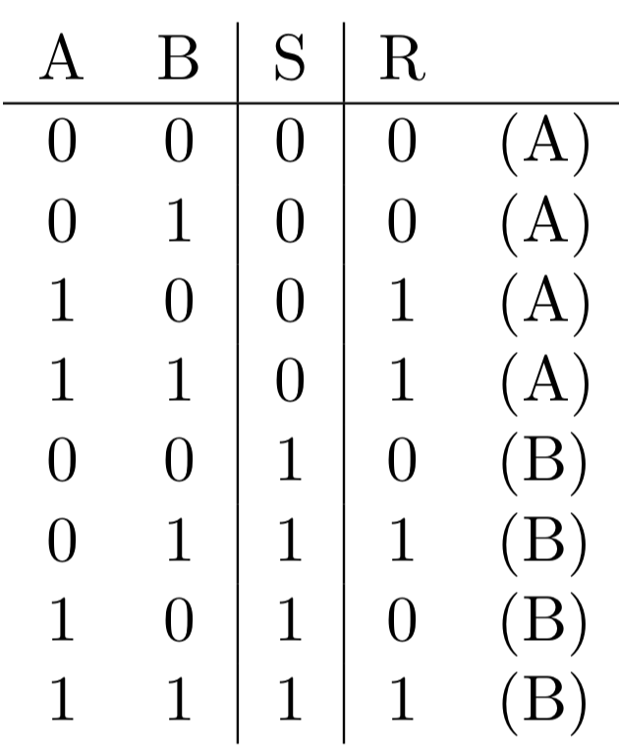
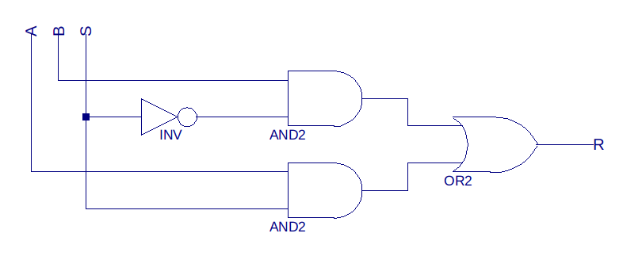
Build a Bit Multiplexer
Given input A, B, and S

Slide 7
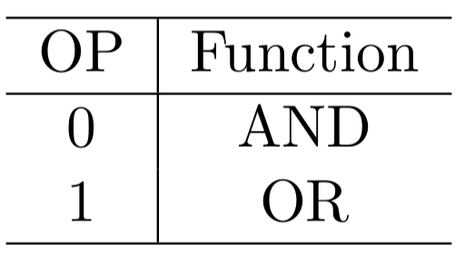
ALU (Arithmetic Logic Unit)
Introduce the “opcode” – the selector

Slide 8
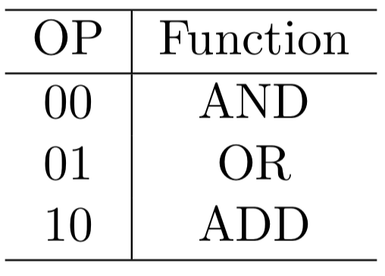
ALU (adding Addition)
Basic one-bit ALU with addition

Slide 9
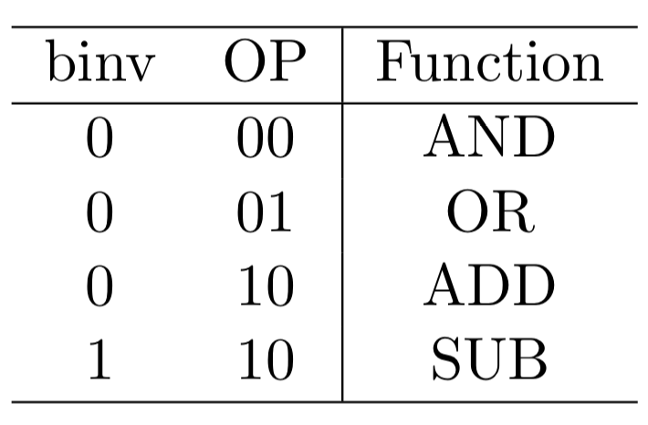

ALU (adding Subtraction )
$a −b=a+ \overline{b}$ + 1
Add “binvert”
Set CarryIn to 1 for the least significant bit

Slide 10
Multibit ALU
Op(2)
A 32-bit ALU

Slide 11
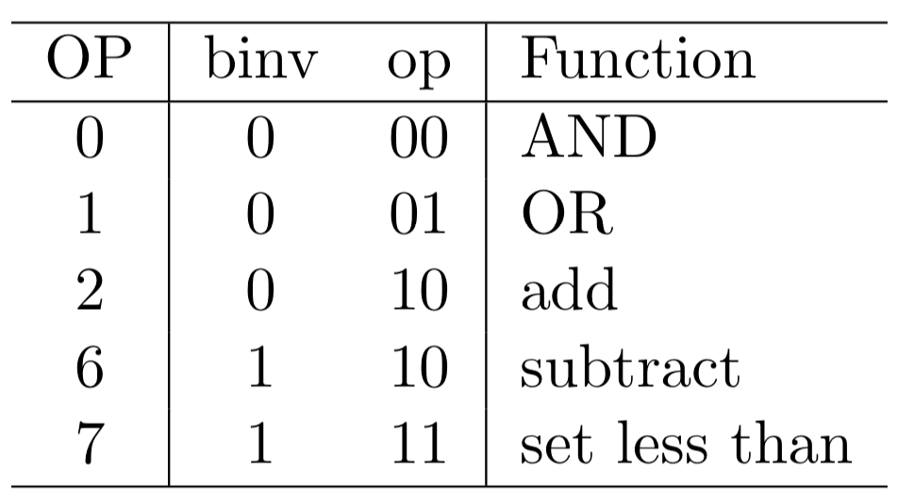
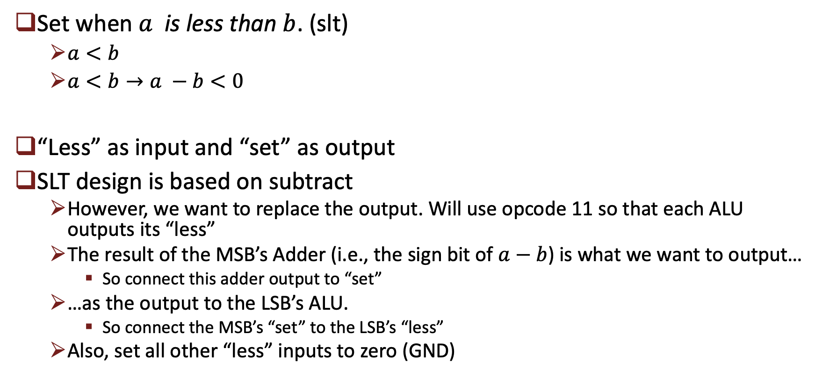
Multibit ALU (adding Set Less Than)
Set when $a$ is less than $b$. (slt)
  $a<b$
  $a<b→a −b<0$
“Less” as input and “set” as output
SLT design is based on subtract
  However, we want to replace the output. Will use opcode 11 so that each ALU outputs its “less”
  The result of the MSB’s Adder (i.e., the sign bit of $a−b$) is what we want to output…
    So connect this adder output to “set”
  …as the output to the LSB’s ALU.
    So connect the MSB’s “set” to the LSB’s “less”
  Also, set all other “less” inputs to zero (GND)

Slide 12
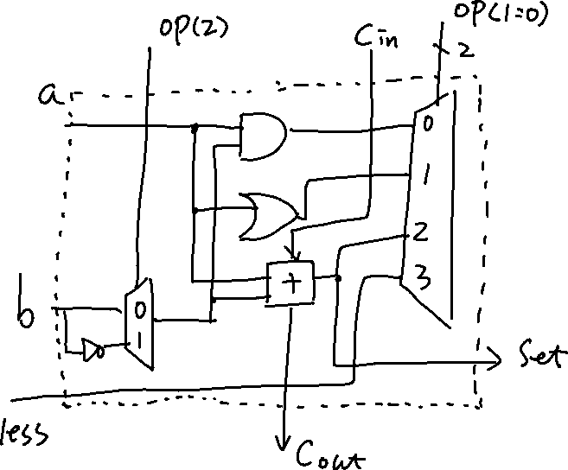
1-bit ALU with SLT

Slide 13
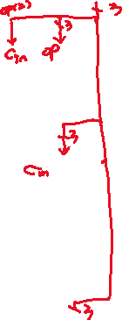
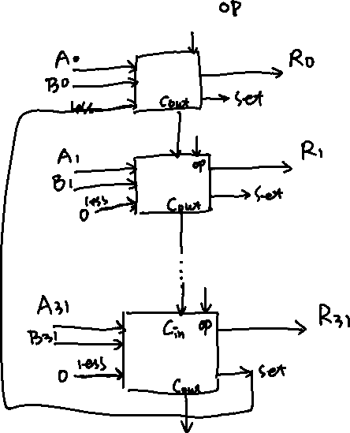
32-bit ALU w SLT

Slide 14
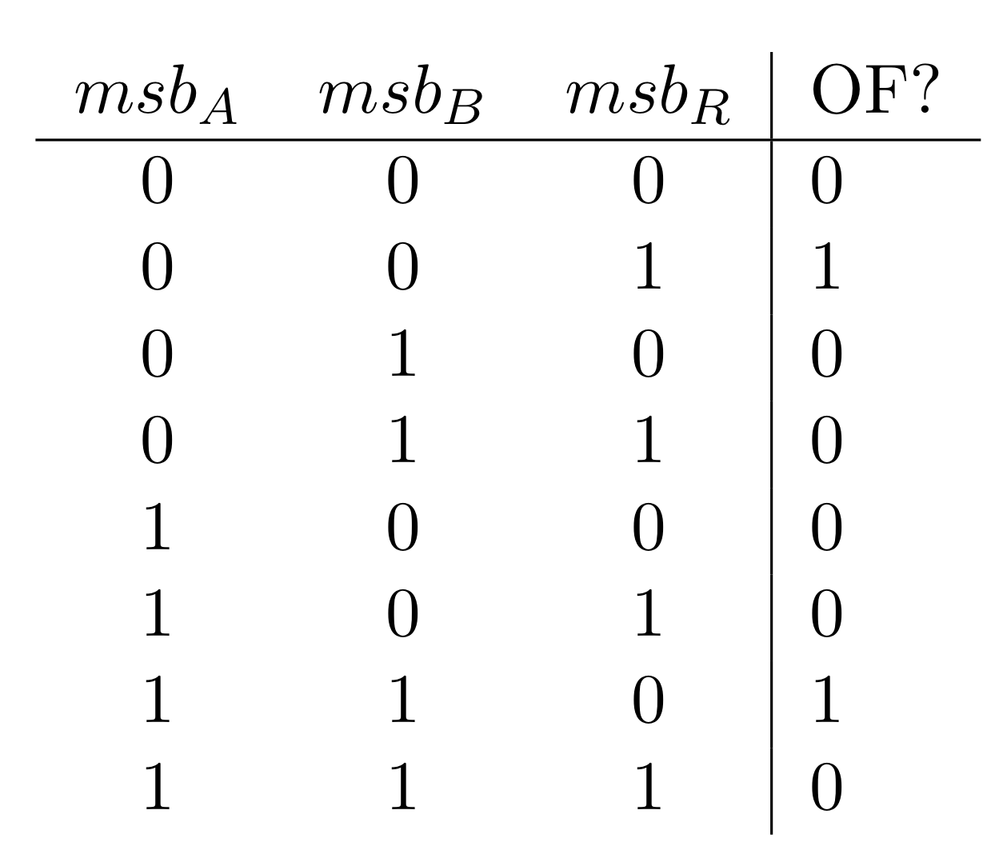
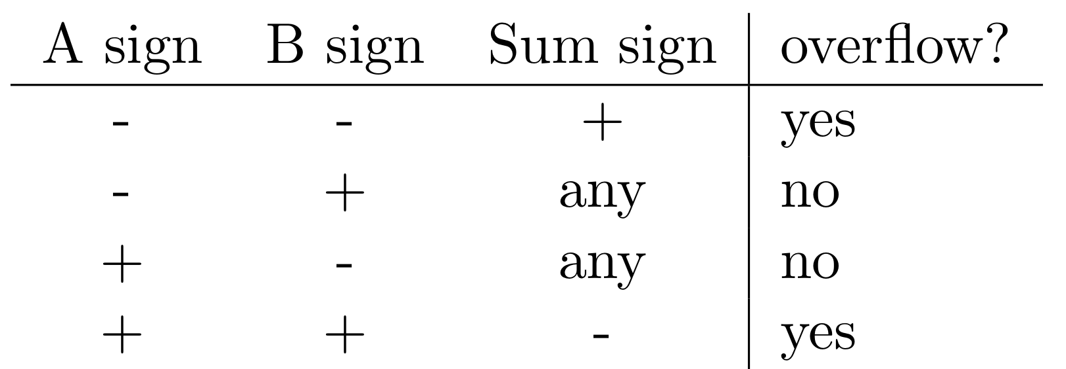
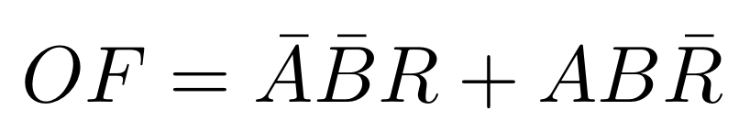
Multibit ALU (Overflow detection)
Only matters in MSB ALU

