Slide 1
CSSE 132
Data Representation
Tuesday, March 10, 2020

Slide 2
Goal of Week 1 - 3
Build the core of a CPU - Arithmetic Logic Unit (ALU)
Let’s begin with building an Adder
Before that: how are “numbers” represented on a computer?

Slide 3
Questions
How to convert binary, decimal, and hexadecimal?
How do computers represent information?
  Bits, bytes, words, etc.
How do computers handle signed numbers?
Notes:
Do a quick recap on the top-down view.

Slide 4
A recap on numbering systems
Decimal is a 10 digit number system (base 10)
  0,1,2,3,4,5,6,7,8,9
Binary is a 2 digit number system (base 2)
  0,1
Hexadecimal is a 16 digit number system (base 16)
  0,1,2,3,4,5,6,7,8,9,A,B,C,D,E,F
Notes:
Do a brief counting example. From 0 -> exhausted the least digit -> reset to 0 -> add one to the higher significant digit

Slide 5

Binary
Use decimal as an example:
  ${15}_{10}=1 × {10}^{1}+5 × {10}^{0}$
So ${110}_{2}=1 × 2^{2}+1 × 2^{1}$ $+0 × 2^{0}$
  ${=6}_{10}$
Notes:
Write the 3-digit binary table on board.

Slide 6
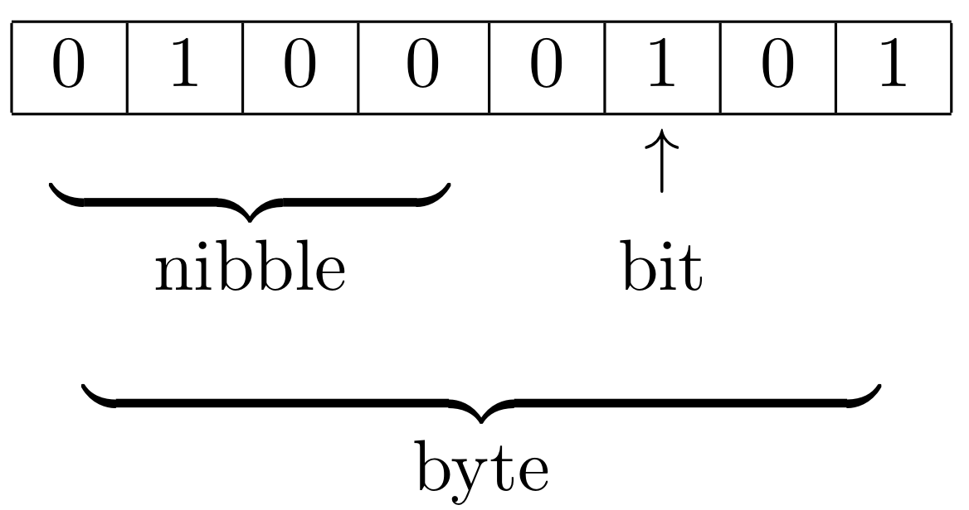
Units of data
Bit (b): One bit
Bytes (B): 8 bits
Nybble: 4 bits
Word: many bytes. Commonly 4 bytes, depends on hardware.

Slide 7
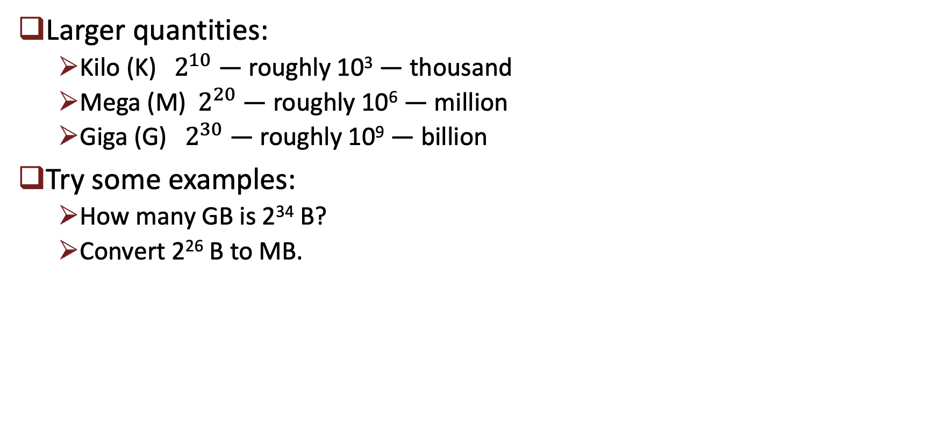
Units of data (cont.)
Larger quantities:
  Kilo (K)${ 2}^{10}$ — roughly 10³ — thousand
  Mega (M)${ 2}^{20}$ — roughly 10⁶ — million
  Giga (G) ${ 2}^{30}$ — roughly 10⁹ — billion
Try some examples:
  How many GB is 2³⁴ B?
  Convert 2²⁶ B to MB.

Slide 8
Hexadecimal
Writing zeros and ones is annoying.
Let’s do 4 bits (a nybble) a time.
Let’s write out all hex and their binary.
An example:
How about hex to binary? Say 0xA7F8
0xCAFE

Slide 9
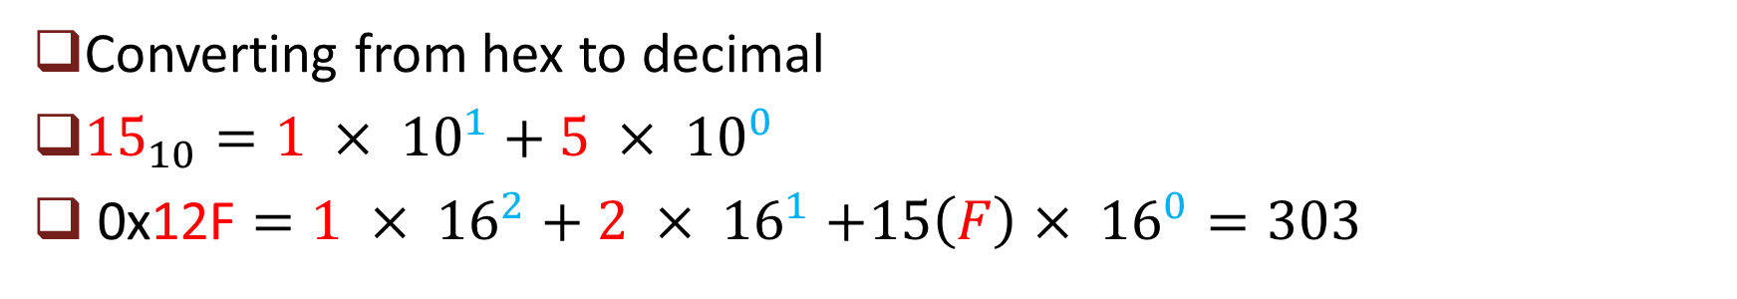
Hexadecimal (cont.)
Converting from hex to decimal
${15}_{10}=1 × {10}^{1}+5 × {10}^{0}$
0x12F $=1 × {16}^{2}+2 × {16}^{1}$ $+15\left(F\right)× {16}^{0}=303$

Slide 10
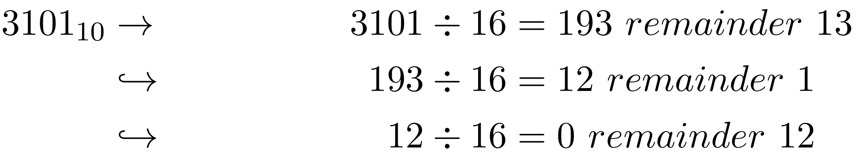
Hexadecimal (cont.)
Converting from decimal to hex:
  Divide by base, recursively.
  Take remainder as the digit, starting from the least significant digit.
  Example: convert 3101 of decimal to hex
  Another example: 500
D
1
C
0xC1D

Slide 11

Negative numbers
Naïve approach: use one more bit as the sign?
Two’s complement for signed number:
  1011→ ${1×(−2}^{3})+1×2^{1}+1×2^{0}=−5$
Notes:
It is wasteful to use MSB as sign only

Slide 12
Negative numbers (cont.)
Shortcut to find –x from x (≠ min value): Flip all bits and add 1.
  5 (0101) → –5
    0101 flip bits → 1010
    Add one 1010 + 1 = 1011 → (–5)
Can be used to identify the value of a negative number

Slide 13
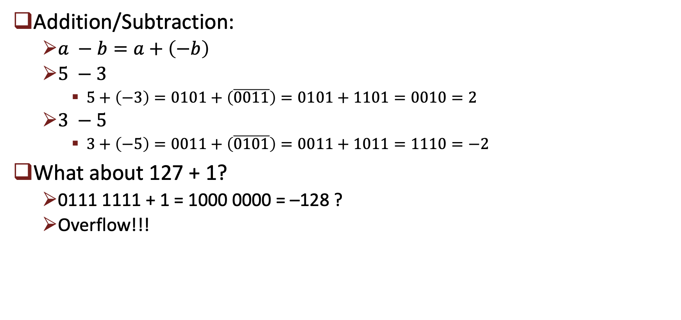
Negative numbers (cont.)
Addition/Subtraction:
  $a −b=a+\left(−b\right)$
  $5 −3$
    $5+\left(−3\right)=0101+\left(\overline{0011}\right)=0101+1101=0010=2$
  $3 −5$
    $3+\left(−5\right)=0011+\left(\overline{0101}\right)=0011+1011=1110=−2$
What about 127 + 1?
  0111 1111 + 1 = 1000 0000 = –128 ?
  Overflow!!!

