Slide 1
CSSE 132 The Stack
Tuesday, October 8, 2019

Slide 2
Outline
Motivation
Stack overview
Practice

Slide 3
0 int do_nothing()
1 {
2 int a = 3;
3 int b = 4;
4 return 0;
5 }
6 int add(int a,int b)
7 {
8 int result;
9 result = a + b;
10 do_nothing();
11 return result;
12
13 }
14 int main()
15 {
16 int res = 0;
17 int a = 1;
18 int b = 2;
19 res = add(a, b);
20 return res;
21 }
Questions:
Three functions have same variables named a,b. Why they can have different values in different functions and not interfere with each other?
Write the sequence of line numbers in the order of the code being executed.
How does the program know to go back line 20 when add function completes?

Slide 4
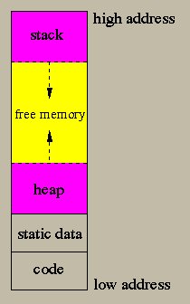
Why Stack?
Handle local variables/automatic variable.
Handle function calls.

Slide 5
Local variable: Begin with some boring text
When a function is called, a ”private space” (a.k.a. stack frame) is created.
A stack frame is specified by a stack pointer (sp) (and/or frame pointer).
When another function is called, the previous “private space” gets set aside for later, and a new ”private space” is created for the new function.
After a function is finished, its stack frame gets released, and back to where it was called.

Slide 6
How to handle local variable: Example
i = 3
x = 3
….
i = 2
x = 2
….
i =1
x = 1
int count_down(int i){
int x = i;
if(x == 1)
return 1;
else
return count_down(x - 1);
}
int main(){
count_down(3);
}

Slide 7
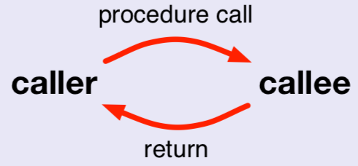
How to handle function call
Caller vs. callee
caller the code that calls the procedure
callee the code that implements the procedure

Slide 8
What the caller does
Set up input argument in registers (r0, r1, r2, r3)
bl addr : Branch link to procedure, return address goes in lr aka r14
On return, read return val from r0.

Slide 9
What the callee does
Back up registers to be modified: lr (maybe also other regs r4-r11)
Run function body
Fill up r0 for return
Restore registers
Go back to where it was called by checking lr or the place lr was stored.

Slide 10
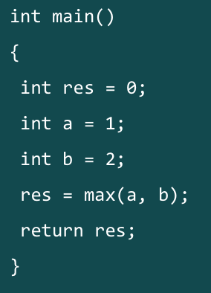
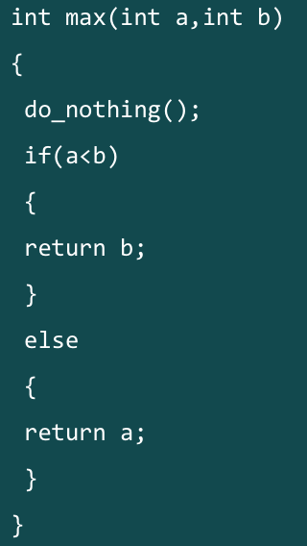
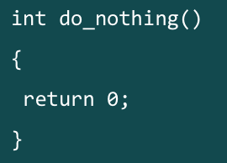
Example: max()

Slide 11
Function call: Prologue
sub sp, sp, #16 /* End of the prologue. Allocating space on the stack for the function called.*/
str lr, [sp, #14] /* Start of the prologue. Saving Frame Pointer and LR onto the stack */

Slide 12
Function call: Prologue (cont.)
mov r0, #1 /* setting up local variables (a=1). This also serves as setting up the first parameter for the function max */
mov r1, #2 /* setting up local variables (b=2). This also serves as setting up the second parameter for the function max */
bl max /* Calling/branching to function max */

Slide 13
Function call: Epilogue
add sp, sp, #16 /* Start of the epilogue. Readjusting the Stack Pointer The Stack Frame of a function is finally destroyed at this step. */
ldr pc, [sp, #-4]/* End of the epilogue. Jumping to previously saved LR via direct load into PC. */
*leaf v.s. non-leaf function https://azeria-labs.com/functions-and-the-stack-part-7/

