Slide 1
CSSE 132
Pointer and Arrays
Wednesday, October 2, 2019

Slide 2
Questions
What is pointer?
How to carefully use pointer?
  pointer operation
  pointer arithmetic
How does data arrays work in C?
How to use pointer to access array?

Slide 3
Variables in memory
When you do int x:
  x is placed in certain address
  machine handles/remember address of x
0x0000 0008 | x

Slide 4
Pointer operation
Type int* x means “x is the address of an int”
Getting the Address: &x means “address of data in x”
& is the address operator and asks “where is this thing?”
Retrieving data with an address: *xp means “go get data in memory at xp”

Slide 5
Pointer illustration
Pointer is the address (key) to a content (cabinet)
int* ptr;
int var = 50;
ptr = &var;
//*ptr == 50

Slide 6
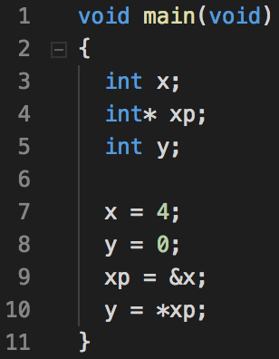
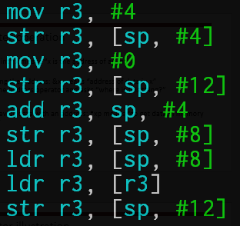
Example: pointers1.c
[ ] means to sum the things inside and use as an address

Slide 7
Pointer arithmetic
Assume a pointer p with type <type>, which to the address X
Then p + n (n is an integer) points the address of X + n*type_size
In other words, (p + n) points to the next n object with type <type>.

Slide 8
Pointer arithmetic (cont.)
0x0000 0008 | x
0x0000 000c | xp
0x0000 0010 | y
int x;
int* xp;
int y;
x = 4;
xp = &x;
y = 0;
xp = xp + 2 // it adds two of the size of type in xp
*xp = 7;
What is y? (assume using GCC)

Slide 9
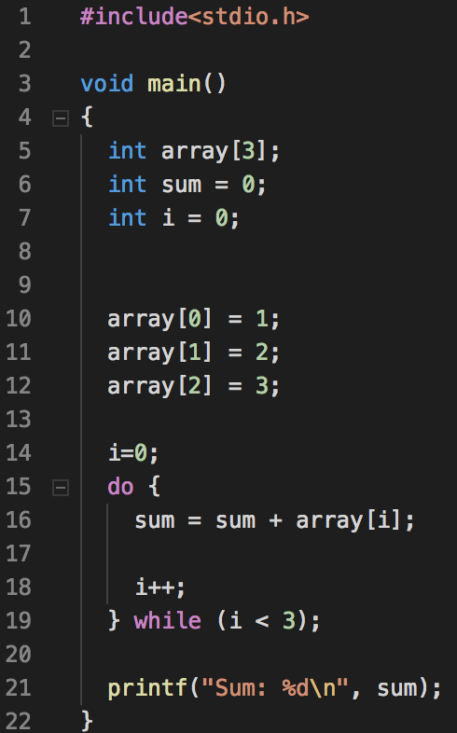
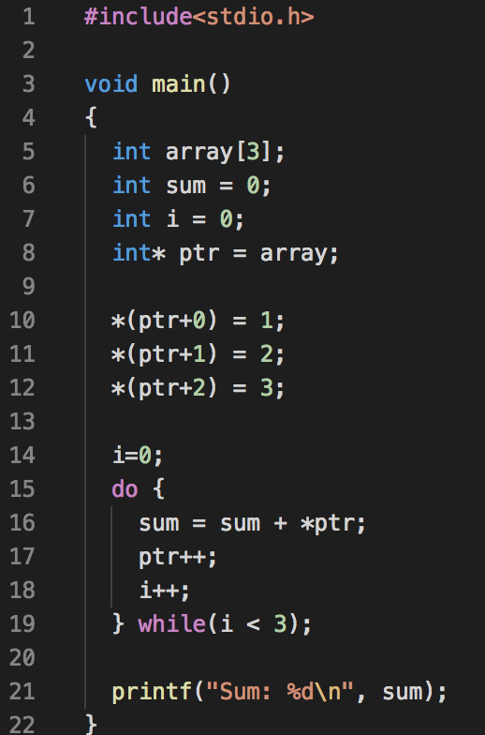
Arrays are Pointers
Arrays are a continuous chunk of memory
  array[1] is *(array + 1)

Slide 10
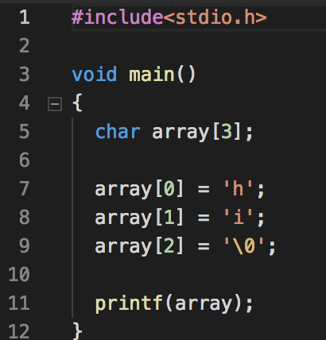
Strings
Arrays of characters(1byte)
  Length is determined by the location of a null char ‘\0’

Slide 11
Struct
Declaration
  struct name
  {
  char first_name[10];
  char last_name[10];//things in the struct.
  };
Use struct
  struct name my_name;
  my_name.first_name = “CSSE”;
  my_name.last_name = “132”;

Slide 12
Multi-dimensional arrays
Arrays of another arrays
  char array[3][4];
  array[i][j] == *(array + i*4 + j)
Examples:
  int main(int argc, char** argv)

Slide 13
Pointer of pointer
What is int ** ?
  int x;
  int* p;
  int** pp;
  x = 10;
  p = &x;
  pp = &pp;
Can we do the same to &, like &&x?
  NO.
0x0000 0008 | x | 10
0x0000 000c | p | 0x0000 0008
0x0000 0010 | pp | 0x0000 000c

Slide 14
Struct usage
Struct is same as any other data type, any operation applied to other data type is applicable to struct.
  struct array
    struct name your_names[10];
    your_names[0].first_name = “CS”;
    your_name[0].last_name = “SE”;
  struct pointer (use -> instead of .)
    struct name* another_name;
    another_name = &my_name;
    printf(“%s”,my_name->last_name);

Slide 15
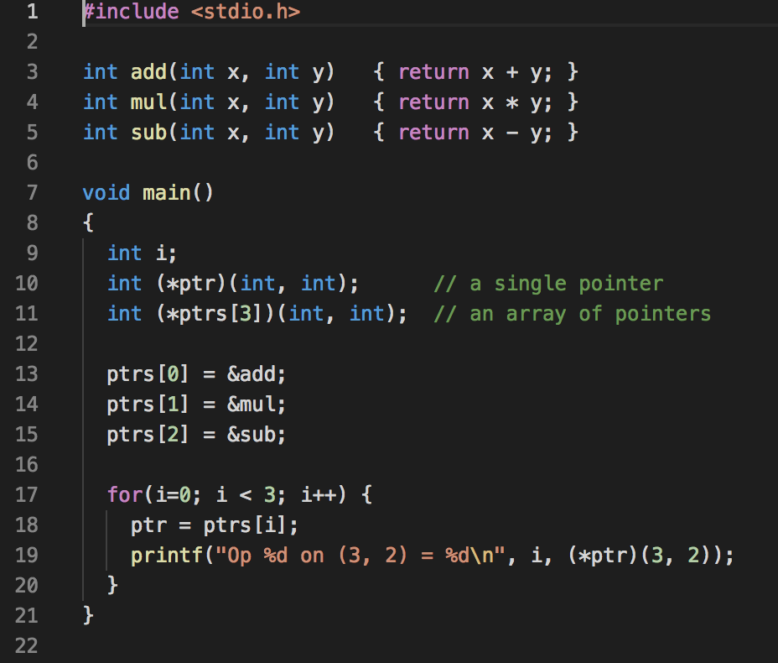
Function pointer (Optional)
Declaration return_type (*name)(input_arguments)

