Slide 1
CSSE 132 Exam1 Review
Tuesday, March 26, 2019

Slide 2
Notes
You are allowed to bring one single-sided, hand-written 8.5 by 11 inch cheat sheet.
You will need to submit your cheat sheet together with the exam.
You will need your Raspberry Pi for coding part of the exam.
Be sure it can connect to WiFi, and remotely accessible.
Bring a calculator if you have.
No other electronic devices are allowed.
Laptop is only allowed during the coding part. (same as quizzes)

Slide 3
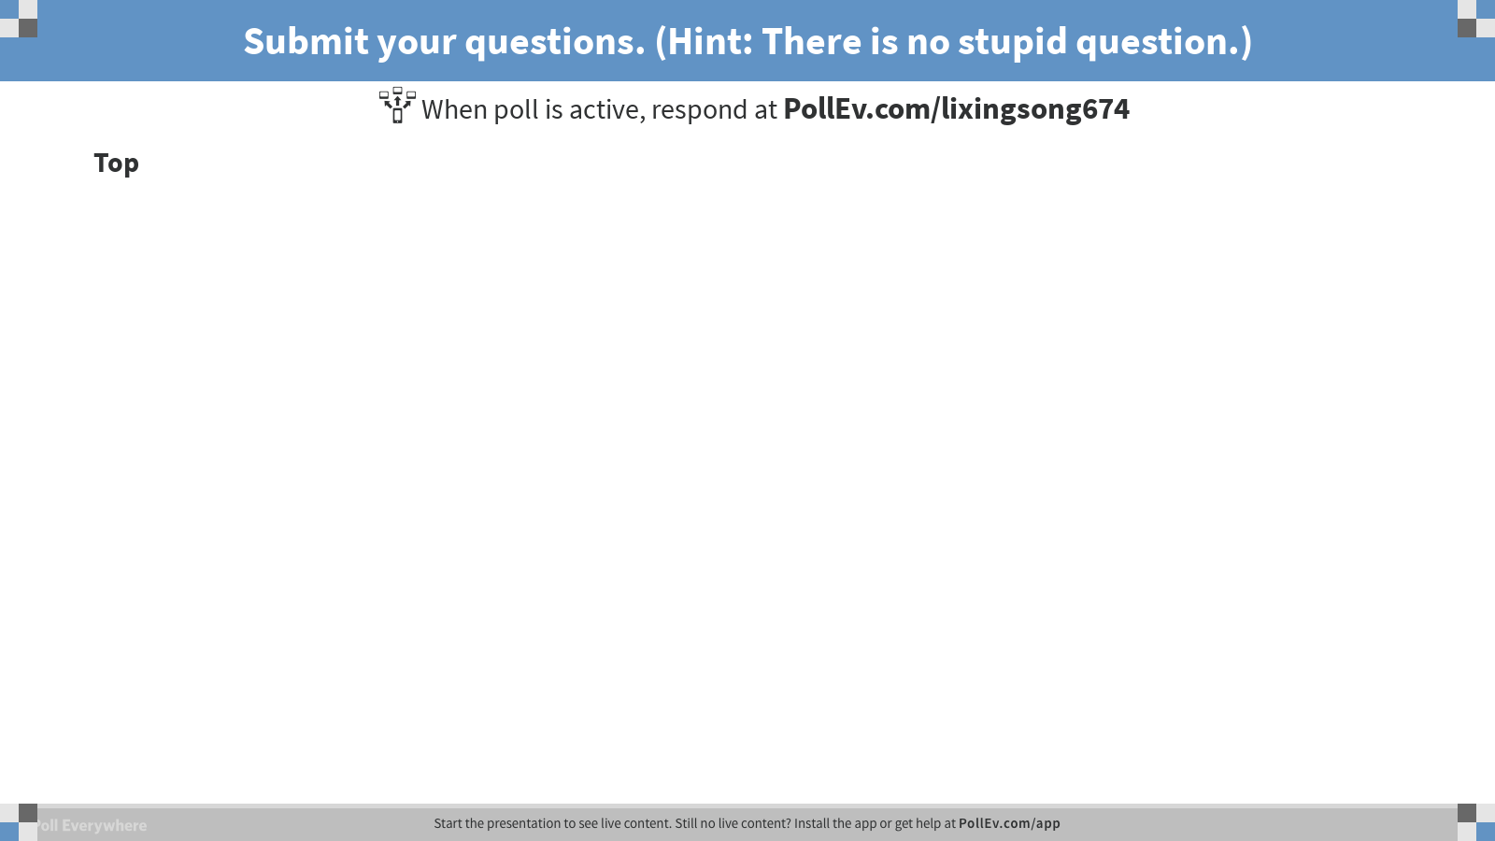
Notes:
Submit your questions. (Hint: There is no stupid question.)
https://www.polleverywhere.com/discourses/Sl9R8yt5vC7vDUW

