Slide 1
CSSE 132 Boolean Logic
Tuesday, September 10, 2019
Adapted from CMU 15-213/18-213/15-513

Slide 2
Outline
In order to make 1 + 1 = 2 happen, we need know
The Boolean operation using common logic gates?
The magic of Boolean logic (next lecture).
And, we need know how to do binary addition/subtraction.
A critical problem: Overflow
Notes:
Do a quick recap on the top-down view.

Slide 3
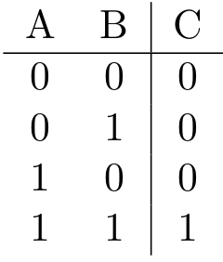
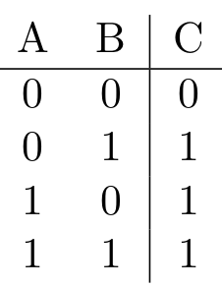
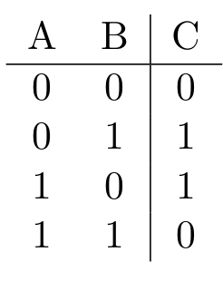
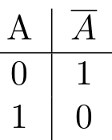
Boolean Algebra
And (All True)
A&B = 1 when both A=1 and B=1
Or (Any True)
A|B = 1 when either A=1 or B=1
Exclusive-Or (Xor) (Only One True; When Different)
A^B = 1 when either A=1 or B=1, but not both
Not (Flip)
~A = 1 when A=0

Slide 4
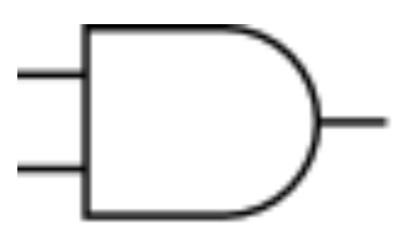
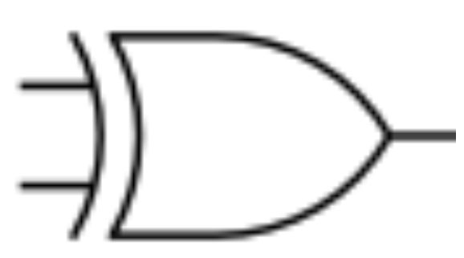
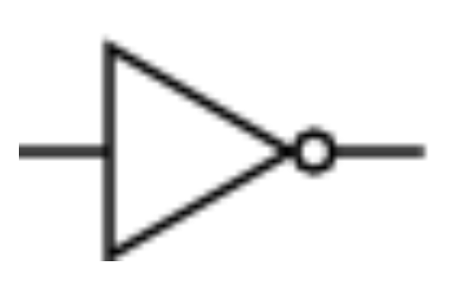
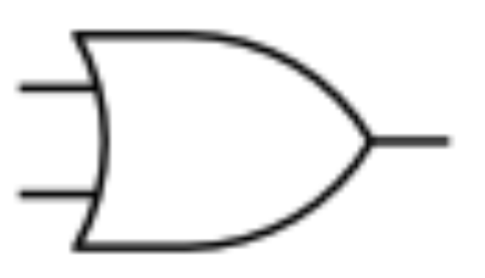
Notation and Symbols
AND: &
OR: |
XOR: ⊕ or ^
NOT: $\overline{A}$ or ~

Slide 5
General Boolean Algebras
Operate on Bit Vectors
Operations applied bitwise
01101001
& 01010101
01000001
01101001
| 01010101
01111101
~ 01010101
10101010
01000001
01111101
10101010
Notes:
All of the Properties of Boolean Algebra Apply

Slide 6
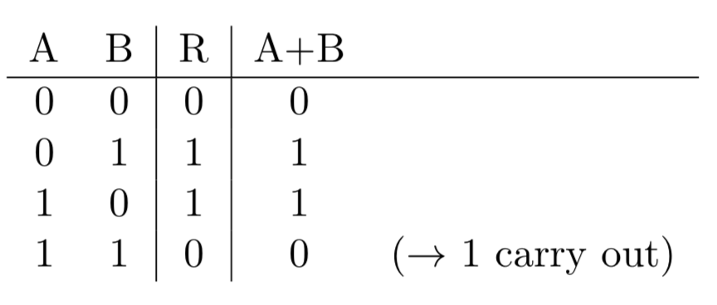
(Foreshadow) Gates can compute
Gates actually knows nothing about computation
But we can use their properties to make computation happen.
Make A + B happen using $(\overline{A}$ B)+$(\overline{B}$A).

Slide 7
Addition (Unsigned)
Start with decimal example:
512 + 333
532 + 379
Binary (working within certain bit width):
0110 (6) + 0001 (1)
0110 (6) + 0110 (6)
1110 (14) + 0110 (6)
Overflow means the answer is wrong

Slide 8
Unsigned Addition Summary
u
Standard Addition Function
Ignores carry output
Implements Modular Arithmetic
s = UAdd_{w}(u , v) = u + v mod 2^{w}
Operands: w bits
• • •
+
v
• • •
True Sum: w+1 bits
u + v
• • •
Discard Carry: w bits
UAdd_{w}(u , v)
• • •
True Sum
2^{w+1}
Overflow
2^{w}
0
Modular Sum

Slide 9
Addition (signed)
Operands: w bits
u
• • •
+
v
• • •
True Sum: w+1 bits
u + v
• • •
Discard Carry: w bits
TAdd_{w}(u , v)
• • •
True Sum
0 111…1
2^{w}–1
1010 (-6) + 1010 (-6)
= 4 ?
Overflow
Result
0 100…0
2^{w –1}–1
011…1
0 000…0
0
000…0
1 011…1
–2^{w –1}
100…0
1 000…0
–2^{w}
Overflow

Slide 10
Subtracting
$a−b=a+\left(−b\right)$
$b ↔−b$: Flip the bits and add one (or simply carry in a 1)
Example:
1010 (-6) - 0001 (1)
1010 (-6) – 0011 (3)

Slide 11
Overflow examples
Which one(s) is overflow? (all signed number)
1101(-3) + 1011(-5)
1111(-1) + 0011(3)
0101(5) + 0111(7)
Overflow means the answer is wrong

Slide 12
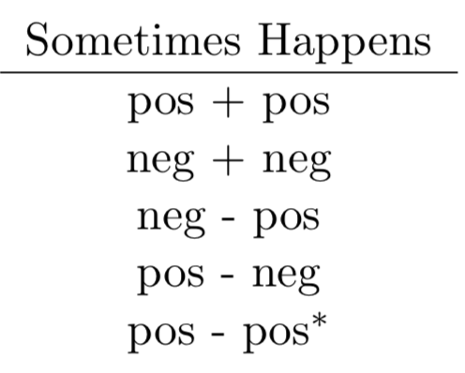
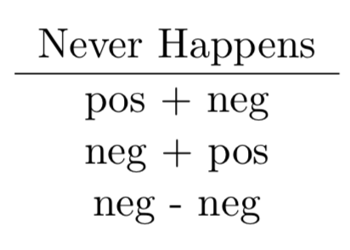
Overflow discussion
Need more bit than you have
True Sum
0 111…1
2^{w}–1
Overflow
Result
0 100…0
2^{w –1}–1
011…1
0 000…0
0
000…0
1 011…1
–2^{w –1}
100…0
1 000…0
–2^{w}
Overflow

