Slide 1
Introduction to Eclipse
Operation Catapult
Rose-Hulman Institute of Technology
Computer Science and Software Engineering
Notes:
Before class, go to the drop box and pick out a few graphics projects to show off in case not many students want to show off theirs. Some may have animations.
Take to class:
Graded Quizzes from day 1
Quiz (for each student)
Quiz solution (for each assistant and me)
Eclipse coding solutions (for each assistant and me)
Live Coding transcripts (for each assistant and me) [none today]
Pictures of students and assistants
Printout of these slides and notes, if you wish
As students arrive:
Hand back the in-class quizzes from the previous session.
Answer the “anything you found confusing …” questions from the previous session’s in-class quiz.
Hand out today’s in-class quiz and remind them how we use the daily quizzes.
“What other questions do you have?”

Slide 2
Integrated Development Environments
What do they do?
Why use one?
Our IDE − Eclipse
Details on next slides
Notes:
[outline slide, details on subsequent ones, don’t dawdle]
IDLE is also an IDE.
Good for new programmers, because it is so simple to learn.
But not so powerful.
Show them this slide and the next few slides, THEN have them start Eclipse.

Slide 3
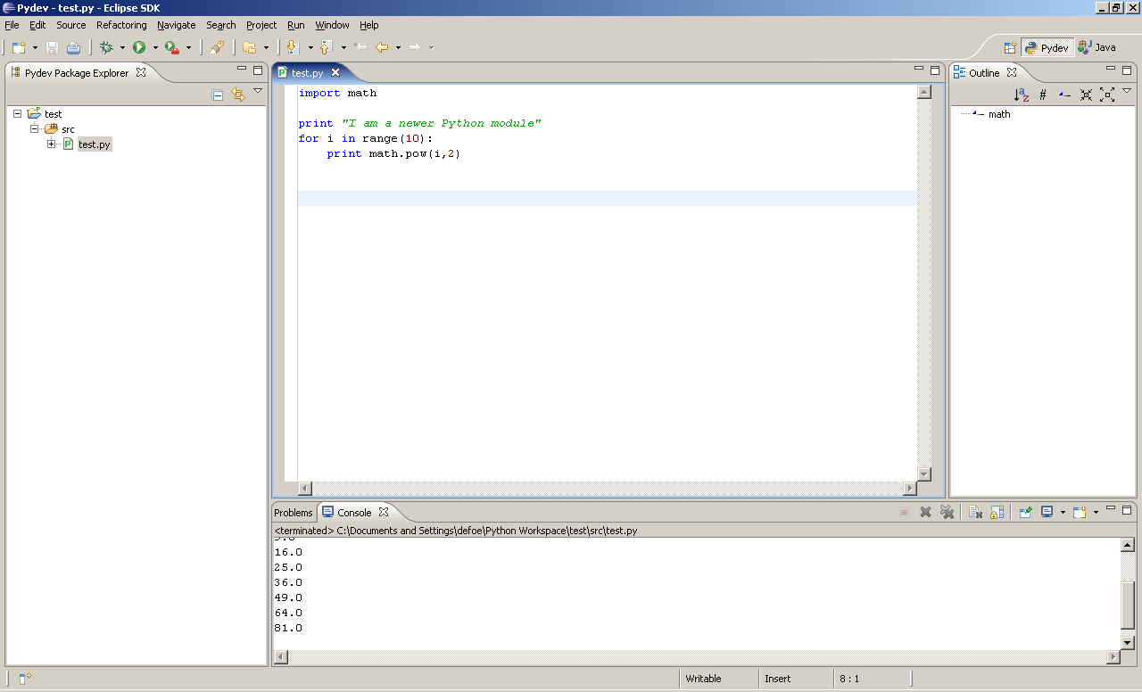
IDEs − What do they do?
Let us compile, run, and debug
Show an outline of our module (file)
Show outline of entire project
Display program output
Help us enter and edit code
Notes:
At first, the amount of stuff you see in Eclipse can be overwhelming. Once you get used to the environment, you'll be glad it is all there.

Slide 4
IDEs − Why use one?
Harness the power of the computer to make us more productive!
Notes:
Computers have done a lot to advance other fields of engineering. (e.g., SolidEdge for the MEs, process simulation for the ChemEs, etc.)
Computers are also powerful tools to advance computing itself!

Slide 5
IDEs − Why Eclipse?
Powerful
Easy to use
Free and open-source
An IDE for any language, not just Python

Slide 6
Basic concepts in Eclipse
Workspace − where your projects are stored on your computer
Project − a collection of files, organized in folders, that includes:
  Source code
  Compiled code
  Design documents
  Documentation
  Tests
  And more…
Notes:
Mention that everyone should have their workspace set to c:/ecilpseWorkspaces/CSSE120/ for the entire quarter

Slide 7
Fixing Eclipse First
Link from home page
http://www.rose-hulman.edu/class/csse/resources/InstallationInstructions/2011-2012/EclipseWorkaround-2011-2012.html
Notes:
This is for a 2011-2012 Eclipse set up issue. Future versions can hopefully disregard.

Slide 8
Setting up Eclipse on your laptop
Get the ZIP file (linked from the Catapult page)
Follow the instructions to install Eclipse and PyDev
Ask for help as needed

Slide 9
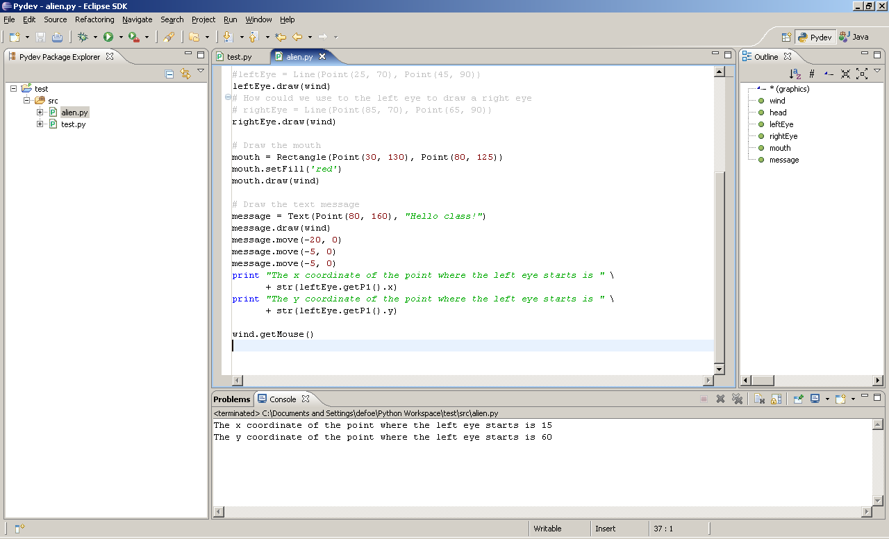
Views, Editors, PyDev Perspectives
Tabbed views of source code
Perspective switcher
Outline view
Package explorer view
Editor view
Tabbed views of results
Notes:
A perspective displays a set of views and editors that are appropriate for the task at hand. Perspectives include: PyDev, Java and lots more
Show students:
How to change perspectives (in case they ever accidentally get to the wrong perspective).
How to reset the perspective (for when they mess up their windows).

Slide 10
Follow Along…
Pydev Perspective
File ➢ New ➢ Pydev Project
File ➢ New ➢ Pydev Module
Type print("hello world")
Run the program
Type a few more print statements, including one that is wrong.
  See where the error message appears and how clicking on it brings you to the offending line.
Notes:
Show students the basics, but just the basics, of writing and running a Python program in Eclipse. Things to point out include:
How Python runs the parser continuously in the background
That Save is sometimes needed to make that background process catch up
How errors are displayed, in the Edit window AND in the tab at the bottom
Where Console input and output appears
Auto-completion

Slide 11
Eclipse in a Nutshell
Workspace − where your projects are stored on your computer
Project − a collection of files, organized in folders
Perspective − a set of views and editors
View − an area of a window showing focused information (code, outline, results, etc.)
Notes:
Quick recap.

