Slide 1


The Do’s and Don’ts of Software Process Improvement
Steve Chenoweth, RHIT
Notes:
Image from http://www.marchpr.com/blog/2011/09/social-media-dos-and-don%E2%80%99ts/.

Slide 2
Describes the CMMI approach
Is there a relationship between quality of processes and quality of products produced?
  The whole quality movement (TQM) is based on this notion.
  Key thing – it has a lot of pieces to deal with.
    Like how do you control suppliers with supply chain management? Or,
    How do you manage customer expectations through support and marketing?

Slide 3
CMM and CMMI are “Models”
Describe generally how processes should work.
Need an interpretation or implementation by a particular organization.
E.g., if you want to be agile, they will look a lot different!
  See Jeff Sutherland’s blog, for example.
Goal should be the improved results, not “achieving a certain CMM level.”

Slide 4
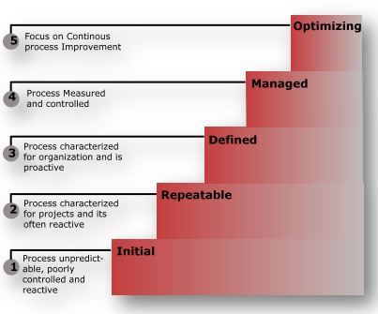
And here they are…
Notes:
From http://www.c-sharpcorner.com/uploadfile/nipuntomar/cmmi-capability-maturity-model-integration/.

Slide 5
Improvements focus on process areas
Requirements management
Project planning
Project monitoring and control
Supplier agreement management
Measurement and analysis
Process and product quality assurance
Configuration management

Slide 6
What’s the assessment process?
Done by someone authorized, using a standardized assessment method.
“SCAMPI” v 1.1 enables:
  Gain insight into an org’s engineering capability
  Relate to the CMMI model
  Prioritize improvement plans
  Focus on improvements, given current level
  Derive capability level ratings and a maturity level rating
  Identify development/acquisition risks relative to these

Slide 7
Assessment team compares implementation to levels in the model
Fully implemented?
Largely implemented?
Partially implemented?
Not implemented?
Then they generate their findings.

Slide 8
The two CMMI level representations
Staged levels
  “Software engineering”
Continuous levels
  “Systems engineering”
But, the goal is to improve the processes, whichever rating scheme you use.
E.g., you may have developed all the process tools, but can’t get your teams to use them!

Slide 9
Orgs get into this to first develop a “baseline”
Desired outcomes might be to improve:
Delivered quality
Productivity
Schedule
Reduced overtime
Defect injection rate
In-process defect removal efficiency
Defect distribution

Slide 10
“Faster / cheaper / better?”
CMM people disagree it’s “Pick any two!”
  They say, “Pick any one!”
Create an SEPG (Software Engineering Process Group), and start by asking senior management questions like:
  What is the business imperative in our marketplace?
  What gives us a competitive edge?
  Why do customers buy from competitors?
Management needs to set these priorities.
Notes:
Kan p 443

Slide 11

Level 2 = “Managed”
Beyond “everyone work harder” or “longer”.
Use science to reduce cycle time.
Reduce time to delivery.
Not – circumvent existing processes and standards.
Avoid the “ritualistic dance.”
  Game playing with the customers, about delivery dates and what they’ll get.
Need estimates you can believe in.
Notes:
Image from http://www.selinaogrady.com/post/29256819032/ritual-religion-and-violence-are-the.

Slide 12

How to achieve?
Gather and analyze historical data
  To develop and calibrate estimation models.
Codify good engineering and management practices that lead to more reliable results.
Establish the means to control the product’s requirements and configuration baselines.
  “What” are you building?
Enjoy the strong support
of leadership in achieving
this goal.
Notes:
Image from http://www.vi-hotels.com/en/loipersdorf/special-offers/pure-fasting-enjoyment-base-fasting/.

Slide 13
Keep it simple
Checklists
Assume people know their jobs
Address exceptions with training
  Different from standard reference docs
Think – “How do I make this agile?”

Slide 14
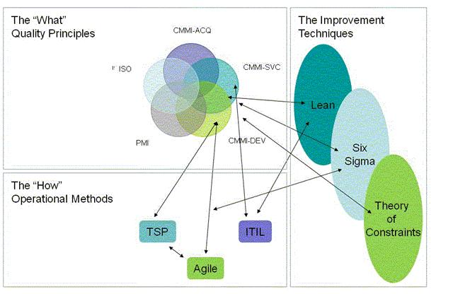
CMMI + other processes
Notes:
From http://www.scrumalliance.org/community/articles/2008/july/agile-and-cmmi-better-together.

Slide 15
Measuring the value
Need data to support benefits of process improvement.
  Field-reported defects
  Cost variance
  Schedule variance
  Functional variance
Notes:
Kan p 447

Slide 16
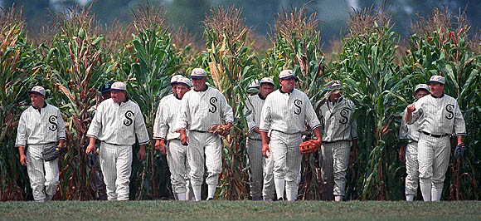
Measuring process adoption
Pilot projects vs broad deployment and implementation.
Can’t use the “Field of dreams” approach.
“Process releases” to change things.
Monitor adoption rates.
  How many projects “should be using”?
Here they come, now.
Notes:
Image from http://speakoutsarasota.com/a-field-of-dreams-can-come-true/.

Slide 17
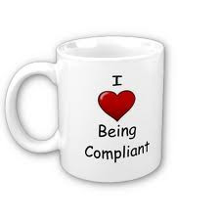
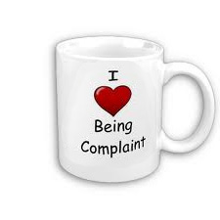
Measuring compliance
vs
SQA group leads in
verifying this, too.
Do activities and work products both conform to designated standards and requirements?
Good place to use checklists.
  E.g., about how code inspections are done.

Slide 18
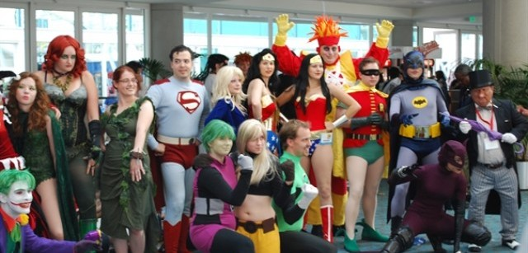
This is culture change
Culture =
  Rituals (formalities, rules, new traditions)
  Ceremonies
  Artifacts
  Symbols
So, do stuff,
like a
celebration!
Geeks celebrating – from “film school rejects” website.
Notes:
Image from http://filmschoolrejects.com/news/comic-con-episode-iv-a-fans-hope-trailer-is-a-geek-celebration.php.

Slide 19
Detractors
Software developers mostly don’t like process.
  Process feels like a detraction.
  Jacobson recently noted that software creation is increasingly perceived as an art, not engineering.
CMMI, for example, doesn’t guarantee product success.
Defining processes around tools is a mistake.
Is customer-enforced compliance a good thing?
Is quality of deliverables the same as achieving business goals?
Notes:
See, for example, http://www.the-software-experts.com/e_dta-sw-process-food.php, or http://www.scribd.com/doc/11161107/Fallacy-of-ISO-CMMI-Certifications.

