Slide 1
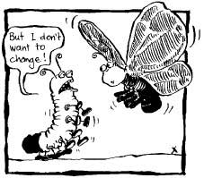

The Problem of Making Change
Steve Chenoweth, RHIT
Notes:
Image from http://schreinerbfacomdes.wordpress.com/2013/09/26/musically-inclined-evolution-in-genres/.

Slide 2
One goal of the MSSE program…
Is for you to become great at your chosen profession.
But, we also have an obligation to the software industry, to contribute to improving that industry…
  Indirectly
  Through you

Slide 3
So,
We are hoping you become change agents.
But, we know that’s not easy.
You are trying to make change from the bottom, within an organization.
How to get the changes you know are needed to actually happen!?

Slide 4
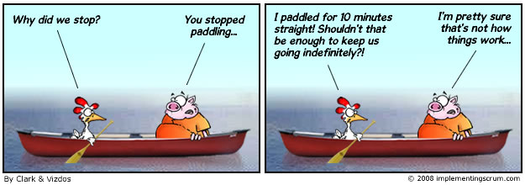
Change always takes longer than expected, to take hold…
Notes:
Cartoon from http://www.implementingscrum.com/2011/02/15/scrum-and-organizational-change-management/.

Slide 5

How come?
Notes:
Kay Sage’s 1940 urrealist “Danger, Construction Ahead.” Image from http://www.twocoatsofpaint.com/2012/02/sly-and-witty-female-surrealists-in-los.html. It’s in the Yale University Art Gallery.

Slide 6
As engineers, what we’d like is…
Better ideas win on their own merits.
It’s objective, or at least clear, so eventually everyone agrees on the same course.
After all, our work is all based on objective realities, like, “What runs best in the computer.”
So, if we have a discussion with someone, and our points are stronger, then…

Slide 7

By all rights,
They ought to change and do things the way we proved they should be done.
We sort of do this to customers.
  At least when we are
  the experts on a
  technology that they
  want to use.
And our casual
“water cooler
conversations” do
lead to improved
product and process
ideas being imple-
mented, we think.
“Here’s why you need the new wheels, too…”
Notes:
Image from http://www.visualphotos.com/image/2x4604154/mechanic_explaining_repairs_to_customer.

Slide 8
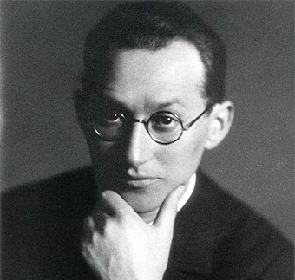
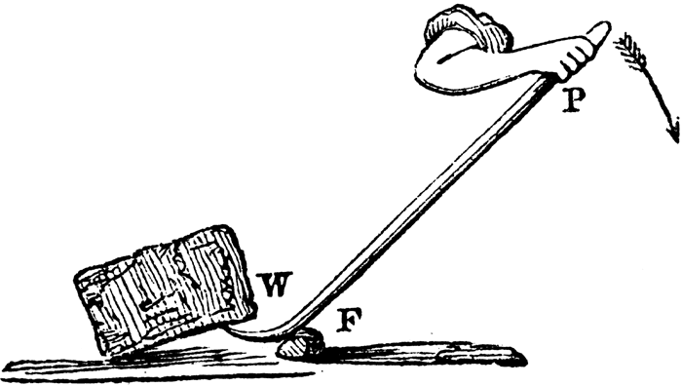

But organizations don’t readily change…
In 1947, Kurt Lewin proposed “the stages of learning/change”:
Stage 1 - Unfreezing: Creating the Motivation to change
  Disconfirmation
  Creation of survival anxiety or guilt
  Creation of psychological safety to
  overcome learning anxiety
Stage 2 - Learning new concepts, New Meanings for Old Concepts, and New Standards for Judgment
  Imitation and identification with role models
  Scanning for solutions and trial-and-error learning
Stage 3 - Internalizing New Concepts, Meanings and Standards
  Incorporation into self-concept and identity
  Incorporation into ongoing relationships
It’s all soft science…
Notes:
Image of Lewin from http://www.biografiasyvidas.com/biografia/l/lewin.htm.
Crowbar image from http://blogs.sfweekly.com/thesnitch/2010/11/crowbar_fight.php.
Charlie Brown image from http://www.dreamhost.com/dreamscape/2013/04/15/uptime-brigade-what-is-it-what-do-they-do/charlie-brown-argh/.

Slide 9

During Stage 2,
Everything’s chaotic, versus how it is now.
Everyone knows it would be a
struggle to get over that, learn
all the new stuff, and settle
back down.
So they resist all our good
ideas!
  The odds are that things won’t
  change.
Notes:
Image from http://www.whatdoesitmean.com/index1512.htm.

Slide 10
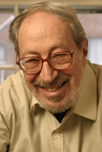

How tough is it?
Lewin’s model was adopted by Edgar Schein
to explain what’s necessary to cause “transformational” organizational change:*
Everyone assumes current success is based on everything about the current ways of acting.
  “Culture” is a learned defense mechanism, to avoid uncertainty and anxiety.
  All the cultural elements of behavior have “secondary value.” Lots of conjectured dependencies!
  Borderline superstitious.
*I.e., change that sticks.
Notes:
Edgar Schein image from http://mitsloan.mit.edu/faculty/detail.php?in_spseqno=41040.
Ladder walker image from http://psychiclibrary.com/beyondBooks/ladder-superstition.

Slide 11
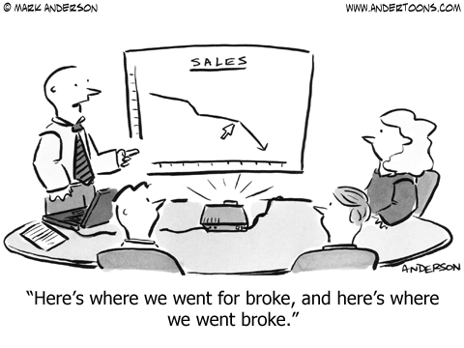
The inherent barriers are real
Everyone knows change is hard. In relearning, you lose your identity.
  It often requires some kind of
  crisis to propel change, like a
  public scandal that explodes
  myths.
  Attempts to induce organi-
  zational change produce
  responses like denial,
  scapegoating, and bargaining.
  Changing a culture requires power – “change agents” make it happen using interventions, or it evolves via leadership or via self-assessment and rebirth within the organization.
Notes:
Cartoon from http://blog.asmartbear.com/unprofitable-saas-business-model.html.

Slide 12

Things you can expect
Denial – Oddly, when you ask why people haven’t tried something new, which you’d sparked their interest in, they’ll explain they figured out why it isn’t valid after all.
Scapegoating – The problem is in some other department, and we’re ok, etc.
Maneuvering and bargaining –
This is extra work. It has to be
worth a lot MORE to be worth
taking it on.
Notes:
Image from http://licensedmentalhealthcounselor.org/2012/05/03/parents-denial-of-their-childs-mental-health-issues-doesnt-make-it-go-away/.

Slide 13
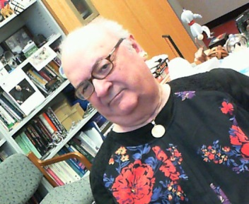
But the software business has some advantages…
Everyone knows we have to change to survive.
People know they have to adopt new processes, switch to creating different kinds of products, and adapt to changing organizations.
We know our project work has a significant amount of “new work” and so is inherently risky.
Being in limbo is part of the job!
  We’re used to “learning anxiety.”
  We all suffer from “incompetence.”
  Group memberships change.
  Fluid identity is a part of the work.

Slide 14

How to push it over the top
Schein’s Principles:
Survival anxiety or guilt must be greater than learning anxiety.
Learning anxiety
must be reduced
rather than
increasing survival
anxiety.
I.e., Inject hope!
Above - We all get “computer anxiety” when staring down new technology.
Notes:
Image from http://ninetyninepercentscientist.wordpress.com/2009/12/.

Slide 15

Some specifics
Have a compelling positive vision.
Give formal and informal training on new skills needed.
Learners have to be involved, and the learning flexible.
Build new culture – like
relevant “family”
groups and teams.
  E.g., Bust-up existing
  organizations, whose
  ratings of good vs bad
  are based on the old ways.
Provide practice, with
coaches and feedback.
“If the boss calls, get their name!”
Notes:
Image from http://abcnewsradioonline.com/business-news/chit-chat-biggest-time-waster-at-work.html.

Slide 16

More specifics
Provide positive role
models.
Give forums for learning
problems.
Introduce systems and
structures consistent with
the new way of thinking
and working.
Schein says, “Most transformational change programs fail because they do not create these eight conditions.”
Easy to be an unquestioned role model if you’re the Dad and they’re like 6.
Notes:
Image from http://www.essentialbaby.com.au/kids/caring-for-kids/raising-boys-dads-as-role-models-20080919-4ju9.html.

Slide 17
Where to start
Have a clear definition of the operational problem or issue causing a need for change.
Provide specific new behavioral goals.
Then consider how the existing culture will aid or hinder these things.
There’s a lot more – See Schein’s book: Organizational Culture and Leadership. Jossey-Bass; 4 ed., 2010. ISBN 0470190604.

