Slide 1
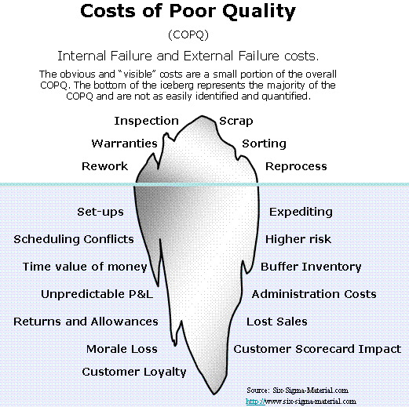

Conducting in-process quality assessments
Right – What we’re avoiding here…
Kan, Ch 15
Steve Chenoweth, RHIT
Notes:
Image from http://www.six-sigma-material.com/Cost-of-Poor-Quality.html.

Slide 2
Versus similar-sounding activities
In-Process Quality Assessment (this one!)
  Determining if a particular product development is on-track, and how to correct any discrepancies.
  Done by people on the project - possibly with help from outsiders.
Software Project Assessments (Ch 16)
  To judge quality of a whole project, or its processes.
  Often like a retrospective.
  Organization may be the focus, not just a single project.
  Usually run by outsiders.
Quality Audit (different – more official version of Ch 16 process)
  Organization is the focus – multiple projects.
  Formally checks the processes you are using. “Certification” may be at stake. Could be pass / fail.
  Like, does it meet some standard (like ISO 9000), or does it meet some contractual specification.
  Run by outsiders.

Slide 3
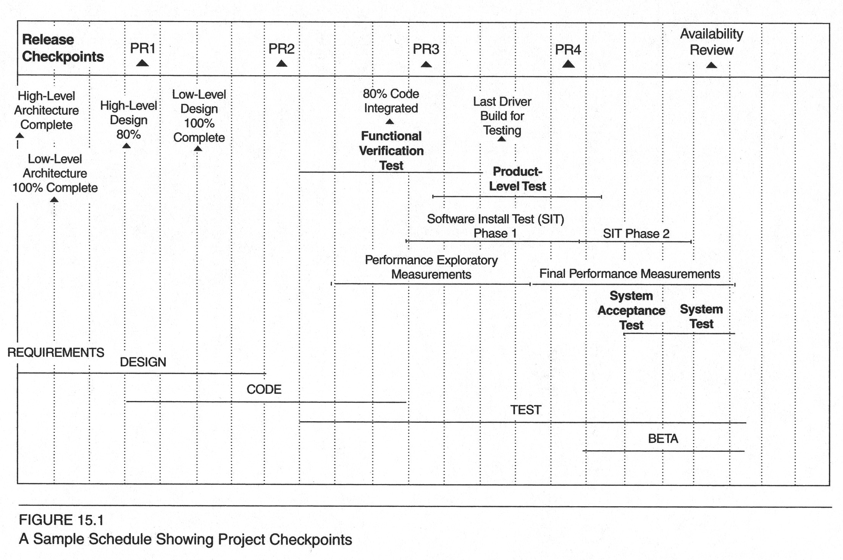
Usually done as a series of checkpoints or milestones
Notes:
Kan, p 398

Slide 4
Phases in a quality assessment
1. Preparation phase:
  What data should I look at?
  Depends on which phase the project is in
  If iterative, also get data from prior iterations
  Need qualitative data, too:
    Who do you need to talk to?
    Do I have people from different areas?

Slide 5
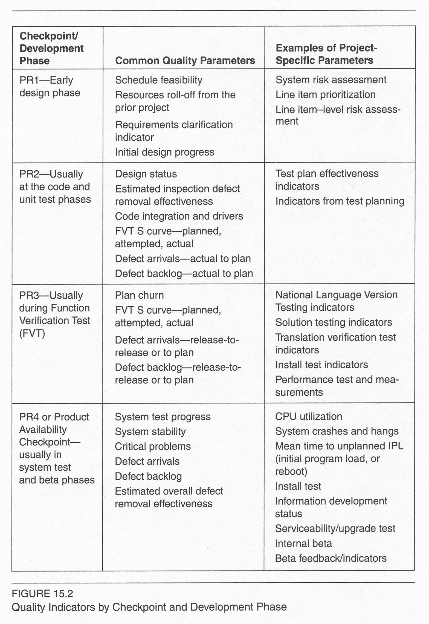
Types of assessments
Notes:
Kan, p 401

Slide 6

Need a list of open-ended questions
Where are we?
What’s the outlook?
Where are the weak areas?
What are the risks?
Are there any migration plans? What are they?
How does this project compare to past projects in your view?
Notes:
Image from http://esol.britishcouncil.org/methodology/asking-questions.

Slide 7
Phases, cntd
2. Evaluation phase:
Analyze the quantitative data:
  Use tools like control charts, trend charts, pareto diagrams, or statistical techniques.
  Where are the gaps?
Classify the qualitative data:
  What are the outliers.
  What doesn’t cross-validate.
  What are the expert opinions?
Simplify conclusions with “dashboards,” etc.
Notes:
Samples of red-yellow-green light evaluations are on Kan p 405.

Slide 8
Phases, cntd
3. Summarization phase:
Key issues and concerns
  At Lucent, the worst ones were called “project affecting.”
Problem areas
Potential impacts
Also – what’s ok!

Slide 9
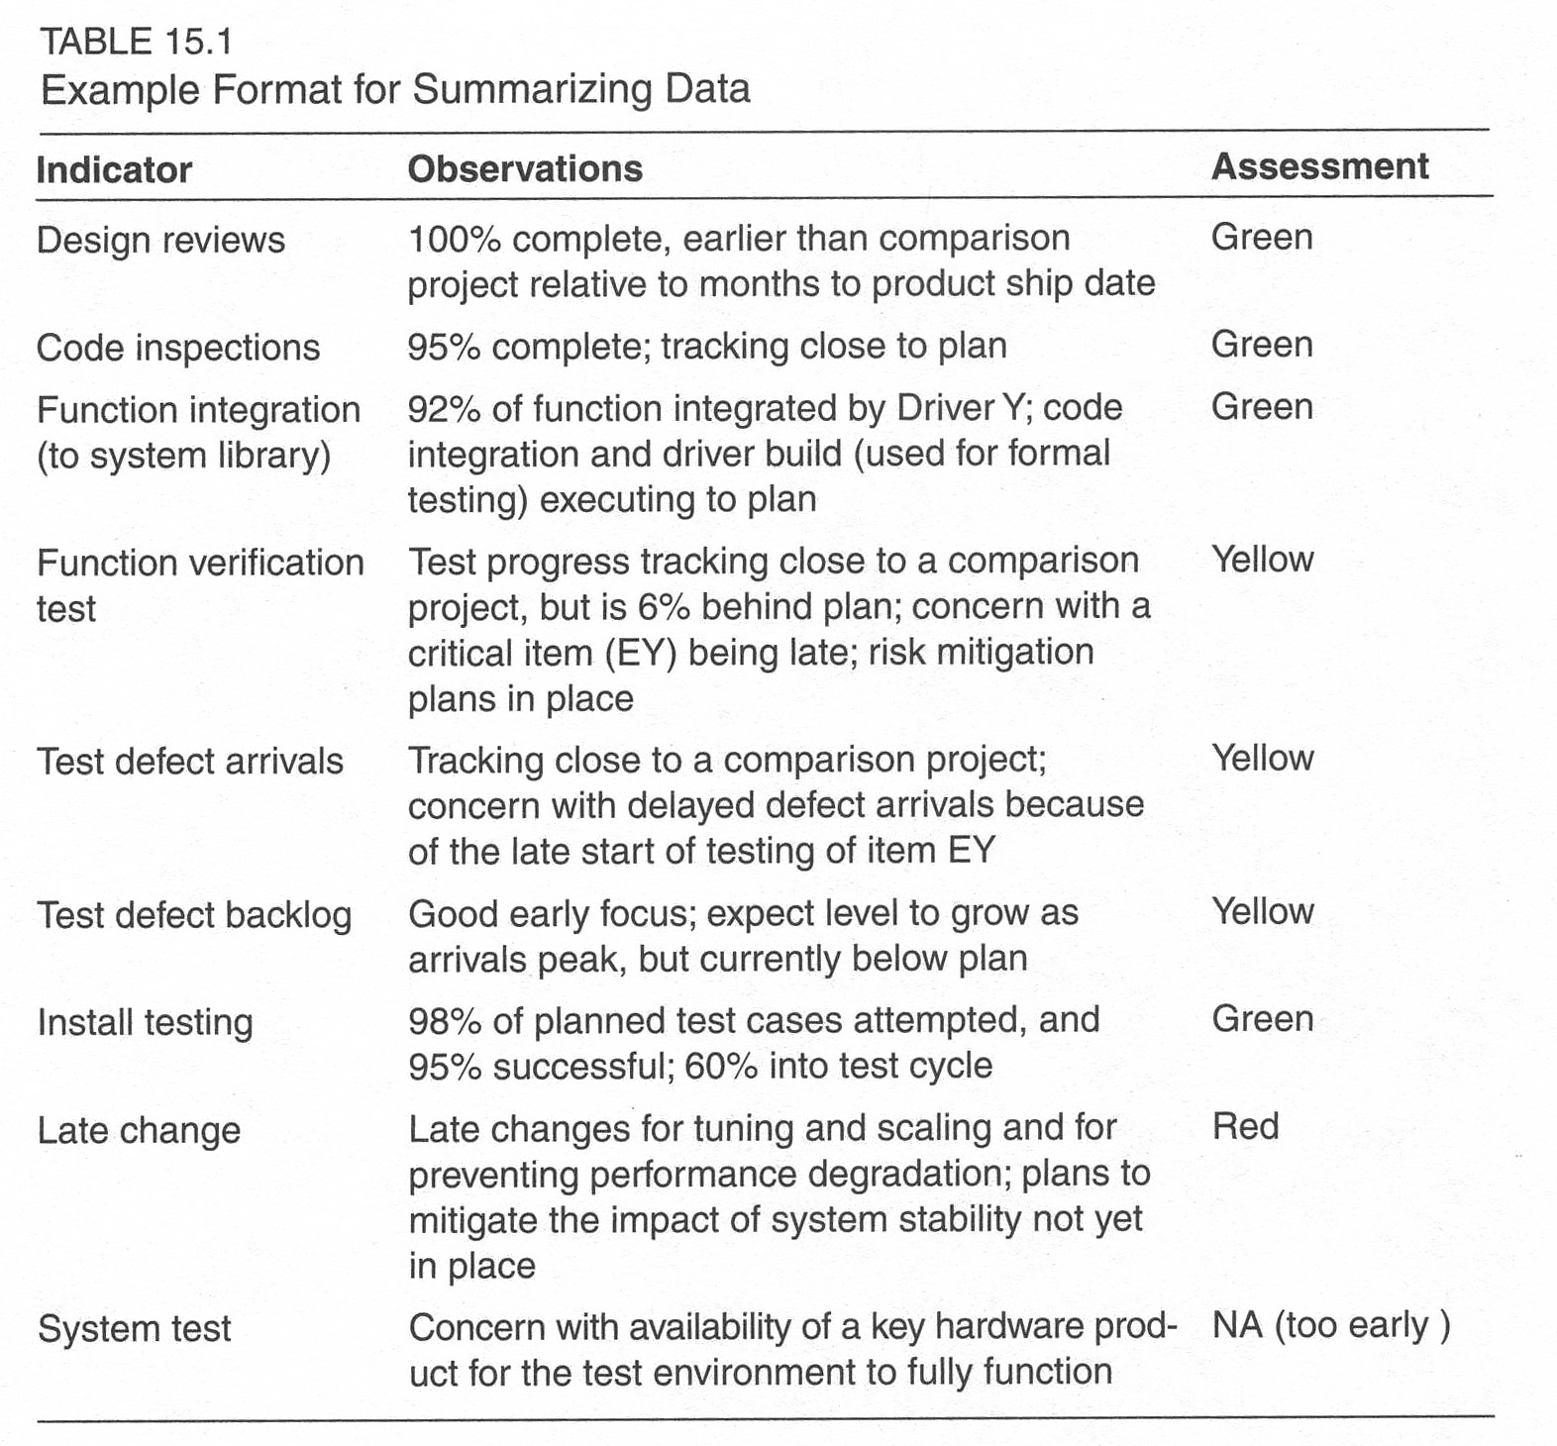
Sample summary
Notes:
Kan, p 407.

Slide 10
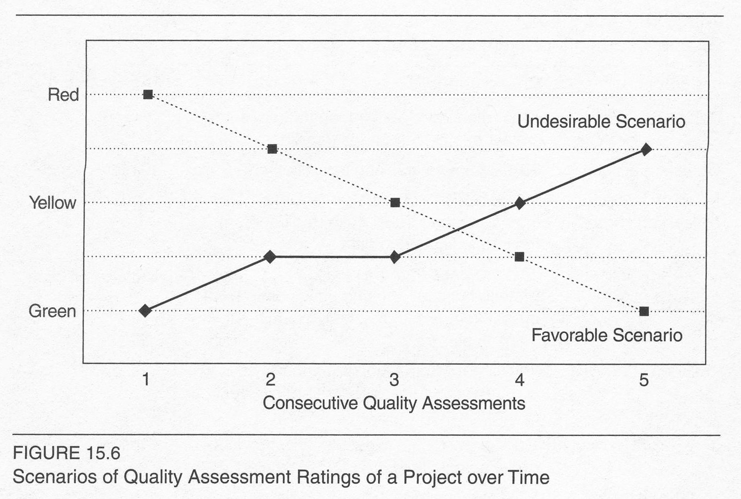
Scenarios over time
Notes:
Kan, p 408

Slide 11
Phases, cntd
4. Recommendations and risk mitigation:
Part of the summary.
Tend to be unique, require creativity, expertise and experience.
  See likely causes, like steps left out.
  Have ideas, like “transfer risk to someone else”!

