Slide 1


Measuring and analyzing customer satisfaction
Kan, Ch 14
Steve Chenoweth, RHIT
Notes:
Image from http://www.chiropractorfreehold.com/chiropractor-in-freehold-nj-wins-the-2012-talk-of-the-town-customer-satisfaction-award/.

Slide 2

Recall from Week 1
CSSE576 Learning Outcomes: Acceptance
Effectively verify customer
satisfaction.
On-site and beta testing
Customer surveys
Analyzing data

Slide 3

And from Week 2
How do we know if it’s “quality”?
Mean time to failure
Defect density
Customer problems
Customer
satisfaction…
Do you see “quality” here?

Slide 4
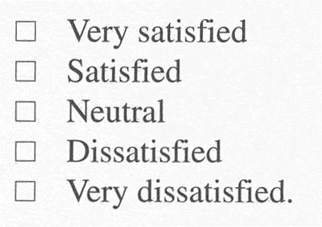
Customer Satisfaction Metrics
Often a 5-point scale:
Can be overall, or
For specific qualities.
HP uses “FURPS”:
  Functionality
  Usability
  Reliability
  Performance
  Service
Week 2, cntd
Notes:
Kan p 98

Slide 5
Customer Sat
Can be expressed to the customer as a question, in different ways:
Completely satisfied?
Satisfied?
Dissatisfied?
Neutral or worse?
Most commonly asked for
Week 2, cntd

Slide 6
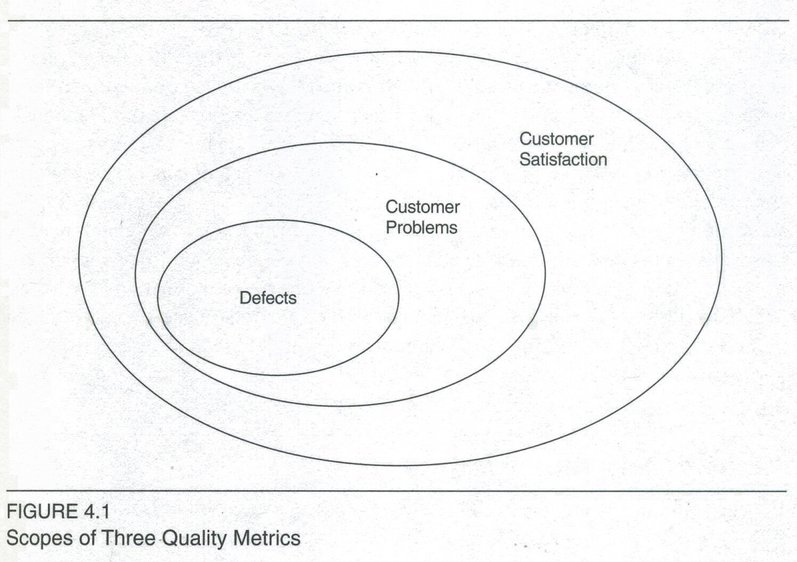
Relative scope of the 3 metrics
These are subset relationships
Week 2, cntd
Notes:
Kan p 99

Slide 7
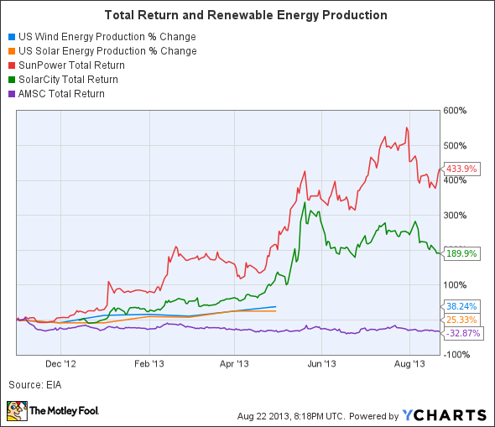
And from Week 7 (last week)
Why availability?
In Ch 14 to follow, Kan shows that, in his studies, availability stood out as being of highest importance to customer satisfaction.
It’s closely related to
reliability, which we’ve
been studying all along.
Right – We’re not the only ones with availability problems. Consider the renewable energy industry!

Slide 8
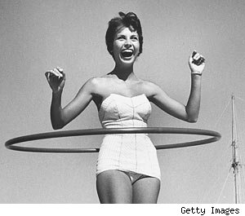
So, on to cust sat proper!
The ultimate validation of quality.
Tom Demarco claims that
Microsoft Word is a Great
Product. Why?
  So many people use it.
TQM: Customer satisfaction
is the direct link with
ongoing use.
  A leading indicator of
  future sales.
Wham-O! A great product
in action, 1957. 25 Million
were sold in under 4 months.
Notes:
Image from http://www.takeitoutsidefitness.com/2011/05/craft-new-body-diy-basic-hula-hoops.html.

Slide 9
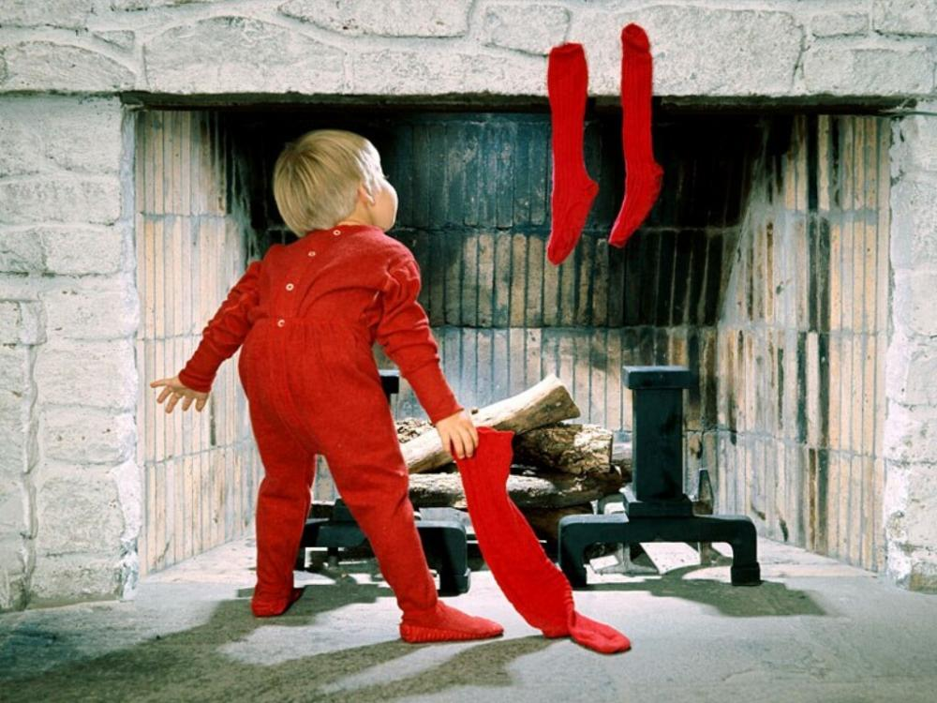
It’s a real thing (psychologically)
Starts with customer expectations prior to purchase. “Anticipated performance.”
Could be, say (Miller, 1977):
  Ideal
  Expected
  Minimum tolerable
  Desirable
Link is to perception of
filling that need after
purchase.
  Does it perform
  “as expected”?
Notes:
This is the Wikipedia view of cust sat. From http://en.wikipedia.org/wiki/Customer_satisfaction.
Image from http://alwaysapastor.com/anticipation/.

Slide 10
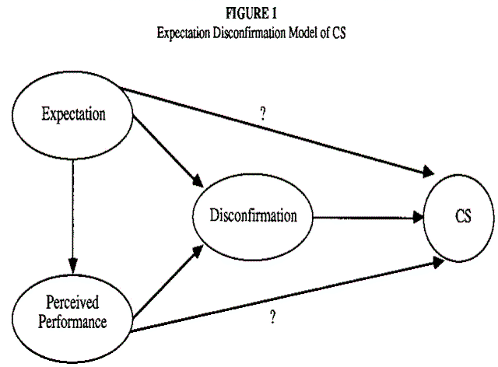
The Disconfirmation Model
Compares expectations and perceived product performance.
Traditional paradigm is based on:
  Expectations
  Performance
  Disconfirmation
  Satisfaction
A sum of satisfactions
over the features used.
Has both cognitive and
affective components.
CS = Customer Sat. The “Disconfirmation” proves indirectly the two ? Relationships.
Notes:
“The disconfirmation is positive when a product performs over the expectations”! It’s negative when performance is worse than expected.
Image from http://www.acrwebsite.org/search/view-conference-proceedings.aspx?Id=7500.

Slide 11
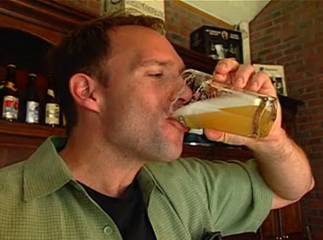
Two marketing events are involved
Retaining existing customers
Targeting non-customers (5 times more costly):
Why do they buy? Hedonic and utilitarian values:
  Sensory and experiential
  Over time, instrumental
  and functional qualities
  prevail.
Right – Long view: is it all just
utilitarian?
Notes:
Image from https://www.flickr.com/.

Slide 12
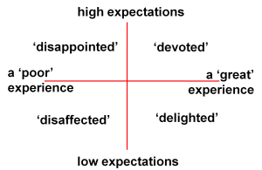
Can you do better?
In the 1990’s, at NCR, we tried for “customer delight.”
Found it’s mighty hard to sustain!
Right – Here’s the problem:
Notes:
Image from http://www.andyhanselman.com/2012/06/27/create-customer-delight-with-an-online-response-but-be-quick/.

Slide 13
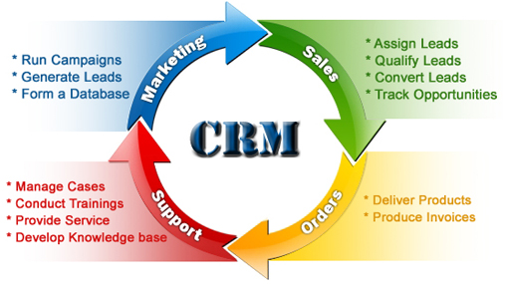
Use surveys to measure?
Maybe you already have the data?
  Ongoing customer relationships with marketing
  Complaint data
  Customer visits
  Customer advisory
  councils & user
  conferences
  Trouble tickets
Or, it’s time for a
survey!
Notes:
We are now living in a world where even the corner candy store has a Customer Relationship Management system.
Image from http://www.zoho.com/crm/how-crm-works.html.

Slide 14

Different methods → different results
Face-to-face
  Personal interview
  Focus groups
Telephone interviews
Mailed questionnaires
Emailed questionnaires
Notes:
Image from http://gowestgroup.com/marketing-assessment-questionnaire/.

Slide 15

Face-to-face
High validity
  You can read facial
  expressions and gestures.
  Easy to ask follow-up
  questions.
  Can use exhibits to aid
  in explanations
But, interviewers also
tend to deviate from
the agenda as they
build a personal relationship!
“So, how do you like your new car sound system?” – Asked better if they were in the car?
Notes:
Image from http://www.fastweb.com/career-planning/articles/715-the-informational-interview-face-to-face-with-a-new-career.

Slide 16

Telephone interviews
Less expensive
Easy to monitor for quality
Can be computer-aided
Easier to keep short
More balkers
Say, how about those new servers in the cloud!?

Slide 17
Mailed / emailed
Looks like junk mail
Low response rates
  Respondents may differ from those ignoring
Questionnaire must be pre-validated
  Need professional knowledge and experience
How do you “sample” a large customer base?
  It’s an art form
Notes:
Sampling – see Kan pp 377+

Slide 18
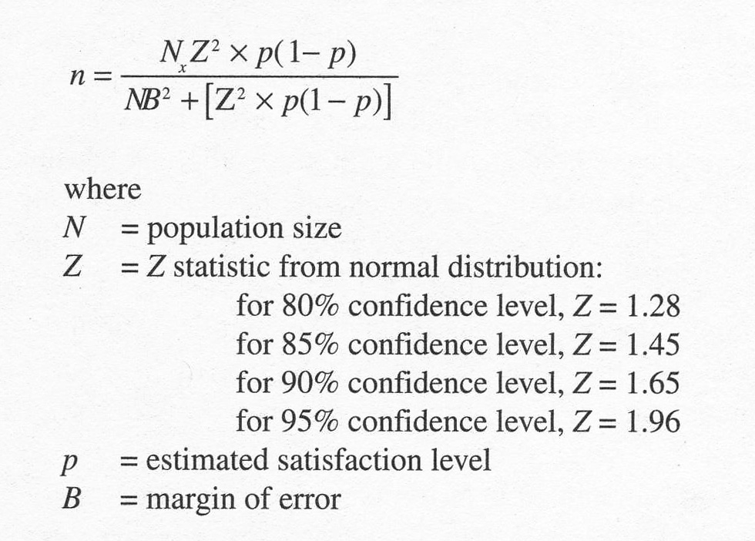
How big is big enough?
Notes:
Kan p 380

Slide 19
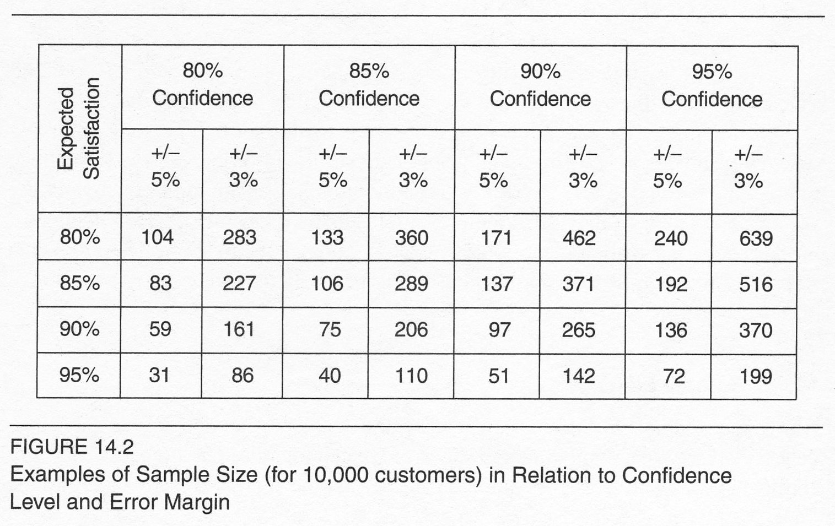
Or,

Slide 20

What rating scale to use?
Most common:
  Very satisfied
  Satisfied
  Neutral
  Dissatisfied
  Very dissatisfied
Then look at the
distribution of
responses…
The satisfied customer in action. Wait! They aren’t using the product!
Notes:
Image from http://www.getuwired.us/Small-Business-Web-Marketing/2011/08/add-an-agony-filter-to-your-internet-marketing-strategy/.

Slide 21
How to you act on the data?
Hard to know if it’s all global.
So, you should’ve picked things that will enable this!
What areas of strength and weakness could you use for quality improvements?
Interpretation is an art:
  High satisfaction with reliability and low satisfaction with documentation – does not necessarily mean you should work on the latter!
Notes:
Kan p 382

Slide 22
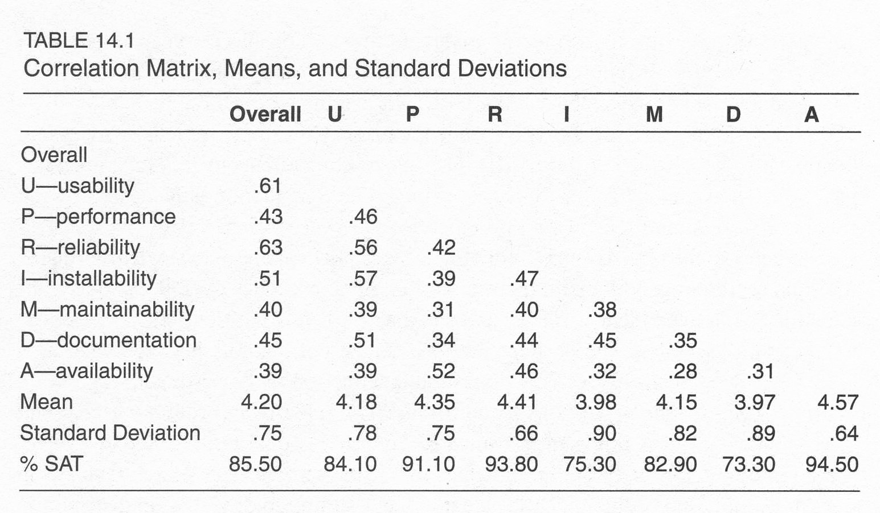
Kan’s UPRIMD-A parameters
Notes:
Kan, p 384

Slide 23
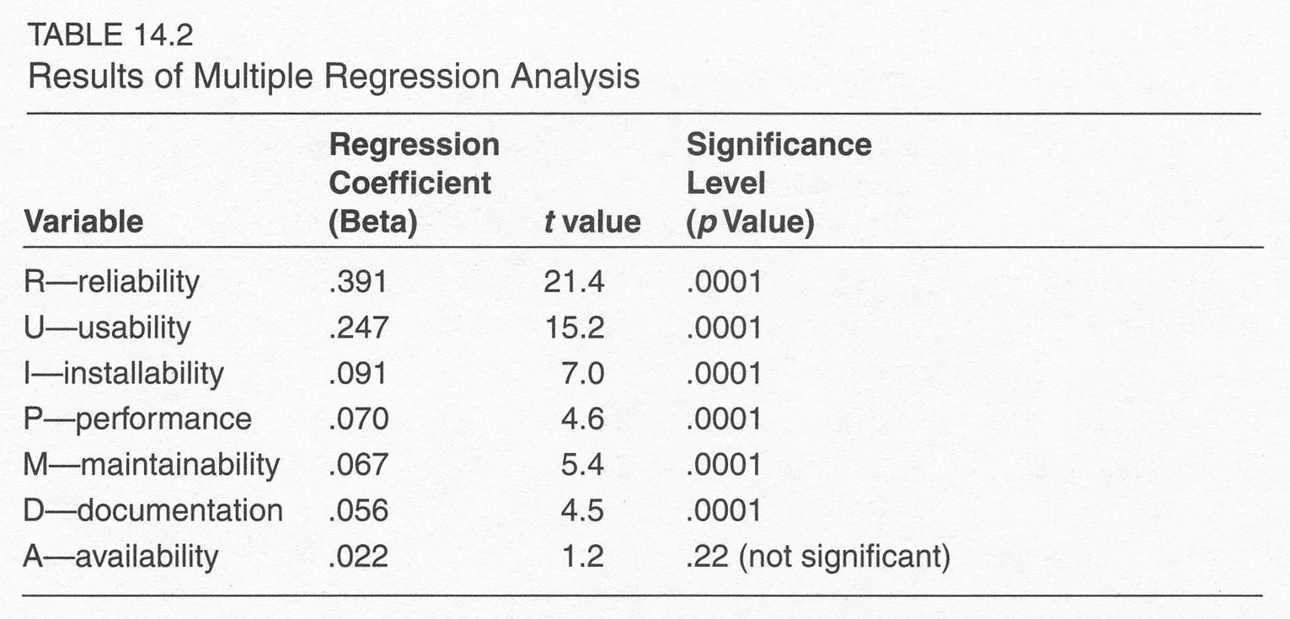
Multiple regression analysis
Notes:
Kan, p 385

Slide 24
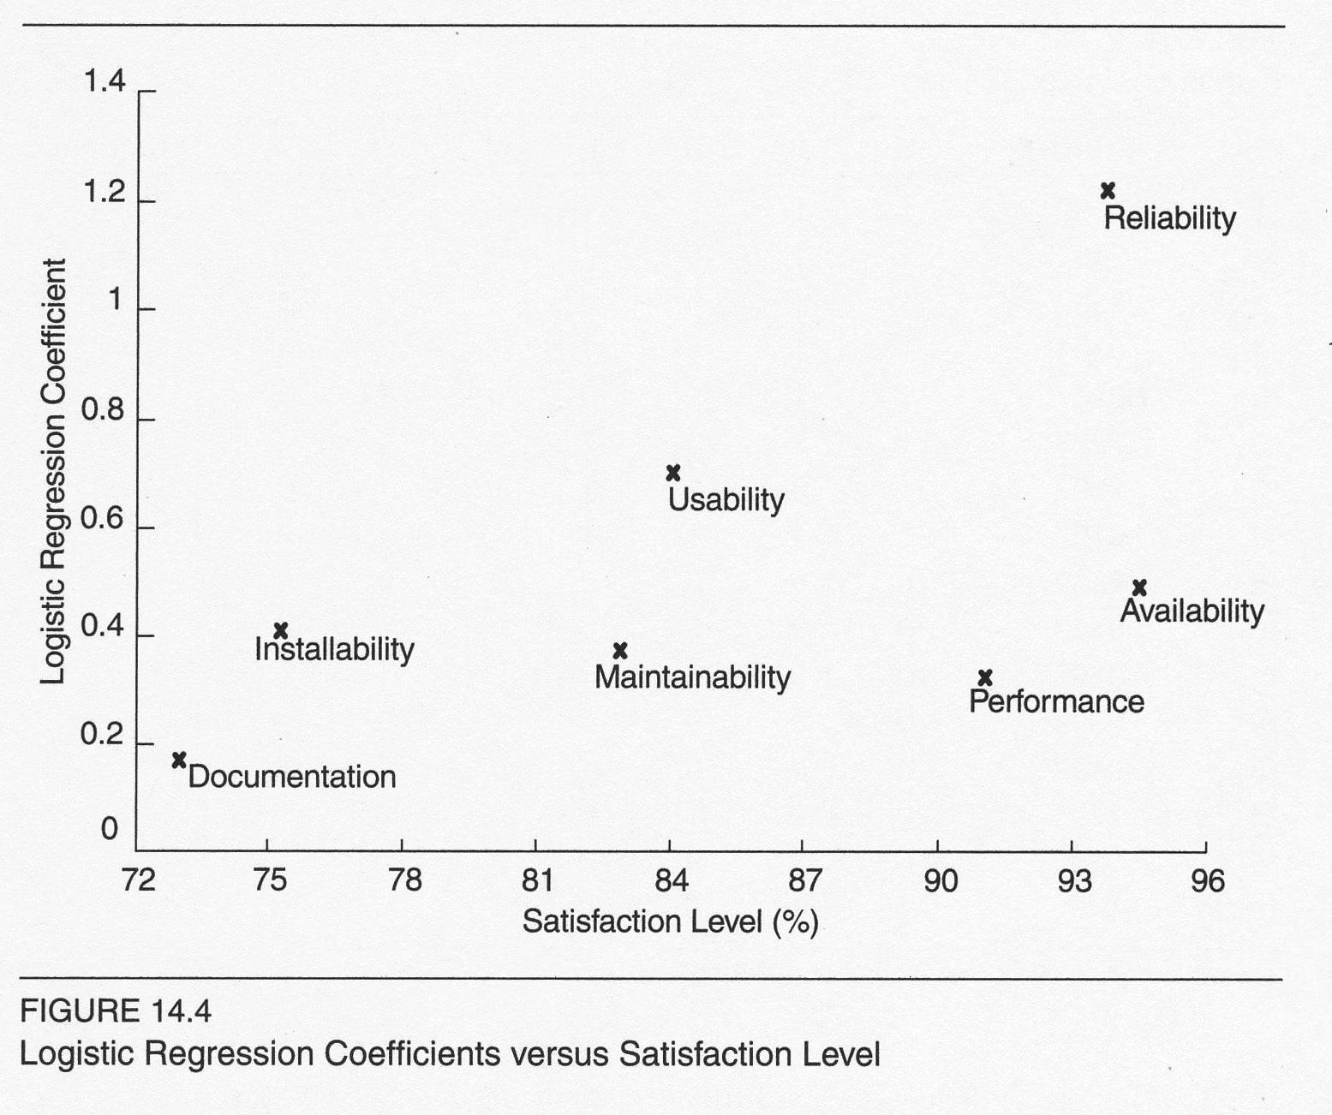
Logistic regression coefficients
Notes:
Kan p 388

Slide 25

How about organizational sat?
This can color satisfaction with products.
Satisfaction and loyalty could be primarily company-based.
  Support and service span products.
  Marketing does, too!
  Company image is
  considered.
Notes:
“Image” image from http://www.easyrentpro.com/company_profile.php.

Slide 26
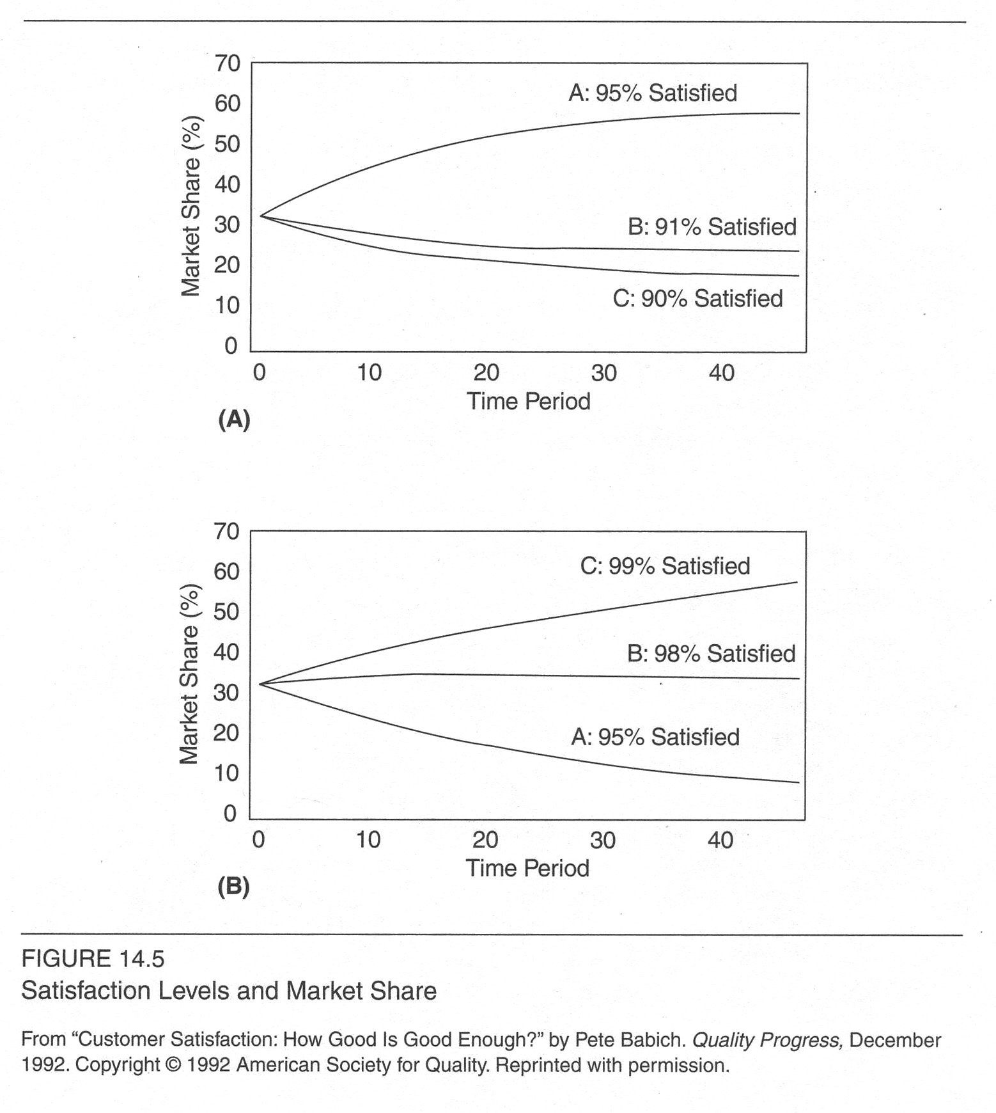
How good is good enough?
Need to consider effect of trends over time.
Notes:
Kan p 391

Slide 27
Recommendations for small orgs
Post-purchase call back program
Complaint management process*
Customer satisfaction survey program
*Likely to be most important!
Leverage the benefits of customer involvement in:
  Requirements
  Design
  Functional verification test
  Various forms of customer testing

