Slide 1
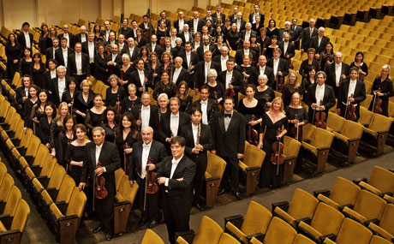

Performance Metrics and Performance Engineering
Steve Chenoweth, RHIT
Above – They look ready to perform, but why are they sitting in the audience seats?
Notes:
Picture of New York Philharmonic from http://www.nycgo.com/venues/new-york-philharmonic.

Slide 2
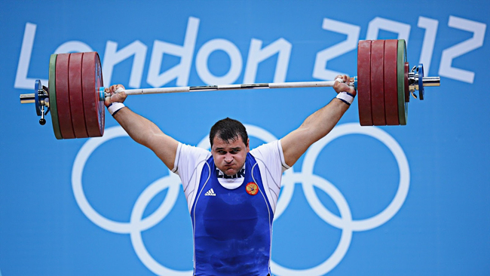
What is performance?
It’s both of:
  How fast, and
  Capacity (how many)
Usually, a combination
of these like,
  How fast will the system respond, on average, to 10000 simultaneous web users trying to place an order?
Notes:
Image is Russian weightlifter, from http://www.poliquingroup.com/ArticlesMultimedia/Articles/Article/1086/How_Russian_Weightlifters_Train.aspx.

Slide 3
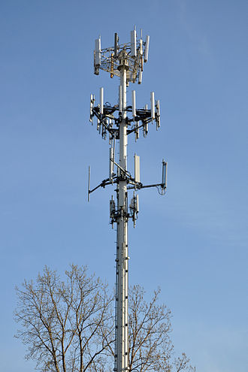
Customers care about performance
Some systems are sold by performance!
  Customers divide the cost by how many users it will handle at some standard rate of user activity,
  Then they compare that to the
  competition.
“And, how many simultaneous cell phone calls will yours handle?”
Notes:
Image from http://en.wikipedia.org/wiki/Cell_site.

Slide 4
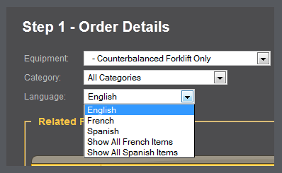
Software performance engineering
Starts with asking the target customers the right questions.
    How fast SHOULD the system respond, on average, to 10000 simultaneous web users trying to place an order?
X 1000
Notes:
Image from http://www.ivestraining.com/forklift-resource-center/ives-training-group-web-order-system/.

Slide 5
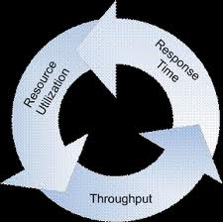
The key factors all relate
Resource consumption generates the responses, up to the capacity.
And the response rate
degrades as you approach
the limit.
At 50% capacity, typically
things take twice as long.
Notes:
Image from http://www.theserverside.com/news/1363731/Performance-Engineering-a-Practitioners-Approach-to-Performance-Testing.

Slide 6
It’s systematic
Goal is to push requirements into design, coding, and testing.
Everyone has numbers to worry about.
They worry about them early.
Contrasts with, “Wait till it hits the test lab, then tune it.”

Slide 7
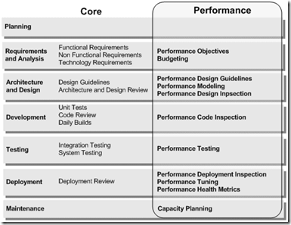
Here’s how
Notes:
Image from http://blogs.msdn.com/b/jmeier/archive/2008/11/20/patterns-practices-performance-engineering-cheat-sheet.aspx

Slide 8
Main tool – a spreadsheet
Typical new system design analysis – For a network management system
Note: These
are all resource
consumption
estimates
Note: Having everything add up to only
60% allows for some “blocked time”

Slide 9
Performance is another quality attribute
And “Software performance engineering” is very similar to “reliability engineering,” already discussed.
Use a spreadsheet,
Give people “budget” accountabilities, and
Put someone in charge.

Slide 10

Start with “scenarios”
Document the main “situations” in which performance will be an important consideration to the customer.
These are like “use cases” only more general.
Due to Len Bass, at the SEI.
He looks harmless enough…
Notes:
Image of Bass from http://www.dimap.ufrn.br/sbcars2009/en/notes.html.

Slide 11
Bass’s perf scenarios
Source: One of a number of independent sources, possibly from within system
Stimulus: Periodic events arrive; sporadic events arrive; stochastic events arrive
Artifact: System
Environment: Normal mode; overload mode
Response: Processes stimuli; changes level of service
Response Measure: Latency, deadline, throughput, jitter, miss rate, data loss

Slide 12
Example scenario
Source: Users
Stimulus: Initiate transactions
Artifact: System
Environment: Under normal operations
Response: Transactions are processed
Response Measure: With average latency of two seconds

Slide 13
For an existing development project
Find a “very needed” and “doable” performance improvement
Whose desired state can be characterized as one of those scenarios!
  Add “where it is now!”

Slide 14

What do you do next?
The design work –
Adopt a tactic or two…
  My descriptions are deceptively brief
  Each area – like designing high performance into a system – could be your career!
What on earth could improve
a performance scenario
by 100%?
It’s only running half as fast as it should!
Notes:
Image from http://www.forbes.com/2010/10/18/financial-advisors-fire-clients-markets-brokers_slide.html.

Slide 15
The tactics for performance
Mostly, they have to work like this
Tactics
to control
performance
Events
arrive
Responses
generated
within time
constraints
Notes:
From Bass’s Software Architecture in Practice, 2nd Ed., Fig 5.6.
There is now a new and even better 3rd Ed!

Slide 16
Typically…
The events arrive, but
Some reasons can be ID’ed for their slow processing
Two basic contributors to this problem:
  Resource consumption – the time it takes to do all the processing to create the response
  Blocked time – it has to wait for something else to go first

Slide 17
Which one’s easier to fix?
Blocked time – sounds like it could lead pretty directly to some solution ideas, like:
  Work queues are building up, so add more resources and distribute the load, or
  Pick the higher priority things out of the queue, and do them first

Slide 18
Blocked time, cntd
In your system, of course, adding resources may or may not be possible!
  Add disk drives?
  Add CPU’s?
  Speed up communication paths?
On servers, these are standard solutions:
  Put every DB table on its own disk drive
  Stick another blade in the rack, etc.

Slide 19
Resource consumption?
You first have to know where it is:
If you’re trying to speed up a GUI activity, time the parts, and go after the long ones.
If it’s internal, you need some way to “observe” what’s happening, so you can do a similar analysis.
  Put timings into the various pieces of activity
  Some parts may be tough to break down, like time spent in the O/S

Slide 20
Bass’s Performance Remedies
Try one of these 3 Strategies – look at:
  Resource demand
  Resource management
  Resource arbitration
See next slides for details on each →

Slide 21
Resource Demand – example:
Server system has “the database” for retail inventory (for CSSE 574’s NextGen POS):
  Transactions hit it at a high rate, from POS
  Managers also periodically do huge queries, like, “What toothpaste is selling best West of the Mississippi?”
  When they do, transactions back up
How to fix?

Slide 22
Resource Demand – options:
Increase computational efficiency
Reduce computational overhead
Manage event rate
Control frequency of sampling
Bound execution times
Bound queue sizes

Slide 23

Resource Management – example:
You have a “pipe and filter” system to convert some data for later processing:
It runs too slowly, because it reads and writes all files on the same disk (on your laptop, say)
How to fix?
Non-XML
data from
outside
XML data
you can
process
Clean up
Convert
Picture from http://www.dossier-andreas.net/software_architecture/pipe_and_filter.html.

Slide 24
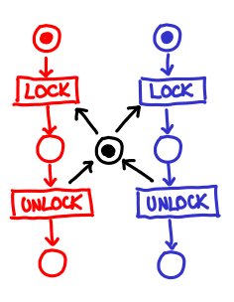
Resource Management – options:
Introduce concurrency
  How about on your project?
Maintain multiple copies of
data or computations
Increase available resources
Concurrency adds a layer of complexity.
Notes:
Image from http://blog.ezyang.com/2011/03/petri-net-concurrency/.

Slide 25
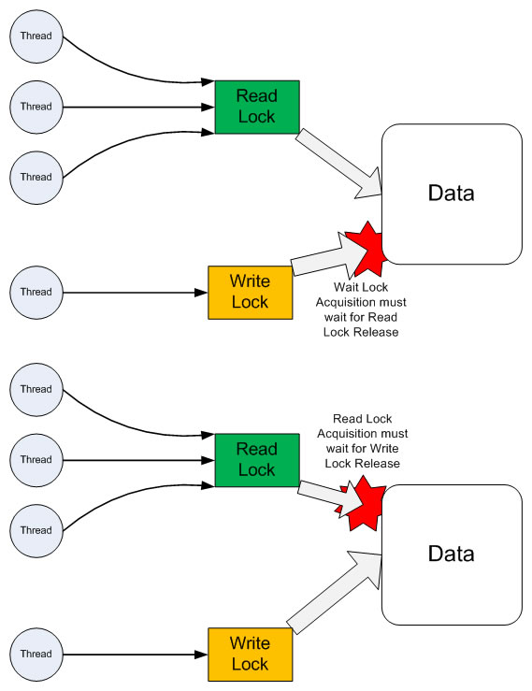
Resource Arbitration – example:
In reader / writer scheduling…
For a shared resource, like a
DB table…
Why give priority to the readers?
Right - Reader / writer concurrency – almost everyone gives priority to readers – Why?
Notes:
Reader/writer lock image from http://swinbrain.ict.swin.edu.au/wiki/Concurrent_Programming_-_Reader_Writer_Lock.

Slide 26
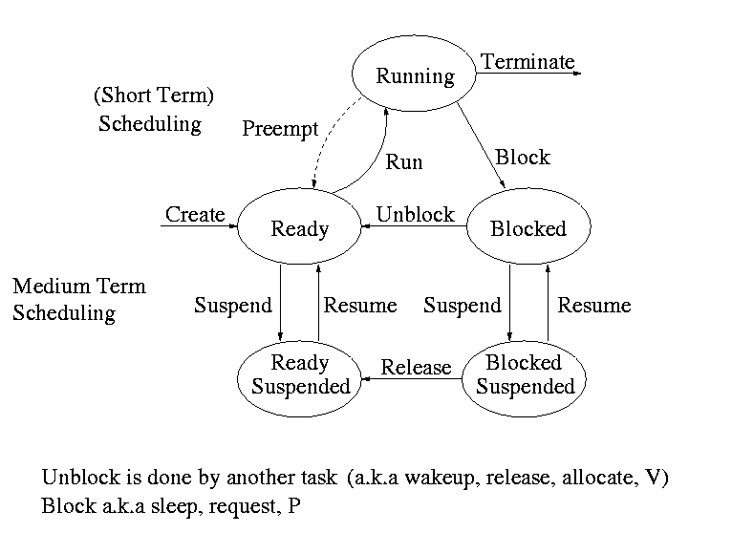
Resource Arbitration – options:
Scheduling policy
  FIFO
  Fixed-priority
    semantic importance
    deadline monotonic
    rate monotonic
  Dynamic priority
  Static scheduling
Above - Memory allocation algorithm – more complex than you’d think it needs to be?
Notes:
Image from http://cs.nyu.edu/~gottlieb/courses/2000-01-spring/os/chapters/chapter-3.html.

Slide 27
What about multi-processing?
We started this discussion a couple classes ago.
I put link out on schedule page, about multicore.
A good opportunity to share experience.
To begin with, everyone knows that the thing doesn’t run twice as fast on two processors.
Now we’re faced with “more processors” being the performance solution provided by hardware…

Slide 28
Multicore issues
From the website intro:
Scalability-problem, where number of threads increases beyond the number of available cores.
Memory-problem can occur in shared memory architecture when data is accessed simultaneously by multiple cores.
I/O bandwidth
Inter-core communications,
OS scheduling support-Inefficient OS scheduling can severely degrade performance.

Slide 29
Cloud issues
From the other website intro:
the costing/pricing model, which is still evolving from the traditional supercomputing approach of grants and quotas toward the pay-as-you-go model typical of cloud-based services;
the submission model, which is evolving from job queuing and reservations toward VM deployment;
the bringing of data in and out of the cloud, which is costly and results in data lock-in; and
security, regulatory compliance, and various "-ilities" (performance, availability, business continuity, service-level agreements, and so on).
Notes:
- See more at: http://www.computer.org/portal/web/computingnow/archive/september2012#sthash.oVTGvPk1.dpuf

Slide 30
Customer expectations
“The tail at scale” article:
Even rare performance hiccups affect a significant fraction of all requests in large-scale distributed systems.
Eliminating all sources of latency variability in large-scale systems is impractical, especially in shared environments.
Using an approach analogous to fault-tolerant computing, tail-tolerant software techniques form a predictable whole out of less predictable parts.

Slide 31
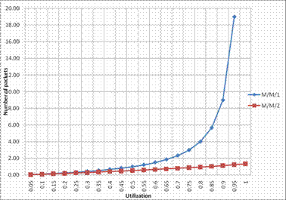
This is the tail that users see
Notes:
Image from http://lejpt.academicdirect.org/A16/151_166.htm.

Slide 32
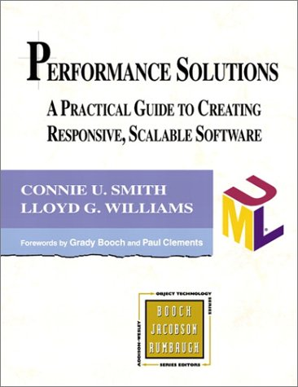
Performance Engineering –
There’s a book on it
Notes:
Image from http://www.perfeng.com/paperndx.htm.

