Slide 1


Availability Metrics and Reliability/Availability Engineering
Kan Ch 13
Steve Chenoweth, RHIT
Left – Here’s an availability problem that drives a lot of us crazy – the app is supposed to show a picture of the person you are interacting with but for some reason – on either the person’s part or the app’s part – it supplies a standard person-shaped nothing for you to stare at, complete with a properly lit portrait background.
Notes:
Image from https://arthistory.rice.edu/content.aspx?id=66.

Slide 2
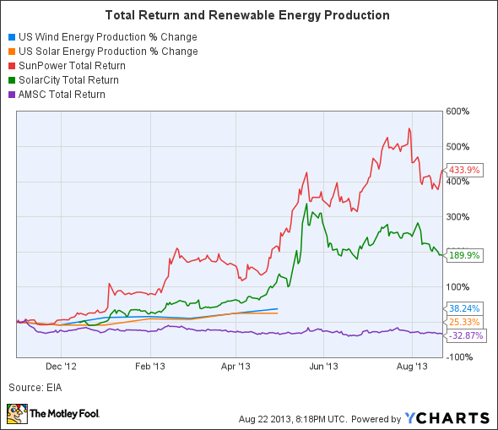
Why availability?
In Ch 14 to follow, Kan shows that, in his studies, availability stood out as being of highest importance to customer satisfaction.
It’s closely related to
reliability, which we’ve
been studying all along.
Right – We’re not the only ones with availability problems. Consider the renewable energy industry!
Notes:
Image from http://www.fool.com/investing/general/2013/08/26/renewable-investors-need-to-look-ahead.aspx.

Slide 3
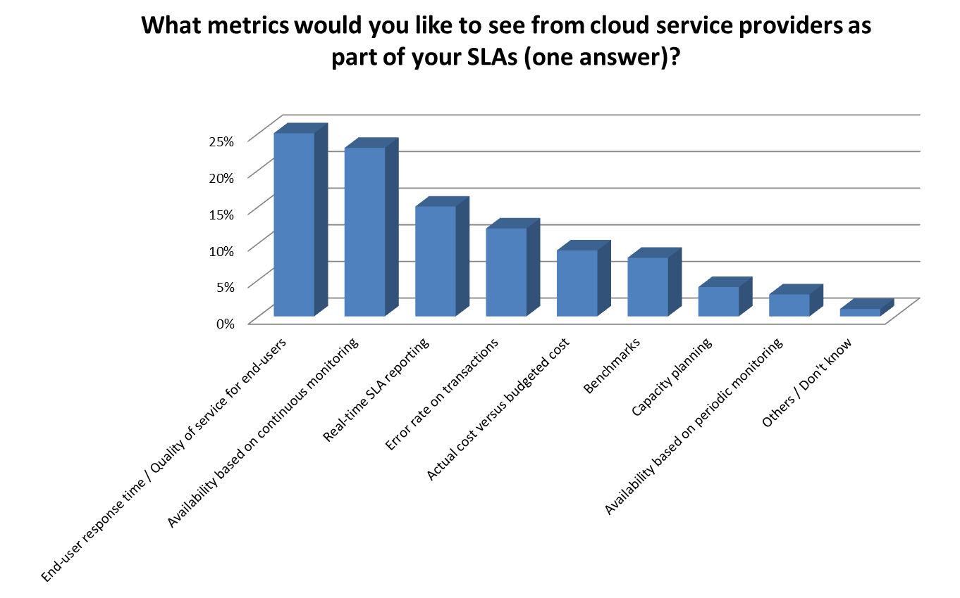
Customers want us to provide the data!
Notes:
From http://apmblog.compuware.com/2014/04/30/the-problem-with-cloud-slas/.

Slide 4
“What” has to be up /down
Kan starts by talking about examples of total crashes.
Many industries rate it this way.
You need to know what is “customary” in yours.
This also crosses into our next topic – if it’s “up” but it “crawls,” is it really “up”?

Slide 5

Three factors → availability
The frequency of system outages within the timeframe of the calculation
The duration of outages
Scheduled uptime
E.g., If it crashes at night when you’re doing maintenance, and that doesn’t “count,” you’re good!
Notes:
From Kan p 360.
Image from http://aspiringgentleman.wordpress.com/2013/08/19/if-a-tree-falls-in-the-forest-what-was-the-question/.

Slide 6
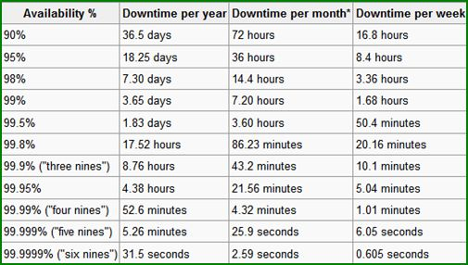
And then the 9’s
We were here in switching systems, 20 years ago!
Notes:
Image from http://www.compuquip.com/it-services-blog/2011/04/the-public-cloud-isnt-the-panacea-its-being-marketed-as/.

Slide 7
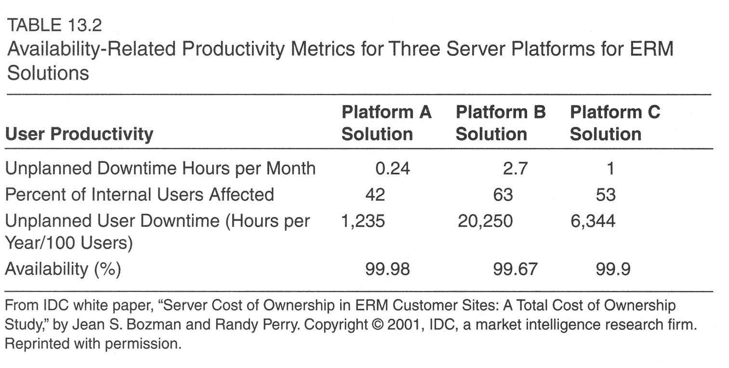
The real question is the “impact”
Notes:
Kan p 362

Slide 8
Availability engineering
Things we all do to max this out:
RAID
Mirroring
Battery backup (and redundant power)
Redundant write cache
Concurrent maintenance & upgrades
  Fix it as it’s running
  Upgrade it as it’s running
  Requires duplexed systems
Notes:
Kan pp 363-4

Slide 9
Availability engineering, cntd
Apply fixes while it’s running
Save/restore parallelism
Reboot/IPL speed
  Usually requires saving images
Independent auxiliary storage pools
Logical partitioning
Clustering
Remote cluster nodes
Remote maintenance

Slide 10
Availability engineering, cntd
Most of the above are hardware-focused strategies.
Example of a software strategy:
“Watcher”
“Well, he’s dead!”
Ping /
heartbeat
Its work queue
“My process”
Fresh load of “My process”
Attach to old
work queue

Slide 11
Standards
High availability = 99.9+%
Industry standards
Competitive standards
In credit rating business,
  There used to be 3 major services.
  All had similar interfaces.
  Large customers had a 3 way switch.
  If the one they were connected to went down, they just switched to another one.
  Until it went down.

Slide 12
Relationship to software defects
Standard heuristic for large O/S’s is:
  To be at 99.9% availability,
  There has to be 0.01 defect per KLOC per year in the field.
  5.5 sigmas.
  For new function development, the defect rate has to be substantially below 1 per KLOC (new or changed).
Notes:
Kan p 365

Slide 13
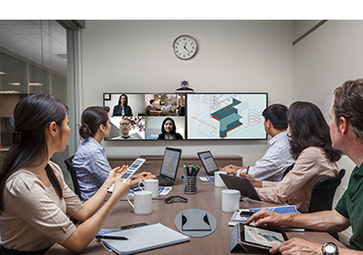
Other software features associated with high availability
Product configuration
Ease of install and uninstall
Performance, especially
the speed of IPL or reboot
Error logs
Internal trace features
Clear and unique messages
Other problem determination
capabilities of the software
Remote collaboration – a venue where disruptions are common, but they are expected to be restored quickly.
Notes:
Kan p 366
Image from http://www.polycom.com/products-services/realpresence-platform/realpresence-collaboration-servers.html

Slide 14
Availability engineering basics
Like almost all “quality attributes” (non-functional requirements), the general strategy is this:
  Capture the requirements carefully (SLA, etc.)
    Most customers don’t like to talk about it, or have unrealistic expectations
    “How often do you want it to go down?” “Never!”
  Test against these at the end.
  In the middle, engineer it, versus…

Slide 15

“Hope it turns out well in the lab!”
Saying in the system architecture business…
  “Hope is a city on denial.”
Instead,
  Break down requirements into “targets” for system components.
  If the system meets these, it will meet the overall requirements.
Then…
Right – “Village on the Nile, 1891”
Notes:
Image from http://en.wikipedia.org/wiki/Nile.

Slide 16
Make targets a responsibility
Break them as far down as needed, to give them to individual people, and/or individual pieces of code or hardware.
These become “budgets” for those people to meet.
Socialize all this with a spreadsheet that’s passed around regularly with updates.
Put someone in charge of that!

Slide 17
Then you design…
Everyone makes “estimates” of what they think their part will do, and
Creates a story for why their design will result in that:
  “My classes all have complete error handling and so can’t crash the system,” etc.
Design into the system the ability to measure components.
  Like logs for testing, that say what was running when it crashed.
Writes tests they expect to be run in the lab to verify this.
  Test first, or ASAP, are best, as with everything else.
Compare these to the “budgets” and work on problem areas.
  Does it all add up, on the spreadsheet?

Slide 18
Then you implement and test…
The test results become “measured” values.
These can be combined (added up, etc.) to turn all the guesswork into reality.
  Any team initially has trouble having those earlier guesses be “close.”
  With practice, you get a lot better (on similar kinds of systems).
You are now way better off than sitting in the lab, wondering why pre-release stability testing is going so badly.

Slide 19
Then you ship it…
What happens at the customer site, and
How do you know?
  A starting point is, if you had good records from your testing, then
  You will know it when you see the same thing happen to a customer.
    E.g., same stuff in their error logs, just before it crashed.
You also want statistics on the customer experience…

Slide 20

How do you know customer outage data?
Collect from key customers
Try to derive, from this, data like:
  Scheduled hours of operations
  Equivalent
  system years of
  operations
  Total hours of
  downtime
  System
  availability
  Average outages per system per year
  Average downtime (hours) per system per year
  Average time (hours) per outage
What do you mean, you’re down? Looks ok from here…
Notes:
Kan p 366
Image from http://www.pdmi.com/help.htm.

Slide 21
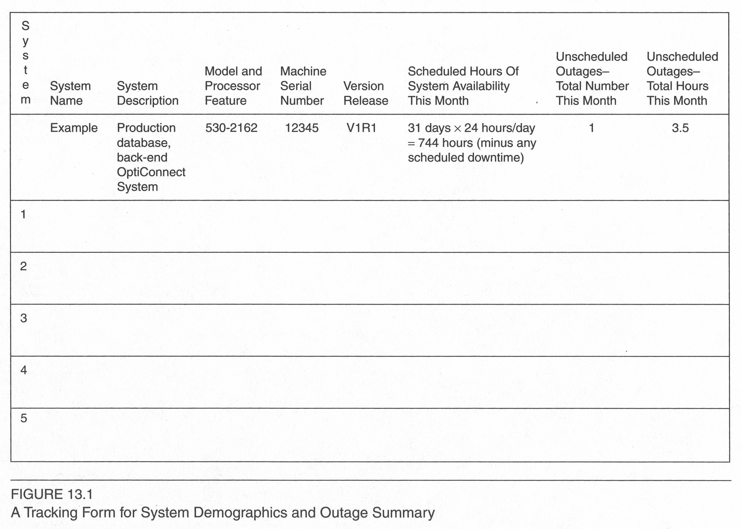
Sample form
Notes:
Kan p 367

Slide 22
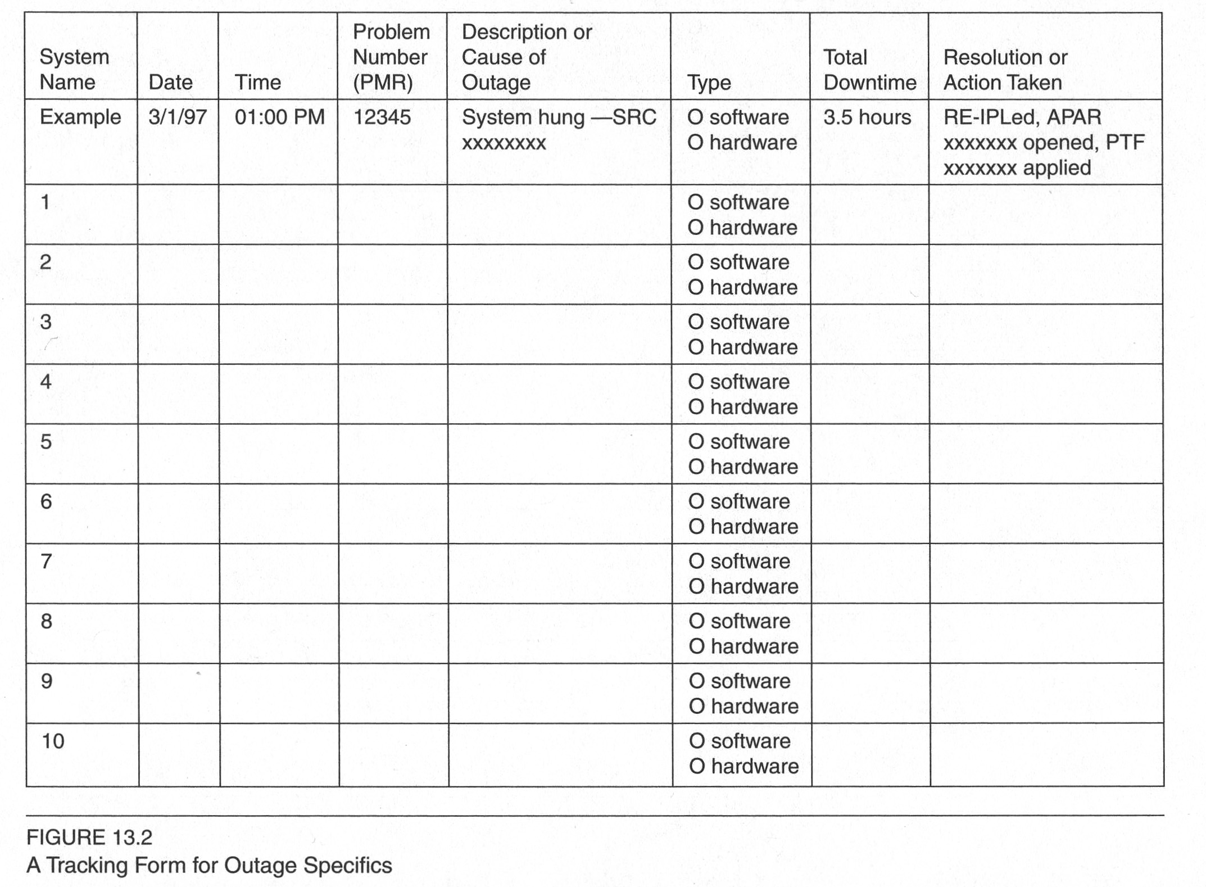
Root causes - from trouble tickets
Notes:
Kan p 368

Slide 23
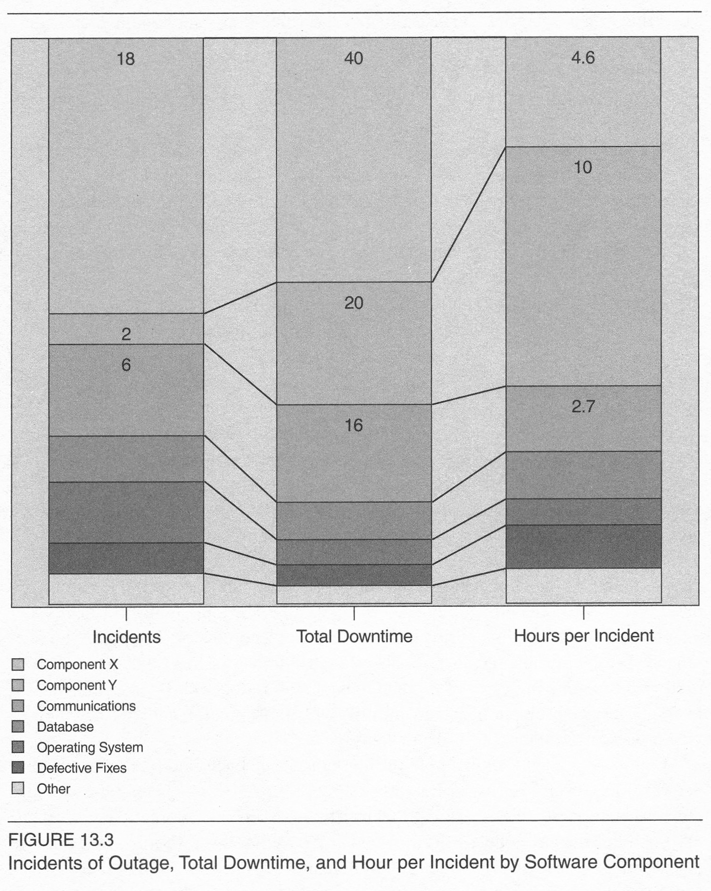
Goal – narrow down to components
Notes:
Kan p 370

Slide 24
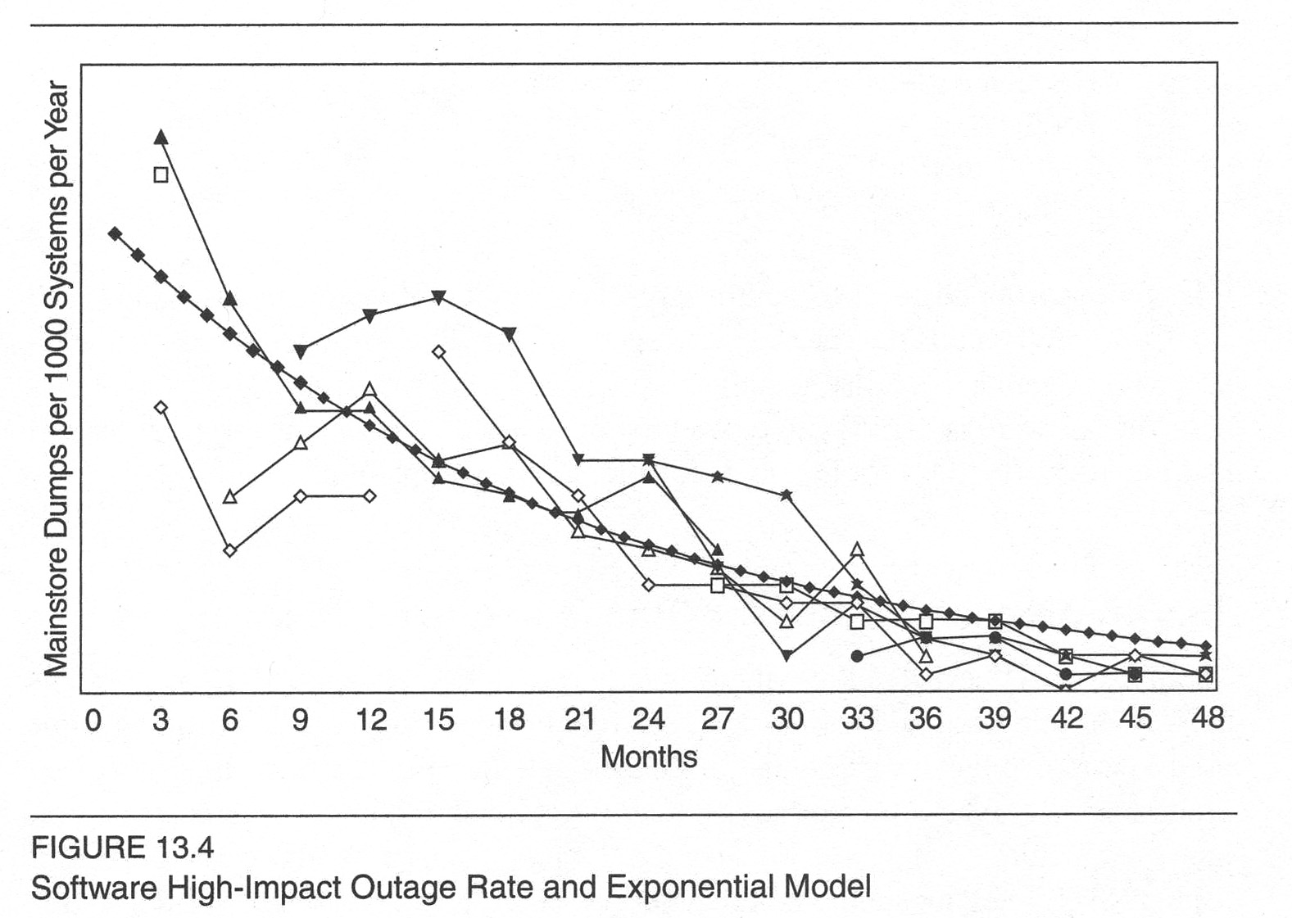
With luck, it trends downward!
Notes:
Kan p 371

Slide 25

Goal is to gain availability from the start of development, via engineering
Often related to variances in usage, versus requirements used to build product
  Results in overloads, etc.
Design highest reliability into
strategic parts of the system:
  Start and recovery software have to be “golden.”
  Main features hammered all the time – “silver.”
  Stuff run rarely or which can be restarted – “bronze.”
  Provide tools for problem isolation, at the app level.
Notes:
Medal images from http://arthurmurray-newmexico.com/ballroom-dancing-lessons-program/gold-silver-bronze.

Slide 26
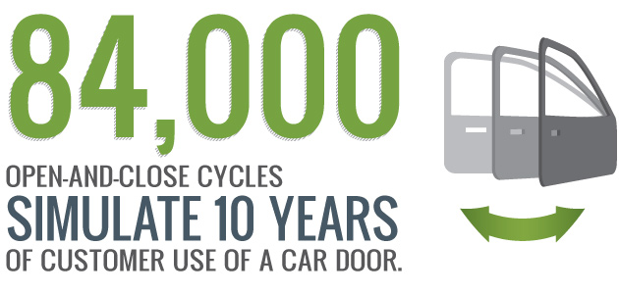
During testing
In early phases, focus is on defect elimination, like from features.
But, availability could also be considered, like having a target for a “stable” system you can start to test in this way.
Test environment needs
to be like customer.
  Except that activity may
  be speeded up, like in
  car testing!
Notes:
Image from http://www.autoalliance.org/auto-innovation/testing.

Slide 27
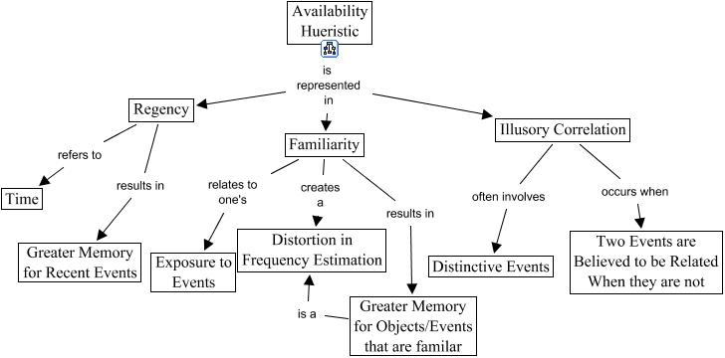
Hard to judge availability and its causes
More on “customer satisfaction” next week!
Notes:
From http://cmapspublic3.ihmc.us/rid=1040063289750_1962783788_6111/Problem%20Solving%20-%20Heuristics%20-%20Availability.cmap

Slide 28
Sample categorization of failures
Severity:
High: A major issue where a large piece of functionality or major system component is completely broken. There is no workaround and operation (or testing) cannot continue.
Medium: A major issue where a large piece of functionality or major system component is not working properly. There is a workaround, however, and operation (or testing) can continue.
Low: A minor issue that imposes some loss of functionality, but for which there is an acceptable and easily reproducible workaround. Operation (or testing) can proceed without interruption.
Priority:
High: This has a major impact on the customer. This must be fixed immediately.
Medium: This has a major impact on the customer. The problem should be fixed before release of the current version in development, or a patch must be issued if possible.
Low: This has a minor impact on the customer. The flaw should be fixed if there is time, but it can be deferred until the next release.
From http://www.stickyminds.com/sitewide.asp?Function=edetail&ObjectType=ART&ObjectId=3224.

Slide 29
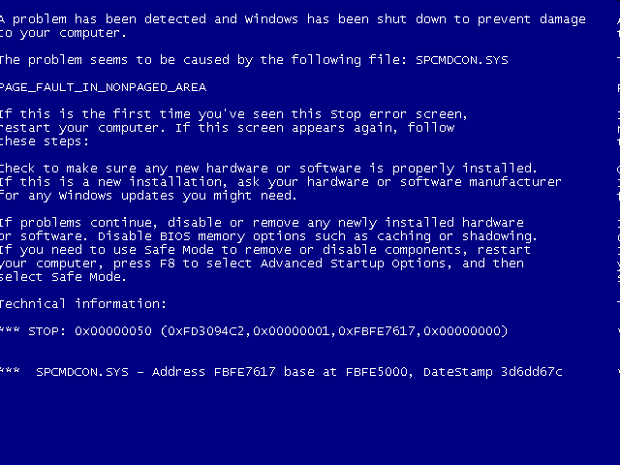
Then…
Someone must define how things like “reliability” are measured, in these terms. Like,
“Reliability of this system = Frequency of high severity failures.”
Blue screen of death…

Slide 30
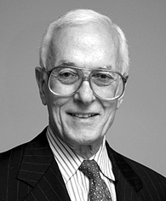
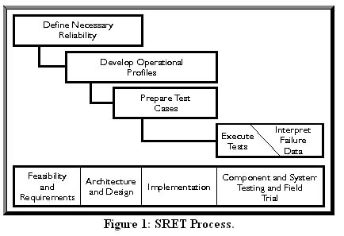
Let’s look at Musa’s process
Based on being able to measure things, to create tests.
New terminology: “Operational profile”…
Notes:
Image of the late John Musa from http://www.computer.org/portal/web/computingnow/musa.

Slide 31
Operational profile
It’s a quantitative way to characterize how a system will be used.
Like, what’s the mix of the scenarios describing separate activities your system does?
  Often built up from statistics on the mix of activities done by individual users or customers
  But the pattern of usage also varies over time…

Slide 32
An operational profile over time… a DB server for online & other business activity

Slide 33
But, what’s really going on here?
Time | Server CPU Load (%) | Activity
8:00 AM | 25 | Start of normal online operations
9:00 AM | 35
10:00 AM | 60 | Morning peak
11:00 AM | 50
12:00 PM | 40
1:00 PM | 50
2:00 PM | 60
3:00 PM | 75 | Afternoon peak
4:00 PM | 60
5:00 PM | 35 | End of internal business day
6:00 PM | 30
Time | Server CPU Load (%) | Activity
7:00 PM | 35
8:00 PM | 45 | Evening peak from internet usage
9:00 PM | 35
10:00 PM | 30
11:00 PM | 25
12:00 AM | 50 | Start of maintenance - backup database
1:00 AM | 50
2:00 AM | 45 | Introduce updates from external batch sources
3:00 AM | 60 | Run database updates (E.g., accounting cycles)
4:00 AM | 10 | Scheduled end of maintenance
5:00 AM | 10
6:00 AM | 10
7:00 AM | 10

Slide 34
Here’s a view of an Operational Profile over time and from “events” in that time. The QA scenarios fit in the cycle of a company’s operations (in this case, a telephone company)
Legend:
NEs -- Network Elements (like Routers and Switches)
EMSs -- (Network) Element Management Systems, which check how the NE’s are working, mostly automatically
OSs -- Operations Systems – higher level management, using people
FIT – Failures in Time, the rate of system errors, 10⁹/MTBF, where MTBF = Mean Time Between Failures (in hours).
Customer care calls --
Problems & Maintenance
Service provider users
OSs
Subscribers
traffic
Clock
EMSs
All
busy hour customer care calls
traffic scheduled activity
Customer site
equipment
NEs
Environment
{
Disasters,
backhoes
affect
NEs
EMSs
OSs
Service provider
Customer site staff
FIT rates
Network expansion stimuli --
New business / residential development
New technology deployment plans

Slide 35
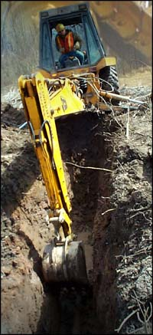
On your systems…
The operational profile should at least define what a typical user does with it
  Which activities
  How much or how often
  And “what happens to it” – like “backhoes”
Which should help you decide how to stress it out, to see if it breaks, etc.
  Typically this is done by rigging up “stimulator” - a test which fires random data values at the system, a high volume of these.
“Hey – Is that a cable of some kind down there?” Picture from eddiepatin.com/HEO/nsc.html .

Slide 36

Len Bass’s Availability Strategies
This is from Len Bass’s old book on the subject (2nd ed.).
Uses “scenarios” like “use cases.”
Applies “tactics” to solve problems architecturally.

Slide 37
Bass’s avail scenarios
Source: Internal to the system; external to the system
Stimulus: Fault: omission, crash, timing, response
Artifact: System’s processors, communication channels, persistent storage, processes
Environment: Normal operation; degraded mode (i.e., fewer features, a fall back solution)
Response: System should detect event and do one or more of the following:
  Record it
  Notify appropriate parties, including the user and other systems
  Disable sources of events that cause fault or failure according to defined rules
  Be unavailable for a prespecified interval, where interval depends on criticality of system
Response Measure:
  Time interval when the system must be available
  Availability time
  Time interval in which system can be in degraded mode
  Repair time

Slide 38
Example scenario
Source: External to the system
Stimulus: Unanticipated message
Artifact: Process
Environment: Normal operation
Response: Inform operator continue to operate
Response Measure: No downtime

Slide 39
Availability Tactics
Try one of these 3 Strategies:
  Fault detection
  Fault recovery
  Fault prevention
See next slides for details on each →

Slide 40
Fault Detection
Strategy – Recognize when things are going sour:
Ping/echo – Ok – A central monitor checks resource availability
Heartbeat – Ok – The resources report this automatically
Exceptions – Not ok – Someone gets negative reporting (often at low level, then “escalated” if serious)

Slide 41
Fault Recovery - Preparation
Strategy – Plan what to do when things go sour:
Voting – Analyze which is faulty
Active redundancy (hot backup) – Multiple resources with instant switchover
Passive redundancy (warm backup) – Backup needs time to take over a role
Spare – A very cool backup, but lets 1 box backup many different ones

Slide 42
Fault Recovery - Reintroduction
Strategy – Do the recovery of a failed component - carefully:
Shadow operation – Watch it closely as it comes back up, let it “pretend” to operate
State resynchronization – Restore missing data – Often a big problem!
  Special mode to resynch before it goes “live”
  Problem of multiple machines with partial data
Checkpoint/rollback – Verify it’s in a consistent state

Slide 43
Fault Prevention
Runtime Strategy – Don’t even let it happen!
Removal from service – Other components decide to take one out of service if it’s “close to failure”
Transactions – Ensure consistency across servers. “ACID” model* is:
  Atomicity
  Consistency
Process monitor – Make a new instance (like of a process)
  Isolation
  Durability
*ACID Model - See for example http://en.wikipedia.org/wiki/ACID.

Slide 44
Hardware basics
Know your availability model!
But which one do you really have?
a₁
a₁
a₁
a₂
a₂
A = a₁ * a₂
a₂
A = 1 - ((1 - a₁)*(1 - a₂))
a₃
A = 1 - ((1 - a₁)*(1 - a₂)*(1 - a₃))

Slide 45
Interesting observations
In duplicated systems, most crashes occur when one part already is down – why?
Most software testing, for a release, is done until the system runs without severe errors for some designated period of time
Predicted
time when
target
reached
Number of failures
Time
Mostly “defect” testing here.
“Stability” testing here.

Slide 46
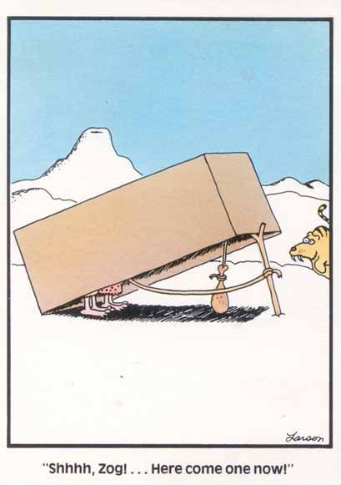
Warning – you’re looking for problems speculatively
Not every idea is a good one – just ask Zog from the Far Side…

