Slide 1
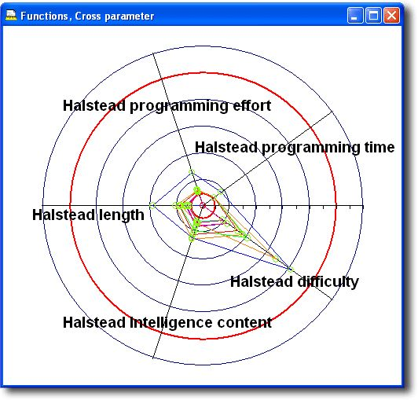

Metrics and lessons learned for OO projects
Kan Ch 12
Steve Chenoweth, RHIT
Above – New chapter, same Halstead. He also predicted various other project variables with his “software science.”
Notes:
Image from http://www.ristancase.com/html/dac/manual/2.12.03%20Software%20Metrics%20Reports.html.

Slide 2
Major OO metrics
Use OO concepts and constructs, like Abstract class, Instance, and Inheritance.
Classes and methods are the basic constructs.
  Amount of function can be estimated based on the number of identified classes and methods.
  Also use size or function points of these.

Slide 3
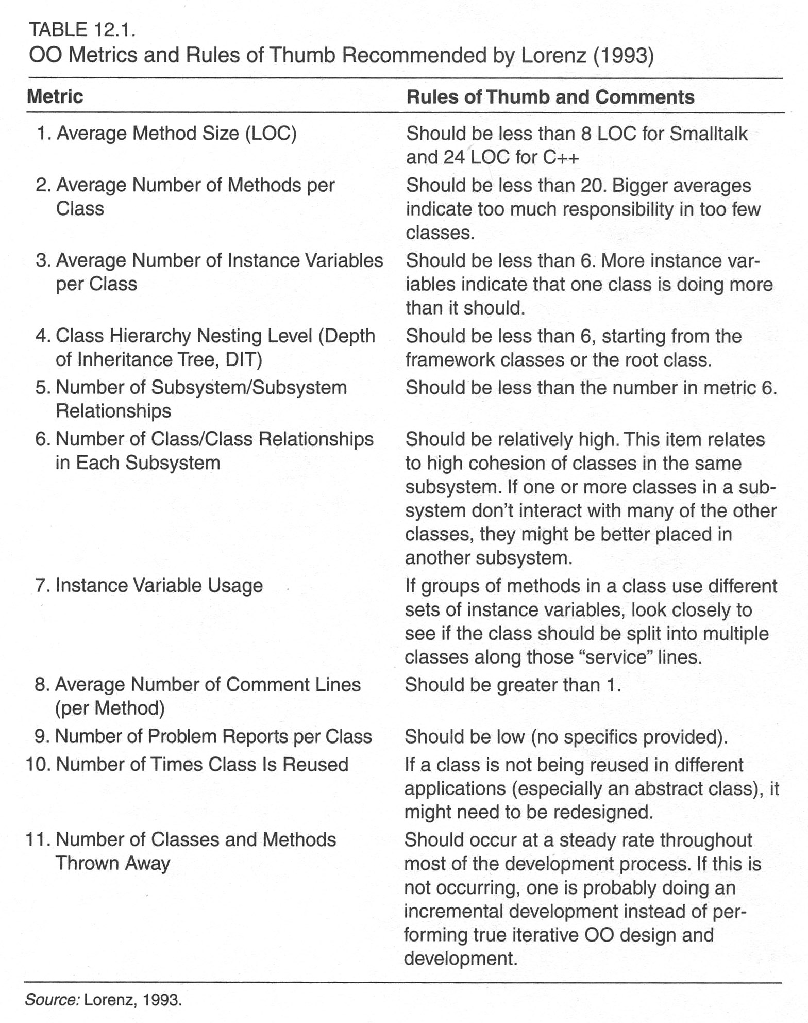
Lorenz’s metrics
Notes:
Kan, p 335

Slide 4
IBM’s OOTC
Kan looked at what IBM’s Object Oriented Technology Council recommended to IBM’s product divisions.
  Compared six projects.
  Ranged from large to small.
  One had much larger number of methods per class, a large class, and a larger maximum depth of inheritance tree than guidelines suggested.
  This one also had a high defect volume and rate.

Slide 5
The CK metrics suite
Chidamber and Kemerer, 1994
Six OO design and complexity measures.
  Weighted metrics per class (WMC).
    Sum of cyclomatic complexities of the methods.
    Hard to measure, because of inheritance.
    Often just the average number of methods per class.
  Depth of inheritance tree (DIT).
    Length of maximum patho of a class hierarchy from the node to the root of the inheritance tree.

Slide 6
The CK metrics suite, cntd
Number of children of a class (NOC).
  Number of immediate successors (subclasses) of a class.
Coupling between object classes (CBO).
  Number of classes a given class is coupled to.
Response for a class (RFC).
  Number of methods that can be executed in response to a message.
Lack of cohesion on methods (LCOM).
  How closely local methods are related to local instance variables in a class.

Slide 7
The CK metrics suite, cntd
Chidamber and Kemerer applied these six metrics to a C++ project and to a Smalltalk project.
Low DITs and NOCs – authors thought the designers might not be taking advantage of reuse through inheritance.
Had striking differences in CBOs and RFSs.
  Median values for Smalltalk site much higher.
  Reflected language differences.

Slide 8
The CK metrics suite, cntd
Basili, et al (1996) studied students doing C++ programming.
Found that:
  The six CK metrics were relatively independent.
  Low values of DITs and NOCs.
  LCOM did not predict faulty classes.
  DIT’s, RFC’s, NOC’s and CBO’s did correlate with faulty classes.
  These OO metrics were more predictive than code metrics.

Slide 9
The CK metrics suite, cntd
1997 study by Chidamber, Darcy and Kemerer:
  Three systems for financial trading.
  Small values for depth of inheritance (DIT).
  Found that WMC, RFC, and CBO were highly correlated.
  Kan thinks many more empirical studies are needed.
  In this study, they also estimated the CK metrics suite’s effects on productivity.
    Found that high levels of CBOs and LCOMs were associated with lower productivity.

Slide 10
Productivity metrics
Kan generally stays away from these.
He recommends Capers Jones’s work.
Studies generally measure number of units of output per unit of effort.
  In OO development, classes or methods per PY or PM.
Kan did calculations for some IBM projects.
  A high number of classes per PM related to a small number of methods per class.
  IBM’s heuristic – 1 to 3 PM per (key) business class.

Slide 11
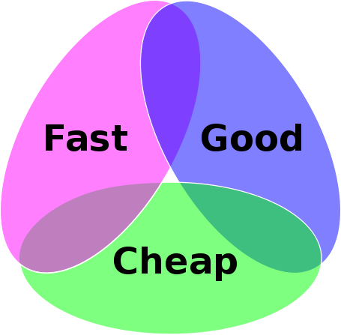
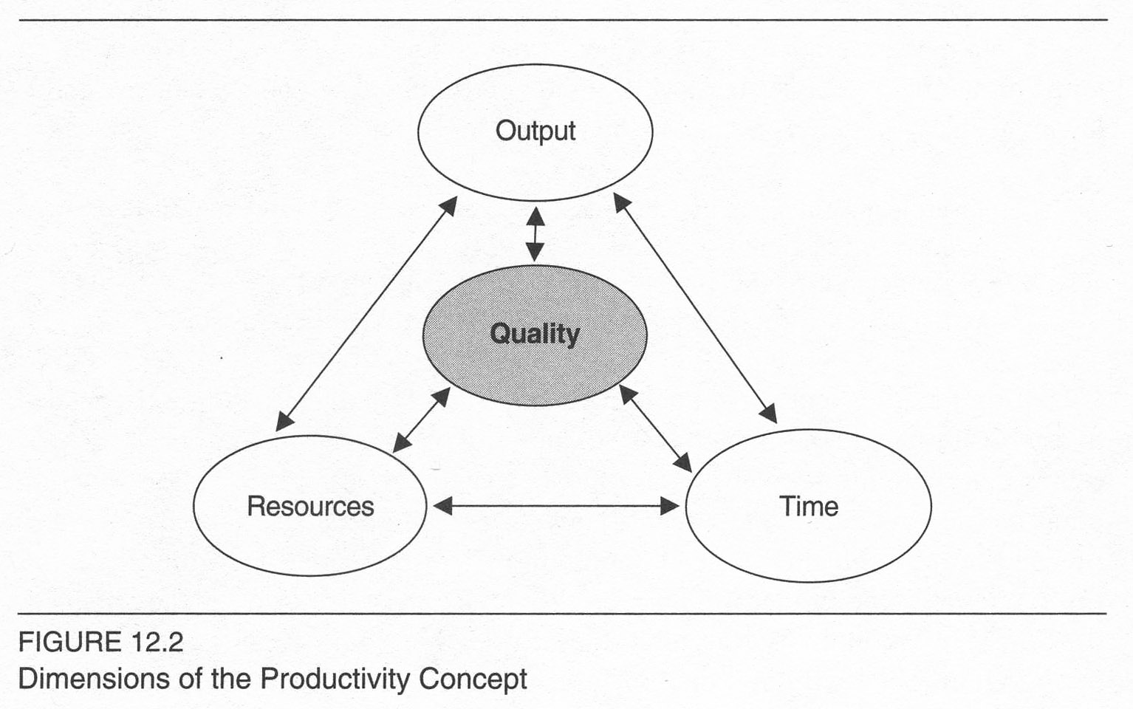
Kan’s dimensions of productivity
Everyone has a different version of this!
Kan points out that it’s not just 2-dimensional – output vs effort.
Notes:
Kan’s is on p 346.
The Fast / Good / Cheap one is the “Project management triangle” from Wikipedia - http://en.wikipedia.org/wiki/Project_management_triangle.

Slide 12
Quality and quality management metrics
In OO, it’s defects per class.
  Data not as common as for non-OO projects.
  Kan found defect rates from 0.21 defects per class to 0.69 per class.
  Equivalent to 2.6 defects per KLOC (new and changed code) to 8.2 defects per KLOC.
Kan’s non-OO experience has been:
  4 to 9 defects per KLOC.

Slide 13
For quality management…
“The OO design and complexity metrics can be used to flag the classes with potential problems for special attention.”
Kan thinks metrics for non-OO projects also pertain to OO.
  Test progress S curve
  Testing defect arrivals over time
  Testing defect backlog over time
  Number of critical problems over time
  Number of system crashes and hangs over time
  The effort/outcome paradigm for interpreting in-process metrics
Notes:
Quote from Kan p 347

Slide 14

OO – Lessons learned
Kan conducted assessments of IBM OO projects.
  Need to allow a learning curve, when moving to OO.
  Formal classroom education is needed (sounds like software engineering!).
  Domain-specific knowledge also is needed.
Notes:
Cartoon from http://appliedscienceresearch.labanca.net/?p=67.

Slide 15
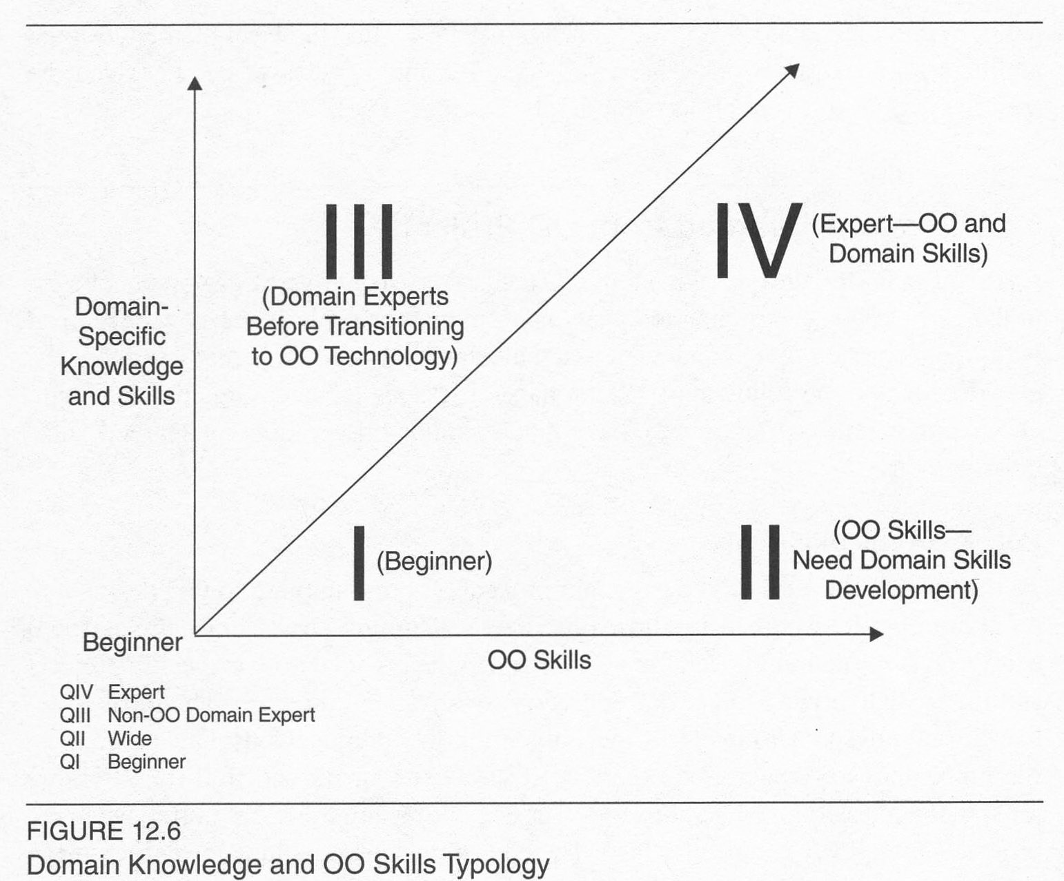
Kan’s developer typology
Notes:
Kan, p 352

Slide 16
Kan’s OO tips
A consistent process architecture in an organization.
Monthly goals or mini-milestones set.
Good reusable classes – hard to build.
  OO technology does not = code reuse.
  An inherent conflict between development cycle time and building reusable classes.
Performance – projects fail because of it.
  More on that next week.
Quality and development practices –
  OO makes bugs easier to find and fix.
  OO projects have lower defect rates during testing phases and in the field.

Slide 17
Recommendations for small orgs
Design and complexity metrics work well.
Need a chief architect for overall system design.
Small teams own small subsystems.
Use OO counting tools. Many things can be tracked without tools:
  Methods per class
  Depth of inheritance tree
  Number of children
  Number of classes
  Methods thrown away (!)
Procedural tools also apply.

