Slide 1
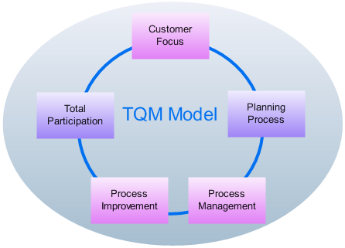

Quality Management Models
Right – To keep in mind – For Kan, this is part of Total Quality Management.
Kan Ch 9
Steve Chenoweth, RHIT
Notes:
Image from http://www.edrawsoft.com/TQM-Diagrams.php.

Slide 2
This is “What Management Should Do”
Not the same as, “How to accurately predict the quality of a product,” which was the theme of Ch 7 and 8.
  Those were for “Reliability estimation.”
  Relied on having a full cycle of experimental data.
In quality management, you want to intervene.
  Which of course spoils the experiment.

Slide 3
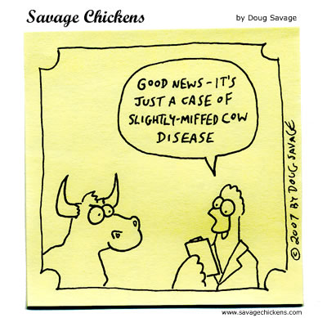
In particular
A “management model” should Say “what to do” to control quality, early and often.
Even so, we can use Rayleigh, exponential, etc. reliability models to see how things are going.
Management just doesn’t want to hear that we turned out a terrible product but got a great reliability experiment out of it!
Notes:
Cartoon from http://www.savagechickens.com/2007/09/test-results.html.

Slide 4
Bottom line
“Get it right the first time” pays off.
Keep errors from being injected in.
Don’t wait to “see how it goes” during formal testing.
Improving the front end quality is a big win.
If product is beyond that, adding unit testing or pre-integration testing helps.

Slide 5

Rayleigh model
Articulates points about early prevention.
“Myers’ principle” – The more defects found during formal testing, the more that remain to be found later”!
  Indicate that error injection rate is high.
  Iceberg size is the analogy.
Notes:
Ice berg image from http://blog.gustavkaser.com.au/iceberg/.

Slide 6
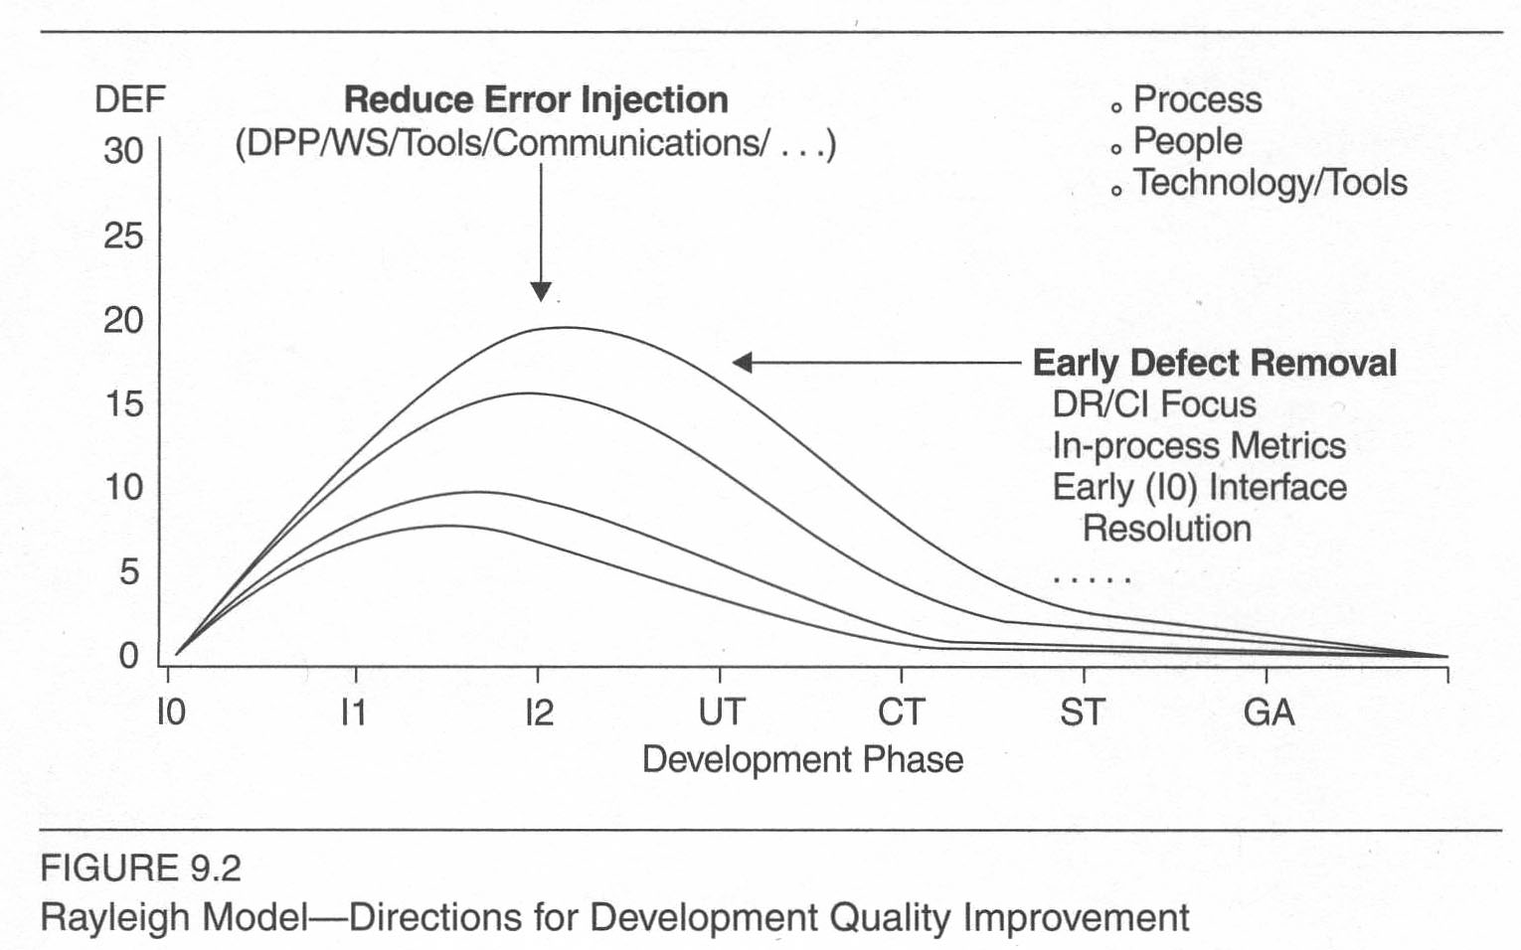
Rayleigh, cntd
Worst
Best
Notes:
Kan p 238

Slide 7
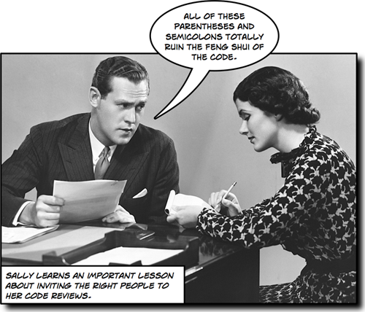
Defect removal models assume…
Current experience follows past experience.
No way to know if that’s correct!
Lower defect removal rates
could mean:
  Lower error
  injection, or
  Poor reviews
  and inspections.
Notes:
Image from http://www.jasonawesome.com/2010/06/01/executing-a-php-code-review/.

Slide 8
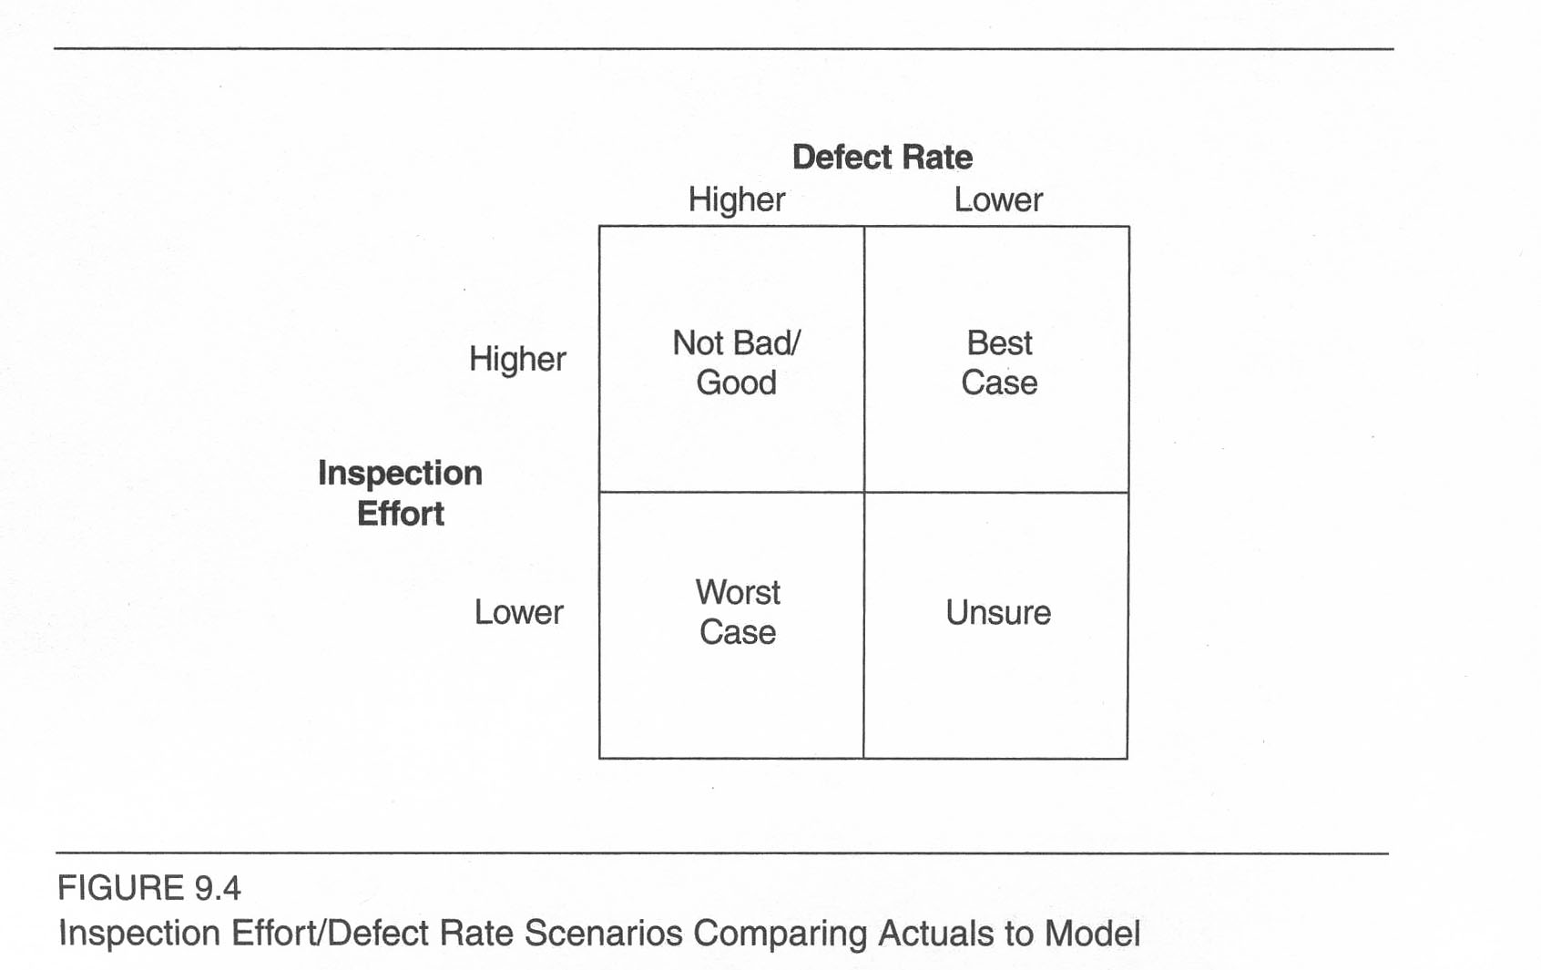
Your mileage can vary…
Notes:
Kan p 240

Slide 9
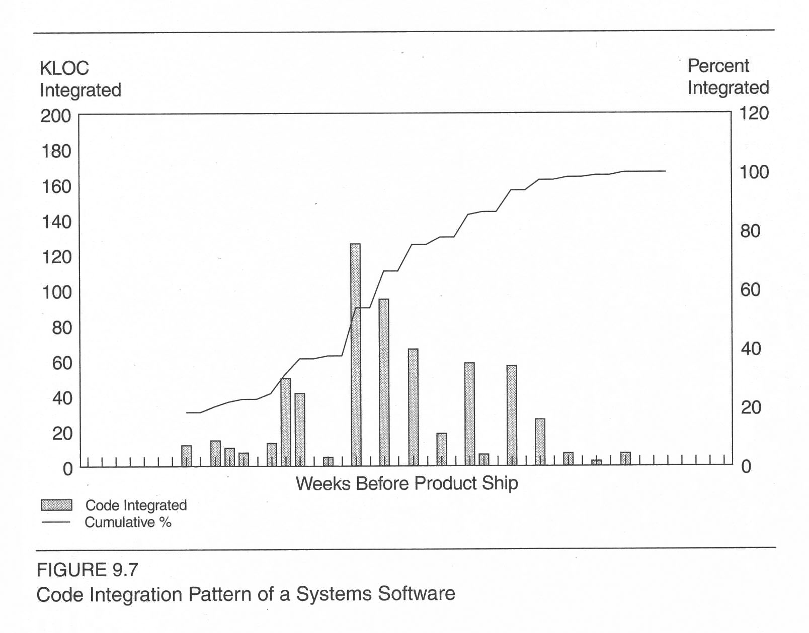
Use code integration pattern?
Another way to manage quality.
Look for what’s not yet integrated!
New code added here.
Notes:
Kan p 243

Slide 10

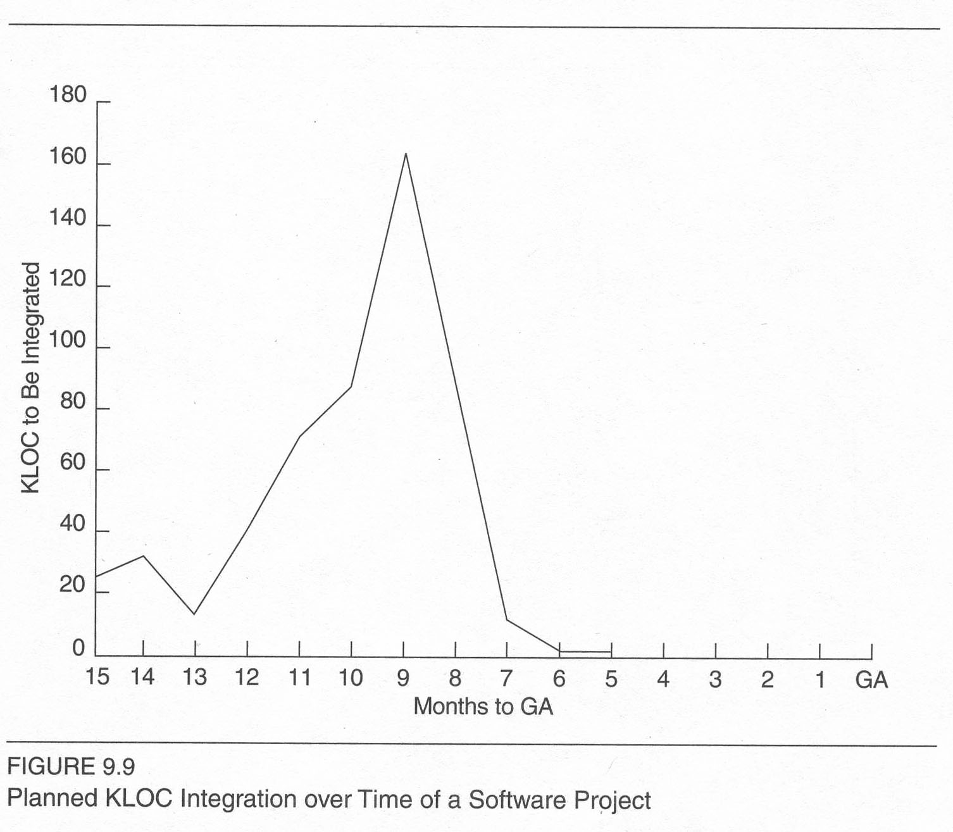
Integration management
“Late adders” to integration are a red flag!
Can test statistics vs prior products.
  What’s “pattern” of integration?
  What’s “worst” vs “best”?
  Expected overall rate
    Could use “lines of code”
Notes:
Kan p 247
Image from http://en.wikipedia.org/wiki/List_of_red-flagged_Formula_One_races.

Slide 11
Use PTR arrival and backlog?
PTR = Problem Tracking Report
“Can the code-freeze date be met without sacrificing quality”?
“Will the PTR arrival and backlog decrease to the predetermined desirable levels by the code freeze date?”
Use empirical models, based on prior data.

Slide 12
PTR concocted formulas
Like Kan’s on p 252:
  It includes a negative cubic term for “Week” and
  A squared term for “KLOC”.
It was accurate within one week, for when arrivals would decrease to the predetermined desirable level prior to code-freeze.
But – Does anyone know why?

Slide 13
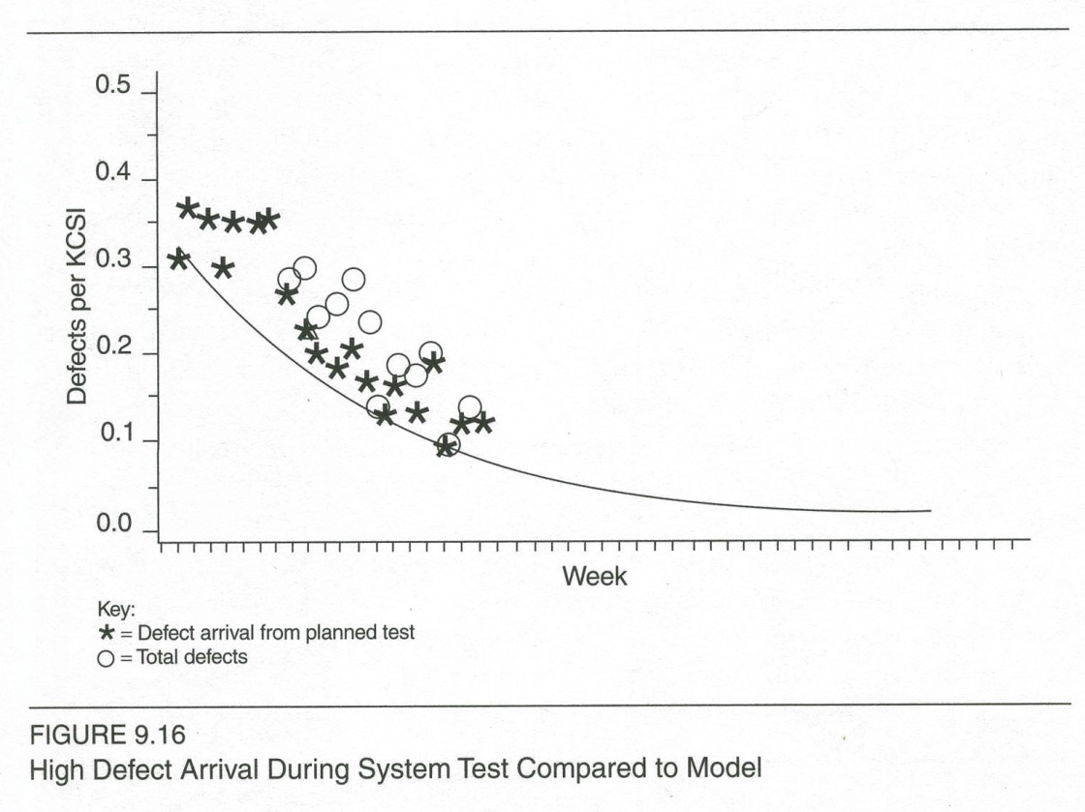
Backend reliability growth models
Defects higher than expected – caused a quality improvement program!
Notes:
Kan p 255

Slide 14
What did they do?
“Blitz testing” – made-up stress testing
Customer evaluation
More code inspections
Design reviews
Extension of system test – more test suites
Notes:
Kan p 255

Slide 15
Do you have a good model?
Kan re-emphasized his standards:
  Predictive validity
  Simplicity
  Quality of assumptions
For management models, he suggests:
  Timeliness of quality indications
  Scope of coverage
  Capability to be the major criterion

Slide 16
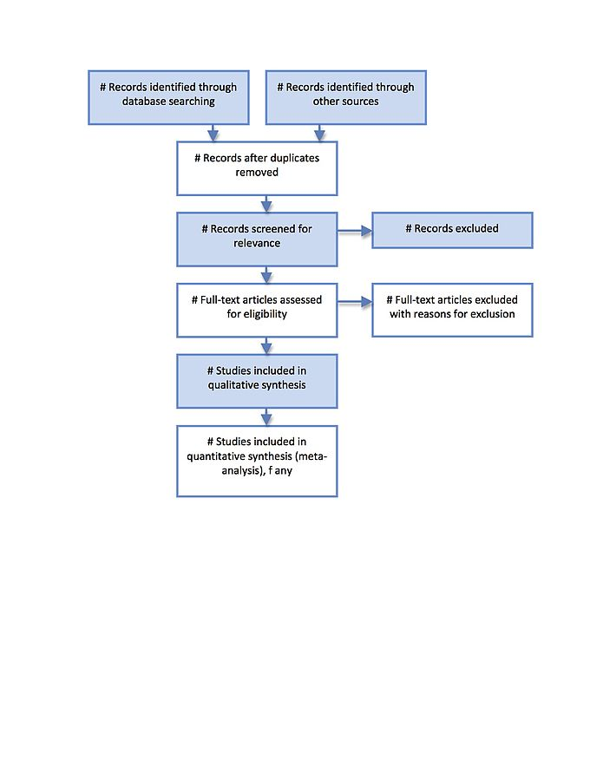
To gather the data
Need systematic reporting, like for:
  Defect tracking
  Metrics calculations
Kan gives examples
Right – In our culture, in general, we are slowly but surely finding systematic ways to get a grip on complex processes. Here’s one for combining results of many research studies to gain a “meta-analysis” that increases confidence in the overall meaning.
Notes:
Pp 258+
Image from http://en.wikipedia.org/wiki/Preferred_reporting_items_for_systematic_reviews_and_meta-analyses.

Slide 17
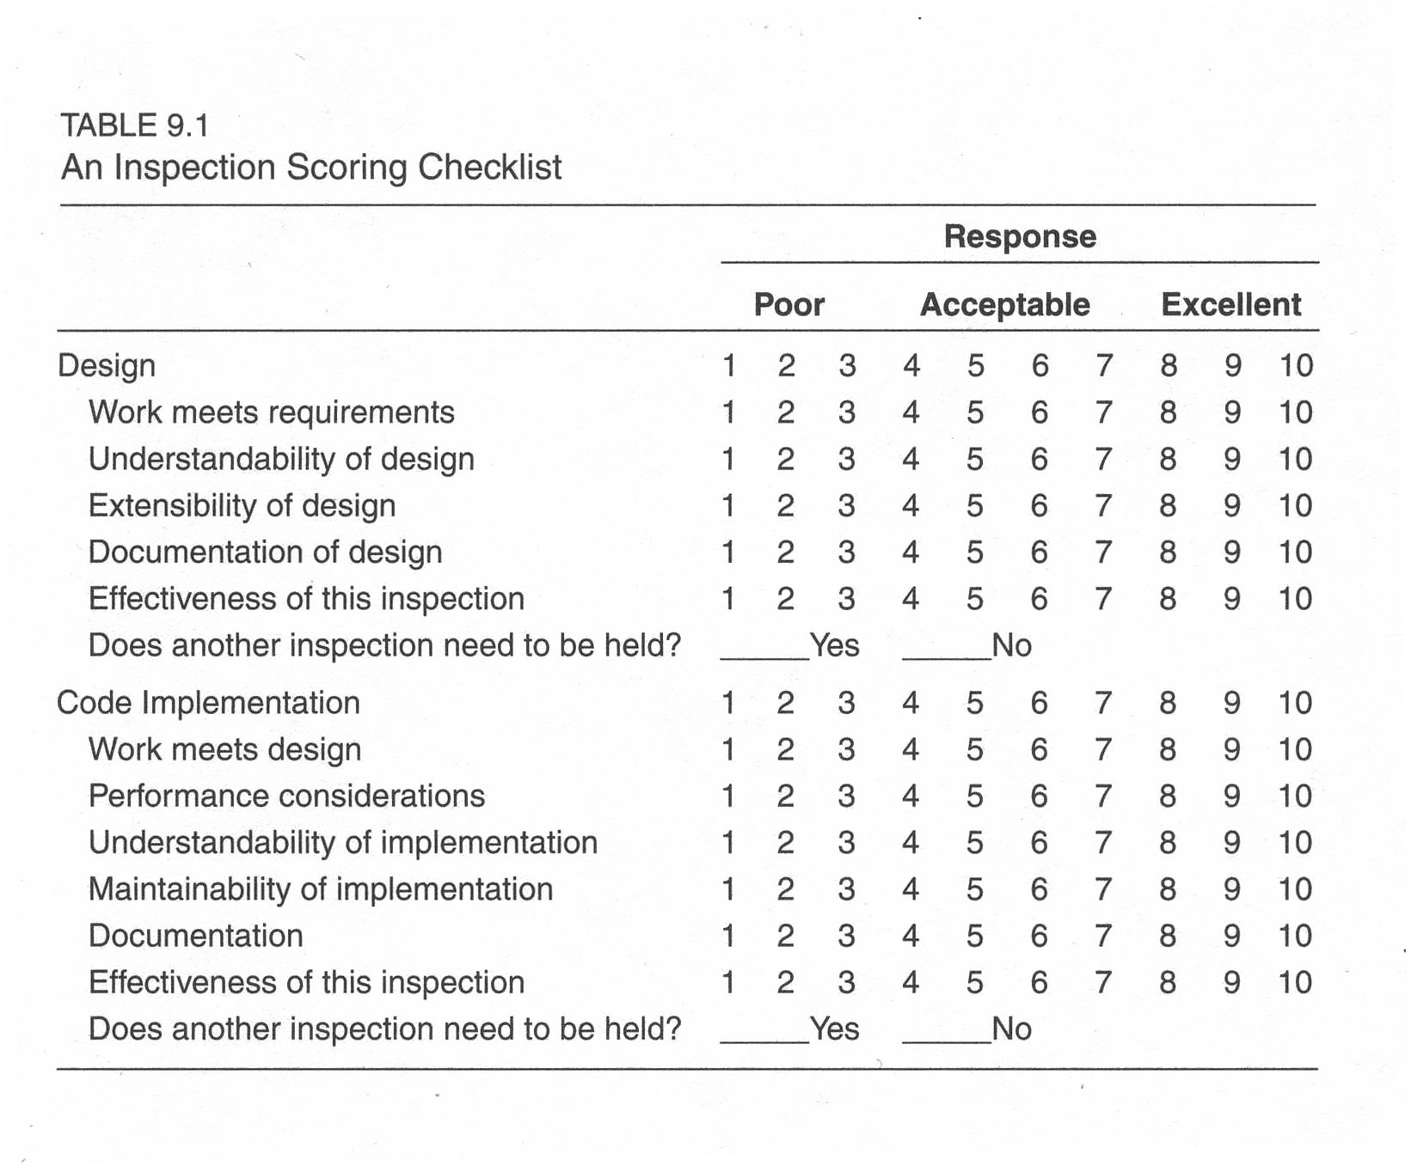
Inspections
Hard to know if people are being objective!
Need to know the small-team dynamics.
“I don’t want to give Dave less than an 8!”
Notes:
Kan p 261

Slide 18
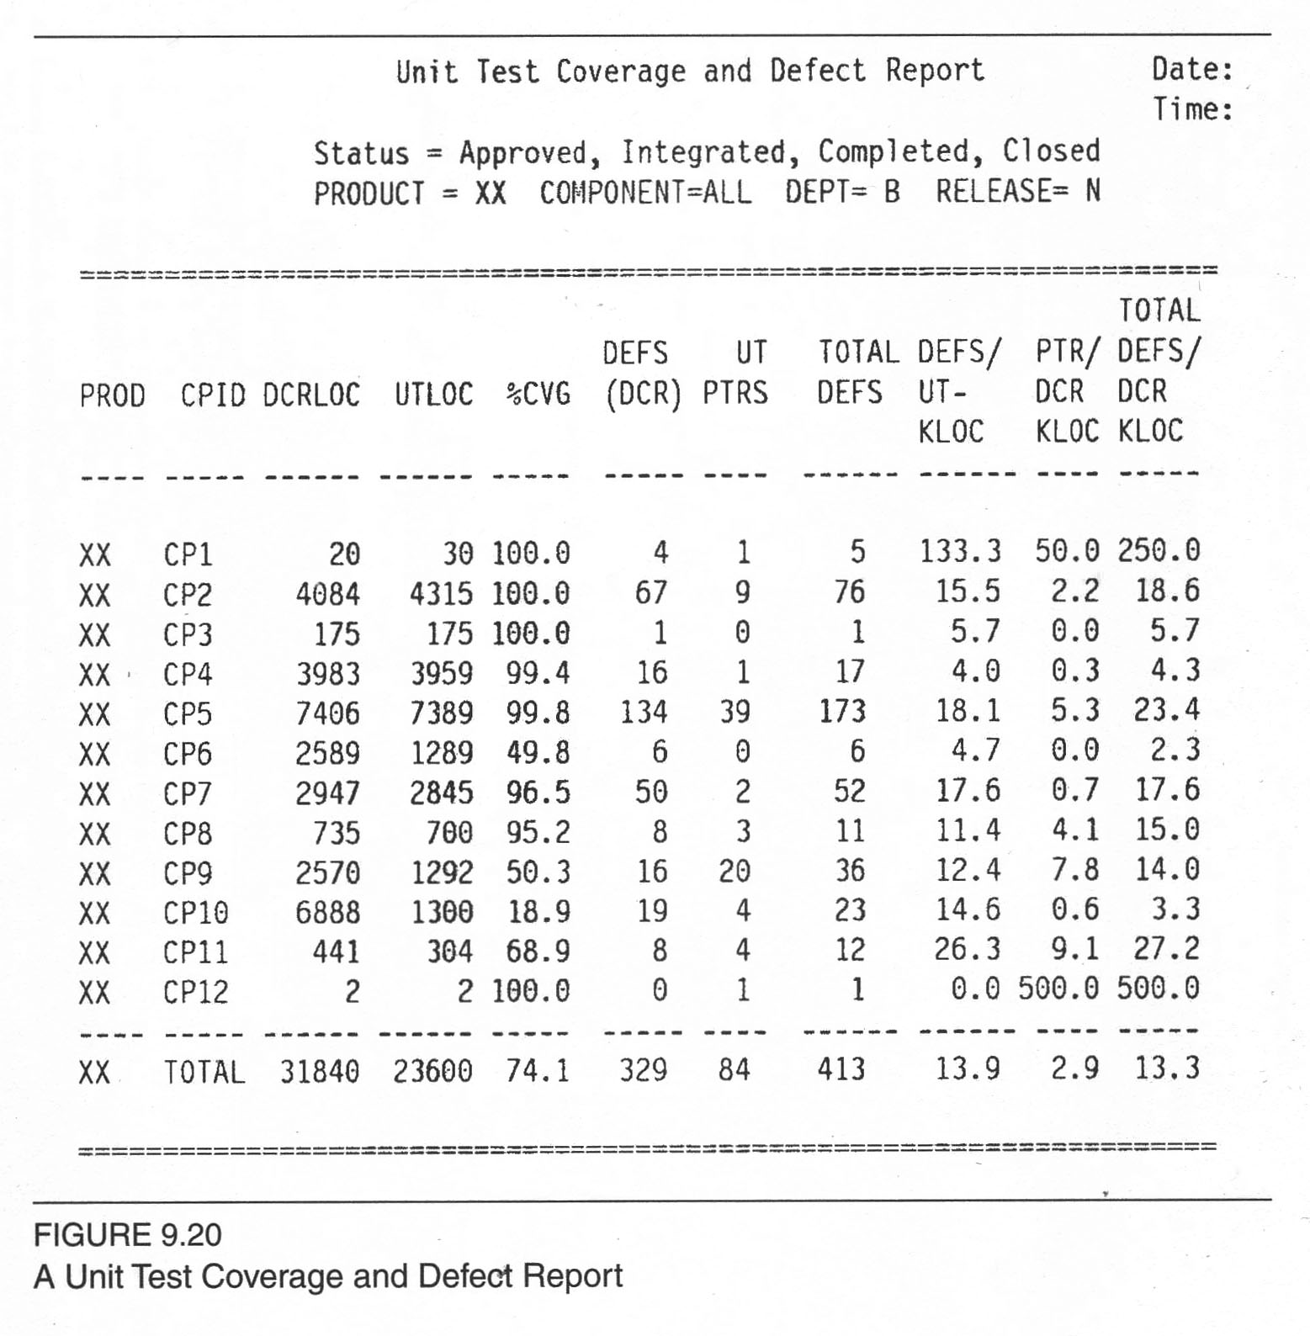
Test coverage
Notes:
Kan p 264

Slide 19
“Orthogonal” defects
Test “different things”
Kan proposes these defect types:
  Function
  Interface
  Checking
  Assignment
  Timing/serialization
  Build/package/merge
  Documentation
  Algorithm

Slide 20
Rating defect attributes
Activity
Trigger
Impact
When fix is known:
  Target
  Defect type
  Defect qualifier
  Source
  Age
Notes:
Kan p 268

Slide 21
Recommendations for small orgs
What leads to early defect removal?
  Rayleigh model proposed
  Front end – use inspection scoring checklist
  Middle – use code integration pattern
  Back end – use a testing defect-related metric
Notes:
Kan p 269

