Slide 1
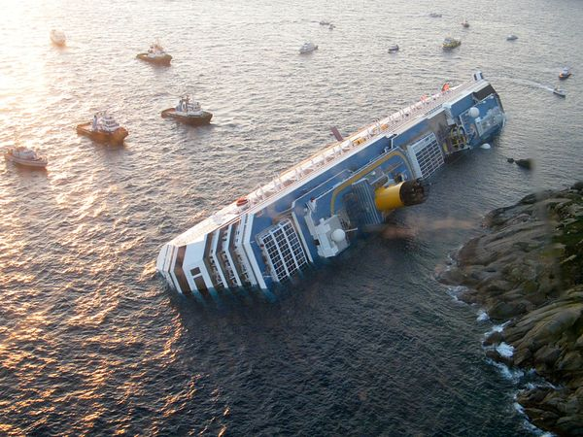

Defect Removal Effectiveness
Left – Some defects are easier to remove than others. This is the cruise ship Costa Concordia, which partially sank on Jan 14, 2012, just off the rocky coast of the Italian island Giglio, with a ripped hull. 32 people died. The ship was refloated in order to remove it and cut it up for scrap.
Kan ch 6
Steve Chenoweth, RHIT

Slide 2
Quality is two “things”
The presence of good things. And,
The absence of bad things.
In Ch 6, Kan focuses on the latter.
In theory, it also covers the former.
  You can test for the presence of a feature.
    If it’s not there, it’s a bad thing.

Slide 3
Defect removal
Assumption we can do this is based on our philosophy about how things are made:
  It can be done right (probably).
  We can discover (eventually) if it’s not right.
  If we discover that, we can fix it (with a struggle).
  Most things we do are worth fixing if you know they are not right.

Slide 4
Defect removal effectiveness
Has to do with eliminating defects systematically.
Also efficiently.
Also, before the customer sees them!
And, managing our development processes:
  There ought to be a way to be more effective or efficient about improving quality.
Being good at this could let us develop bigger, more complex products.

Slide 5
Inspections / operations
A process where we try to eliminate defects.
“Testing” itself is unique, among these.
  Arguably, it doesn’t “inject” defects.
  Just “finds” them so they can be “removed.”
Actually, “inspections” are the same way.
  But they may be considered “part of” something bigger
    Like requirements gathering, design, etc.

Slide 6
What is removal effectiveness?
A ratio – how many we got, out of what we could have achieved:
__ Defects found or removed__ * 100%
Defects present that we could have
So, how do we know what we could have?
These = the number eventually found!

Slide 7
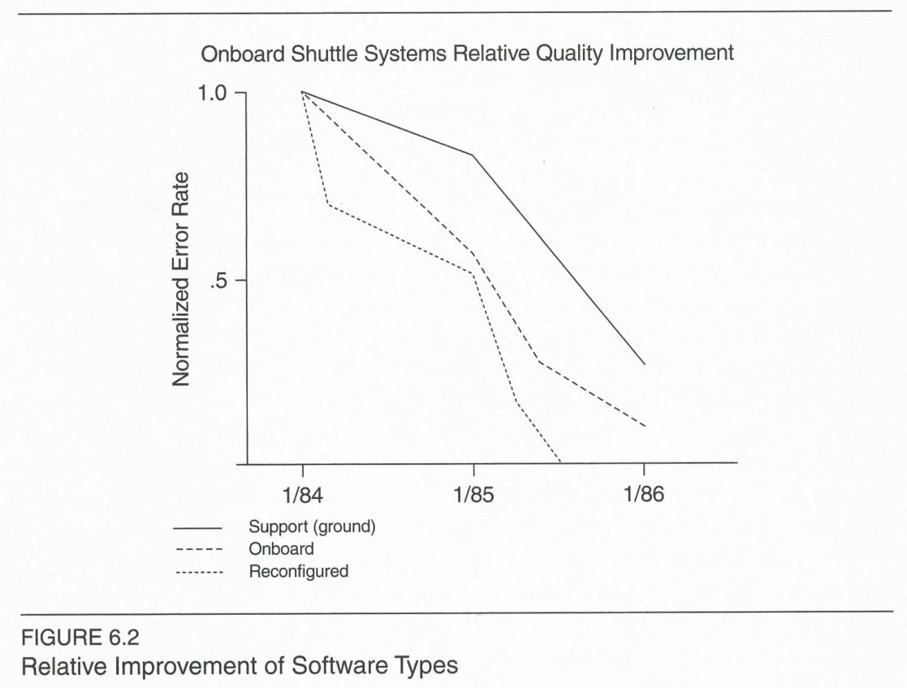
Related theme – early detection
Results of IBM Houston’s “Early detection” program for Space Shuttle software, mid-1980’s.
Notes:
Kan p 163

Slide 8
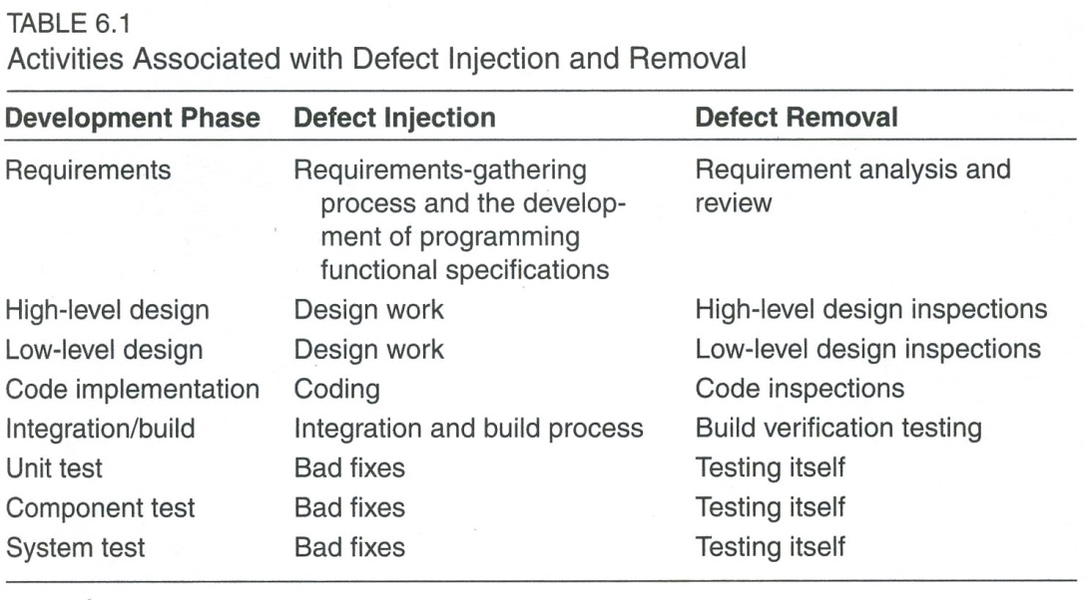
More refined definitions
Notes:
Kan p 165

Slide 9
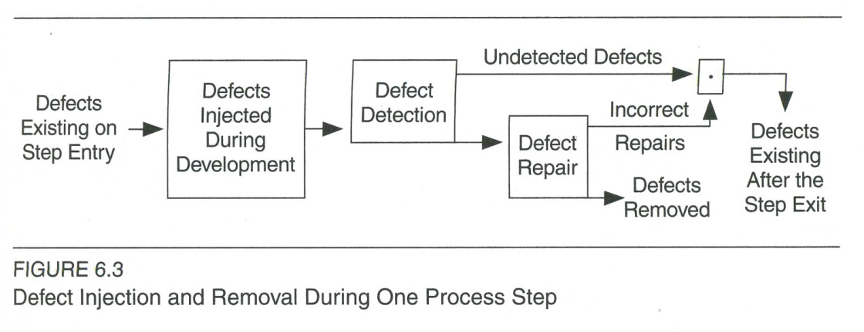
And the process, for each step
Notes:
Kan p 165

Slide 10
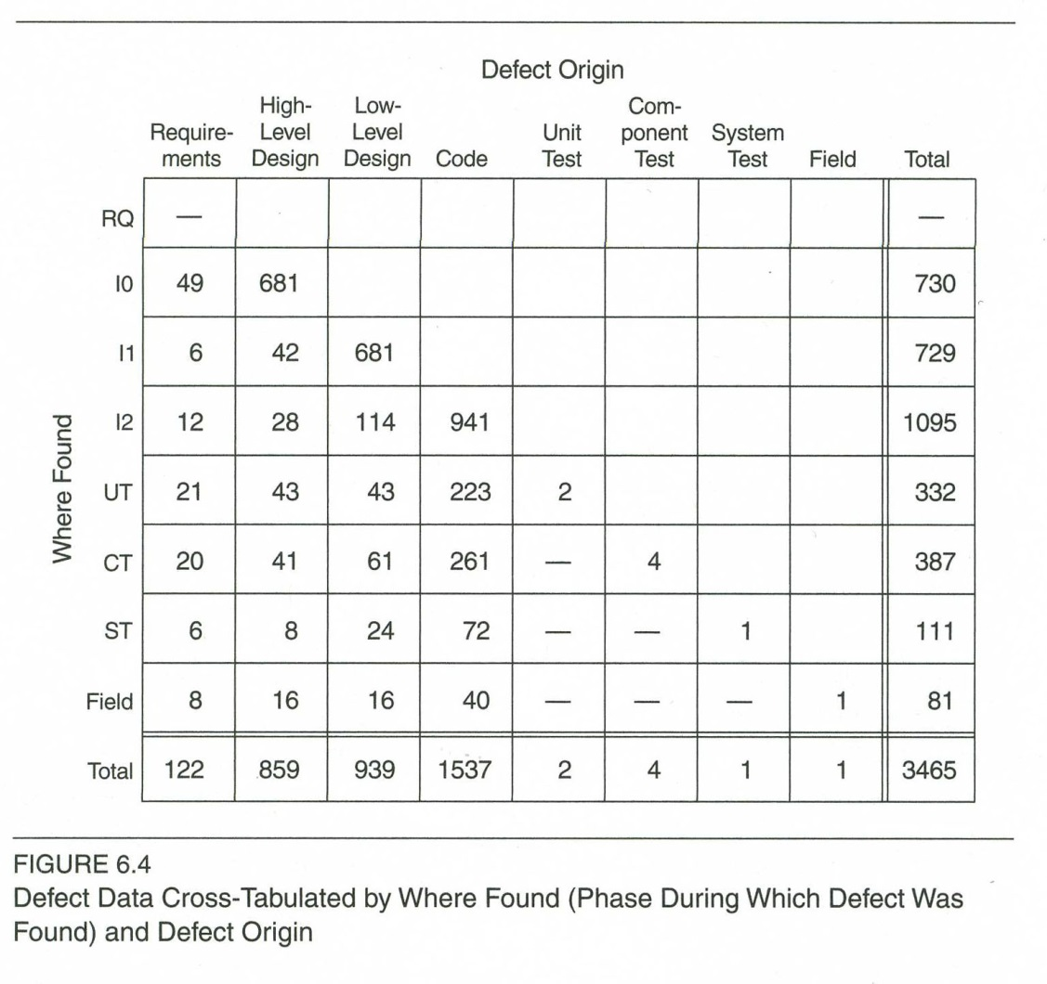
Kan’s source for a lot of calcs
Notes:
Kan p 166

Slide 11
Which gives results like…
Unit Test Effectiveness
TE(UT) = 332/(332+387+111+81) * 100%
= 332/911 * 100% = 36%
Defect Removal Effectiveness
DRE = ( 3465 – 81 / 3465 ) * 100% = 97.7%
Notes:
Kan p 168

Slide 12
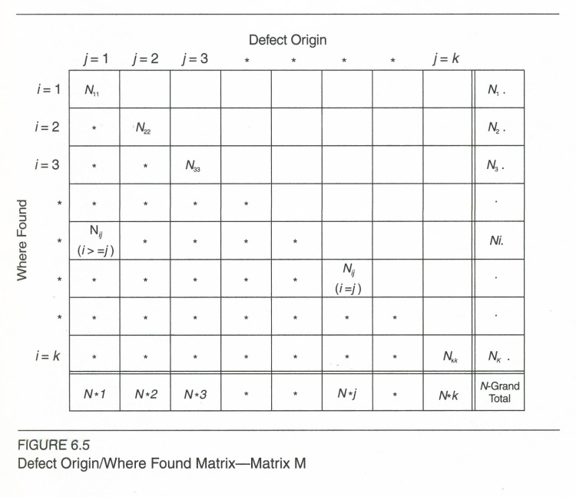
A matrix can be useful
Notes:
Kan p 171

Slide 13
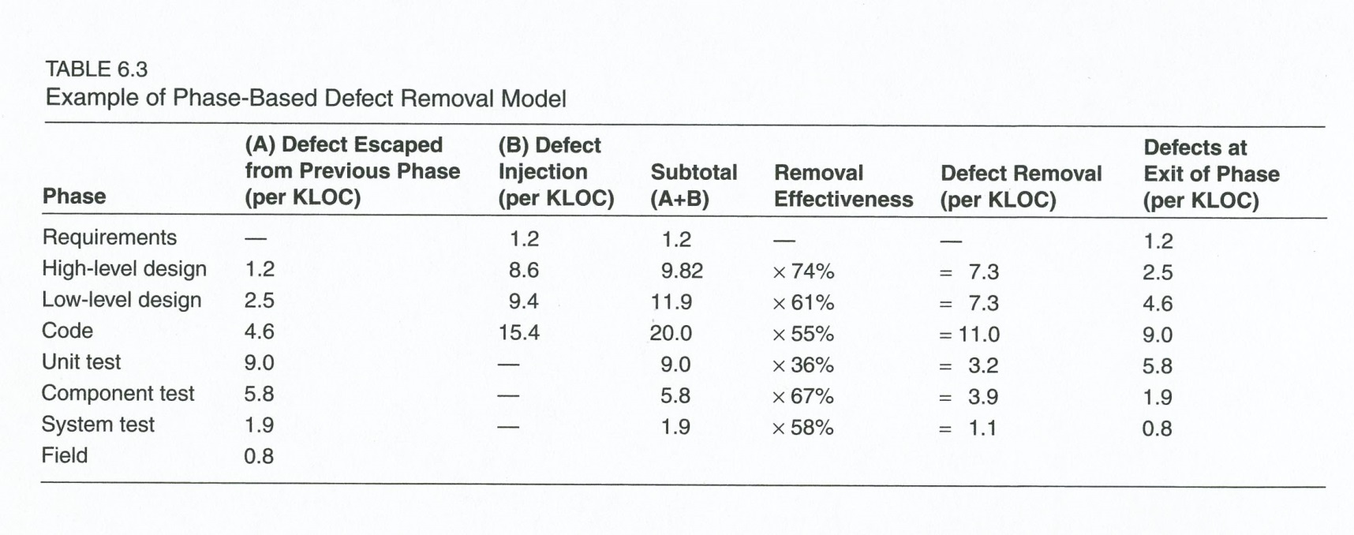
Or tables showing calcs
Notes:
Kan p 173

Slide 14
Kan’s special two-phase model
Assumes that:
There are only two phases of defect removal.
Their effectiveness is the same.
Kind of hypothetical!
Notes:
Kan p 174

Slide 15
Two-phase model, cntd
Definitions:
MP = Major problems found before formal testing
PTR = Errors found in formal testing or field
μ = MP/PTR, where μ > 1.
Q = defects in released software.
TD = Total defects over life: MP + PTR + Q.

Slide 16
Two-phase model, cntd
Model allows you to conclude that:
Q = TD / μ²
So, for example, in Fig 6.4, if
  TD = 34.6 defects / KLOC, and
  Q = 0.81 defects / KLOC, then
  0.81 = 34.6 / μ² , and
  μ = 6.5.
  “If the effectiveness is the same for the two phases, then the number of defects to be removed by the first phase must be at least 6.5 times the number to be removed by testing in order to achieve the quality target.”
Notes:
Kan pp 176-7.

Slide 17
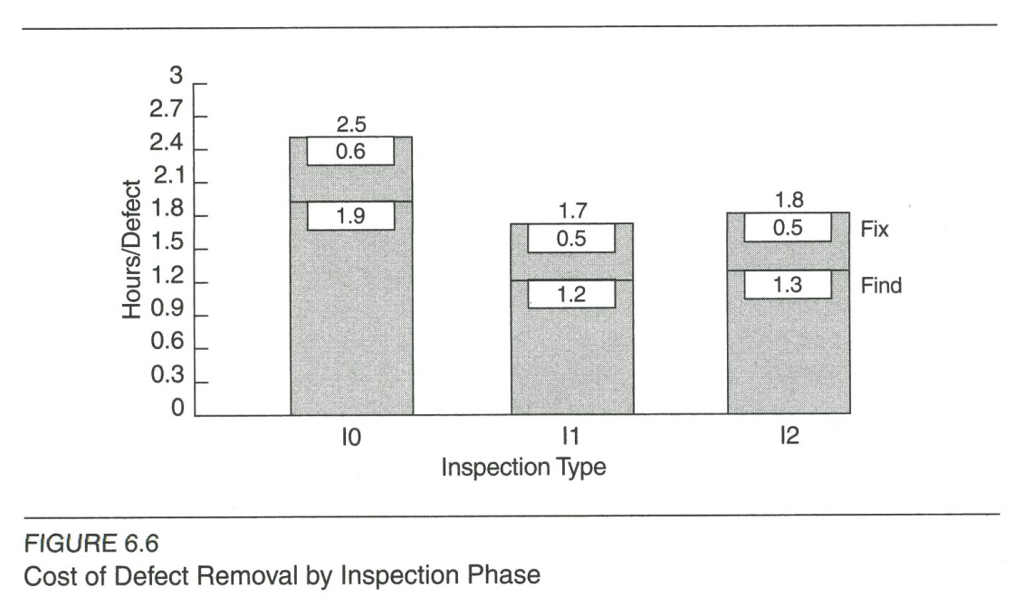
Cost effectiveness
Notes:
Kan p 178

Slide 18
But, early inspections must be rigorous
Fagan’s model 5-step inspection and walkthrough:
Overview (for communications and education)
Preparation (for education)
Inspection (to find errors and to walk through every line of code)
Network (to fix errors), and
Follow-up (to ensure all fixes are applied correctly)
Notes:
Kan p 180

Slide 19
Related to process maturity?
Jones’s defect removal rates for different CMM levels:
Level 1: 85%
Level 2: 89%
Level 3: 91%
Level 4: 93%
Level 5: 95%
Notes:
Kan p 181

Slide 20
Kan’s recs for small orgs
Defect removal effectiveness bears a direct correlation with quality of field performance.
Start with the overall defect removal effectiveness indicator and the test effectiveness indicator.
Assess the stability or variations in these across projects and improve them.
Compare with industry baselines.
Start to examine inspection effectiveness, and loop back for continuous improvement.
Use a tracking system to gather data bout defect origins.

Slide 21
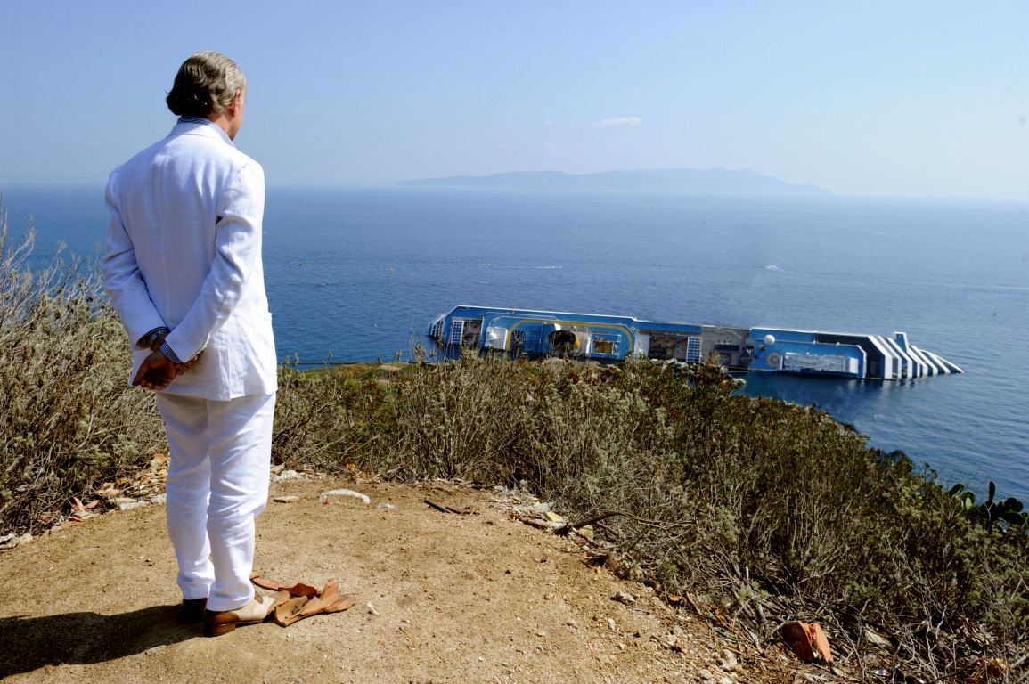
And, in conclusion…
The lead character, Jep, in the movie “The Great Beauty,” considers the disaster that you already considered.
It won the 2014 Academy Award for “Best Foreign Film.”
Quality.
Notes:
Image from http://janusfilms.com/thegreatbeauty/. Jep was played by Toni Servillo.

