Slide 1
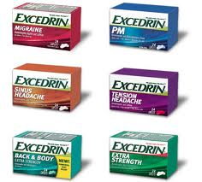

Software Maintenance and Evolution
CSSE 575: Session 8, Part 1
Evolvable Products and Intro to Software Product Lines
Steve Chenoweth
Office Phone: (812) 877-8974
Cell: (937) 657-3885
Email: chenowet@rose-hulman.eduz
Above – Software product lines make the choice of a pain killer at the drug store seem simple in comparison!

Slide 2

We just saw…
In week 7’s discussions:
Jarzabek’s approach to controlling software evolution by a “mixed approach” to defining features and generating them.
  Based on the problem of having unnecessary complexity in the solution as it evolves over time
But there are other ways to skin a cat…
Notes:
Surprised cat from http://www.cabq.gov/pets/rescue-groups.

Slide 3
Product lines = “Load lines” in configuration management - A problem!
Also called “code lines”
For one product: What goes into a particular release for a particular customer or group of customers at a given time?
We know there are issues with the time part:
  What goes into Release 1.2.45 vs the next release?
    “What’s ready?”
    “What’s important?”
And – as soon as it’s not the same for everyone, at least at one time, you have the “product lines” problem

Slide 4
Same thing only different…
When you have multiple, closely-related products as the user uses them, so they need commonalities from that perspective:
  Say, 5 products for the same customer, which are supposed to work together, and
  All 5 sit in the same labs, and the same admin/technician ends-up as the operator for all 5, and
  He/she’d like one common interface for lots of reasons, and
  “No can do” because they all were done by different groups at different times, not anticipating this.
So, you should’ve had some common software in these, but didn’t.

Slide 5
Or,
Products that should form some software “suite” from the development perspective, like –
  Photoshop, and
  Dreamweaver
And they ought to have lots of common underlying software, so as to make their ongoing development simplified.

Slide 6
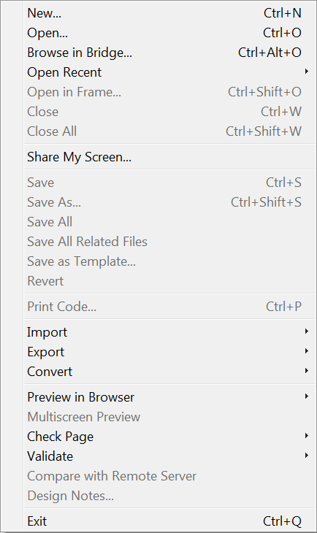
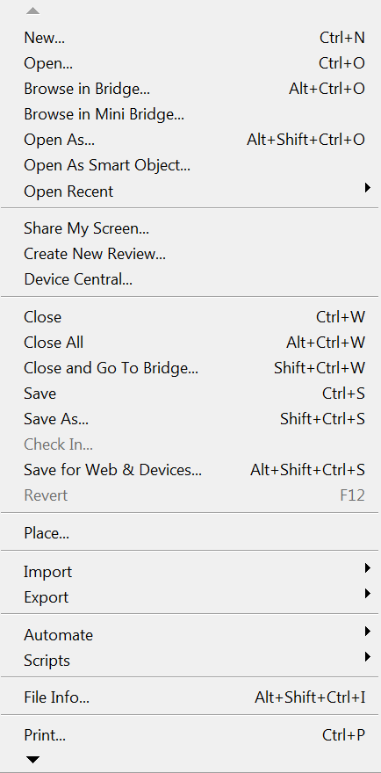
Compare file menus…
Dreamweaver
Photoshop →

Slide 7
Product Lines
Here’s the approach most people now take to producing multiple, related products at the same time.
  This includes, especially, multiple versions of the same product, intended for different customers.
Develop product 1
1-Spl
= 4
“load
lines”
that
are
better
than
3 !
Develop product 2
2-Spl
Develop core
product
CORE
Develop product 3
3-Spl

Slide 8
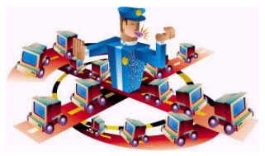
So, you really have…
Fan-in of code for a “build,” from various organizations and outside sources, and
Fan-out of most of the modules into multiple destinations (products or versions)!
Keeping complex build processes straight requires the establishment of policies, and of automation implementing those – like “when code has to arrive for final testing, to be included in a release.”
Notes:
Image from http://projects.cerias.purdue.edu/ocrproj/participants.html.

Slide 9
What makes product lines work?
You have to spend time finding commonalities
  Be sure these are “done” only once
That means, your configuration management system has to be smart enough to merge:
  Common parts from where they are, with
  The special parts that make this “product”
This “build” process happens over and over
  For testing, as well as sending to customers

Slide 10
How do you, the developer, manage what’s “common” vs what’s “different”?
Support “variation points” by –
Inclusion or omission of elements
Inclusion of a different number of replicated elements
Selection of versions of elements that have the same interface but different behavioral or quality attribute characteristics
Supporting these variations can cause:
In OO systems, specializing or generalizing of classes
Building extension points
Introducing build-time parameters
A need for reflective programs, which analyze their data & situation
Overloading of types (good and bad)

Slide 11
This is another way to see…
The source code “clone problem”
  See Week 9-2 slide set
  The Reverse Engineering Survey Paper you read also discussed clones (Week 5)
    The percentage of clones in a large software system tends to remain stable, even with refactoring!
    It’s not necessarily a bad smell, but requires “awareness” by the programmers
  And Jarzabek’s ideas for controlling clones were discussed last week –
    Control conceptually what code does what
    Generate the code from the concepts if possible
You’ll see lots more about product lines, if you take CSSE 577 (Architecture).

Slide 12
Wait, wait – one more view of clones
Koschke argues, from studying programmers’ habits, that the root cause for clones is –
  They are forced to duplicate code because of the limitations of the programming language being used.
  Different kinds of changes have “cross-cutting concerns”
    E.g., copy-and-paste of parameter validation in a new method
  They often delay code restructuring until they have copied and pasted several times.
    This tells them the possible variations to be factored out.
    It avoids the unnecessary flexibility of trying to predict these.
    “Extreme programming in the small.”
Notes:
Rainer Koschke, “Identifying and removing software clones.” In Software Evolution, by Mens & Demeyer. Springer, 2010, ISBN 978-3-642-09529-0.

Slide 13
Koschke, cntd
Lots of organizations clone code on purpose. Some good examples:
Forking – Start with the same code, expecting to use it to build a different system.
Templating – Directly copy behavior when abstracting this isn’t available.
Customization – The existing code doesn’t solve a new problem.

Slide 14
Koschke, cntd
He argues that if –
  Type 1 clones = exact copies
  Type 2 clones = syntactically identical copies
  Type 3 clones = copies with further mods
Then,
  Type 1 & 2 clones are “the worst of the bad smells,” but
  Type 3 can be a good thing
    Avoid the need for general and complex code as an alternative
Everyone agrees that “clone detection” is important!

Slide 15
Koschke, cntd
Studies of cloning evolution found that –
  The number of clones from release to release was predictable
    Doesn’t occur in peaks, but
    Does grow over time – 17% → 22% in Linux kernel, 1994 → 2004.
  Clones tended to occur within the same subsystem
  With refactoring practices, many clones exist only for a short period of time

Slide 16
The paper you read on product lines
Oliveira, et al, “A variability management process for software product lines”:
The product line approach (PL) gives specific products from a set of core assets for a given domain.
Applicable to domains in which products have been well-defined
Need to have variability management.
UML is a good tool for such analysis.
  In their study, this made explicit a higher number of variabilities, and
  It offered better support for variability tracing.

Slide 17
Other approaches to evolvable products
Improving product evolvability through refactoring –
  See Fowler!
Improving product evolvability through use of frameworks –
  Discussed in 574 – See Larman!
Highlighting points of variation and making them easy to change –
  See Feathers!
  Includes discussing parameterization, etc.
Improving product evolvability through having the right architecture – and maintaining it –
  To be discussed in 577

Slide 18
Other approaches, cntd
Luer argues that two recent trends have changed the meaning `of evolvability:
  Increasingly interchaneagable components
  Increasing component distance (for physical distribution)
Changes focus from design-time evolvability to deployment-time evolvability
In Service Oriented Architectures (SOAs), there’s lots of discussion of plugging-in what you need at the time, from available products that have anticipated your needs.
  Sounds great from the user’s perspective
  Another 577 topic!
Research contributions arrive from metaphors, new tools, models, and runtime evolution theories.
Software product evolution remains a very pragmatic area of study, driven by real costs and needs.
Notes:
Article is “The evolution of software evolvability,” by Chris Luer, et al. IWPSE 2001.

Slide 19
The paper you read on evolvability
Anda, “Assessment of software system evolvability”:
Ease of further development, of software systems, is difficult to assess
Existing studies have investigated the relations between particular software metrics and effort on evolving individual classes.
Little attention has been given to methods for assessing and measuring evolvability of complete software systems:
  Concluded that doing this should use a combination of structural code measures and expert assessments.
  Used a case study assessing the evolvability of four functionally equivalent systems.
The paper also gives with directions for future work on evolvability assessments – need to pin down what the term even means!

Slide 20
The underlying issues
“There is nothing to keep the developer from changing the reused code once it has been pasted” – Chris Luer, 2001.
Software evolution evolves as the very notion of software evolves itself.
Computer scientists have traditionally considered software as a static and mathematical object.
  This initial and narrow view needs to be dramatically revised if we want to fully understand what software really is in practice.
Notes:
From EVOLV08, Jean-Marie Favre’s keynote address under the title ‘Past, Present and Future of Software Evolution: From Software-Now to Software-over-Centuries.

