Slide 1
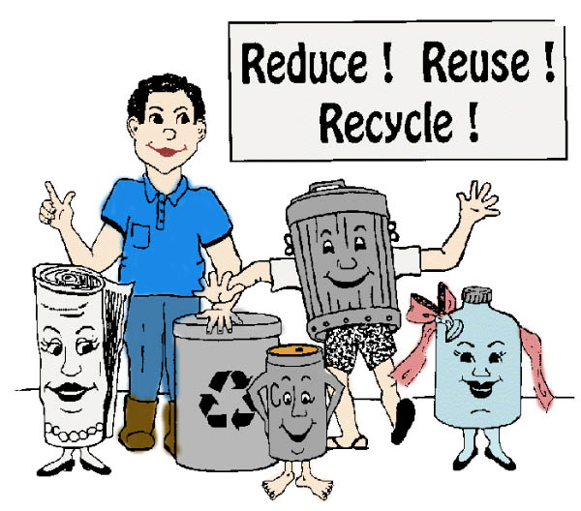

Software Maintenance and Evolution
CSSE 575: Session 7, Part 3
Reuse-based software maintenance & evolution
Below – Reuse is very popular these days! From http://www.mrbigben.com/hong_kong_website/enviromental_protection_page.html.
Steve Chenoweth
Office Phone: (812) 877-8974
Cell: (937) 657-3885
Email: chenowet@rose-hulman.edu

Slide 2

The basic trick
Abstraction can hide some of the essential complexity from the programmer.
We must find a way to fill-in missing details, before a complete, executable program is produced –
  From abstract program specifications,
  Via a “generator”,
  Instead of from concrete components.
Stan Jarzabek, from whom these ideas are taken.
Notes:
Material taken in part from Effective Software Maintenance and Evolution: A Reuse-based approach, by Stanislaw Jarzabek. Auerbach Publications, ISBN 0-8493-3592-2.
See http://www.crcnetbase.com/doi/pdfplus/10.1201/9781420013115.fmatt.

Slide 3
Based on the opportunity
That today’s software contains a large amount of similar and repetitive code.
Tend to be implicit and dispersed in the code.
So, similarity needs to be expressed in a generic and adaptable form.
  This could reduce the number of conceptual elements,
  E.g., unifying similar patterns.

Slide 4
Mixed strategy for evolution
Combine program code and its design into a unified representation.
Emphasis on design info useful for maintenance.
Can unify similarity patterns with generic, adaptable program structures.
We still cannot reduce the inherent complexity of the problem!
Notes:
From Jarzabek, p. 122.
The limitation of the problem complexity also was brought out in the paper you read on Measuring Evolution (see slide set 9-3).

Slide 5

Concepts
Reuse the knowledge of past changes to effectively implement future changes. Need:
  Clear change visibility
  Clear understanding of similarities and differences
  Nonredundancy via unifying similarity patterns of evolutionary changes, via generic structures
  Avoid the explosion of look-alike
  components
Right – A Harry Potter look-alike. From http://www.blameitonthevoices.com/2007/11/harry-potter-look-alike-from-india.html.

Slide 6
Mixed-strategy ideas
Use a programming language to express the syntax and semantics of a program, including:
  Its component architecture and
  Its runtime behavior, like
    User interfaces
    Business logic
    Database
Then impose a special language on conventional program structures,
  To express the syntax and semantics of change.

Slide 7
Jarzabek chose “XVCL”
As this special language.
XML-based “variant configuration language”
Can express program changes of any type and granularity
An XVCL processor interprets change specs and modifies programs accordingly.
Can manage multiple changes implemented over time.
Includes handling change interactions.
Includes building generic design solutions.
Notes:
See http://xvcl.comp.nus.edu.sg/cms/index.php.

Slide 8
Mixed-strategy goal
Create a plane at which all changes become first-class citizens and
Can be designed and understood –
  In synergy, and
  Without conflicts
  Within a program structure.
Beyond OO, this “prescribes an approach” to achieve separation of concerns.

Slide 9
So we look at two sides…
Program construction-time concerns:
  How various features have been implemented in system releases
  Visibility of past changes
  Changeability
  Traceability of information from requirements to code
  Genericity
  Cross-cutting concerns

Slide 10
And
2. Program runtime concerns:
  Program behavior
    User interface
    Computation logic
    Persistence
    Storage of data, etc.
  Componentization
  Underlying component platforms
  Quality attributes

Slide 11
So
XVCL deals with the construction-time concerns, and
A regular programming language deals with the runtime concerns.
We’ll look at this just a little because –
  It looks promising and, who knows? Could be the wave of the future.

Slide 12
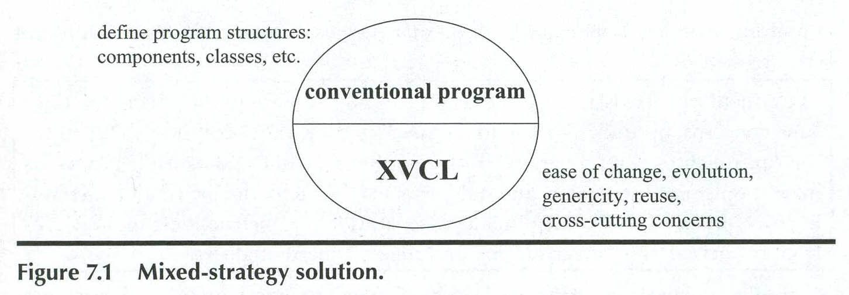
Or,

Slide 13
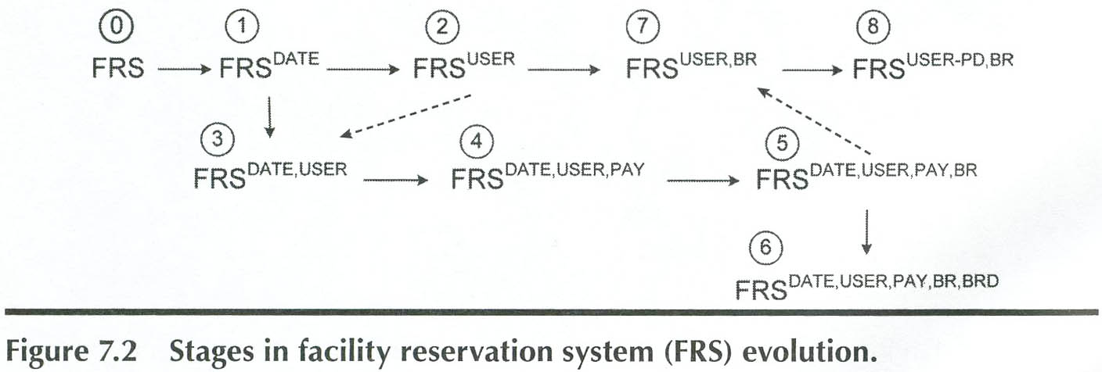
Using the Facility Reservation System (FRS) as an example…
Notes:
Here’s a typical example of a system evolution path, for a fairly simple software product.

Slide 14
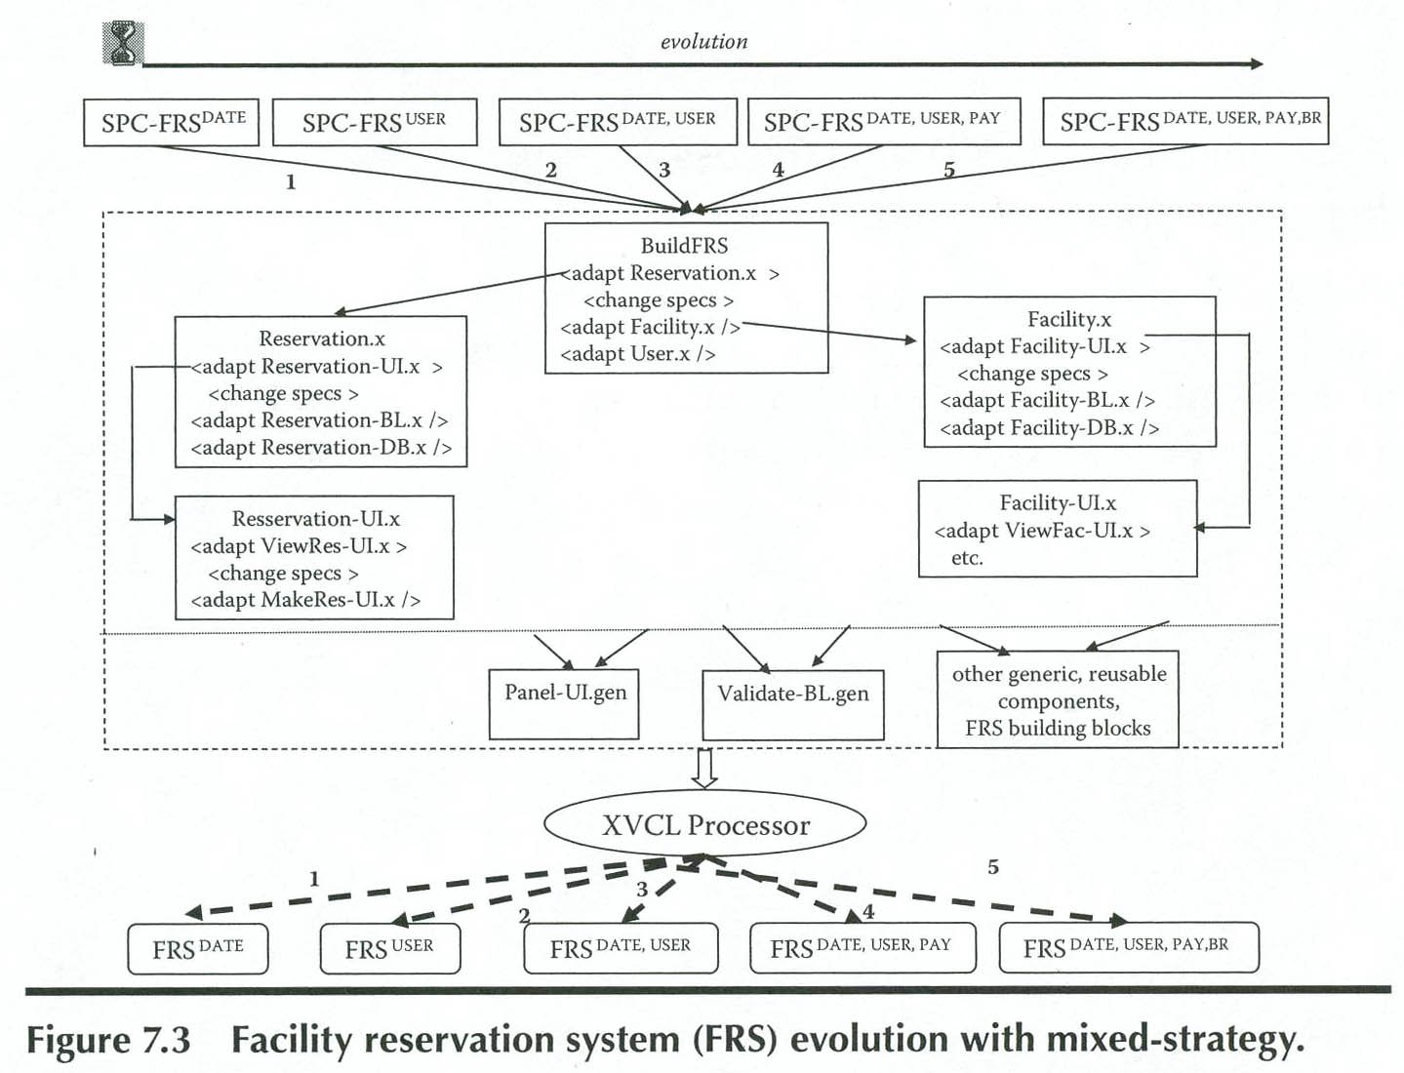
Here’s the X-framework for 5 initial stages of FRS.

Slide 15
In this figure,
Top-level FRS decomposition of specs, showing XVCL <adapt> commands.
The x-framework contains the full knowledge to build each FRS release, shown as x-frames enclosed in the dashed rectangle.
Five FRS releases produced from the x-framework.
Notes:
The top-most x-frames contain the specs of how to build a specific FRS release.
The XVCL processor interprets change specs and propagates the changes across the x-framework, producing custom component versions.
It takes time to build the XVCL framework, in the middle, as well as the system itself!

Slide 16
Example…
Suppose we find a lot of similarity among modules in these groups:
  CreateRes, CreateFac, CreateUser
  DeleteRes, DeleteFac, DeleteUser
  UpdateRes, UpdateFac, UpdateUser
But there also are differences in each of these, within a group, implied by the operation and the entity!
And there are differences implied by specific features (like DATE, USER, or PAY) implemented in a given FRS release.

Slide 17
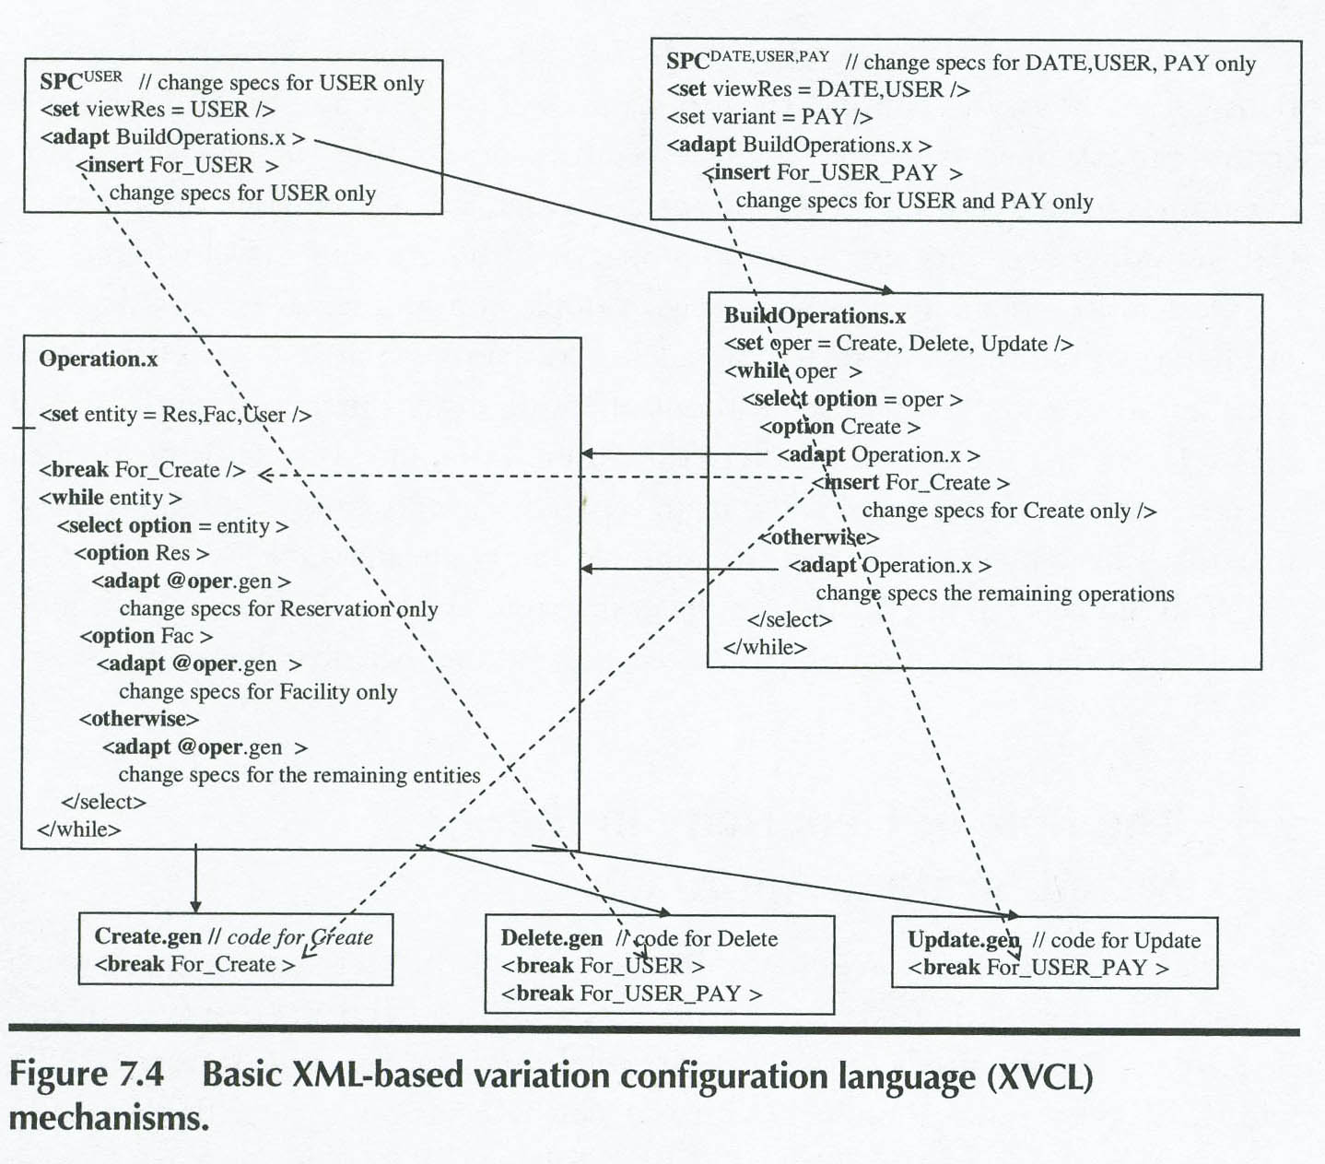
XVCL working on these…
Notes:
The solid lines are <adapt> commands.
The dashed arrows link <insert> commands to matching <break> points.
Custom operations for specific entities (e.g., CreateRes, CreateFac, CreateUser) are obtained by adapting generic operation x-frames (e.g., Create.gen).
BuildOperations.x and Operation.x navigate the process of building operations.
Changes specific to certain operations (like Create) are specified in BuildOperations.x. For operation Create, we insert Create-specific changes into matching <break>s named For_Create, placed in x-frames Operation.gen and Create.gen.
Changes specific to a certain operation (e.g., CreateRes) are specifie in Operation.gen.
Changes specific to a given FRS release are specified in the respective SPC (spec).

Slide 18
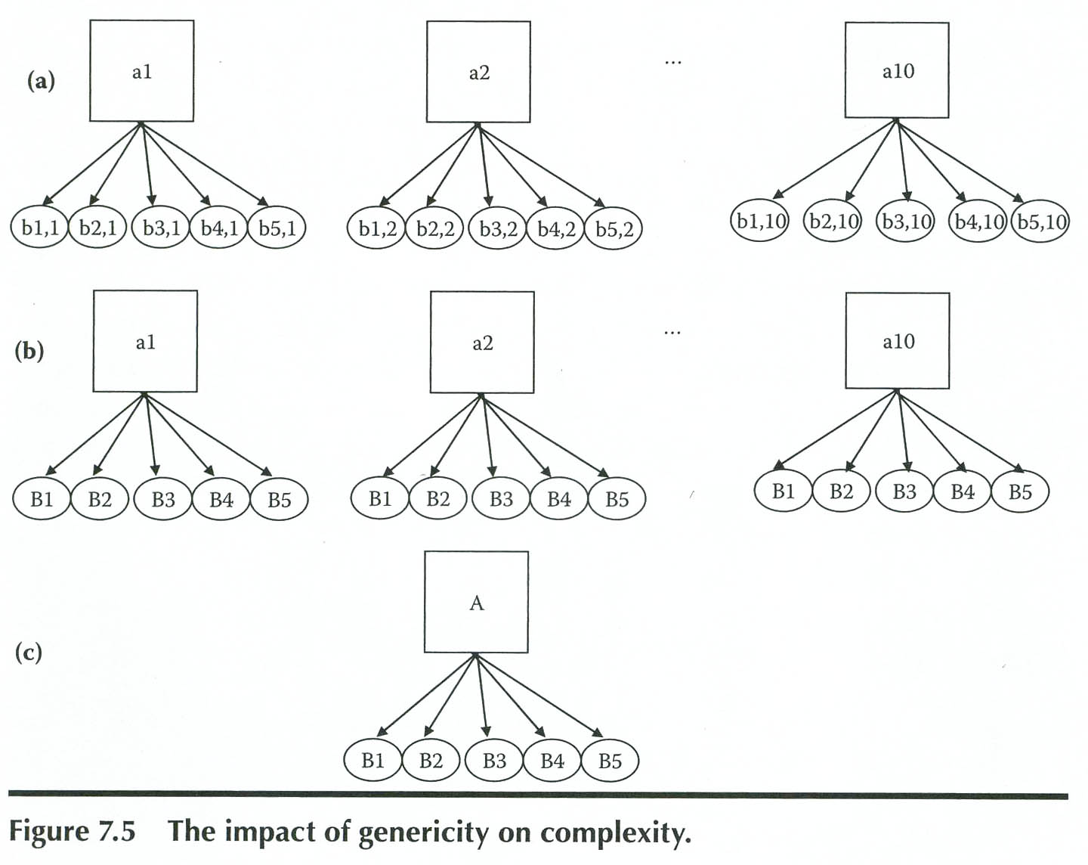
Genericity in action
Notes:
The output of this process is “program components that we can easily adapt to specific needs of various system releases.”
Suppose these are 10 user interface forms, a1 thru a10. Each interacts with, say, 5 business logic functions, B1 thru B5.
(a) If each business logic function is implemented separately for each user interface form, we have to manage 10 + 10*5 = 60 components, with 50 interactions (the arrows in the figure). See top row of the figure.
(b) If we can unify the business logic functions across 10 forms, so that all ten are used only with 5 generic functions, we can reduce the solution space to 10 + 5 = 15 components and 50 interactions, with the slightly added complexity of representing these generically.
(c) If we can further unify ten user interface forms with one generic form A, then we can reduce the solution space to 1 + 5 = 6 components, each group consisting of 10 specific interactions. Plus the complexity of more generic action!

Slide 19
“Mixed” Conclusions
Having generic components along with specifications of adaptation gives a clear view of what’s similar and what’s different among system releases.
The generic specs avoid repeating the same or similar changes specifications.
Patterns are more visible.
An intentional way to maximize reuse
  Reducing evolution complexity
  Giving traceability from requirements to coding
  Maximum changeability
Notes:
And, of course, it’s still “researchy”!

Slide 20
The article you read
A step towards software preventive maintenance, by Singh and Goel.
The “real world” has software with –
  Increased usage
  Operating in unforeseen conditions
  At throughput much higher than initial expectations
Can we make such products “age gracefully”?

Slide 21
Article, cntd
The authors consider what “preventive maintenance” for such things means
  And develop a model for PM integrated into the product lifecycle.
    Really describing “maintainability”
  Similar to how preventive maintenance has become important with hardware.

Slide 22
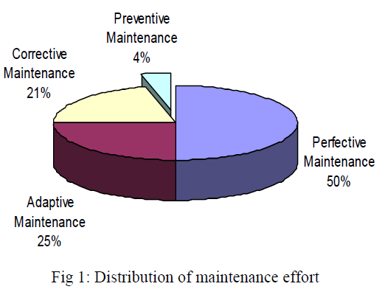
Article, cntd
Right now, not much of the maintenance pie goes for PM:

Slide 23
Article, cntd
PM can be seen as a key part of “risk management” for a product or service.
Differs from hardware PM:
  Software failure is caused by design faults, not physical deterioration.
  Replacing software components at scheduled intervals!?
  No off-the-shelf software components like hardware. Everything at the top level is unique.

Slide 24
Article, cntd
Two main reasons for an increasing software failure rate over time:
  Product aging
    Degradation of code and documentation quality by continual maintenance.
  Software process execution aging
    Degradation in performance of a software system through continuous running

Slide 25
Article, cntd
Goal of software PM – software fault-tolerance by counteracting aging effects.
PM activities include:
  Cooperation between client and maintainer organizations
  Joint analysis of the present condition as well as forecasted needs of the software
  PM can be corrective, adaptive or perfective

Slide 26
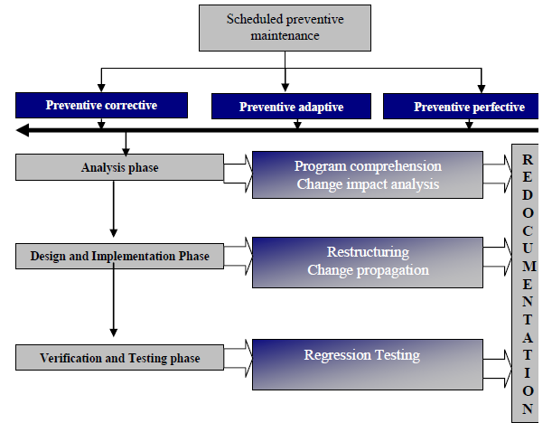
Article, cntd
Model of Preventive Maintenance
Notes:
This is “the lifecycle of any type of maintenance request.”

Slide 27
Article, cntd
Key aspects of PM:
  Program comprehension
  Change impact analysis
  Restructuring
  Change propagation
PM is tied to:
  Monitoring system health
  Issuing periodic enhancements
  Operations like “software rejuvenation”
  Historical data and trend analysis to predict problems

Slide 28
Article, cntd
The key role of documentation is because…
  A major distinction between development and maintenance is the set of constraints imposed on the maintainer by the existing implementation of the system. Information about system artifacts, relationships and dependencies can be obscure, missing, or incorrect as a result of continued changes to the system. This situation makes it increasingly difficult for the maintainer to understand the software system and the implications of a proposed change

Slide 29
Article, cntd
Assertions about the advantages of software PM:
  The costs of emergency maintenance or corrective approaches outweigh the cost of PM.
  PM can be scheduled for good times in the operational profile of a system.
  Management and customers need to make PM a priority

Slide 30
Assignments and Milestones
This week, you’ll need to use your imagination a bit, to link what you’re working on to our discussion topics!
See the assignments for details.

