Slide 1
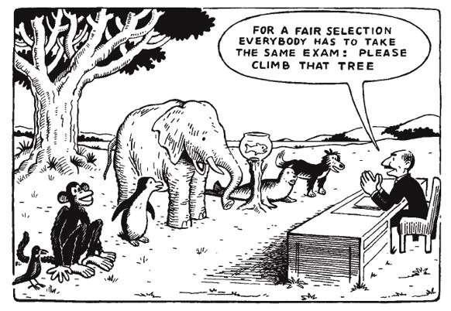

Software Maintenance and Evolution
CSSE 575: Session 6, Part 3
Problems with Changing Software - 2
Below – How do you know if your unit test really tested the important things? Did you use representative data? Does it predict success in integration testing? Cartoon from http://bornstoryteller.wordpress.com/2011/06/27/national-standards-are-they-necessary-guest-blog/.
Steve Chenoweth
Office Phone: (812) 877-8974
Cell: (937) 657-3885
Email: chenowet@rose-hulman.eduz
Notes:
The only way to make metrics interesting is to imagine you are the one making decisions about the product…
Remember that SW Maintenance is the large part of software expenditure and you need to optimize that!

Slide 2
A few more cool examples…Ch 10
“I can’t run this method in a test harness.”
Reasons could include:
  Method not acccessible to the test
  Hard to construct the parameters to call a method
  Method has bad side effects, like modifying a database or launching a cruise missile
  Need to “sense through” some object that the method uses
Notes:
This is all on pp 137 – 150.

Slide 3
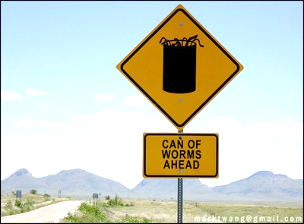
Testing a private method
Feathers’ opening comments:
Private methods tend to be of dubious quality.
They often look very general, but really work only for the things in their class that use them.
Making them public opens a can of worms!
Notes:
Can of worms from http://quarterlifelady.com/?p=2386.

Slide 4
Private methods, cntd
Thus, these represent things that are inherently not testable – questionable design.
His example (in C++):
class CCAImage
{
private:
void setSnapRegion(int x, int y, ind dx, int dy);
…
public:
void snap();
…
};
Notes:
CCAImage class is used to take pictures in a security system.
The class has a snap() method that uses a low-level C API to control a camera and “take” the picture.
A single call to snap() can result in a couple different camera actions…
Snap() calls setSnapRegion to place images in a buffer.
Unfortunately, the API to the camera has changed, so we need to make a change to SetSnapRegion.
How to write tests for this?

Slide 5
Private methods, cntd
Feathers’ solution:
Make the private class protected instead of private.
Then delegate to a testing subclass:
class TestingCCAImage : public CCAImage
{
public:
void setSnapRegion(int x, int y, ind dx, int dy)
{
// call the setSnapRegion of the superclass
CCAImage::setSnapRegion(x, y, dx, dy)
}
};
Notes:
Feathers also shows how this can be done with a “using” declaration in C++.

Slide 6
Undetectable side effects
Feathers’ example – a class that calls methods on other objects, and we never have a clue how things turn out:
Public class AccountDetailFrame extends Frame
implements ActionListener, WindowListener
{
private TextField display = new TextField(10);
…
public AccountDetailFrame(…) {…}
public void actionPerformed(ActionEvent event) {
String source = (String)event.getActionCommand();
if (source.equals(“project activity”)){
DetailFrame detailDisplay = new DetailFrame();
detailDisplay.setDescription(
getDetailText() + “ “ + getProjectionText());
detailDisplay.show();
String accountDescription = detailDisplay.getAccountSymbol();
accountDescription += “: “;
…
display.setText(accountDescription);
…
}
}
…
}
Notes:
This class creates GUI components, receives notifications from them using actionPerformed, and calculates what it needs to display and displays it.
It builds up detailed text and then creates and displays another window.
When the window is done with its work, it grabs information from it directly, processes it a bit, and then sets it onto one of its own text fields.
There is no decent way to create a test harness to see what this class does.

Slide 7

Undetectable side effects, cntd
Feathers’ solution – separate dependencies, including using Bertrand Meyer’s Command / Query separation principle Part 1:
Public class AccountDetailFrame extends Frame
implements ActionListener, WindowListener
{
private TextField display = new TextField(10);
private DetailFrame detailDisplay;
…
public AccountDetailFrame(…) {…}
public void actionPerformed(ActionEvent event) {
String source = (String)event.getActionCommand();
performCommand(source);
}
public void performCommand(String source){
if (source.equals(“project activity)){
setDescription(getDetailText() + “ “ + getProjectionText());
…
String accountDescription = detailDisplay.getAccountSymbol();
accountDescription += “: “;
…
setDisplayText(accountDescription);
}
} cntd →
Bertrand Meyer – Also author of the Eiffel programming language and of “design by contract” programming.
Notes:
Image from http://en.wikipedia.org/wiki/Bertrand_Meyer.

Slide 8
Undetectable side effects, cntd
Feathers’ solution – separate dependencies, including using Bertrand Meyer’s Command / Query separation principle Part 2:
…
void setDescription(String description){
detailDisplay = new DetailFrame();
detailDisplay.setDescription(description);
detailDisplay.show();
}
String getAccountSymbol(){
return detailDisplay.getAccountSymbol();
}
void setDisplayText(String description){
display.setText(accountDescription);
}
}
…
}

Slide 9
Undetectable side effects, cntd
We can now subclass and override to test whatever code is left in performCommand:
public class TestingAccountDetailFrame extends AccountDetailFrame
{
String displayText = ““;
String accountSymbol = “”;
void setDescription(String description{
}
String getAccountSymbol(){
return accountSymbol;
}
void setDisplayText (String text){
displayText = text;
}
}

Slide 10
Undetectable side effects, cntd
And a test exercise on the performCommand method would look like this:
public void testPerformCommand(){
TestingAccountDetailFrame frame = new TestingAccountDetailFrame();
frame.accountSymbol = “SYM”;
frame.performCommand(“project activity”);
assertEquals(“SYM: basic account”, frame.displayText);
}

Slide 11
Another cool example…Ch 11
Impact analysis during maintenance –
Feathers’ dream tool – he highlights code in the IDE, and it tells him everything impacted if he changes that code!
Need to reason backward and forward about changes
  Backward = deduce the set of objects that affect values at a particular point in code.
  Forward = look at a set of objects and determine what will change downstream if they stop working.

Slide 12
Reasoning forward example
This is what generates index now!
We want to make changes to this code, to allow the index to change as items are added to the ArrayList:
import java.util.ArrayList;
import java.util.Iterator;
/**
* @author chenowet.
* Created Jul 12, 2011.
*/
public class InMemoryDirectory {
private ArrayList<Element> elements = new ArrayList();
public void addElement(Element newElement){
elements.add(newElement);
}
public int getElementCount(){
return elements.size();
}
public Element generateIndex() {
Element index = new Element("index");
for(Iterator it = elements.iterator(); it.hasNext();){
Element current = (Element)it.next();
index.addText(current.getName()+"\n");
}
addElement(index);
return index;
}
public Element getElement(String name){
for (Iterator it = elements.iterator(); it.hasNext();){
Element current = (Element)it.next();
if (current.getName().equals(name)) {
return current;
}
}
return null;
}
}
Notes:
From pp. 157+

Slide 13
Reasoning forward example, cntd
Issues:
Need to generate the index last -- it doesn’t work if rebuilt.
But this was ok in the existing app.
Now, we’d like index creation and maintenance to happen automatically as a side effect of adding elements.
How to test as we develop this change?

Slide 14
Reasoning forward example, cntd
So we need tests that:
Add elements in various ways,
Generate an index,
Get the various elements and see if they are correct, and
Test to see if the index is correct.
How do we know this is the extent of the testing needed?

Slide 15
Reasoning forward example, cntd
The tests are just a description of how we expect to use the directory (and revisions to the add function).
We know what the directory is supposed to do.
But, could we have known this just by looking at the code itself?

Slide 16
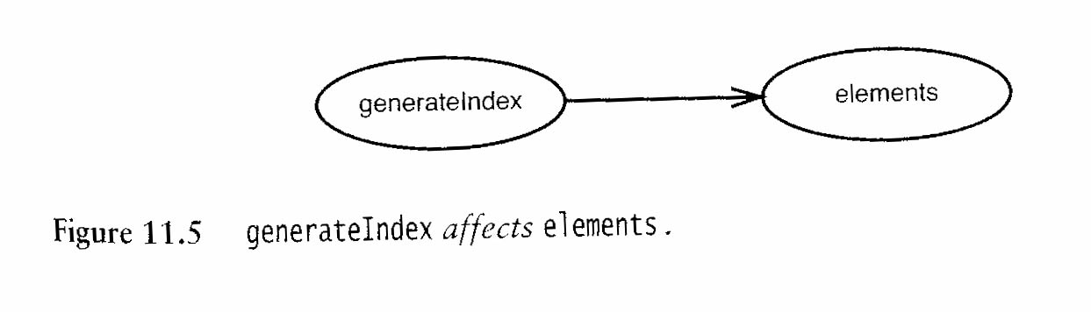
Reasoning forward example, cntd
Our goal is to remove functionality from generateIndex and add it to addElement.
So,
  What calls generateIndex?
    Nothing in the class itself.
    So it must just be client classes.
  What do we modify in generateIndex?
    We create a new element (the index) and add it to the ArrayList (the directory).
    Thus, this method affects the elements in the list.
…But we’re not done!

Slide 17
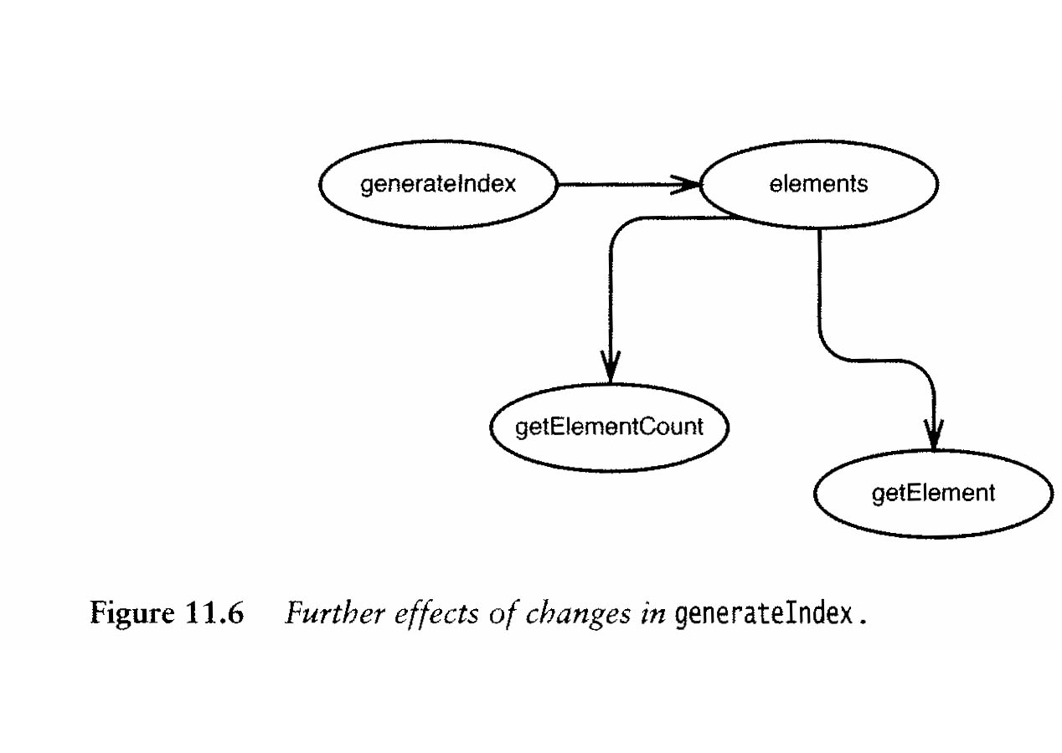
Reasoning forward example, cntd
Where else is the elements collection used?
  Used in getElementCount and in getElement.
  Used in addElement, but we don’t care!

Slide 18
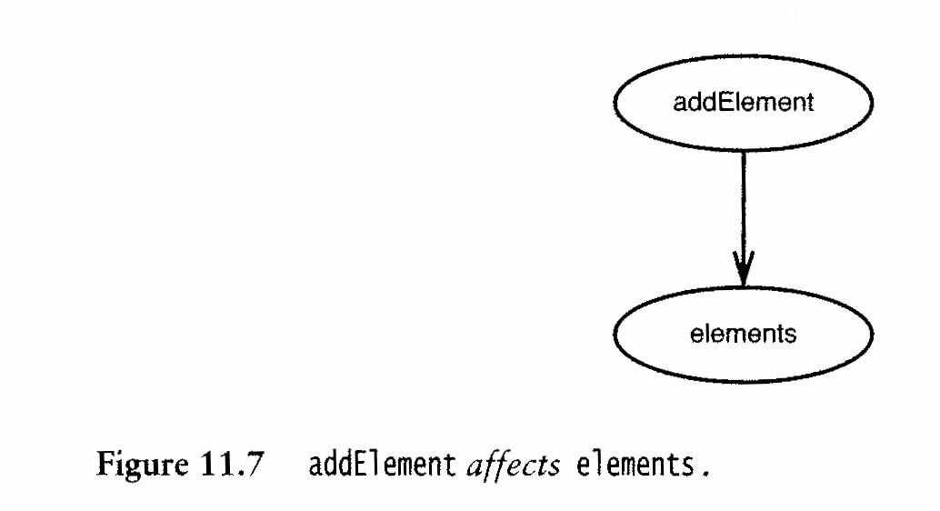
Reasoning forward example, cntd
Also need to look at how addElement impacts the surrounding software:
  It affects the elements collection.
…But we’re not done!

Slide 19
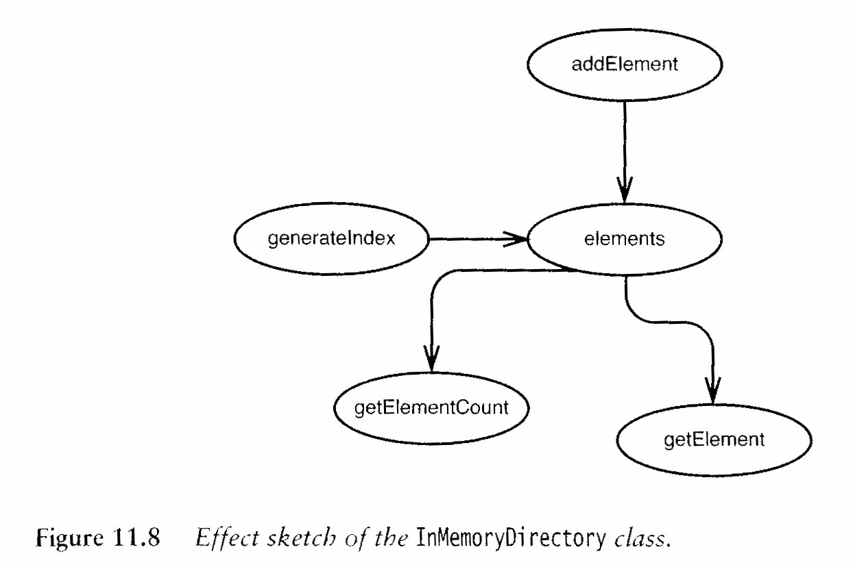
Reasoning forward example, cntd
As before, we also need to see what the elements collection itself can affect, giving this overall picture:

Slide 20
Reasoning forward example, cntd
Could we have missed anything?
  Superclasses and subclasses?
  Is the data in InMemoryDirectory public?
    Not in this case!
  What about the elements themselves?

Slide 21
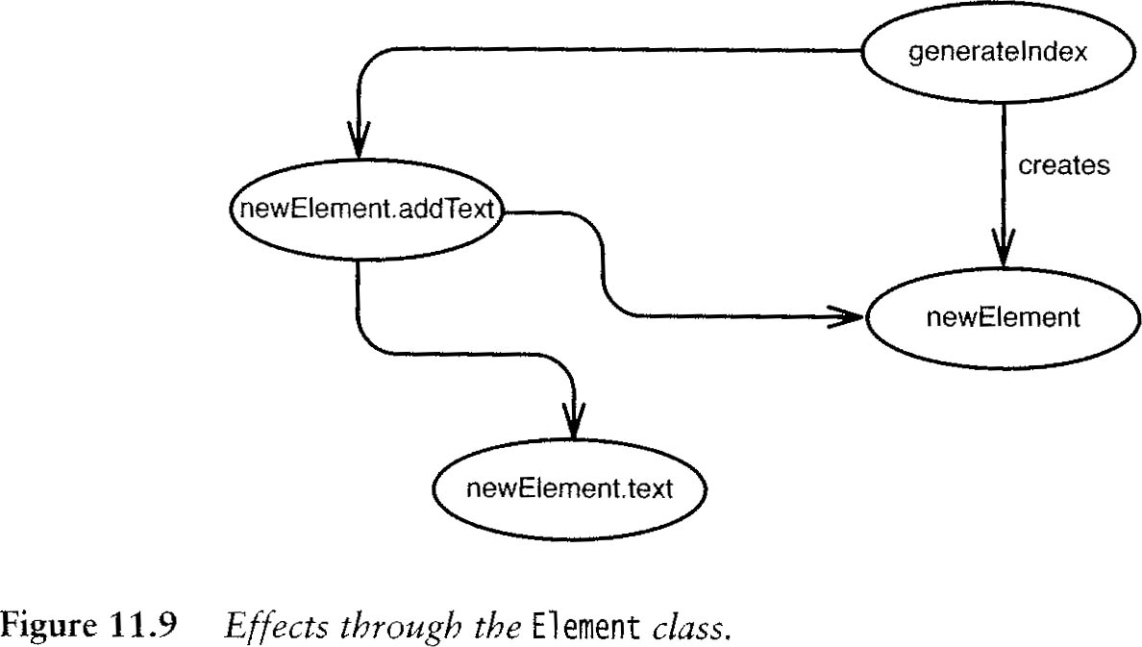
Reasoning forward example, cntd
/**
* @author chenowet.
* Created Jul 12, 2011.
*/
public class Element {
private String name;
private String text;
public Element(String name){
this.name = name;
this.text = "";
}
public String getName(){
return this.name;
}
public void addText(String newText){
this.text = this.text + newText;
}
public String getText(){
return this.text;
}
}

Slide 22
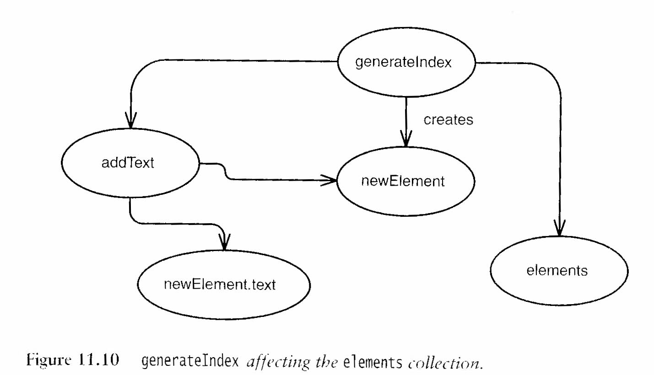
Reasoning forward example, cntd
So, overall, the impacts are:

Slide 23
Reasoning forward example, cntd
Heuristics for analyzing effects propagation:
Look for methods returning values
  Assuming these are used!
An object that takes another object as a parameter
  Can change that object!
  Depends on the language
Other side effects like
  Changing global or static data

