Slide 1
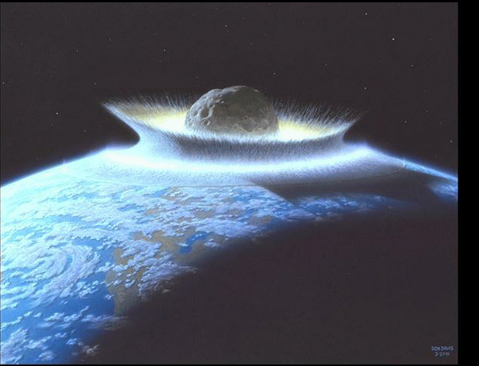

Software Maintenance and Evolution
CSSE 575: Session 5, Part 3
Software Change Impact Analysis
Below – The proverbial image of impact, in this case to illustrate the role of Adobe in social media. From http://www.jmorganmarketing.com/social-media-roi-and-impact-for-adobe/
Steve Chenoweth
Office Phone: (812) 877-8974
Cell: (937) 657-3885
Email: chenowet@rose-hulman.edu
Notes:
The only way to make metrics interesting is to imagine you are the one making decisions about the product…
Remember that SW Maintenance is the large part of software expenditure and you need to optimize that!

Slide 2

Software Change
Software Changes and
Entropy Results
  Ripple-Effects of Software
  Changes
  Changes on Changes
  Hydra-Effect…
How do we get a handle on these changes?
What do we have to help us?
Symbol for Creative Entropy, a company who build iPhone and iPod apps. From http://www.creativeentropy.com/
Notes:
Ripple-effects you know about – change something and this causes you to have to make additional, unexpected changes elsewhere in the system.
The “Changes on changes” problem is that the original design gets fuzzy, as we know from bad smells and refactoring.
The phenomenon of a population increasing in response to an increase in its per-capita mortality rate has recently been termed the 'hydra effect'. See for example, http://www.usf.uos.de/~msieber/data/SieberHilker_JMB_2011.pdf.

Slide 3

Software Change Impact Analysis
Definition: Software Change Impact Analysis (SCIA) identifies potential effects of proposed software changes
Most SCIA approaches use structure, semantics, and/or change histories to identify software change impacts
Current analyses largely identify potential effects of changes with requirements traceability and source code dependencies
Notes:
What is software change impact analysis in your own words?
There are really two ways people use the term “impact analysis” – the other being “the impact of outside events on your software,” like the Y2K event, or an operating system upgrade.

Slide 4
Software Change Impact Analysis Approaches
Notes:
How do we incorporate these for an impact analysis?
What are the two most prominent software impact analysis approaches used today? [[Dependency analysis and Traceabilility]]

Slide 5
Impact Analysis is Iterative
Software Change
Proposals
Examine
Software and
Change
Specification
Starting
Impact Set
(SIS)
Trace
Potential
Impacts
Candidate
Impact Set
(CIS)
False Positive
Impact Set
(FPIS)
Discovered
Impact Set
(DIS)
Perform
Software
Change
Actual
Impact Set
(AIS)
AIS = CIS + DIS - FPIS
Notes:
Start with examining the CR – determine the starting impacts for a search
Trace the impacts finding true impacts and eliminating false positives. → Precision and recall is another way to measure these…
How is the “actual impact set” calculated for an impact analysis?
Why is an impact analysis necessarily iterative? [[Imprecise analysis with a discovery nature]]

Slide 6
Traceability View of Life Cycle Objects
Program
Dependence
Graphs
Initial Change Set
Design1
Code 1
Test 1
Req’t 1
Design2
Code 2
Test 2
Req’t 2
Design3
Code 3
Test 3
Type and Strength
Notes:
Think/pair/Share
Source code dependencies are traceable with the Program Dependence Graph (PDG) or some analysis of the control and data handling in the program. How are the other dependencies captured?
The simplified analysis described on the previous slide provides the basis for analyzing and navigating the manifold dependencies
There are a series of builds that go with the dialogue as follows:
The initial change set on the left traces directly to “Req’t 1” and subsequently to “Req’t 2.”
The next build introduces traces to the Design components, a less abstract artifact of the development. Note that the dotted line depicts the idea of an indirect dependency and that subsequent dependency relationships are indirect.
The next build introduces traces to Code components.
The next build then closes the loop with test components. Actually, dependencies for test are related back to their respective life cycle objects – e.g., an integration test would also have a Design component dependency relationship. We simplified this slide to convey the traceability relationships as they pertain to impact analysis.
The next build shows the Program Dependence Graphs as the formalism used with source code – software code analysis has a long record of analyzing dependencies and we stand on broad shoulders here.
The next build introduces the notion that “not all dependencies are created equal.” While we use general graph theoretic techniques for analyzing the nodes (SLOs) and edges (dependency relationships), if we didn’t take into account the structural and semantic aspects of the dependency network, the result would be a complete transitive closure – everything related to everything. Therefore, we use dependency strength and type to guide the analysis (much more here than can be presented in a short time.)

Slide 7
Static Impact Analysis
Up to this point, we have talked about static impact analysis…
Note that the accuracy is highly dependent on the representation form (code and configuration)
  Generally, more formal, more accurate
  With precision of formal methods, the structural impact analysis is very accurate
  With the less formal representations like interpretive languages (e.g., Python), less accurate
Notes:
Less dependency information in informal languages and development approaches – potential challenge with Agile.
More leverage with semi-formal approaches (pre and post conditions, invariants), and formal methods (provably correct)
What leverage can we get for doing impact analysis with the languages we choose? [[More leverage with semi-formal approaches (pre and post conditions, invariants), and formal methods (provably correct)]]

Slide 8
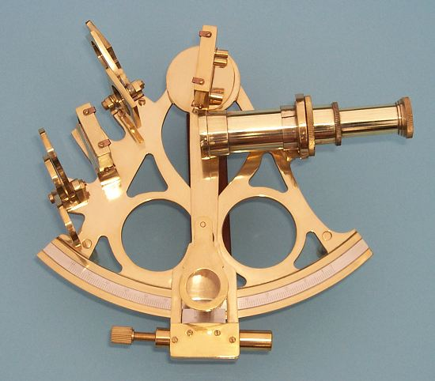
Structure and Semantics in Impact Analysis
Structure largely from representation form
Semantics gleaned from naming and language constructs
  Objects with meaningful names
  Language idioms like class, method,
  message, etc. give clues to meaning
Search techniques on semantics
  Simple grep
  Sophisticated heuristically guided techniques
Notes:
For traceability, documents pose a substantive problem and invariably, info retrieval techniques are used.
For code, Transitive closure and information retrieval …
False positives and negatives, precision and recall…
What is the difference between programming language semantics and search semantics for impact analysis?

Slide 9
Dynamic Impact Analysis
Based on software runtime data and dynamic/interactive behaviors of the system
  Depends on a set of executions of the system
  Capturing these in a usable form can be tricky
Tend to produce more precise results than static approaches
Execute software system
Analyze runtime relationships of program entities
Changes requested
Impact Set
Collect system runtime data
Notes:
CoverageImpact
PathImpact
CollectEA

Slide 10

Change Histories for Impact Analysis
Software
Understanding
Change
Propagation
Resource
Allocation
Bug
Prediction
Bugzilla
CVS
Repos
Historical
Information
Extraction
Notes:
True or False: Change propagation information can be gleaned from change histories of a program.

Slide 11
Application of Impact Analysis
How hard is it to find the dates in a program?
  Small program, easy language, newer platform, relatively good coding practice -- not to bad…
  Very large program, antiquated platform and language, bad coding practice -- that’s another story!
What were some of the techniques used to deal with this massive maintenance problem?

Slide 12
Inside & Outside Impacts Collide - Dates with Disaster
1970-01-01 => Bank 30 Mortgages Overflow
1996-01-01 => Overflow Unisys Mainframe
1998-01-01 => Flag year 98 or 2 year horizon
1999-01-01 => Flag year 99 or 1 year horizon
1999-08-22 => Overflow GPS Week Counter
2000-01-01 => Overflow 2-digit years
2000-01-10 => First 9-character date
2000-10-10 => First 10 character date
2000-02-29 => 2000 was a leap year
2000-12-31 => 366th day of the year
2001-01-01 => Twenty First Century
2001-01-01 => Overflow Tandem systems
2010-01-01 => Overflow ANSI C Library
2034-09-30 => Overflow UNIX time function
2038-01-19 => Overflow UNIX systems
2042-09-18 => Overflow IBM System/360
Notes:
Finding all the dates in the program could be important!
This is an example of a requirements-level change with lots of impact!

Slide 13
Key Year 2000 Compliance Activities
Converting Systems For Year 2000 Compliance
Understand
Year 2000
Situation
Plan and
Prepare for
Year 2000
Analyze
Portfolio &
Impacts
Convert/Transition
System and Data for
Year 2000 Compliance
Evaluate Year
2000 Compliance
and Deploy
Y2K Awareness
  Executives
  Line Managers
  Systems Org.
Scope Exposures
  Business
  Process
  System Platform
  (HW, SW, COTS)
Justify Effort
  Risk ...
  Cost/Benefit
  Budget
  ROI
Define Strategy
  Incremental
  Tactical
  Complement
  Triage
Develop Plan
  Resources
  Schedule
  Deliverables
Build Team
  Skills Mix
  Tools
  Training
Obtain Info.
  Documents
  Stakeholders
Conduct Inventory
  Hardware
  Software
  Communications
  COTS Apps.
Identify Date Impacts
  Pattern search
  Transitive closure
Assess Impacts
  False positives
  Embedded licenses
  Upgrade paths
Develop Integration
Testing Approach
  Date/time standards
  Specification...
Update Hardware
  OS. Firmware
  Systems Services
Update COTS
  Business
  Middleware
Convert/Translate
  Source Code
  Design
  Specification
  Documentation
Build Y2K Test Suite
  Boundaries
  Load/Stress
  Date ripples
Plan Conversion
Scrub Data
  Completeness
  Consistency
  Accuracy
Design Loaders
  Schema
  Data ...
Convert Data
  All at once
  Phased
  On-the-Fly
Plan Transition
with release
  Training
  Mirrored Ops
  Cut-over...
Conduct IV&V
  Integration
  Acceptance
Evaluate System
for Deployment
Produce
Deployment
Package
  Installation
  Training ...
Deploy System
Plan/Support Post
Year 2000
  Workarounds
  Disaster
  Recovery

Slide 14
Date Conversion Approaches
Expansion: Expands date fields to respond to century
Windowing: Retains 2 digit dates by constraining meaningful dates to < 100 years
Encoding/Compression: Retains 2 digits by fitting century information into existing space
Y2K

Slide 15

Where is Impact Analysis going?
More formal representations
Built into Requirements tools
Built into IDEs
Incorporated in Immersive Virtual Environments and

Slide 16

Ryder & Tip Article – on Impacts
Changes to OO systems ripple because of polymorphism:
  Subtyping
  Dynamic dispatch (binding)
Big question – what to test after
changes?
  Look at “atomic” changes
Need to analyze:
  Do regression tests
  If they fail, decide what
  changes would be safe
Barbara Ryder is now the CS department head at Virginia Tech
Notes:
“Change Impact Analysis for Object-Oriented Programs,” by Barbara G. Ryder and Frank Tip. PASTE 2001. File “impact OOIA-RyderTip.pdf” under Resources on course website.
Author image from http://people.cs.vt.edu/~ryder/.

Slide 17
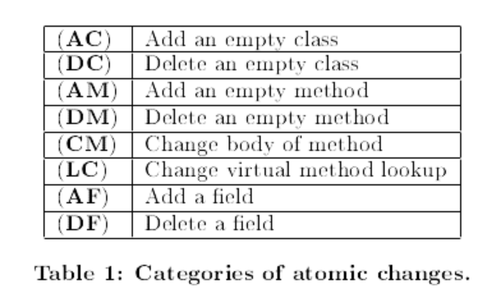
Article - What are “atomic changes”?
Notes:
The authors spend time discussing LC in particular, because it has dynamic behavior.
They define a formal way of expressing these changes.
This is an example of an area where deep studies could benefit software engineering, by showing the effects of different categories of program changes.

Slide 18
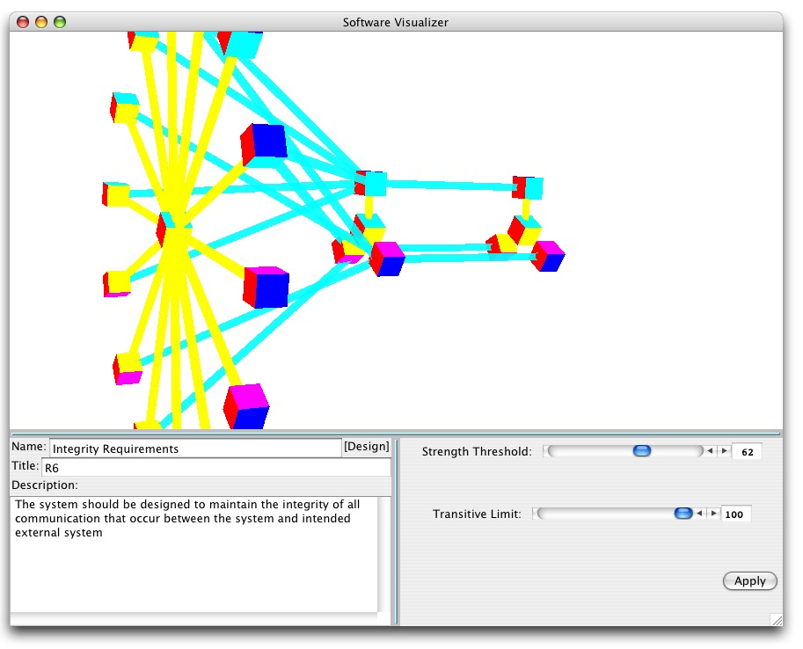
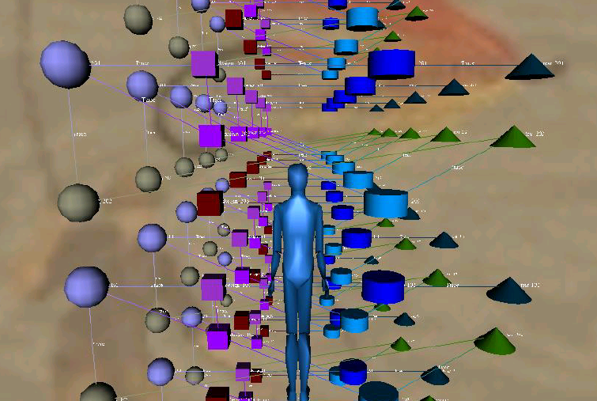
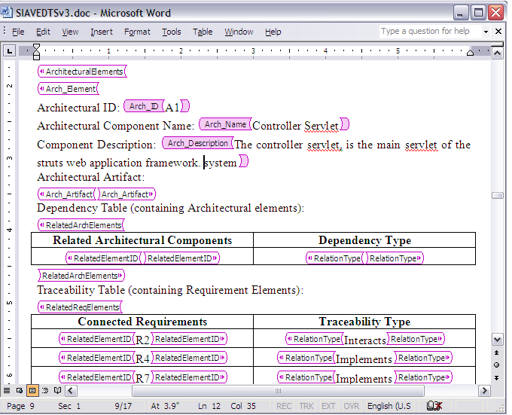

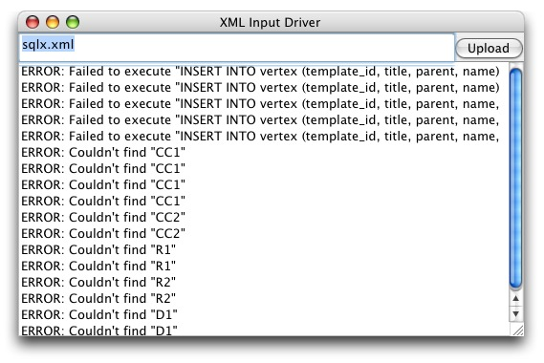
Software Impact Analysis Virtual Environment (SIAVE)
Populate DOC Template
Security
Target/
Protection
Profile
SIA Virtual Environment
Vendor’s
DOC
Revised DOC
(Tagged)
DOC Artifacts
& Security
Dependencies
(SQLX)
Parsers
XML
Dependency
Analyzer
XLST
file
Vendor Preparation Environment
Evaluator’s Environment
Notes:
This is an example of a domain-specific tool – this one’s for security-related analysis.
See http://www.jmu.edu/iiia/webdocs/Reports/SIAVE%20CISC%20RR%2003-01.pdf and http://www.jmu.edu/iiia/webdocs/Reports/SIAVE%20CISC%20RR04-02.pdf, research which Shawn was a part of.

Slide 19
DOCTemplate

Slide 20
The SIAVE Prototype
Basic Architecture
CCTool
DOC Conditioning
& Capture Parsers
Dependency IA Model
Browser(s) XML/VRML
TOE Conditioning & Capture
TOE Analysis and Navigation
Dependency Analyzer
Dependency Database
Web and File System
Notes:
This slide outlines the basic architecture of the SIA-Viz Environment.
We exploit the fact that the software artifacts in the TOE are available on the computer file system and the web. We can use HTML/XML addressing to navigate the documents readily. From the Common Criteria Evaluation Methodology, we developed a Security Impact Analysis Model. This provides the formal representation that connects SLOs through a network of dependencies. From this, we are developing the dependency analyzer to “slice” out the relevant elements for the Evaluator to examine. This information is feed into the Security Impact Analysis Database for further slicing and analysis during the navigation, and feed into the Traceability and source Code Visualizers to prepare it for investigation using the XML/VRML-based Browsers.
While the Traceability and Code Visualizers are separate at this time, we plan to integrate them. We’ve discovered that source code will not always be the only formal representation we can glean dependencies from automatically. Increasingly, products like Rational provide intermediate forms of requirements models and design that can be mined for dependencies.
Also, with our aim to develop a flexible metaphor mechanism that can evolve with the evaluator’s needs, we have built the META4Design tool to support the visualization aspects of the artifacts.
Note that at the top of the architecture is the ST/PP (produced by CCTool) and TOE (Revised), both providing the information base to be evaluated. The SIA browser makes much of the analysis transparent to the evaluator and provides a reasonable mechanism to navigate the key area of interest.

Slide 21
Assignment and Milestone Reminders
Journal / Milestone entries for this week –
Let’s look at the updated assignments, under ProjectWork!

