Slide 1


Software Maintenance and Evolution
CSSE 575: Session 5, Part 2
Reverse Engineering Tools and Techniques
Above – Things to do while reverse-engineering your mechanical pencil. From http://gmbhnews.com/view/DavesMechanicalPencils.html.
Steve Chenoweth
Office Phone: (812) 877-8974
Cell: (937) 657-3885
Email: chenowet@rose-hulman.edu

Slide 2
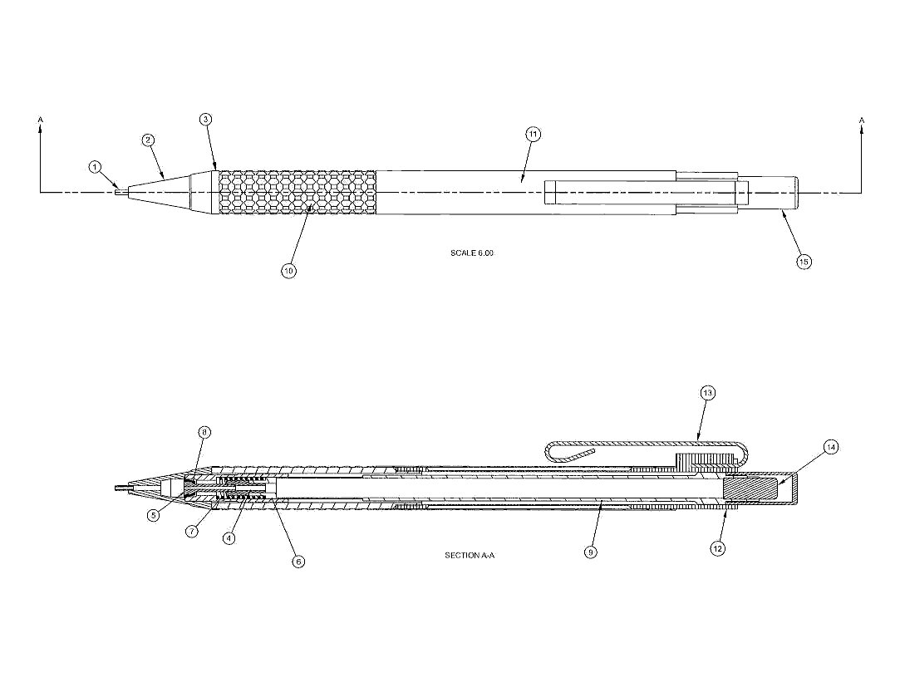
Example: Reverse Engineering a Pencil
Notes:
Where do you start when reverse engineering a tangible product like a mechanical pencil? [[by examining the structure and operation of the pencil]]

Slide 3
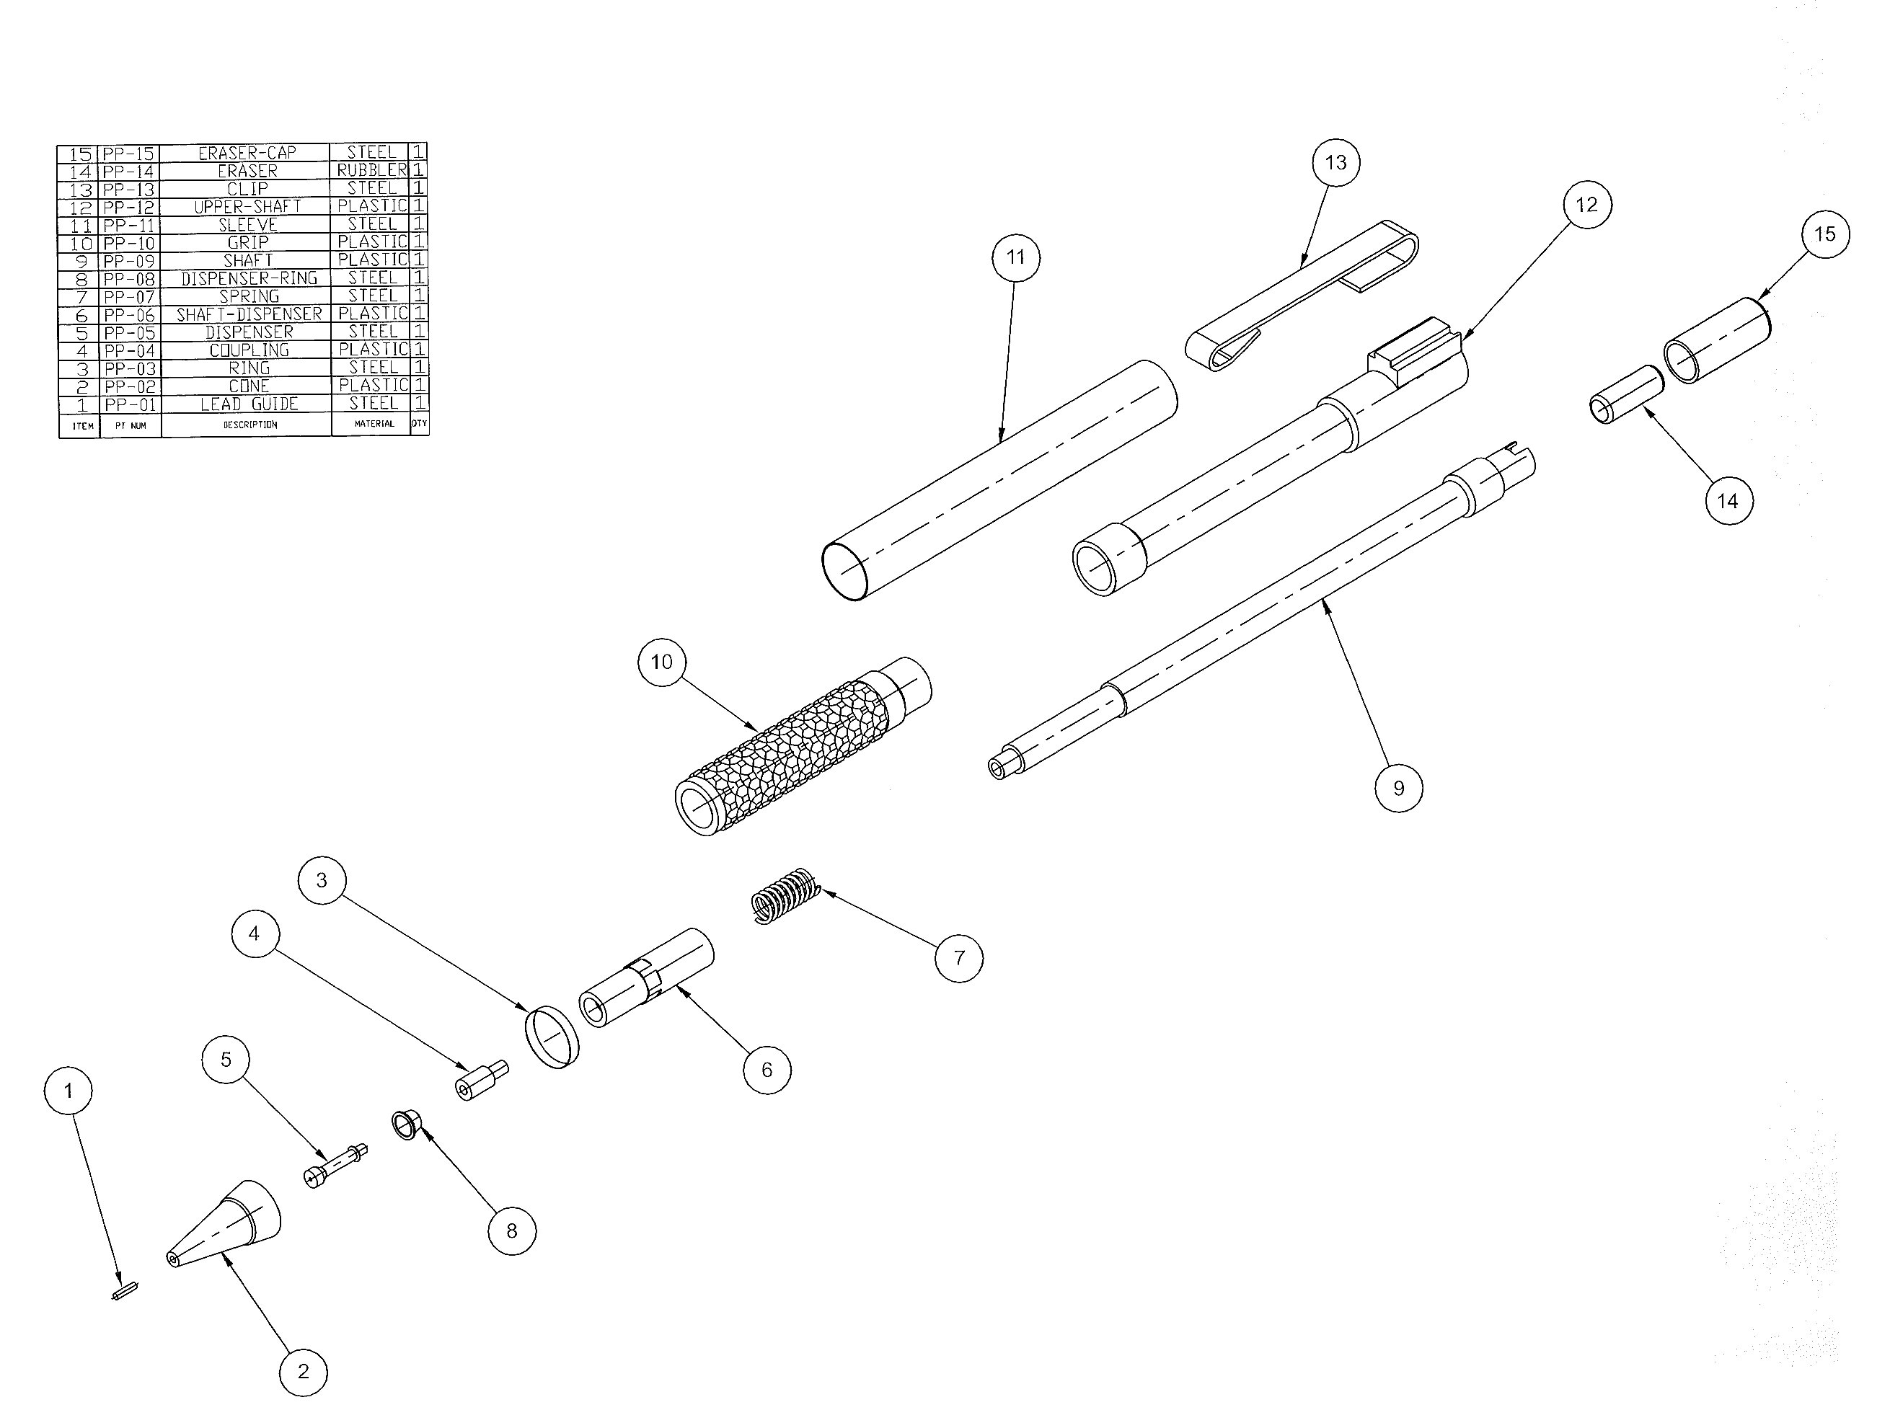
What are the Relevant Pencil Parts?
Notes:
You can take it apart, like in the “secrets of the universe” joke (prior lecture).

Slide 4
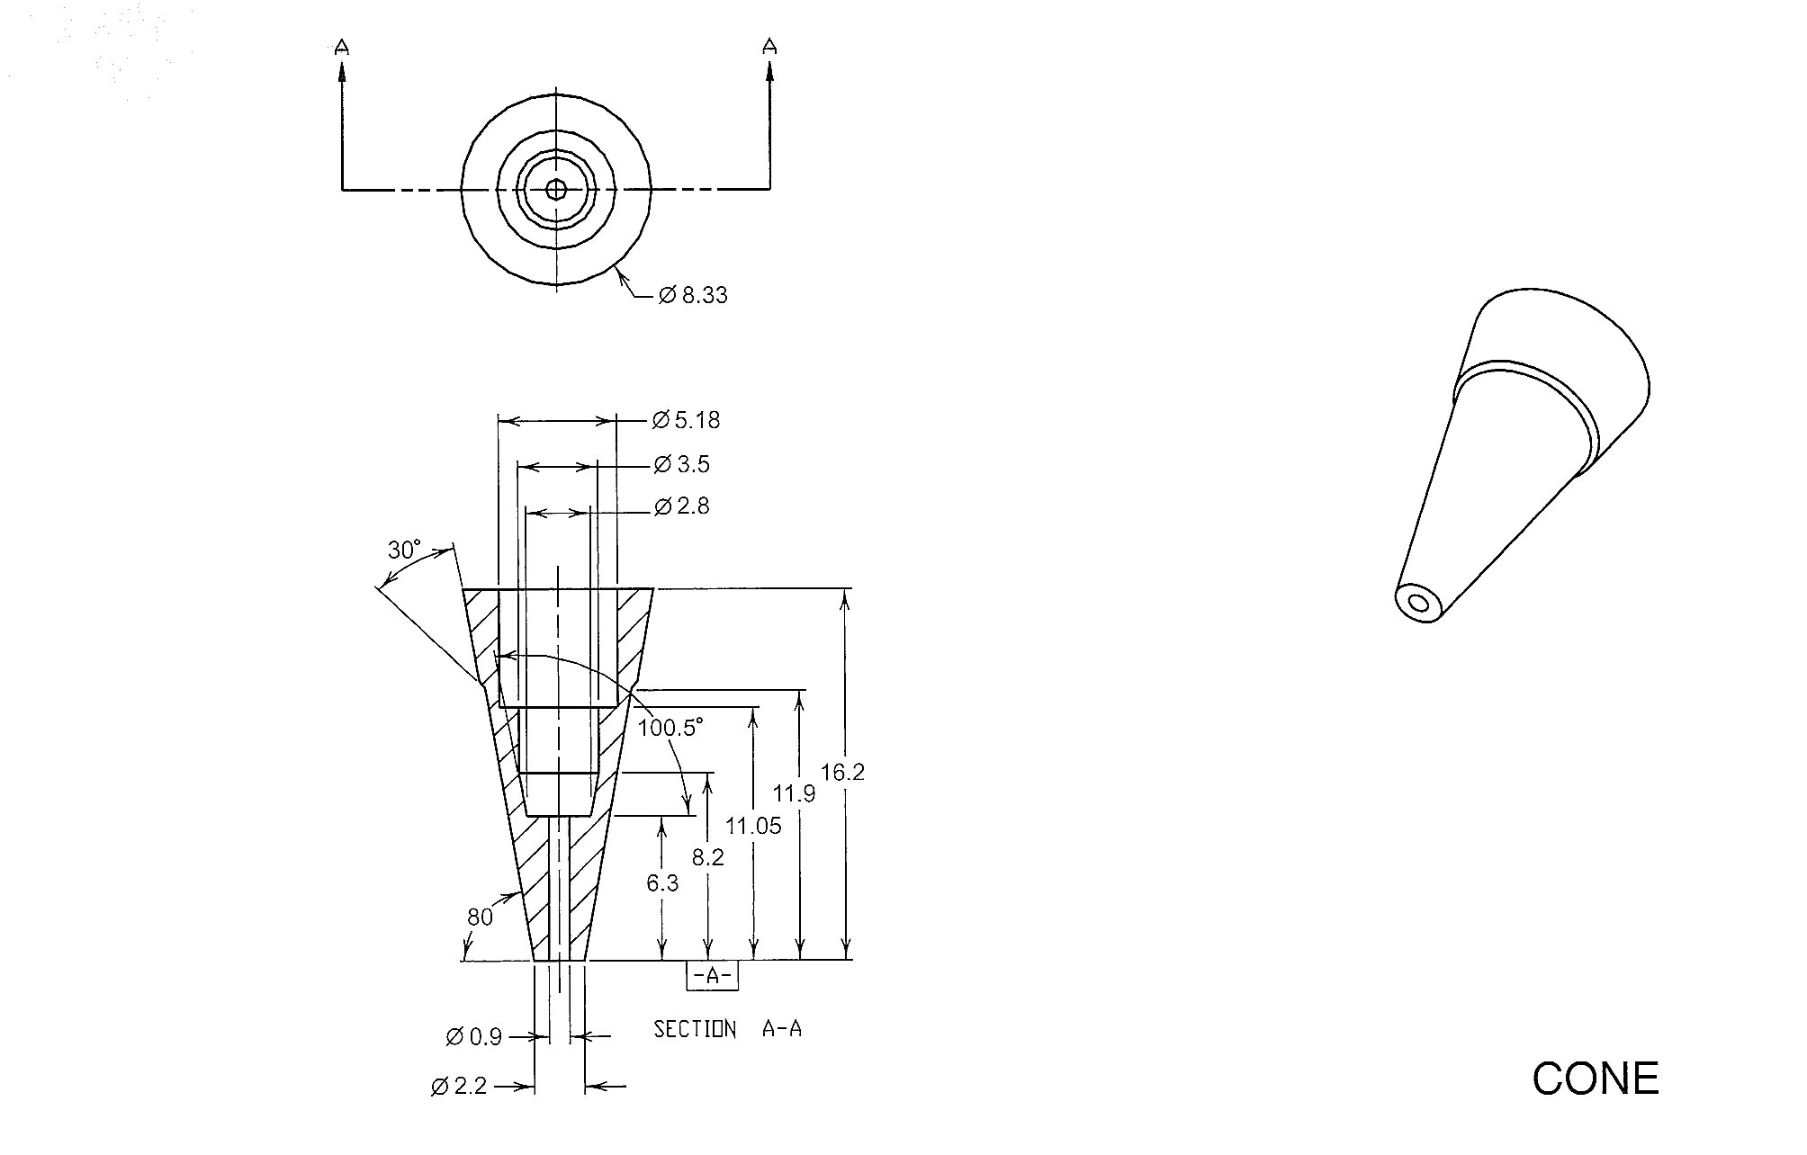
Evaluate the Pencil Parts: Cone
Metal to prevent wear
Tapered to 1) provide writing control
subject to preference, 2) maximise
writing space or options

Slide 5
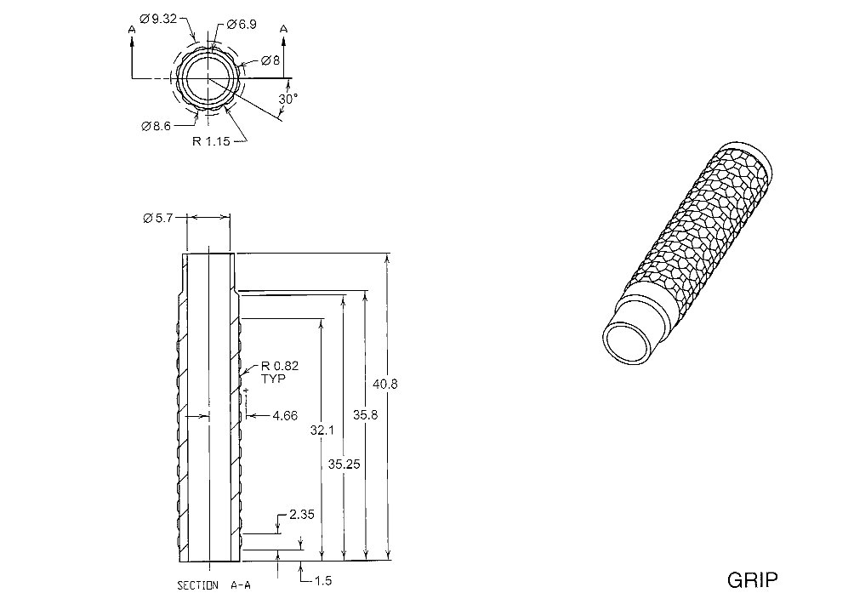
Evaluate the Pencil Parts: Grip
1) Rubber or plastic,
2) Easily formed,
3) Different colours
4) One stage production process
(no machining)
5) Formed surface to provide grip
6) Size suitable for reasonable grip

Slide 6
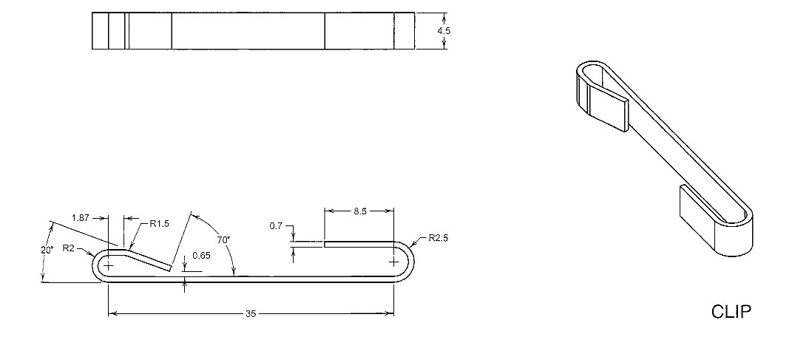
Evaluate the Pencil Parts: Clip
1) Made of metal or plastic
2) Designed as spring to flex
3) Designed to retain pencil against a surface
Notes:
How are software and tangible products similar in trying to glean the properties that will enable you to forward engineer the product? [[there is an underlying assumption that your information will be abstract and often incomplete. However, the amount of measurable information on a hard product will probably be higher]].

Slide 7
Recall: SW Reengineering Techniques
Reverse Engineering / Redocumentation /Design Recovery
Restructuring
/Refactoring
Conversion
Migration
Software Salvaging
Requirements
Architecture
Reverse Engineer
Forward Engineer
Physical Design
Implementation

Slide 8
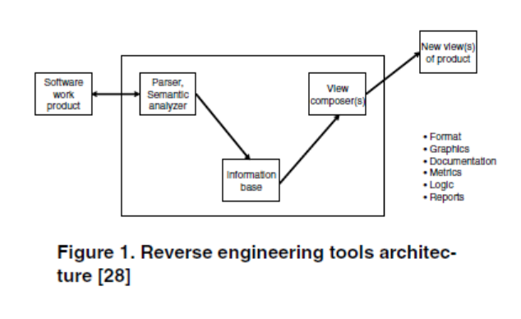
From Canfora & Di Penta’s paper…
What is the range of roles for reverse engineering tools?
Notes:
Paper was introduced at end of prior slide set.

Slide 9
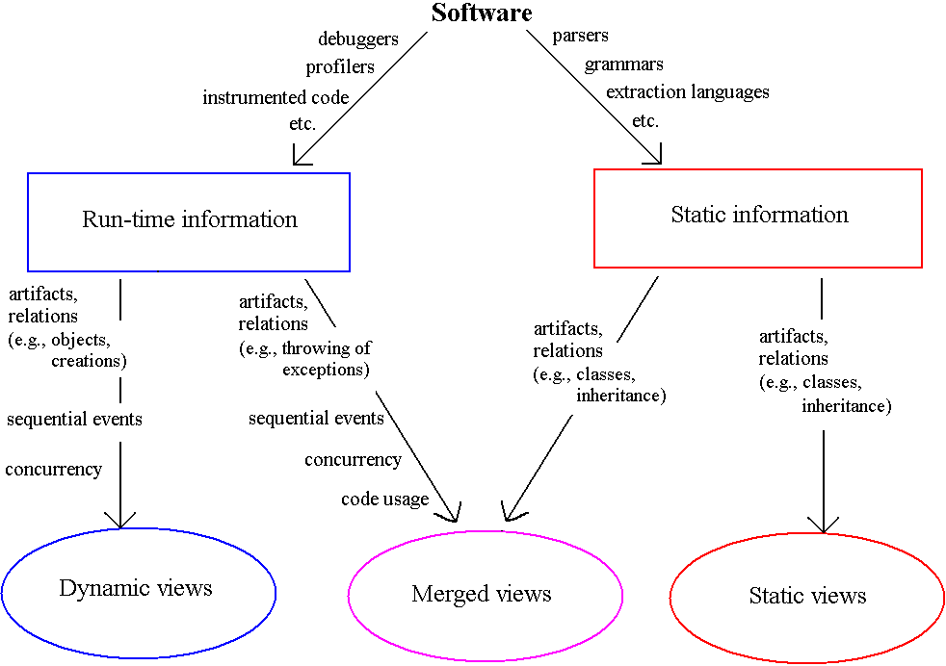
Extracting Info from Software
Notes:
Visualizing software artifacts and elements are critical to Program Understanding. What are examples of helpful dynamic views? [[events and sequencing]]

Slide 10
So, gaining “views” is a goal…
Like what you do during normal maintenance
Only more so
If you’re trying to redo a whole system, it’s impossible to keep all the relationships in your head!
  Or even, say, recovering “what a component does”
If you’re holding the source code –
  Automation of design recovery, etc., is wonderful!
  Over time, the documented design tends to become disconnected from the actual code.
  See the tools described next →

Slide 11
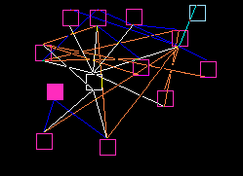
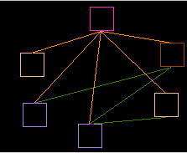
Visualizing Static Models
Examine static structure, architecture
  Relationships between software artifacts
Visualization:
  Class diagrams
  Hierarchical graphs
  Program Dependence Graphs (PDG)
Notes:
What are some static model visualizations that help with understanding a software code base?

Slide 12
The tool (or human) uses heurstics…
H-1 : A globally declared data structure, say DS-X, directly referred to by two or more procedural modules is considered a possible element of data representation for some program object X.
H-2 : Any procedural module that uses or modifies DS-X should be considered a candidate method for object X.
…
Notes:
From Stanislaw Jarzabek, Effective Software Maintenance and Evolution: A Reuse-Based Approach. Auerbach, 2007, ISBN 0-8493-3592-2.

Slide 13
And operations to apply them…
O-1 : Apply rule H-1 to find candidate data representations for objects.
O-2 : A domain expert examines candidates, selects one of the data representations, say, DS-X, and decides whether or not it forms a basis for a sound object. To help in making the decision, the domain expert views procedural modules that refer to DS-X (rule H-2).
O-3 : If the domain expert decides that DS-X is not a suitable data representation for some object, he or she repeats step O-2 trying other data.
…
Notes:
From Jarzabek’s book.

Slide 14
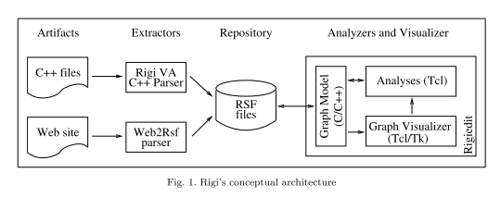
The Rigi reconstruction tool
A commonly used research tool:
Notes:
From “The Rigi Reverse Engineering Environnment,” by Holger M. Kienle and Hausi A. Muller, “rigi-wasdett2008-paper06.pdf” under Resources on the course web site.

Slide 15
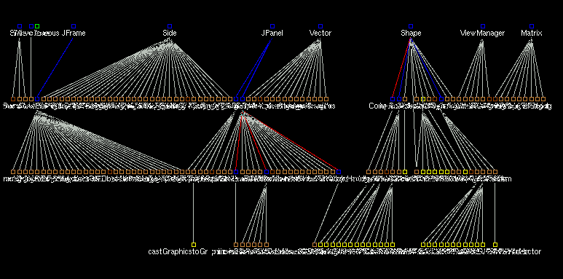
Reverse Engineering Tool: Rigi View 1
Notes:
All nodes except classes, methods, constructors and typecasts have been filtered out and a layout algorithm applied.

Slide 16
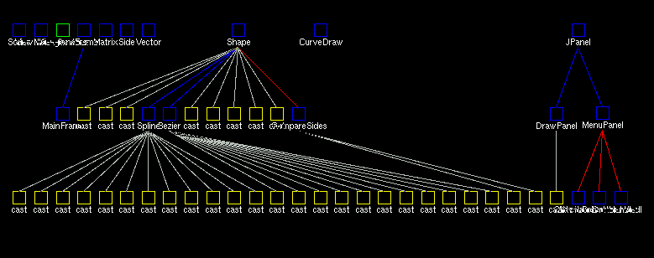
Rigi View 2: Show By Class
Notes:
Methods are collapsed into their classes
All the casts inside a class are attached to that class…

Slide 17
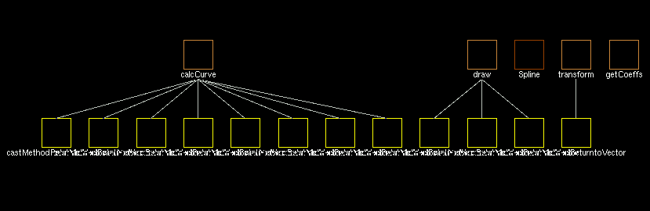
Rigi View 2: Show By Class (2)
Notes:
…but a class node can be opened to show the members inside with their cast nodes attached

Slide 18
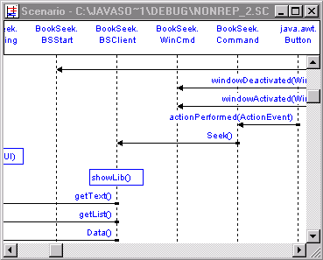
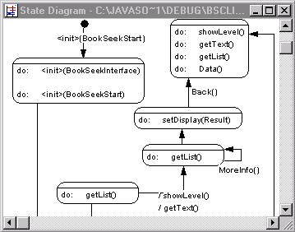
Visualizing Dynamic Models
Examine run-time behavior of software
  Debugger, profiler,
  source code instrumentation
Visualization:
  Scenarios
  (sequence diagrams, activity diagrams)
  State diagrams
  Animations
Notes:
What are some dynamic model visualizations that help with understanding a software code base?

Slide 19
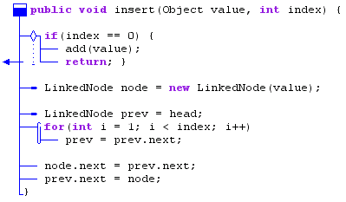
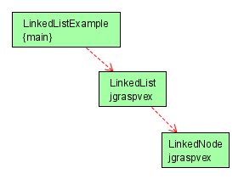
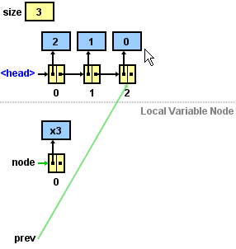
jGRASP http://www.jgrasp.org/
Control Structure Diagram
UML Class Diagram
Data Structure Diagram
Notes:
Visualizations are often built into the software environment – jGRASP is an IDE that exemplifies this.
See tutorial on jGrasp out under Resources.
It’s an open-source competitor of Eclipse, which also has plug-in tools for UML creation from code, etc.

Slide 20
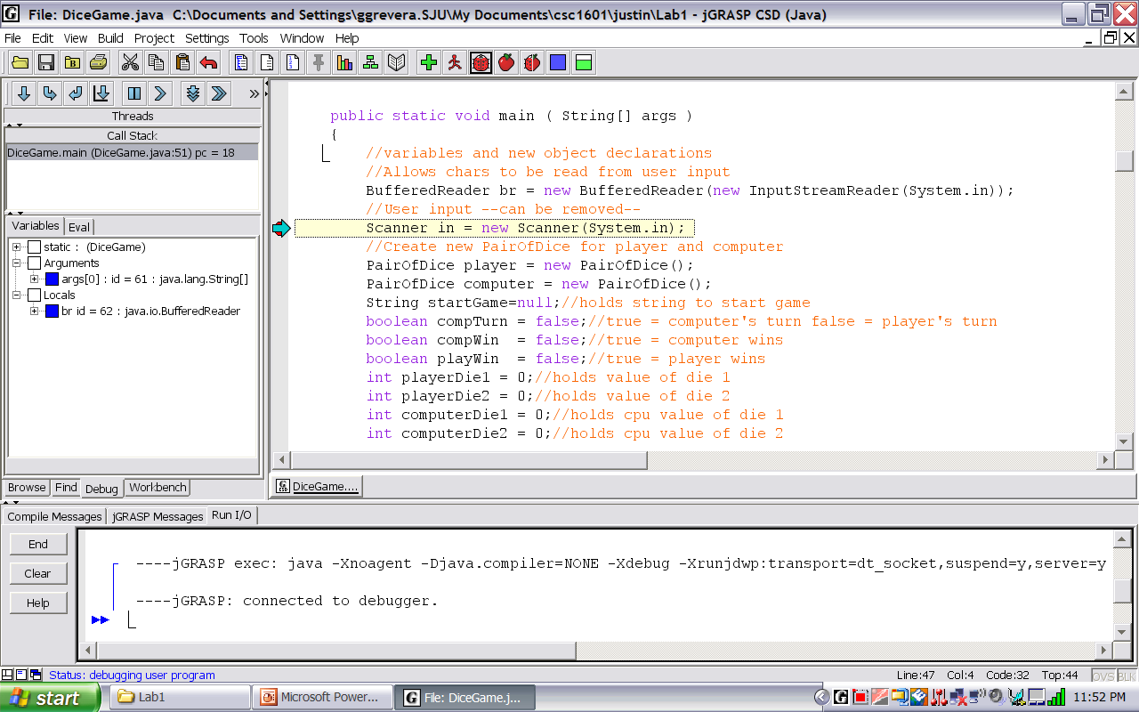
jGRASP Environment

Slide 21
Reverse Engineering:
“Reversing”
Idealism: “Why would anyone want anything besides machine code?”
John von Neumann, reacting to the first Fortran compiler
Realism: “If you think Reverse Engineering Design from Java is hard, abstracting up from binary is near impossible!”
Shawn Bohner

Slide 22
Software “Reversing”
Reversing is dissecting a program and examining its internals
Common applications of Reversing in the software industry to recover the source code of a program because:
  Source code/documentation was lost
  Need to find how the program does particular operations
  Need to improve the performance of a program
  Need to fix a “bug”
  Need to identify a security vulnerability / malware
Notes:
What are three applications of Reversing?

Slide 23
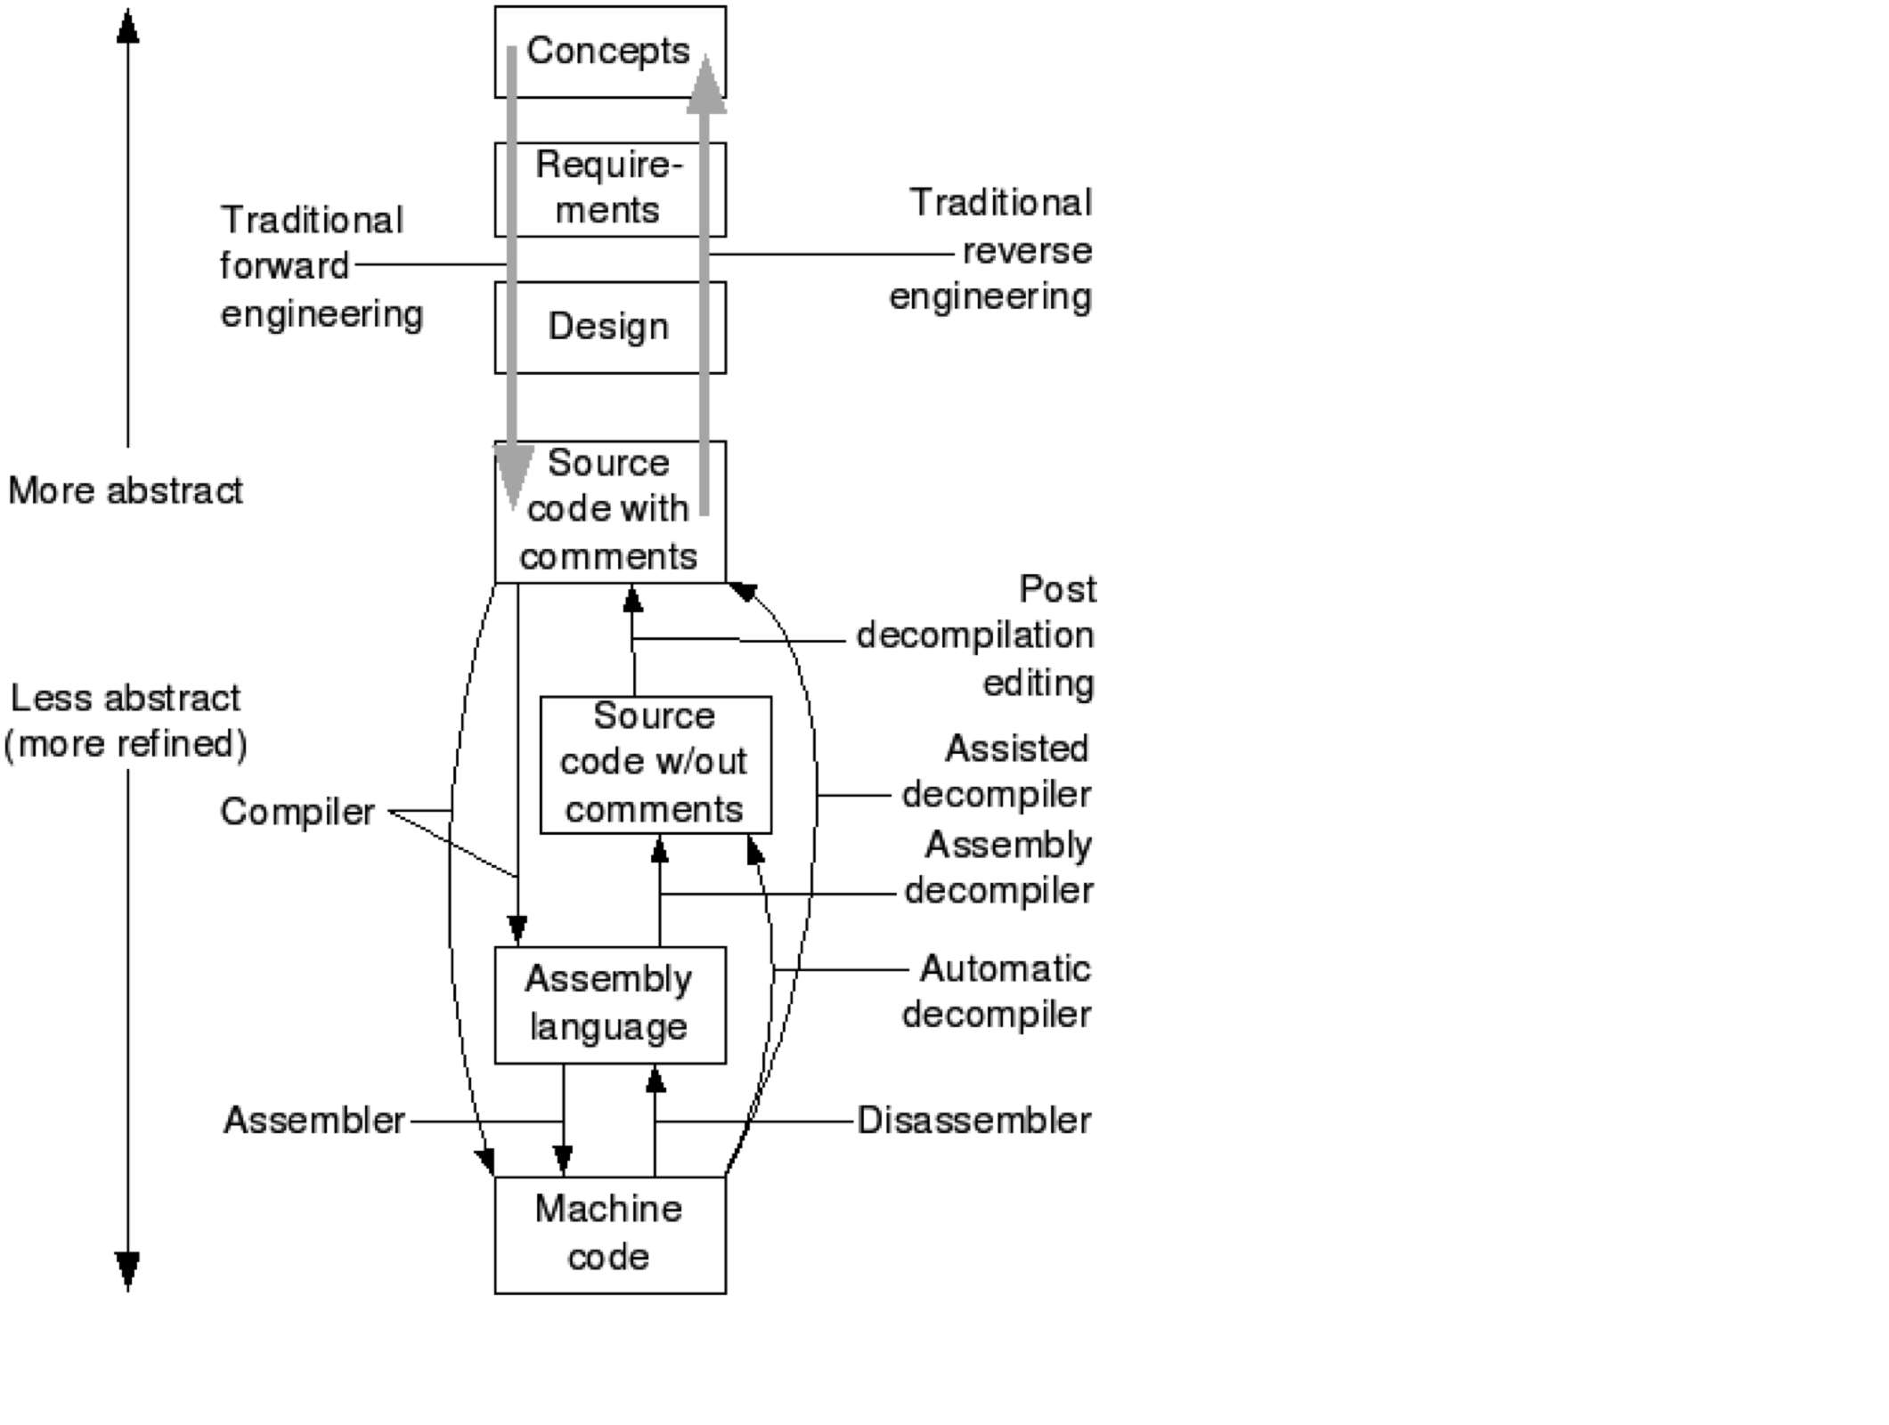
Model of Reversing
Hard, but doable if the
conditions are good.
Really hard, and traction
is mostly when small
segments or simple
situations are attempted.
Notes:
You really need to have good patterns at the lower levels to identify and extract.
Where do you get the best traction for reversing? [[In small simple situations… the larger more sophisticated situations can become untenable]]

Slide 24
Hex Editors
Hex editors read executing programs from RAM
Display their contents in hexadecimal code
Enable the editing of the running hexadecimal code
Hex Editors | RAM Editor | Data Recovery Tools | RAM Disassembler
WinHex | x | x
Tsearch | x |  | x

Slide 25
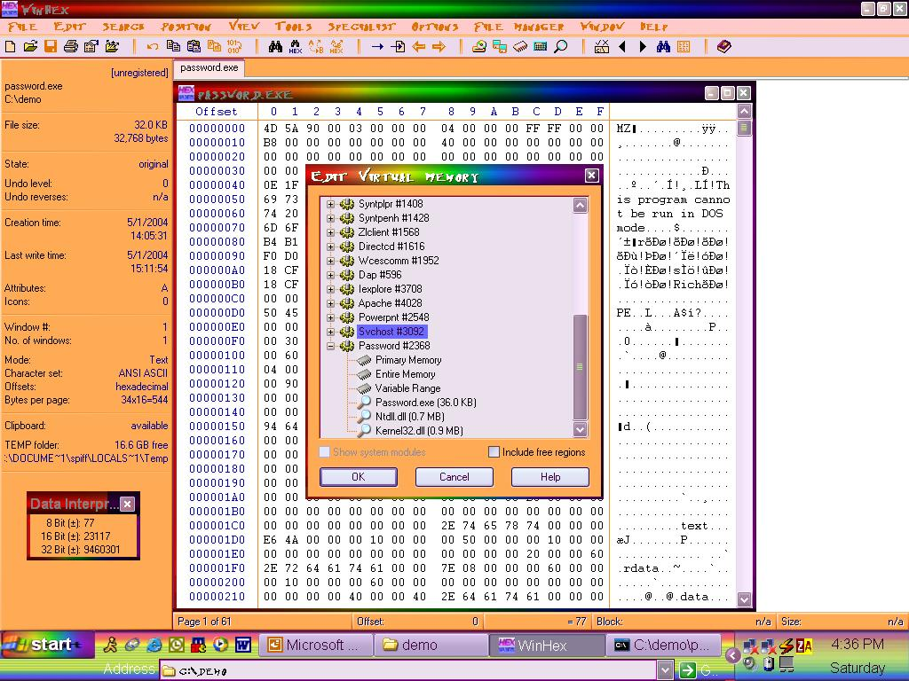
Hex Editors: WinHex

Slide 26
Decompilers
Decompile a binary programs into readable source code
Replace all binary code that could not be decompiled with assembly code
Executable
Decompiler
Source Code
Notes:
True or False: The results from the decompiler are readily readable for use in other programs.

Slide 27
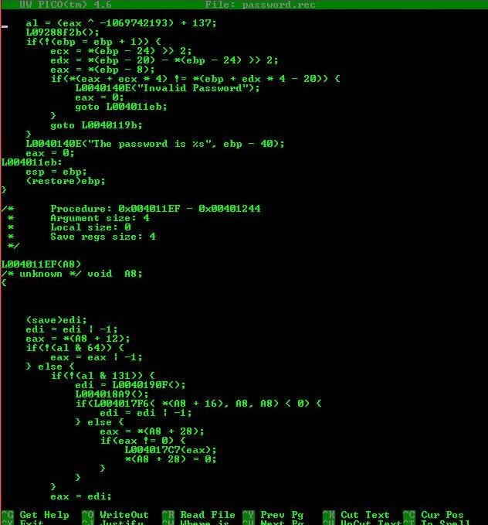
Decom-pilers: REC

Slide 28
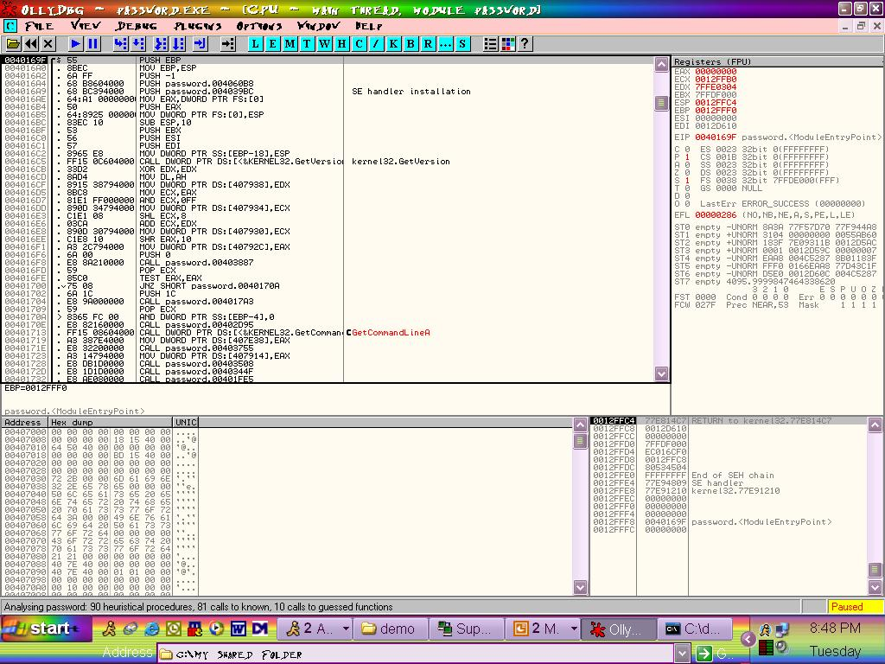
Disassemblers/Debuggers: OllyDbg
Notes:
OllyDbg is a 32-bit assembler level analyzing debugger for Microsoft Windows. See http://www.ollydbg.de/.

Slide 29
Legal Issues: Interoperability
Exposed software interfaces allows development of interoperable software that runs on the platform
Legal case: Sega vs. Accolade
  Ruled in favor of Accolade as they did not violate code copyright of Sega
Notes:
Exposed software interfaces allows development of interoperable software that runs on the platform
Advantage: increases sales penetration on platform
Disadvantage: if the competition offers a product on the same platform
Legal case: Sega vs. Accolade -- Ruled in favor of Accolade as they did not violate code copyright of Sega
Competition benefited market customers
Court essentially authorized reversing for the purpose of interoperability

Slide 30
Legal Issues: Competition
Opponents of software reversing claim that it stifles innovation
Illegal
  Quite provable: directly stealing code
  Hard to prove: decompiling programs and recompiling them to generate a different, but functionally equivalent binary
Legal
  Reversing small parts of a product to gather information, not code
  Then develop code independently
  Funny how scale and independence plays such a role…
Notes:
What is legal from the perspective of competition for doing Reversing?

Slide 31
Legal Issues: Copyright Law
Copyright violation: directly copy protected code sequences from the competitor’s product into you own product
Some have claimed that intermediate copies during RE decompilation violates copyright
If the final product does not contain anything that was directly copied from the original product, copying is considered fair use
Notes:
Some have claimed that intermediate copies during RE decompilation violates copyright
These claims have not held in court because intermediate copies are created when a program is installed from a CD onto a hard disk

Slide 32
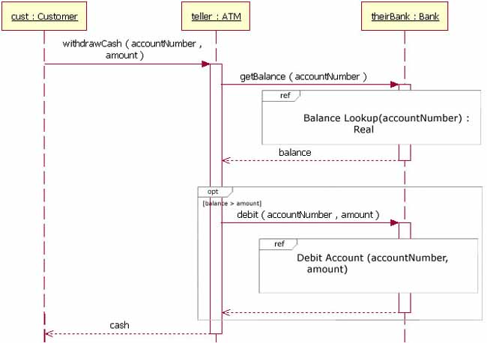
Reverse engineering tool paper
A tool for creating UML sequence diagrams.
Recall these look like this:
Notes:
Paper is “revEngToolp125-merdes.pdf” under Resources on course web site.

Slide 33

Paper, cntd
Goal was to analyze running Java programs.
  Reason – to get the “effective flow of control,” the flow of interactions, in a deployed system.
The authors developed a prototype.
Also created some theoretical foundations – possible ways to do it:
  Program instrumentation – source or byte code
  Runtime instrumentation – Java debug interface
  or AspectJ load time weaving
  Meta-model to use – EclipseUML2, etc.
  Visualize while running?
  SVG graphics
Matthias Merdes
Notes:
Author image from http://programmer.97things.oreilly.com/wiki/index.php/Matthias_Merdes.

Slide 34
Let’s look at the 2 case studies…
Both about reengineering
Both systems had become difficult to add new features
Both redone carefully to analyze the effort in the reengineering work
Notes:
These were optional reading – see schedule for links.

Slide 35
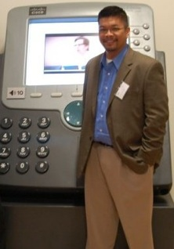
PackRat
PackRat (1998) – needed to redo a TI networking app in order to add more features:
  Customers wanted –
    User interface changes – ease of use
    Network packet decoding enhancements
    (TCP/IP)
  PackRat was used by systems people to
  debug network packets
  The reengineering work was constrained
  to 5 people and 15 weeks!
  System written in C, on Windows 95
Gerald C. Gannod, now at Miami University, Ohio
Notes:
Author picture from http://www.users.muohio.edu/gannodg/Site/Welcome.html

Slide 36
PackRat, cntd
Process used to reengineer the system:
  Design recovery
  Design modification
  Design implementation (modification)
  Concept and requirements stayed the same.
Ran into issues in design recovery:
  Representations often biased by implementations
  Don’t correspond to existing high-level models
  Tried to combine top-down (concept model) and bottom-up (call graph)

Slide 37
PackRat, cntd
They found areas where change was really needed –
  Event handlers with redundant behavior.
  Lots of global data.
The reengineering effort was then combined with rewriting the design to enable the new features needed.
  They had new requirements after all!
Focused on rewriting subsystems that needed to be changed for these.
  Did impact analysis in recovered design to identify these parts
  Had to use existing source code and OS

Slide 38
PackRat, cntd
Some systematic improvements:
  Naming conventions that gave maintainers a clue
  Abstracted procedures based on analysis of a “call graph”
  Made changes to enable future growth
    Knew likely areas where the protocols would change
  Put an object wrapper around the raw data buffer handling
  Used sub-classing to handle packet decoding systematically

Slide 39
PackRat, cntd
Lessons learned:
Systematic approach to reengineering worked
  Design recovery informed the rest, quickly
  It also made code implementation straightforward
Use of OO design methodology allowed them to transition this system toward OO
They completed the project ahead of schedule.

Slide 40

Presenter
Presenter (2002) – U Montana system for bio lab work – experimental designs constantly changing, system not able to handle that
  Very expensive to change
  Had errors – causing bad publications!
Originally written by neuroscientists
  Began with no design
  Poor documentation
  Lots of duplicate code
Michael Oudshoorn, now at University of Adelaide
Notes:
See http://www.lyee-project.soft.iwate-pu.ac.jp/somet_05/PresenSlides/sep28_M.Graham.pdf
Author picture from http://arnetminer.org/person/-/806660

Slide 41
Presenter, cntd
Tried to find key parts of the design
  Change what they had to
  Use tools to help – Rational Rose to create UML
Hired a student to do reengineering
  Initially didn’t know about patterns
  Used MVC
  Set up a class inheritance scheme
  Broke up old, complex classes

Slide 42
Presenter, cntd
Metrics – hard to measure if they simplified complexity
  Added new features at the same time
  25% of time spent understanding old system
    The old architect was available to consult
  COCOMO II estimated big savings over next 5 years
  63% less effort to develop new features
  Faster for new people to learn to be effective

