Slide 1
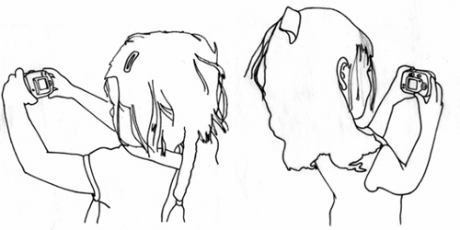
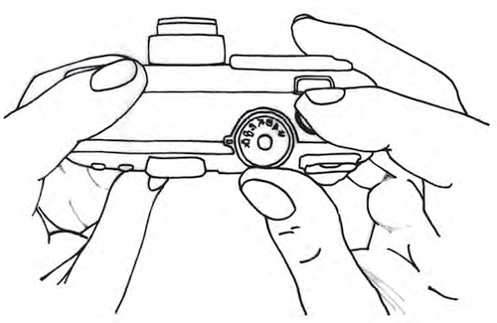

Software Maintenance and Evolution
CSSE 575: Session 4, Part 3
Software Documentation
Steve Chenoweth
Office Phone: (812) 877-8974
Cell: (937) 657-3885
Email: chenowet@rose-hulman.edu
Some user documentation doesn’t even have words! This one does, but the pictures help. It’s from http://www.hideousbeast.com/projects/mmf/mmm/.

Slide 2

Software Documentation
Software Requirements Specification
  Meanings vary in the industry
  IEEE 830 standard
Software Design Specification
  Also varies – consider Agile groups
  IEEE 1016
Other Key Deliverables
  User Documents
  Installation and
  Configuration Documents
  Maintenance Documents
  Source Code
  Project Documents
    Like project plans & test plans
Notes:
While software documentation requirements for delivery vary from organization to organization, these are a reasonable set.
For today, we focus on User Documents.

Slide 3
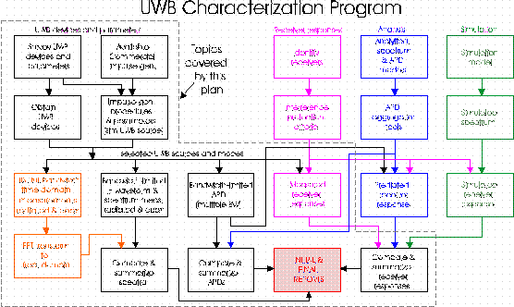
Project Documents
Let’s discuss two that many groups could improve on!
  In design – Use of use cases
  In testing – Test plans
  Deployment plan – What’s that?
Left - Ultra-Wideband Signals for Sensing and Communication: A Master Plan for Developing Measurement Methods, Characterizing the Signals and Estimating Their Effects on Existing Systems.
ITS Ultra-Wideband Measurement Plan. (Master Plan Task 1.2) From http://www.ntia.doc.gov/osmhome/uwbtestplan/testplan_final_pcr2.htm.

Slide 4
Use of Use Cases
Use cases should flow through your documentation, from requirements through testing.
If you’re XP, these could be “user stories”
enhanced for testing.
UC 1: Test case 1
UC 1: Test case 2
UC 1: Test case 3
UC 1: With design info added
UC 1: Test plan
UC 1: Requirements version
UC 1: Test case 4
Above – Proper use case growth – which becomes a maintenance issue all on its own! Suppose you change something on either end?

Slide 5
Test Plans: Components of a Test Plan
Test plan identifier
Introduction
Test items (what to test)
Features to be tested (see figure on previous slide)
Features not to be tested
Testing level (like Integration)
Approach (e.g., Test-first, extent of automation)
Item pass/fail criteria
Suspension criteria and resumption requirements
Test deliverables (like a check-off list of tests done)
Testing tasks
Environmental needs
Responsibilities
Staffing and training needs
Schedule
Risks and contingencies
Approvals (a big deal in industry)
Test results (After - with who tested what and when)
Notes:
You actually would have some differences in the plan, depending on what kind it was - like whether it was for in-house or acceptance testing by users at their site, and other such variables.

Slide 6
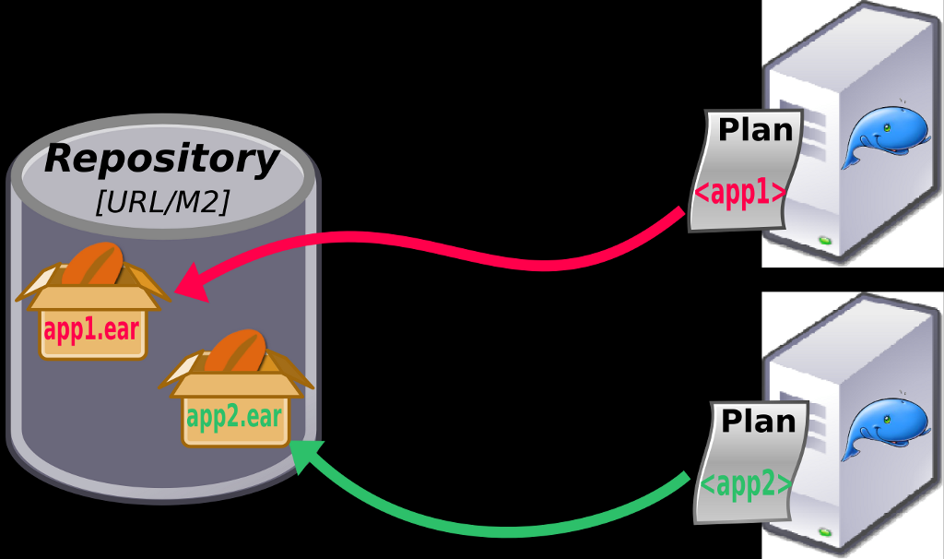
Deployment Plan – What’s that?
Includes a picture of how the software will run on the hardware.
  Ref Larman’s discussion from CSSE 574
  Lots of examples and templates on the web. E.g., DOT’s at http://www.fhwa.dot.gov/cadiv/segb/views/document/sections/section8/8_4_10.htm.
How will you get it from your lab machines at work, to up and running on the users’ machines? (Or into the cloud…)
  Overcoming any issues in getting
  it there
  You should now be expert at this
  Sometimes this is almost as hard
  as the original development!
    Different people may be responsible,
    so it tends to be ignored.
    Among other things, there is usually a
    “conversion” to consider.
Below – Deployment of the JOnAS system, from http://wiki.jonas.ow2.org/xwiki/bin/view/Doc/JOnAS+5_1_0.

Slide 7
User Documentation
Book Definition: User documentation refers to those documents containing descriptions of the functions of a system without reference to how these function are implemented
Shawn’s take - User Documentation is that “part of the system” developed to ensure that usability and understandability does not elude those who will develop, maintain, and use it
Notes:
It’s all those other details that if not present when needed, the user (and other stakeholders) will be disappointed in the system as they try to figure out how the system works.

Slide 8








User Documentation: Audience
Users (and customers :-)
Operators
Helpdesk
Technical support
Developers & Testers
Notes:
Software is a product and has customers – while organizations pay, customers (users) make decisions on the product!
So, are software maintainers an audience for user documentation? Why?
In writing the use documentation, who is the audience? [[users, operators/system admins, helpdesk, tech support]]

Slide 9
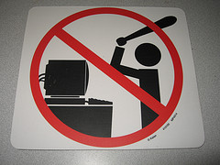
Why Spend Time on User Documentation?
Helps Prevent Customer Dissatisfaction!
Helps Developers
Understand System
Helps Technical
Support, Helpdesk,
(and Maintainers)
Helps System
Survive Evolve!
Notes:
Why do you suppose there exists “signs/cartoons” like the above?
Users cannot figure out something with the system and become frustrated.
After paying good money for the product and it does not meet their expectations, they want to express themselves
While maintainers are not the primary audience for user documentation, does it help them in their job? If yes, how? [[yes, UD provides the user’s view into how the software should work – either the system, specification, or the UD will need to change when an inconsistency is identified.]]

Slide 10
User Documentation
Constituent Document | Function
Installation Manual / Guide | System installation and set up, configuration and customization to hardware and other software systems
Beginner’s Guide / Tutorial | Simple explanations of how to get started using the system
Reference Guide | Provides in-depth description of each system facility and how it can be used
Maintenance Manual / Guide | Outlines the software change processes Refers to req’ts & design specifications Refers to test data and results Summary of new features for releases
Quick Reference Card | Serves as a lookup for key capabilities
System Administration Guide | Provides information on services such as networking, security, and upgrading
Notes:
What role does the maintenance manual / guide serve for the user? [[Provides insight into how to submit change requests, summarizes new features for each release (both current and pending)]]

Slide 11


Examples that always used to be Printed Documentation
Quick reference cards
Brief “getting started” notes
User tutorials
Reference manuals
Alphabetic command lists
What’s the electronic equivalent of each one?
And does it need to run on a smart phone?
Notes:
Smart phone image from http://blog.planprescriber.com/2013/06/04/mobile-apps-mhealth/.

Slide 12

Traditional Examples of Online Documentation
Online Help Facility
Online Tutorials
Demonstrations
Man(ual) Pages (Unix)
Notes:
What are the advantages of having online documentation? [[available with the system during operation, provides

Slide 13
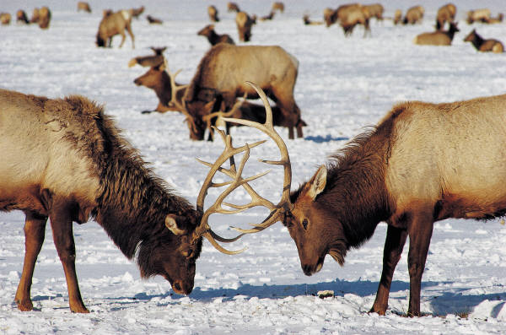
User Documentation Challenges
Merely presents
operator descriptions
Usability is not considered
  Organized according
  to system functions
  instead of key user goals
  Describes how the system works and not how it can be used
Information overload
  Too voluminous for novice users
Don’t do these to your users!

Slide 14
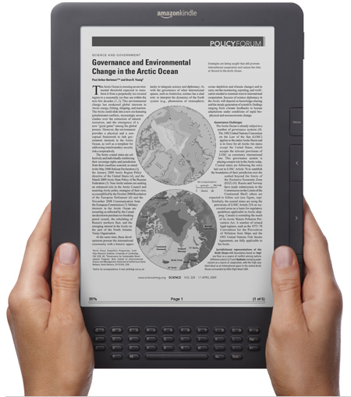
Reading Computer Display is still more Difficult than Paper (1 of 2)
Low contrast between
characters and backgrounds
Emitted light rather than reflected
Poor fonts
Smaller displays require frequent
page turning
Good enuf yet?
Notes:
Kindle DX image from http://www.amazon.com/Kindle-DX-Wireless-Reader-3G-Global/dp/B002GYWHSQ

Slide 15

Reading Computer Display is still more Difficult than Paper (2 of 2)
Reduced body motion make them
more fatiguing
Layout and formatting problems
Note: these are changing with
emerging technologies like
iPad, Kindle, eBook, etc.
Eh?
For lots more info, see your Interaction Design book from 571.

Slide 16
“Printed” Manuals: Suggested Guidelines
(1 of 2)
Let users task guide organization
Let user learning process shape sequencing
Present semantics before syntax
Keep writing style clean and simple
Show numerous examples

Slide 17
Printed Manual: Suggested Guidelines (2 of 2)
For more Involved Documents :
Offer meaningful and complete sample sessions
Provide table of contents, indices, and glossaries
Use advance organizers and summaries
Include list of error messages

Slide 18
Developing Printed Manuals
Prepare user manuals before implementation
Use professional writers and copy editors
  Depends on scale of project
Review drafts thoroughly
Field test early drafts
Provide feedback mechanism to readers
Revise to reflect changes regularly
Notes:
You must be kidding! How will I know how my software will turn out?!?
Nope… I’m not kidding; it’s a quality thing like test driven development

Slide 19

User Documentation Life Cycle
Develop specifications
Prototype
Draft, Edit,
Review,
repeat…
Field test
Publish
Perform post project
review
Maintain!
And my favorite question, “If something changes in the system, how do you know where to fix this document accordingly?

Slide 20
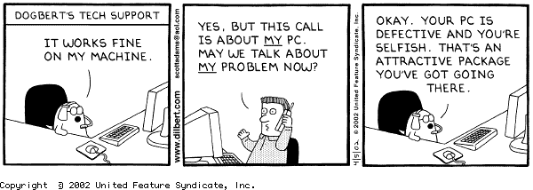
The Funny Side of User Interactions

Slide 21
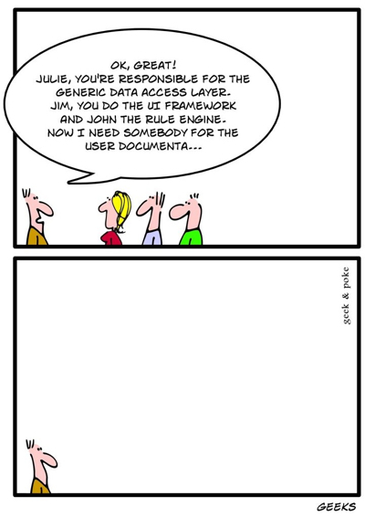
The Funny Side of Documentation
Notes:
From http://www.datamation.com/cnews/article.php/12035_3868851_2/Tech-Comics-Geeks-in-a-Bar.htm.

Slide 22
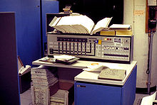
User Documentation – What to Do
Consider –
What is a complete set of user documents?
  Whatever that means in your project!
  For most projects – include admin documents
  Test these with the user, so you can fix them before the final delivery
Left – Operator’s guide for IBM 360 mainframe, in the computer room. That’s the Britannica-sized book on top of everything!

Slide 23
This page intentionally left blank.

Slide 24
Effective Documentation
(not just what’s said, but how it’s said)
Writing style
  Active voice
  Splitting text into manageable chunks
  Repeating complex explanations in different ways
Document standards
Quality assessment
Procedures to encourage concurrent updates
Good design methodologies
Documentation support tools

Slide 25

Discussion of Maintenance Documentation Survey
Survey of software industry professionals
Highlights preferences for and aversions against software documentation tools
Participants agree that documentation tools should seek to better extract knowledge from software artifacts
2 Observations
  Some large-scale software projects had an
  abundance of documentation
  small to medium-scale software projects
  had little to no software documentation
Timothy Lethbridge
in 2012
Notes:
This is the paper you read on software documentation, under Resources. Picture of author Timothy Lethbridge is from http://conferences.computer.org/cseet/2012/CSEET_2012/ASEET.html.

Slide 26
The Survey’s 50 Questions Addressed…
Participant’s personal preference for different types of documentation, and their effectiveness
Ability of a document’s attributes, as opposed to its content, to promote (or hinder) effective communication
State of software documentation in the participant’s organization
Comparison of past projects to current ones
Effectiveness of documentation tools and technologies

