Slide 1


Software Maintenance and Evolution
CSSE 575: Session 2, Part 1
Refactoring Principles
Steve Chenoweth
Office Phone: (812) 877-8974
Cell: (937) 657-3885
Email: chenowet@rose-hulman.edu
Above – Shu Ha Ri – A Japanese way of achieving excellence. From http://www.makigami.info/cms/japanese-learning-system-japan-36.
Notes:
A great question -- What is the “rhythm of refactoring” that Fowler refers to in this chapter or in simple terms the process of refactoring?

Slide 2
Defining Refactoring
Refactoring (noun): a change made to the internal structure of software to make it easier to understand and cheaper to modify without changing its observable behavior.
Refactor (verb): to restructure software by applying a series of refactorings without changing its observable behavior.

Slide 3
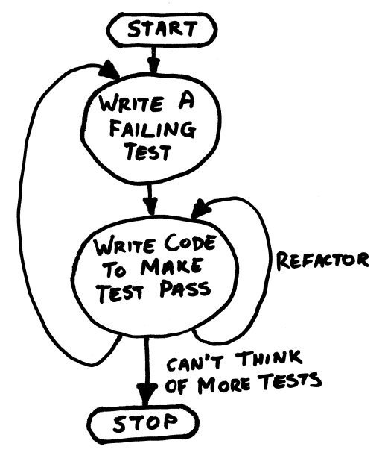
Again, it fits with “Test First”
Fowler describes this in Ch 4
We also describe “test first” in CSSE 576 (Software QA)
Alternate between adding features and refactoring, with “test first”
http://blog.donnfelker.com/category/tdd/page/5/
Notes:
Ok, y’all claim you can’t use Test First with your existing systems.
In your journals, blog about what it would take to move toward that!

Slide 4
Why Should you Refactor?
Refactoring improves the design of software
Refactoring makes software easier to understand
Refactoring helps you find bugs
Refactoring helps you program faster
Notes:
Refactoring improves the design of software
Without refactoring the design of the program will decay
Poorly designed code usually takes more code to do the same things, often because the code does the same thing in different places
Refactoring makes software easier to understand
In most software development environments, somebody else will eventually have to read your code

Slide 5
When Should you Refactor?
Refactor when you add function
Refactor when you need to fix a bug
Refactor as you do a code review
Notes:
Refactor when you add function
Helps you to understand the code you are modifying
Sometimes the existing design does not allow you to easily add the feature
Refactor when you need to fix a bug
If you get a bug report its a sign the code needs refactoring because the code was not clear enough for you to see the bug in the first place
Refactor as you do a code review
Code reviews help spread knowledge through the development team
Works best with small review groups
XP pair programming is active code review taken to its limit

Slide 6
Two Hats of Development & Refactoring
When you use refactoring to develop software, you divide your time between:
  Adding Function
  Refactoring
When adding function, should not refactor, and Vice Versa…
Notes:
You should NOT add functions while refactoring.

Slide 7
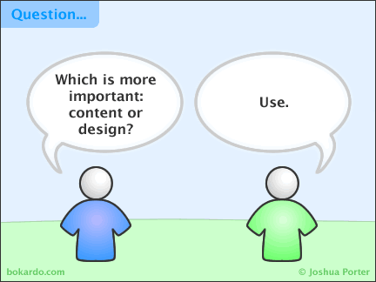
Refactoring and Design
Upfront or Top-Down Design
Agile advocates that you:
  Code first approach that
  comes into your head,
  Get it working,
  and then refactor it into shape
Refactoring changes role of upfront design
  Not looking for perfect design, but only a reasonable one
Refactoring can lead to simpler designs without sacrificing flexibility
http://bokardo.com/archives/comic-content-or-design/
Notes:
How does Refactoring change the role of up-front design?

Slide 8
Refactoring Helps You Program Faster
Sounds counter-intuitive
Yes, improves quality
  Better design, better readability, reduction in bugs, all improve quality
Good design is essential for rapid software development
  The whole point of doing design is to allow rapid development
Notes:
How does refactoring help you to program faster?

Slide 9
Go for “Extreme Normal Form”!
All the code is tested.
The code passes all the tests.
No one on the team can think of code in the system that they could remove or simplify without reducing the feature set.
You never have to go more than one place to change one thing.
Notes:
What is Extreme Normal Form?
You probably need to define this “locally” for your organization, but –
Keep in mind that you’ll be using more and more code from other organizations, as time goes on.

Slide 10

Uh oh - What do I tell my Manager?
Bug in the ointment … who pays for refactoring and where do I get time?
If the manager is technically savvy, introducing the subject may not be that hard
Stress the quality aspects if the
manager is genuinely quality
oriented
  Position refactoring as part of
  the review process
If the manager is schedule
driven, consider a "don't ask
don't tell" strategy
Your visit to the manager’s office:
“How does this add to productivity, Dave?
From http://www.gcegroup.com/en/management/.
Notes:
Is he smiling?

Slide 11
Nowadays…
Most managers of seasoned software development orgs know they’ll be there for the expense of Rel. 2.0, Rel. 3.0, etc.
Many also have a “Do it right the first time” attitude, so support having Rel. 1.0 clean.
But, you can get issues with startups, where getting something out faster is the only game going.

Slide 12
Refactoring Guidelines
Small enough to oversee the consequences
Reproducible to allow others to understand them
Generalized in a way that they are more a rule that can be applied to any structure
Written down to allow sharing and to keep a reference, with instructions how to apply them

Slide 13
There Are Problems with Refactoring
Databases – dictate certain styles
Changing interfaces
Design changes that are difficult to refactor
In non-OO systems, can only do so much
When shouldn't you refactor?
A clear sign that a rewrite is in order is when the code does not work
Notes:
Databases
Most business applications tightly coupled to the database schema
Need to isolate changes to either the database or object model by creating a layer between the models
Such a layer adds complexity but enhances flexibility
Changing interfaces
Don't publish interfaces prematurely -- modify your code ownership policies to smooth refactoring

Slide 14

Reminder - Bad Smells in Code
On session 1, part 03 slides:
Duplicated Code
Long Method
Large Class
Long Parameter List
Divergent Change
Shotgun Surgery
Feature Envy
Data Clumps
Primitive Obsession
Switch Statements
Lazy Class
On session 1, part 04 slides:
Parallel Inheritance Hierarchies
Speculative Generality
Temporary Field
Message Chains
Middle Man
Inappropriate Intimacy
Incomplete Library Class
Data Class
Refused Bequest
Alternative Classes w/ varied interfaces
Comments
Notes:
How you know which set of slides to look at…

