Slide 1
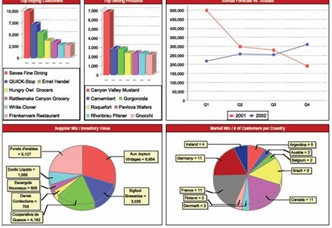

Software Maintenance and Evolution
CSSE 575: Session 2, Part 4
Organizing Data
Businesses also are concerned about organizing data so that what’s important stands out – These are examples of “dashboards” on analytical databases, for managers to use. From http://www.typesofeverything.com/types-of-databases-2/.
Steve Chenoweth
Office Phone: (812) 877-8974
Cell: (937) 657-3885
Email: chenowet@rose-hulman.edu
Notes:
Basic concept: The same data can look easier or harder to understand.

Slide 2

A Basic Rule of Refactoring
“Refactor the low hanging fruit”
  http://c2.com/cgi/wiki?RefactorLowHangingFruit
Low Hanging Fruit: “The thing that gets you most value for the least investment”
Notes:
Refactoring in review - don’t spend much time on it all at one time -
There are ways to improve any design incrementally
Why would you want to manage the amount of time spent on refactoring? [[there is a point of diminishing returns in doing refactoring – there is always ways to improve]]

Slide 3
Some good questions…
About “Do we refactor this, or not?”
“Do we expect to change this code soon?”
“Do people need to understand this code, to do something else right?”
“Can other people understand the code?”

Slide 4
Recall: Composing Methods
Some Bad Code Smells
  Long method
  Duplicated code
  Comments to explain hard-to-understand code
Representative Refactorings
  Extract Method
    Turn a code fragment into a method whose name explains the purpose of the method
  Introduce Explaining Variable
    Put the result of an expression in a temporary variable with a name that explains the purpose
  Remove Assignments to Parameters
    Use a temporary variable
Notes:
Review

Slide 5
Recall: Moving Features Between Objects
Some Bad Code Smells
  Data class
    Class with only get / set methods, and
    nothing else
  Feature envy
    Method more interested in other classes methods than in it own class’ methods
  Large class
Representative Refactorings
  Move Method/Field
    Move a method/field from one class to another
  Extract class
    Create a new class and move field & methods to the new class
  Inline class
    Move fields & methods to another class
Notes:
Review

Slide 6
Organizing Data
Refactorings that make working with data easier – Lots of them!
We’ll be selective…
Self Encapsulate Field
Replace Data Value with Object
Change Value to Reference
Change Reference to Value
Change Unidirectional Association to Bidirectional
Replace Magic Number with Symbolic Constant
Encapsulate Field
Replace Array with Object
Duplicate Observed Data
Change Bidirectional Association to Unidirectional
Encapsulate Collection
Replace Record with Data Class
Replace Type Code with Class
Replace Type Code with Subclasses
Replace Type Code with State/Strategy
Replace Subclass with Fields
We’ll do these!
You read about these!
Notes:
What does the “Organizing Data” refactoring category address in general? [[Refactorings that make working with data easier.]]
We may put any of these, from either column, on the exam.

Slide 7
Organizing Data
Some Bad Code Smells
  Explaining comments
  Public fields
  …
Representative Refactorings
  Replace magic number with symbolic constant
    Area = 3.14159265 * r * r; // bad
    Static final int PI = 3.14159265;
    Area = PI * r * r; // better
  Encapsulate field
    Public fields are bad
    Use private field & get / set methods
  …
Notes:
What are some bad code smells that are addressed by organizing data refactorings? [[Explain comments, reference to value and vice versa, public fields]]

Slide 8
Replace Magic Number with Symbolic Constant
Motivation
  Magic numbers are one of oldest ills in computing
  Nasty when you need to reference the same logical number in more than one place
    Change is a nightmare
    Difficult to understand in code
Most languages allow you to declare a constant
  No cost in performance
  Great improvement in readability
  So long as you know where to go
  to find them!
Replace Magic Number
Notes:
The worst part is that usage tends to be inconsistent – like Pi is 3.14 in one place, and 3.14159 in another. Or, the first day of the week is Sunday in one place, with the days numbered 0 through 6 for a table; but Monday is first somewhere else, and they are numbered 1 through 7! So they’re all the same number, except Sunday!

Slide 9
Replace Magic Number with Symbolic Constant
Situation: You have a literal number with a particular meaning
Solution: Create a constant, name it after the meaning, and replace the number with it
double potentialEnergy(double mass, double height) {
return mass * 9.81 * height;
}
double potentialEnergy(double mass, double height) {
return mass * GRAVITATIONAL_CONSTANT * height;
}
static final double GRAVITATIONAL_CONSTANT = 9.81;
Replace Magic Number
Notes:
For this refactoring a symbolic constant is used, which is the most common Java idiom.
However an alternative is the constant method, which is a method of this form
public static double gravitationalConstant() { return 9.81; }
What is the solution that “Replace Magic Number with Symbolic Constant” supplies?
By the way, it’s actually 9.80665, not 9.81.

Slide 10
Replace Magic Number … Mechanics
Declare a constant and set it to the value of the magic number
Find all occurrences of the magic number
See whether the magic number matches the usage of the constant
  If it does, change the magic number to use the constant
Compile
When all magic numbers are changed, compile and test
At this point all should work as if nothing has been changed
  A good test is to see whether you can change the constant easily
Replace Magic Number
Notes:
When would you NOT use the same value for a magic number that recurs in your program?

Slide 11
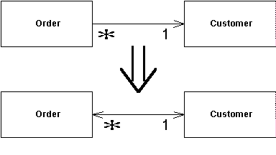
Change Unidirectional Association to Bidirectional
Situation: You have 2 classes that need to use each other's features, but there is only a one-way link
Solution: Add back pointers, and change modifiers to update both sets
Add this pointer to the original pointer
Change Uni to Bi
Notes:
Note that Change Bidirectional Association to Unidirectional (discussed later) reverses this process, when bidirectional isn’t needed.

Slide 12
Organize-Data - A Discussion
class Order...
Customer getCustomer() {
return _customer;
}
void setCustomer (Customer arg) {
_customer = arg;
}
Customer _customer;
}
class Customer {
??? → need a reference to each customer’s orders!
}
Note that customer Class has no reference to order
Change Unidirectional Association to Bidirectional
Change Uni to Bi
Notes:
Think – pair – share exercise…
What was your solution for changing a unidirectional association to a bidirectional?

Slide 13
Add Field to Customer for Uniqueness
class Customer {
private Set _orders = new HashSet();
}
class Order...
Customer getCustomer() {
return _customer;
}
void setCustomer (Customer arg) {
_customer = arg;
}
Customer _customer;
Uniqueness
Change Uni to Bi
Notes:
But which class then “takes charge” of managing the data, including the fact the classes are now linked?
→ See next slide.

Slide 14
Get “Order” to Take Charge
Signal Special Case
class Customer...
Set friendOrders() {
/** should only be used by Order when modifying the association */
return _orders;
}
This code then changes an order’s customer:
class Order...
void setCustomer (Customer arg) ...
if (_customer != null)
_customer.friendOrders().remove(this);
_customer = arg; // change to new customer
if (_customer != null)
_customer.friendOrders().add(this);
}
Update Modifier to update back pointer…
Change Uni to Bi
Notes:
Fowler’s rules (p. 198):
* If both objects are reference objects and the association is one to many, then the object that has the one reference is the controller. (That is, if one customer has many orders, the order controls the association.)
* If one object is a component of the other, the composite should control the association.
* If both objects are reference objects and the association is many to many, it doesn’t matter whether the order or the customer controls the association.

Slide 15
But what if an order has many cust?
class Order... //controlling methods
void addCustomer (Customer arg) {
arg.friendOrders().add(this);
_customers.add(arg);
}
void removeCustomer (Customer arg) {
arg.friendOrders().remove(this);
_customers.remove(arg);
}
class Customer...
void addOrder(Order arg) {
arg.addCustomer(this);
}
void removeOrder(Order arg) {
arg.removeCustomer(this);
}
Reference Customer
Reference Order
Change Uni to Bi
Notes:
Makes changing customers in the order one step messier! See p. 199

Slide 16
Self Encapsulate Field
Situation: You are accessing a field directly, but the coupling to the field is becoming awkward
Solution: Create getting and setting methods for the field and use only those to access the field
private int _low, _high;
boolean includes (int arg) {
return arg >= _low && arg <= _high;
}
private int _low, _high;
boolean includes (int arg) {
return arg >= getLow() && arg <= getHigh();
}
int getLow() {return _low;}
int getHigh() {return _high;}
Self-Encapsulate Field
Notes:
Two schools of thought and hotly debated…
access variables directly/freely within class – readability
Always use accessors (indirect access) – protection

Slide 17
Encapsulate Field
Situation: There is a public field.
Solution: Make it private and provide accessors.
public string _name;
private String _name;
public String getName() {return _name;}
public void setName(String arg) {_name = arg;}
Encapsulate Field
Notes:
One of the principal tenets of object orientation is encapsulation, or data hiding
Should never make your data public
When you make data public, other objects can change and access data values without the owning object's knowing about it
This separates data from behavior
Note that this is different from Self Encapsulate Field…
What is the difference between Encapsulate Field and Self Encapsulate Field?

Slide 18
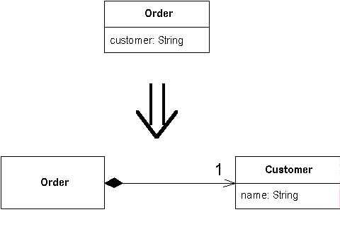
Replace Data Value with Object
Situation: You have a data item that needs additional data or behavior
Solution: Turn the data item into an object
Replace Data Value with Object
Notes:
What is the problem that “Replace Data Value with Object” addresses?

Slide 19
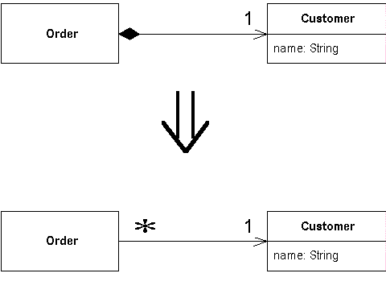
Change Value to Reference
Situation: You have a class with many equal instances that you want to replace with a single object
Solution: Turn the object into a reference object
Change Value to Reference
Change Value to Reference
Notes:
Note that Change Reference to Value reverses this process.

