Slide 1

Software Maintenance and Evolution
CSSE 575: Session 1, Part 1
Course Introduction
Steve Chenoweth
Office Phone: (812) 877-8974
Cell: (937) 657-3885
Email: chenowet@rose-hulman.edu
Notes:
Welcome To CSSE 575!

Slide 2
Agenda
What’s Happening With You?
Software – A Problem of Change
Course Outcomes
Guidelines and Expectations
Term Schedule
What’s Coming Up Soon?
Notes:
This class will be problem-based, with a lot of things to try – in your problem of choice…

Slide 3
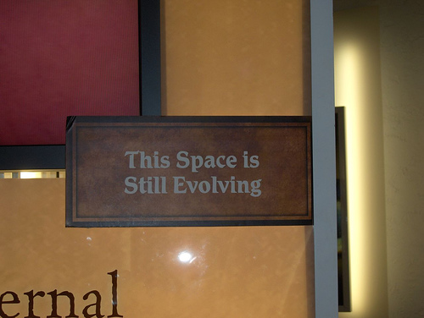
What’s happening with you?
What are you working on?
Where’s your project going?
What else interesting are you doing?
Your system maintenance experience
  Oldest system you have made changes to
  (either individually or with a team)
  Weirdest software change you’ve done
Candid shot from the Creation Museum, Hebron, KY
Notes:
Your own space is evolving… like most software!

Slide 4
Software – A problem of change
The source code and the software artifacts…
Software is part of a computer system that is intended to change
Intangible
Engineered,
not manufactured
Complex
Software is supposed to change…
otherwise it would be in the hardware!
Notes:
We typically say the code or the composite of the software artifacts… but this is a narrow mindset.
For maintenance and evolution we need something more… something that reflect change!
Need a systematic engineering discipline to “ensure maintenance doesn’t eat your software”
What are some aspects about software that make it hard to change? [[intangibility, Engineering it, complexity]]

Slide 5
Software Doesn’t Wear Out
Software doesn’t change with age
or “wear out” with use!
Software “ages” or
becomes “obsolete”
with a changing
environment
Software deteriorates or
“degrades” with
continued changes
Notes:
Why does software become obsolete (name two reasons)?
[[New requirements are introduced… Competitors introduce new features… new technology]]

Slide 6
Problem: Software Degradation
The Original Software Design...
Easy to Understand
Components well isolated to facilitate change
Isolation supports change validation
...Plus a few “Changes”
Increased size and complexity
...but it works (for awhile)
Reliability of system degrades, errors creep in
At some point, it’s unmaintainable ...effort to make the next change becomes prohibitive
Notes:
What causes the software to deteriorate and degrade? Continuous changes

Slide 7
Information Lose Due to Relentless Change
Change
Set 1
Change
Set 2
Baseline
Change
Set N
Code
Design
Spec’s
Notes:
What two things are lost as changes are made to the software system? Structure and people…

Slide 8
Learning Outcomes
By testing on a project, verify best practices of maintenance and evolution
Use sophisticated refactoring techniques to resolve design problems in code.
Apply heuristics selectively and pragmatically to enhance and modernize existing code.
Use ancillary tasks such as user documentation to extend system lifetime.
Describe and apply the theory of system evolution.
Use impact analysis, statistical analysis, and software source analysis to strategize software change.
Perform software modernization approaches such as reverse engineering, reengineering, salvaging, and restructuring.
→

Slide 9

Learning Outcome: Try best practices
By testing on a project, verify best practices of maintenance and evolution
  Try everything possible
  on your project!
  Document that in
  a journal
http://www.jmorganmarketing.com/social-media-best-practices/

Slide 10
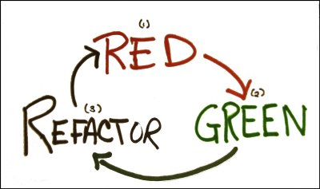
Learning Outcome: Refactor well
Use sophisticated refactoring techniques to resolve design problems in code.
  What are the issues
  when you move a
  method to another
  class? …
http://agileinaflash.blogspot.com/2009/02/red-green-refactor.html

Slide 11
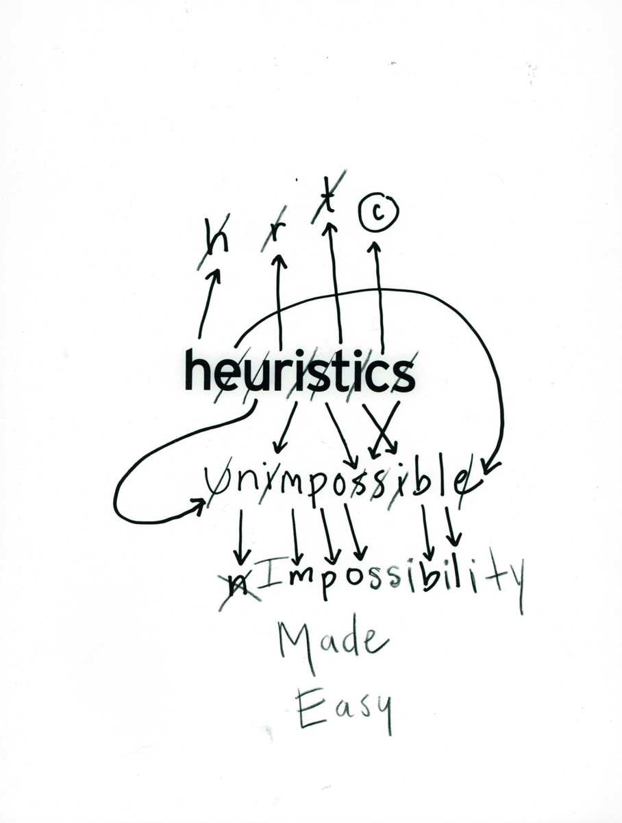
Learning Outcomes: Use heuristics
Apply heuristics selectively and pragmatically to enhance and modernize existing code.
“This thing isn’t object-oriented.
Where do I start?”
“How do I add a feature?”
“I can’t test this method!”
http://www.welcometolace.org/publications/view/heuristics-impossibility-made-easy/

Slide 12

Learning Outcomes: Around the code
4. Use ancillary tasks such as user documentation to extend system lifetime.
  What documentation
  changes support
  system longevity?

Slide 13

Learning Outcomes: Know the theory
5. Describe and apply the theory of system evolution.
  How do “E Systems”
  really progress?
http://www.reclusland.com/compass/2009/01/16/big-brothers-big-sisters/

Slide 14

Learning Outcomes: Judge impact
6. Strategize software change using:
Impact analysis,
statistical analysis, and
software source analysis
http://www.vorchester.com/vnews/?m=200806

Slide 15
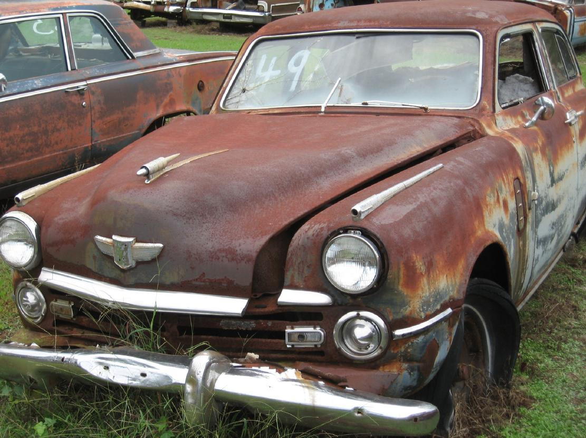
Learning Outcomes: Salvage
7. Perform software modernization approaches such as:
reverse engineering,
reengineering,
salvaging, and
restructuring.
http://www.bobbittville.com/VintageAutoSalvage-AR.htm

Slide 16
Course Mechanics
Project-based course – On your project of choice
  Your journal will be the main mechanism to record your activities
Find most material:
  http://www.rose-hulman.edu/class/csse/csse575/
Grades and drop boxes will be on Angel
Check email for special course updates
Demanding Course ALERT: 9+ hours/week outside of class
Read the assigned material before class

Slide 17
Grading and Evaluation
Examinations (2) 30%
Project Deliverables – Journals and
working samples 50%
Project Mtgs., Class Participation,
Final Presentation 20%
Grade Scale
The usual point scale will apply.
Late Work
Please let me know ahead of time of any special situations!
Notes:
Not the same as in CSSE 574.

Slide 18
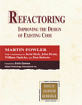
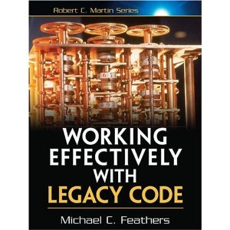
Course Textbooks and Readings
Stuff you should
be facile with
Refactoring: Improving the Design of Existing Code, by Martin Fowler
Publisher: Addison-Wesley Professional; 1 edition (July 8, 1999)
Second Book – Still to Pick! Proposed:
Working Effectively with Legacy Code, by Michael C. Feathers
Readings will also be assigned from two other good textbooks and from relevant papers.
More complex
Code maint ideas
Notes:
We’ll find a good Maintenance book…

Slide 19
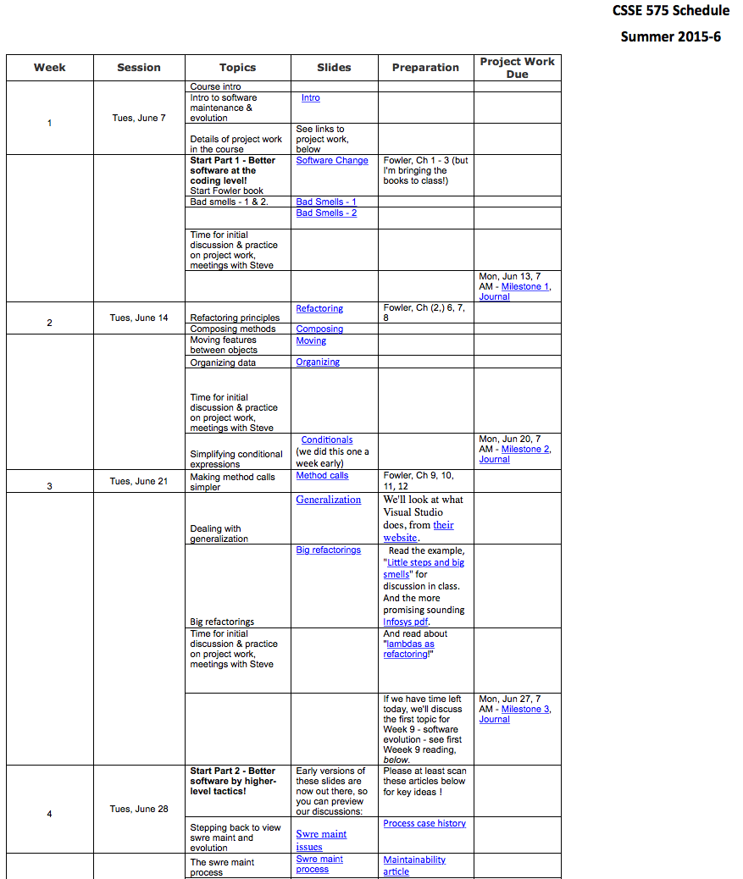
Tentative Summer Quarter Timeline
Refactoring is just the first 3 weeks!
And we’ll get into the special value of this process, for maintenance, right away…
→
Notes:
Open Schedule to see more…
Abbreviations: Type acronyms/abbreviations here
Research Reference: Type Delta/research references here

Slide 20
What’s coming up soon?
Journal – Applying what we discuss in class, to your system:
  Describe changes you make to your code
    Include a couple coding examples demonstrating you know how to apply key methods
  Describe related changes to design and testing
  Describe changes made to related documents (e.g., design changes – refactoring often causes these)
  Date entries, turn in cumulative journal each time
  Turn in weekly before class, in Angel drop box
  Maybe 2 -3 pages / week of description + coding examples
In class – Each week, describe in class how you applied / tried to apply the topics from the prior week (to me, or preferably in class, as appropriate)

