Slide 1


Software Maintenance and Evolution
CSSE 575: Session 1, Part 3
Bad Smells in Code - 1
Steve Chenoweth
Office Phone: (812) 877-8974
Cell: (937) 657-3885
Email: chenowet@rose-hulman.edu
http://hidefdetail.com/blog1/?page_id=117
Notes:
The trick is to find the places that really need refactoring.

Slide 2

Observations on Bad Code Smells
Done with an object-oriented design
  If design is procedural, you have to look for analogous problems, like things that don’t belong together…
  As we go through this material, if your system isn’t OO, try to picture those analogies.
A characteristic of a design that is a strong indicator it has poor structure, and should be refactored
Code smells are rules of thumb
  Not always straightforward that a bad smell must lead to a refactoring – must use judgment

Slide 3
Refactoring Related to Bad Smells
Fowler’s book has –
22 Bad Smells
  Situations to look out for
  “anti-patterns”
72 Refactorings
  What to do when you find them
  Often have design implications
Notes:
Remember that Bad Smells – smell like money – money saved and money earned…
Some of the refactorings will not make sense yet – to be covered later.
You should know: What is the relationship between bad smells and refactoring?

Slide 4
Refactoring Indicators: Bad Smells in Code
Duplicated Code
Long Method
Large Class
Long Parameter List
Divergent Change
Shotgun Surgery
Feature Envy
Data Clumps
Primitive Obsession
Switch Statements
Lazy Class
Parallel Interface Hierarchies
Speculative Generality
Temporary Field
Message Chains
Middle Man
Inappropriate Intimacy
Incomplete Library Class
Data Class
Refused Bequest
Alternative Classes w/ varied interfaces
Comments
Notes:
Talk to the left column today…

Slide 5
How do you know these are “wrong”?
For maintenance –
They make it harder to read the code, “cold.”
Almost any logic makes sense when you are writing it, in the heat of that focused effort.
Rereading it, 5 years later, as a part of a change done, on a limited budget, is a whole different scenario.
“Consistency” is a good smell, in general.

Slide 6
What else is a “good smell”?
Following coding standards, whatever your group uses.
Making code that has “low coupling” –
  It only has to be changed in one place, for a fix or enhancement.
  It’s clear what the effects of a change are.
The code does not get progressively more disorganized over time.
  That’s “entropy”!
  Requires refactoring to maintain the simplicity.

Slide 7
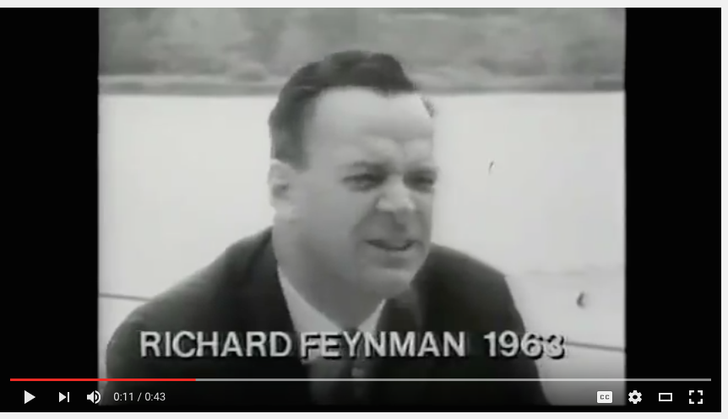
What we’re trying to avoid…
I think this short video tells it all!
Go to https://www.youtube.com/watch?v=lytxafTXg6c.

Slide 8
Doing the math…
Suppose half of the cost of every system is maintenance.
And half the cost of maintenance is “figuring out what to do,” versus doing it.
And, by having highly readable code, we could cut that time in half.
And maintaining the readable state cost us almost nothing, because of the accompanying construction benefits.
Then we’ve saved 1/8th of our development cost.
But, it’s actually more, because it progresses over time.
  Lower “entropy.”
Back to those “bad smells” --

Slide 9
Duplicated Code
#1 Bad Smell – happens all the time…
Situation 1: Same expression in two methods in same class
Solution 1: Make it a private ancillary routine and parameterize it
  Use Extract Method
Situation 2: Same code in two related classes
Solution 2: Push commonalities into closest mutual ancestor and parameterize
  Use Form Template Method for variation in subtasks
Notes:
When the code is in two places, what is the solution to the duplicated code situation?
Non-OO: Here’s a really good example of a bad smell that’s the same in non-OO code, if you translate “methods” to “functions,” etc.

Slide 10
Duplicated Code (continued)
Situation 3: Same code in two unrelated classes
Solution(s) for 3:
  Should classes be related?
    Introduce abstract parent (Extract Class)
  Does code really belong to just one class?
    Make the other class into a client (Extract Method)
  Can commonalities be separated out into subpart or another function object?
    Make the method into a sub-object of both classes
    Use Strategy for polymorphic variation
    (Replace method with method object)
Notes:
Non-OO: Another good example of a bad smell that’s the same in non-OO code. Translate “classes” to “subroutines” maybe?

Slide 11
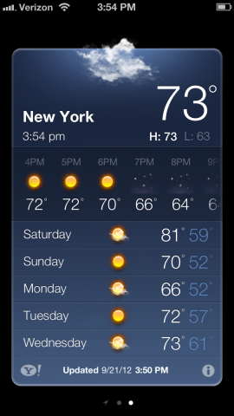
Why is Duplicated Code # 1?
People do it almost by instinct, when they add something new that’s very similar.
  The new weather app also reports on humidity.
  But some people will like the old app.
  So duplicate the code that displays on their phone, but add a spot for humidity to show.
  But keep the old code, too, for those users.
And, it’s awful!
  Now, every change to anything else on the display has to be done twice!
→ Humidity goes here
Notes:
Image from http://www.idownloadblog.com/2012/09/21/the-iphone-5-weather-app-world-clock/

Slide 12
Long Method
Situation: Long Method in Class
  Trying to do too many things
  Poorly thought out abstractions and boundaries
  Micromanagement anti-pattern
Solution: Think carefully about major tasks and how they inter-relate. Aggressively:
  Break up into smaller private methods within the class using Extract Method
  Delegate subtasks to subobjects that “know best” using Extract Class/Method
    Replace data value with object
Notes:
What is the problem/situation that Long Method is trying to address (more than a long method in class)?
Fowler’s heuristic: When you need to make a comment, make a method instead.
Often, a comment indicates:
The next major step
Something non-obvious whose details detract from the clarity of the routine as a whole.
In either case, this is a good spot to “break it up”.
Non-OO: Also applies here, for a long procedure!

Slide 13
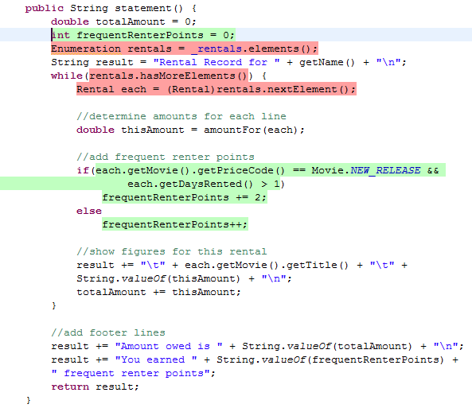
Long Method in Java -- Example
The code is just written in the order the programmer thought of adding the functionality.
Notes:
Example from http://users.encs.concordia.ca/~nikolaos/jdeodorant/index.php?option=com_content&view=article&id=71

Slide 14
Large Class
Situation: Large Classes with too many subparts and methods
Two Step Solution:
  Gather up the little pieces into aggregate subparts
  (Extract class, replace data value with object)
  Delegate methods to the new subparts
  (Extract method)
May have some unnecessary subparts
  Resist the urge to micromanage them!
  Counter example: Library classes
Notes:
What is the two step solution to Large Classes?
Library classes often have large, fat interfaces (many methods, many parameters, lots of overloading)
If the many methods exist for the purpose of flexibility, that’s OK in a library class.
Non-OO: Ditto last slide.

Slide 15
Long Parameter List
Situation: Long parameter list in methods, making them hard to understand
  Trying to do too much
  Too far from home
  Too many disparate subparts
Solution(s):
  Trying to do too much?
    Break up into subtasks (Replace Param w/Method)
  Too far from home?
    Localize passing of parameters (Preserve Whole Object, Introduce Parameter Object)
  Too many disparate subparts?
    Gather up parameters into aggregate sub-parts (Ditto -- Preserve and Introduce object)
Notes:
What is the problem/situation that Long Parameter List is trying to address (more than a long parameters list in methods)?
Structured programming taught the use of parameterization as a cure for global variables.
With modules/OOP, objects have mini-islands of state that can be reasonably treated as “global” to the methods (yet are still hidden from the rest of the program).
i.e., You don’t need to pass a subpart of yourself as a parameter to one of your own methods.
Non-OO: The long parameter list problem happens on function calls, too!

Slide 16
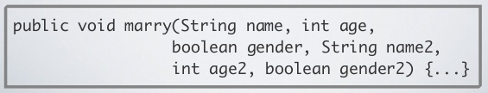
Example
What would a better approach involve?
Notes:
Example from http://www.slideshare.net/valeriomaggio/refactoring-improve-the-design-of-existing-code

Slide 17
Divergent Change
Situation: Class is commonly changed in different ways for different reasons
  Class trying to do too much and contains too many unrelated subparts
  Over time, some classes develop a “God complex”
  Sign of poor cohesion
Solution:
  Break it up, reshuffle, reconsider relationships and responsibilities (Extract Class)
Notes:
God Complex: Acquires subparts that rightly belong elsewhere.
Non-OO: We get this one, for sure!

Slide 18

Shotgun Surgery
Situation: Each time you want to make a single, seemingly coherent change, you have to change lots of classes in little ways
  Opposite of divergent change …
  But also a sign of poor cohesion
Solution:
  Look to do some gathering, either in a new or existing class (Move method/field)
Notes:
God Complex: Acquires subparts that rightly belong elsewhere.
Non-OO: From here, I’ll let you do the translations. I’ll admit some are harder than the ones we began with.

Slide 19
Feature Envy
Situation: A method seems more interested in another class than the one it’s defined in
  e.g., Method A::m() calls lots of get/set methods
  of Class B
Solution:
  Move A::m() (or part of it) into Class B!
  (Move Method/Field, Extract Method)
  Exception: Visitor/iterator/strategy design pattern where the whole point is to decouple the data from the algorithm
Notes:
Feature envy is more of an issue when both A and B have interesting data
What is the exception to dealing with Feature Envy?

Slide 20
Data Clumps
    void Scene::setTitle (string titleText, int titleX, int titleY,
    Colour titleColor){…}
    void Scene::getTitle (string& titleText, int& titleX, int& titleY,
    Colour& titleColor){…}
Situation: You see a set of variables that seem to “hang out” together
  e.g., passed as parameters, changed/accessed at the same time
Solution(s):
  Find clumps that appear as fields and turn them into objects (Extract Class)
  Slim down method signatures (Intro. Param. Object or Preserve Whole Object)
Notes:
Usually, this means that there’s a coherent subobject just waiting to be recognized and encapsulated
In the example, a Title class is dying to be born. If a client knows how to change a title’s x, y, text, and color, then it knows enough to be able to “roll its own” Title objects.
However, this means that the client now has to talk to another class.
This will greatly shorten and simplify your parameter lists (which aids understanding) and makes your class conceptually simpler too.
Moving the data may create feature envy initially -- May have to iterate on the design until it feels right

Slide 21
Primitive Obsession
Situation: All object subparts are instances of primitive types (int, string, bool, …)
  e.g., dates, currency, tel.#, ISBN, special string values
Solution:
  Create some “small classes” that can validate and enforce the constraints
  (Replace Data Value with Object, Extract Class, Introduce Parameter Object)
Notes:
What is the solution for addressing the Primitive Obsession bad smell?
Often, these small objects have interesting and non-trivial constraints that can be modeled
e.g., fixed number of digits/chars, check digits, special values

Slide 22
Switch Statements
Situation: Switch statements indicate misused polymorphism and encapsulation, and results in duplicates of switch statements across code
Solution:
  Eliminate switches with redesigns using polymorphic methods
  (Replace conditional with polymorphism, replace type code with subclasses)
Notes:
Chapt. 1 has an example with switch that became a strategy/state pattern.
What’s the equivalent fix if you have a non-OO system?

Slide 23
Lazy Class
  Situation: Classes that don’t do much that’s different from other classes (distinct lack of diversity)
  Lazy classes are often results of ambitious design or refactoring that gutted a class of useful behavior
Solution:
  When several sibling classes don’t exhibit polymorphic behavioral differences, consider just collapsing them back into the parent and add some parameters
  (Collapse Hierarchy, Inline Class)
Notes:
Why is this a problem?

Slide 24
How to use these “smells”
As you’re working on your system, you find a section of code that looks –
  Unnecessarily messy, or
  Coupled too much to something else, or
  Otherwise hard to work with or extend.
  Then you try to sniff out the “smell” it has.
“Wholesale refactoring” –
  You look through a system for bad smells to fix.
  Try going through yours, one smell at a time!
Where to start today!
Notes:
Why start by going through them one at a time? -- A good way to learn more about that particular smell.

Slide 25
Bad smell examples - 1
Consider the following code snippet for calculating the average of an array of integers:
extern int array1[];
extern int array2[];
int sum1 = 0;
int sum2 = 0;
int average1 = 0;
int average2 = 0;
for (int i = 0; i < 4; i++) {
sum1 += array1[i];
}
average1 = sum1/4;
for (int i = 0; i < 4; i++) {
sum2 += array2[i];
}
average2 = sum2/4;
Notes:
From http://en.wikipedia.org/wiki/Duplicate_code#Example_of_functionally_duplicate_code.

Slide 26
Bad smell examples – 1, cntd
The two loops can be rewritten as the single function:
  int calcAverage (int* Array_of_4) {
  int sum = 0;
  for (int i = 0; i < 4; i++) {
  sum += Array_of_4[i];
  }
  return sum/4;
  }

Slide 27
Bad smell examples – 1, cntd
Using the above function will give source code that has no loop duplication:
extern int array1[];
extern int array2[];
int average1 = calcAverage(array1);
int average2 = calcAverage(array2);

Slide 28
Bad smell examples – 2
Unix “cp” command? Parameters include:
-a, --archive same as -dpR --backup[=CONTROL] make a backup of each existing destination file
-b like --backup but does not accept an argument
-d, --no-dereference never follow symbolic links
-f, --force if an existing destination file cannot be opened, remove it and try again
-i, --interactive prompt before overwrite
-H follow command-line symbolic links
-l, --link link files instead of copying
-L, --dereference always follow symbolic links
-p, --preserve preserve file attributes if possible --parents append source path to DIRECTORY
-P same as `--parents' for now; soon to change to `--no-dereference' to conform to POSIX
-r copy recursively, non-directories as files WARNING: use
-R instead when you might copy special files like FIFOs or /dev/zero --remove-destination remove each existing destination file before attempting to open it (contrast with --force) --sparse=WHEN control creation of sparse files -R, --recursive copy directories recursively --strip-trailing-slashes remove any trailing slashes from each SOURCE argument
-s, --symbolic-link make symbolic links instead of copying
-S, --suffix=SUFFIX override the usual backup suffix --target-directory=DIRECTORY move all SOURCE arguments into DIRECTORY
-u, --update copy only when the SOURCE file is newer than the destination file or when the destination file is missing
-v, --verbose explain what is being done
-x, --one-file-system stay on this file system --help display this help and exit --version output version information and exit
Notes:
From http://c2.com/cgi/wiki?LongParameterList

Slide 29
Bad smell examples - 3
Switch and if statements: How do these differ?
select on x {
case 'A' {
foo
}
case 'B' {
bar
}
} // end case
if something1 {
foo
}
if something2
{
bar
}
Notes:
http://c2.com/cgi/wiki?SwitchStatementsSmell

