Slide 1
DTTF/NB479: Dszquphsbqiz Day 31
Announcements:
  SHA due Tuesday
  Last exam Thursday
  Available for project questions this week
  You will evaluate each other’s presentations during 10th week.
Questions?
Secret sharing

Slide 2
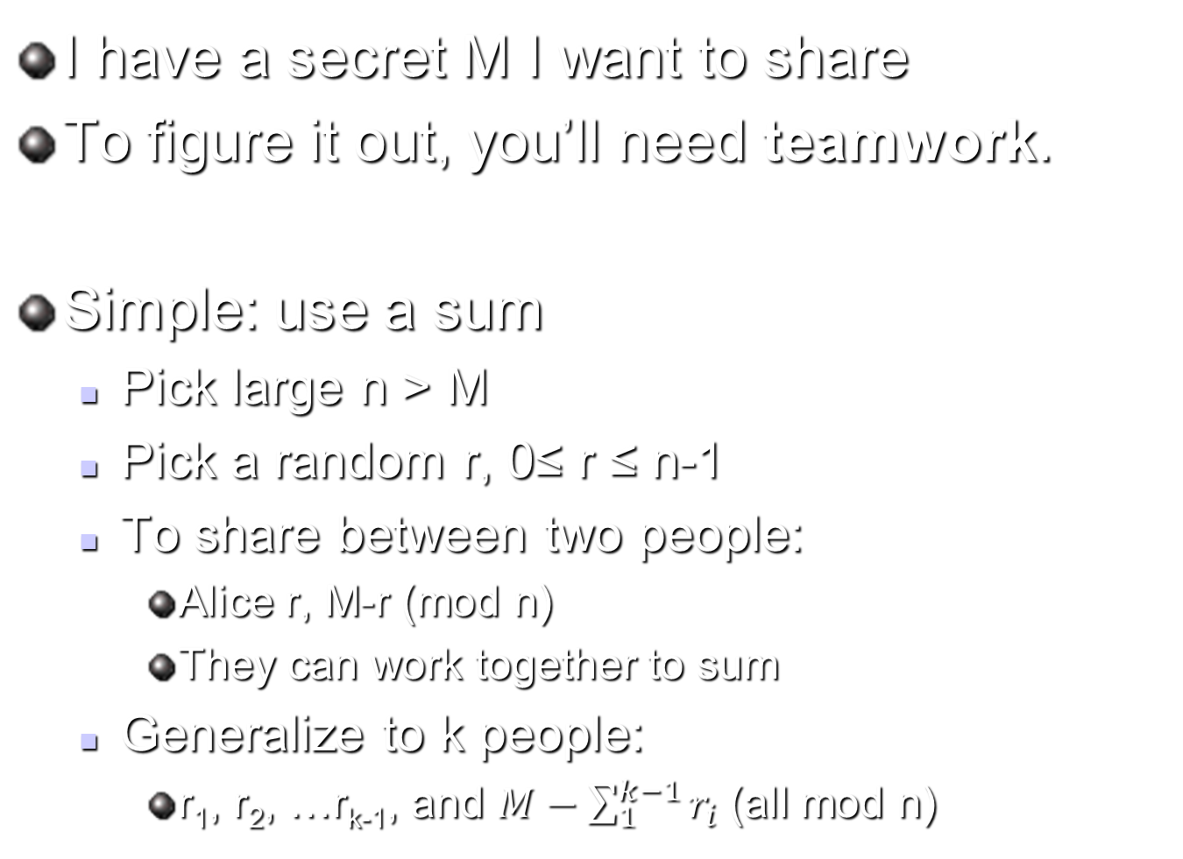
What is secret splitting?
1
I have a secret M I want to share
To figure it out, you’ll need teamwork.
Simple: use a sum
  Pick large n > M
  Pick a random r, 0≤ r ≤ n-1
  To share between two people:
    Alice r, M-r (mod n)
    They can work together to sum
  Generalize to k people:
    r₁, r₂, …r_{k-1}, and $M−\sum_{1}^{k−1}{r_{i}}$ (all mod n)
r
M-r (mod n)
Notes:
If I want 2 people to work together to find M, I can give them r and M-r and tell them to sum
The (mod n) is needed to generate a uniform distribution.

Slide 3
There are many applications of secret splitting and secret sharing
2
Inheritances
Military
Government
Information security
What if I wanted a subset of the people to be able to reconstruct the secret?
Secret splitting is trivial
Secret sharing is not!
Notes:
Rival siblings mentioned in a will
Military: need more than one person to cooperate to press the big red button
Government: a cabinet working together has as much power as the president
Info: divide onto n servers, all of which must be hacked to recover

Slide 4
(t,w)-threshold schemes require t people from a set of w to compute the secret
Knowing t or more pieces makes M easily computable
t–1 or fewer pieces leaves M completely undetermined
If (3,5) threshold scheme:
  {a,d,e} can figure out secret
  {c,e} cannot
  {a,b,c,d} is redundant
Secret splitting (all participants required) is just a special case:
  Let t = w
a
e
c
d
b

Slide 5

Idea: we can use curve fitting to reconstruct a function, and thus a message
3
The y-intercept of the line encodes the secret!
Secret→
Here is a (2,4) scheme:
Your quiz question is an example of a (2,3) scheme

Slide 6
The Shamir threshold scheme uses curve-fitting with higher dimensions
4-5
The y-intercept of the line encodes the secret!
Derivation on board
Secret→

Slide 7
Extensions to Shamir
4-5
Multiple shares
Multiple groups of people
Secret→

Slide 8
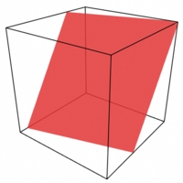
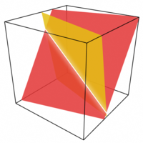
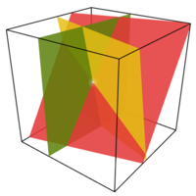
In the Blakely scheme, we represent the secret as the y-coordinate of the intersection of hyperplanes
6
http://en.wikipedia.org/wiki/Secret_sharing

Slide 9
Back to Shamir
7-8
The y-intercept of the line encodes the secret!
Secret→
Your quiz question is an example of a (4, 6) scheme
Project workday tomorrow: quiz due at 2:00 pm.

Slide 10
Mignotte Method
(t, n) threshold scheme
Uses Chinese remainder theorem
Solving a system of equations, mod n

Slide 11
Method
Construct a Mignotte Sequence
Conditions:
  Pairwise relatively prime
  s
Shares:

Slide 12
Reconstruction
Solve:
Using Chinese Remainder Theorem
Unique (mod m₁ *** m_{n} )

