Slide 1
DTTF/NB479: Dszquphsbqiz Day 10
Announcements:
  Computer exam next class
Questions?

Slide 2
Tomorrow’s exam
For each problem, I’ll specify the algorithm:
Shift Affine Vigenere Hill
and the attack:
  Ciphertext only known plaintext
  You may use code that you wrote or that you got from the textbook.
May require you to modify your code some on the fly
Have your algorithms ready to run…

Slide 3
Can we generalize Fermat’s little theorem to composite moduli?
Notes:
Let’s continue where we left off yesterday.

Slide 4
The three-pass protocol is an application of Fermat’s little theorem to key exchange
How can Alice get a secret message to Bob without an established key?
Can do it with locks.
First 2 volunteers get to do a live demo

Slide 5
The three-pass protocol is an application of Fermat’s little theorem to key exchange
Situation: Alice wants to get a short message to Bob, but they don’t have an established key to transmit it.
Can do with locks:

Slide 6

The three-pass protocol is an application of Fermat’s little theorem to key exchange
Situation: Alice wants to get a short message to Bob, but they don’t have an established key to transmit it.
Can do with locks:

Slide 7
The three-pass protocol is an application of Fermat’s little theorem to key exchange
Situation: Alice wants to get a short message to Bob, but they don’t have an established key to transmit it.
Can do with locks:

Slide 8
The three-pass protocol is an application of Fermat’s little theorem to key exchange
Situation: Alice wants to get a short message to Bob, but they don’t have an established key to transmit it.
Can do with locks:
Note: it’s always secured by one of their locks

Slide 9
In the three-pass protocol, the “locks” are
random numbers that satisfy specific properties
K: the secret message
p: a large public prime number > K
The two locks:
  a: Alice’s random #, gcd(a,p-1)=1
  b: Bob’s random #, gcd(b,p-1)=1
To unlock their locks:
  a⁻¹ mod (p-1)
  b⁻¹ mod (p-1)

Slide 10
In the three-pass protocol, the “locks” are
random numbers that satisfy specific properties
K: the secret message
p: a public prime number > K
The two locks:
  a: Alice’s random #, gcd(a,p-1)=1
  b: Bob’s random #, gcd(b,p-1)=1
To unlock their locks:
  a⁻¹ mod (p-1)
  b⁻¹ mod (p-1)
Three-pass protocol:
Alice computes Kª (mod p) and sends to Bob
Bob computes (Kª)^{b} (mod p) and sends it back
Alice computes ((Kª)^{b} )^{a-1} (mod p) and sends it back
Bob computes (((Kª)^{b} ) ^{a-1}) ^{b-1} (mod p) and reads K

Slide 11
In the three-pass protocol, the “locks” are
random numbers that satisfy specific properties
K: the secret message
p: a public prime number > K
The two locks:
  a: Alice’s random #, gcd(a,p-1)=1
  b: Bob’s random #, gcd(b,p-1)=1
To unlock their locks:
  a⁻¹ mod (p-1)
  b⁻¹ mod (p-1)
Three-pass protocol:
Alice computes Kª (mod p) and sends to Bob
Bob computes (Kª)^{b} (mod p) and sends it back
Alice computes ((Kª)^{b} )^{a-1} (mod p) and sends it back
Bob computes (((Kª)^{b} ) ^{a-1}) ^{b-1} (mod p) and reads K
36
59
17
21
41
Toy example:
  36¹⁷ (mod 59) = 12
  12²¹ (mod 59) = 45
  45⁴¹ (mod 59) = 48
  48⁴⁷ (mod 59) = 36
47
Why does it work?

Slide 12
The basic principle relates the moduli of the expressions to the moduli in the exponents
When dealing with numbers mod n, we can deal with their exponents mod _____
So…
  Given integers a and b,
  Since aa⁻¹=bb⁻¹=1(mod p-1)
  …what’s K^{(aba-1b-1)} (mod p)?
Notes:
(n-1) if n is prime, phi(n) otherwise
K^1 or K

Slide 13
Why isn’t this used in key exchange today?
Trappe and Washington say that it’s vulnerable to an “intruder-in-the-middle” attack. Think about this…

Slide 14
You are now prepared to read as much of the rest of chapter 3 as you like
We’ll revisit 3.7 (primitive roots) and 3.11 (fields) later
The rest is more number theory fun.
Tomorrow we start DES

Slide 15
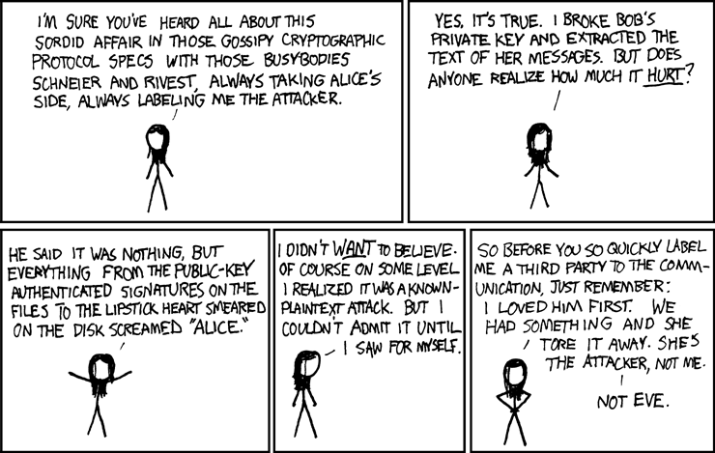
Maybe Alice and Bob’s exchange wasn’t as secure as they thought…
http://xkcd.com/c177.html
Yet one more reason I’m barred from speaking at crypto conferences.

