Slide 1
DTTF/NB479: Dszquphsbqiz Day 8
Announcements:
  Please use pencil on quizzes if possible
Questions?
Today:
  Congruences
  Chinese Remainder Theorem
  Modular Exponents

Slide 2
Hill Cipher implementation
Encryption
  Easy to do in MATLAB.
  Or find/write a matrix library for language X.
Decryption
  Uses matrix inverse.
  How do we determine if a matrix is invertible mod 26?

Slide 3
How to break via known plaintext?
Good work on last session’s quiz.
Idea:
Assume you know the matrix size, n.
Then grab n sets of n plaintext chars ←→ ciphertext
This gives n² equations and n² unknowns.
Then solve using basic linear algebra, but mod n.
Caveat: sometimes it doesn’t give a unique solution, so you need to choose a different set of plaintext.
Hmm. This could make a nice exam problem…

Slide 4
Substitution ciphers
Each letter in the alphabet is always replaced by another one.
  Which ciphers have we seen are substitution ciphers?
  Which aren’t and why?
Breaking ciphertext only uses linguistic structure. Frequencies of:
  Single letters
  Digrams (2-letter combinations)
  Trigrams
  Where do T&W get their rules like “80% of letters preceding n are vowels”? (p. 26)
    See http://keithbriggs.info/documents/english_latin.pdf
Lots of trial and error when done by hand.
Could automate with a dictionary.

Slide 5
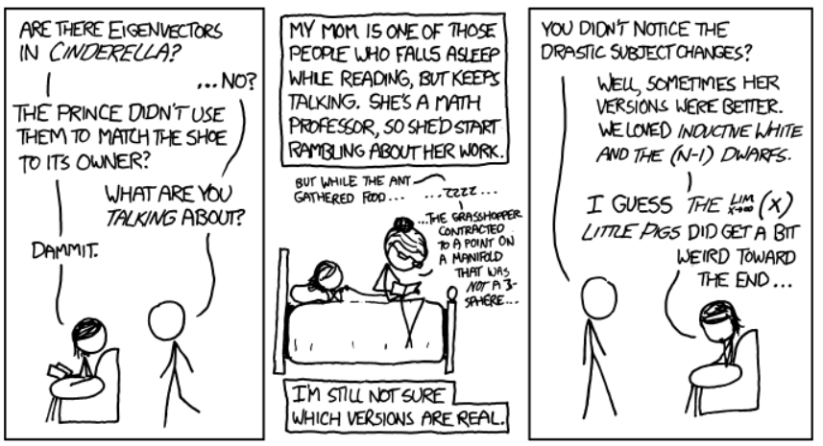
Fairy Tales
http://xkcd.com/872/
Goldilocks’ discovery of Newton’s method of approximation required surprisingly few changes.

Slide 6
Basics 4: Congruence
Def: a≡b (mod n) iff (a-b) = nk for some int k
Properties
You can easily solve congruences ax≡b (mod n) if gcd(a,n) = 1.
  For small numbers, do by hand
  For larger numbers, compute a⁻¹ using Euclid

Slide 7
Solving ax≡b(mod n) when gcd(a,n)≠1
1-2
Let gcd(a,n)=d
If d doesn’t divide b then no solution
Else divide everything by d and solve
(a/d)x=(b/d)(mod (n/d))
Get solution x₀
Multiple solutions:
x₀, x₀+n/d,x₀+2n/d,…x₀+(d-1)n/d
Always write solution with the original modulus
This is an easy program to code once you have Euclid…
←Example: 2x ≡ 7(mod 10)
Example:
3x ≡ 3 (mod 6)

Slide 8
How could we write x ≡ 16 (mod 35) as a system of congruences with smaller moduli?

Slide 9
Chinese Remainder Theorem
Equivalence between a single congruence mod a composite number and a system of congruences mod its factors
Two-factor form
  Given gcd(m,n)=1. For integers a and b, there exists exactly 1 solution (mod mn) to the system:

Slide 10
CRT Equivalences let us use systems of congruences to solve problems
3-4
Solve the system:
How many solutions?
  Find them.

Slide 11
Chinese Remainder Theorem
n-factor form
  Let m₁, m₂,… m_{k} be integers such that gcd(m_{i}, m_{j})=1 when i ≠ j. For integers a₁, … a_{k}, there exists exactly 1 solution (mod m₁m₂…m_{k}) to the system:

Slide 12
Modular Exponentiation
5-6
Compute last digit of 3^2000
Compute 3^2000 (mod 19)
Idea:
  Get the powers of 3 by repeatedly squaring 3, BUT taking mod at each step.

Slide 13
Modular Exponentiation
(All congruences are mod 19)
Compute 3^2000 (mod 19)
Technique:
  Repeatedly square 3, but take mod at each step.
  Then multiply the terms you need to get the desired power.
Book’s powermod()

Slide 14
Modular Exponentiation
Compute 3^2000 (mod 152)

