Slide 1
DTTF/NB479: Dszquphsbqiz Day 31
Announcements:
  See schedule for weeks 8 and 9
  Project workdays, due dates, exam
  Projects: Look at rubrics, example of past project
Questions?
Wrapping up the term
  Remote, fair coin flipping (today)
  Secret sharing (next class)

Slide 2
You can’t trust someone to flip a coin remotely if they really want to win the flip
Alice and Bob each want to win a coin flip
Why can’t they do this over the phone?
Let’s see…

Slide 3
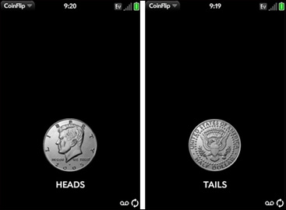
What if Bob flips?
Alice
Bob
Heads!
I’ll flip a coin. You call it.
Looks and sees tails.
Sorry Alice, it was tails…
http://g-ecx.images-amazon.com/images/G/01/oreilly/CoinFlip2._V230746768_.jpg

Slide 4
What if Alice flips?
1
Alice
Bob
I’ll flip a coin. You call it.
Sorry Bob, it was heads.
(silent snicker)
Tails!

Slide 5
We can use related secrets to guarantee a fair flip
3
Alice
Bob
Knows something Bob doesn’t. Gives him a hint.
Uses her secret and Bob’s hint to calculate 2 guesses for Bob’s secret; she can only guess it right ½ the time.
Knows something Alice doesn’t, gives her a hint
Alice guesses and dares Bob to prove she’s wrong
- If she’s right, Bob can’t argue.
- If she’s wrong, Bob can prove it by calc’ing her secret!
Her secret is so secret, the only way Bob could figure it out is using Alice’s wrong guess!
Notes:
This secret is so secret, the only way Bob could figure it out is using Alice’s wrong guess!

Slide 6
What’s Alice’s secret?
The 2 prime factors of a large composite!
2,4
And now for something completely different…
You can find square roots easily if the base p is “special”, a prime congruent to 3 (mod 4)
  There are many such primes:
  3, 5, 7, 11, 13, 17, 19, 23, 29, 31, 37, 43, …
  Proof

Slide 7
We can use related secrets to guarantee a fair flip
Alice
Bob
Knows secret primes
p & q ≡ 3 (mod4)
Tells Bob hint: n = pq
Finds a² ≡ b² ≡ y (mod n) using p, q, and ChRT. Guesses one, say b.
Knows random x, tells Alice
y ≡ x²(mod n)
If b ≡ ±x, Alice won
and Bob can’t argue
If b ≠ ±x, Bob can calculate
p and q using the SRCT
Her secret is so secret, the only way Bob could figure it out is using Alice’s wrong guess!
Notes:
This secret is so secret, the only way Bob could figure it out is using Alice’s wrong guess!

Slide 8
This MATLAB demo ties together many concepts from our number theory work
5-8
Fermat’s theorem
GCD
Chinese Remainder Theorem
  Finding the 4 solutions to y≡x²(mod n) is as hard as factoring n
Square Root Compositeness Theorem
Modular exponentiation
Modular inverse
Miller-Rabin*
Notes:
* I cheated, and just looped, adding 4 to potential prime each time to count (mod 4).

