Slide 1
DTTF/NB479: Dszquphsbqiz Day 24
Announcements:
  Term project groups and topics due midnight
  HW6 due next Tuesday.
Questions?
This week:
  Primality testing, factoring
  Discrete Logs, Computing Discrete Logs

Slide 2
Discrete logs…
But first, some humor:
Bruce Schneier is a genius in the crypto field, the author of the authoritative book on crypto.
Bruce Schneier writes his books and essays by generating random alphanumeric text of an appropriate length and then decrypting it.

Slide 3
Discrete logs…
…are the basis of the ElGamal cryptosystem
…can be used for digital signatures

Slide 4
Discrete Logs
5
Given
Find x
We denote this as
Why is this hard?

Slide 5
Consider this…
6
Solve 9=2^{x} (mod 11)
We denote the answer as L₂(9)
Are there other solutions for x?
By convention, x is defined to be the minimum of all such.
It must be < (p-1). Why?

Slide 6
But consider this…
7
Solve 2150=3621^{x} (mod p) where p=1775754…74581 (100 digits)
How long will exhaustive search take?
  Up to p-2 if 3621 is a primitive root of n.
What’s a primitive root?
Please read section 3.7 (1 page) tonight if you haven’t

Slide 7
One-way functions
Take y=f(x)
If y is easy to find given x, but x is hard to find given y, f is called a one-way function.
Examples:
  Factoring (easy to multiply, hard to factor)
  Discrete logs (easy to find powers mod n, even if n is large, but hard to find discrete log)

Slide 8
Factoring vs. Discrete Logs
Sizes of primes required are roughly similar
We will encounter a number of discrete log algorithms that are analogs to factoring algorithms:
(p-1) algorithm→Pollig-Hellman
Quadratic sieve → Index calculus
RSA → ElGamal

Slide 9
Finding x (mod 2)
On board

Slide 10
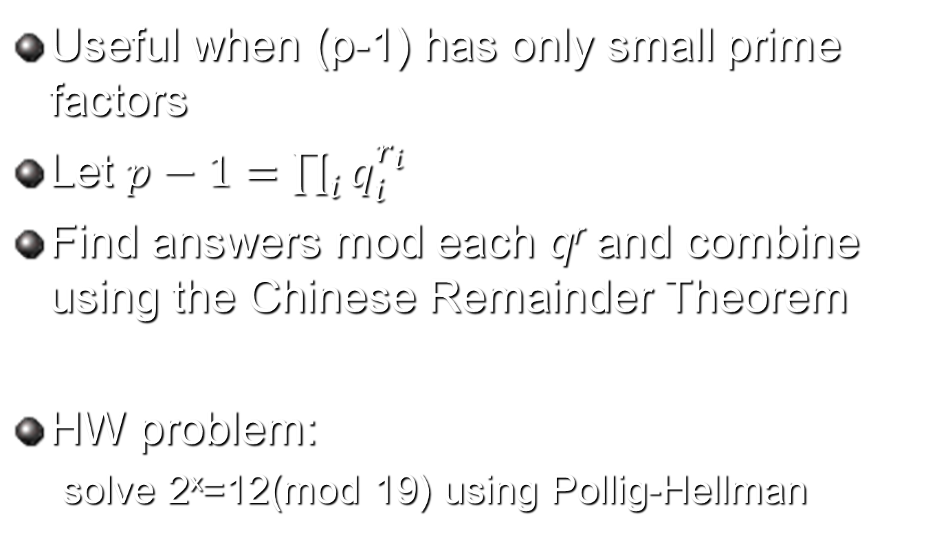
Pollig-Hellman
Useful when (p-1) has only small prime factors
Let $p−1=\prod_{i}{q_{i}^{r_{i}}}$
Find answers mod each q^{r} and combine using the Chinese Remainder Theorem
HW problem:
  solve 2^{x}=12(mod 19) using Pollig-Hellman

