Slide 1

MA/CSSE 474
Theory of Computation
Reduction Part 3

Slide 2
H_{ALL} = {<M> : TM M halts on all inputs}
We show that H_{ALL} is not in D by reduction from H_{ε}.
H_{ε} = {<M> : TM M halts on ε}
R
(?Oracle) H_{ALL} = {<M> : TM M halts on all inputs }
R(<M>) =
1. Construct the description <M#>, where M#(x) operates as follows:
  1.1. Erase the tape.
  1.2. Run M.
2. Return <M#>.
If Oracle exists, then C = Oracle(R(<M>)) decides H_{ε}:
● R can be implemented as a Turing machine.
● C is correct: M# halts on everything or nothing, depending on whether M
halts on ε. So:
● <M> ∈ H_{ε}: M halts on ε, so M# halts on all inputs. Oracle accepts.
● <M> ∉ H_{ε}: M does not halt on ε, so M# halts on nothing. Oracle rejects.
But no machine to decide H_{ε} can exist, so neither does Oracle.

Slide 3
The Membership Question for TMs
We next define a new language:
A = { <M, w> : M accepts w }.
Note that A is different from H since it is possible that M
halts but does not accept. An alternative definition of A is:
A = { <M, w> : w ∈ L(M) }.

Slide 4
A = {<M, w> : w ∈ L(M)}
We show that A is not in D by reduction from H.
H = {<M, w> : TM M halts on input string w}
R
(?Oracle) A = {<M, w > : w ∈ L(M) }
R(<M, w>) =
1. Construct the description <M#>, where M#(x) operates as follows:
  1.1. Erase the tape.
  1.2. Write w on the tape.
  1.3. Run M on w.
  1.4. Accept
2. Return <M#, w>.
If Oracle exists, then C = Oracle(R(<M, w>)) decides H:
● R can be implemented as a Turing machine.
● C is correct: M# accepts everything or nothing. So:
● <M, w> ∈ H: M halts on w, so M# accepts everything. In particular, it
accepts w. Oracle accepts.
● <M, w > ∉ H: M does not halt on w. M# gets stuck in step 1.3 and so
accepts nothing. Oracle rejects.
But no machine to decide H can exist, so neither does Oracle.

Slide 5
A_{ε}, A_{ANY}, and A_{ALL}
Theorem: A_{ε} = {<M> : TM M accepts ε} is not in D.
Proof: Analogous to that for H_{ε}.
Theorem:
A_{ANY} = {<M> : TM M accepts at least one string}
is not in D.
Proof: Analogous to that for H_{ANY}.
Theorem: A_{ALL} = {<M> : = L(M) = Σ*} is not in D.
Proof: Analogous to that for H_{ALL}.

Slide 6
Are Security Properties Decidable?
 | process₁ | process₂ | process₃ | process₄ | file₁ | file₂
process₁ | execute |  | execute |  | own | read
process₂ |  | execute | execute |  |  | read
process₃ |  |  | execute |  |  | own
process₄ |  |  | execute | execute |  | read
Suppose we could show that rights don’t “leak”.
Then we could encode configurations of TMs in this framework:
q a b b q ...
q₅
 | s₁ | s₂ | s₃ | s₄
s₁ | q | own
s₂ |  | a | own
s₃ |  |  | b, q₅ | own
s₄ |  |  |  | b, end

Slide 7
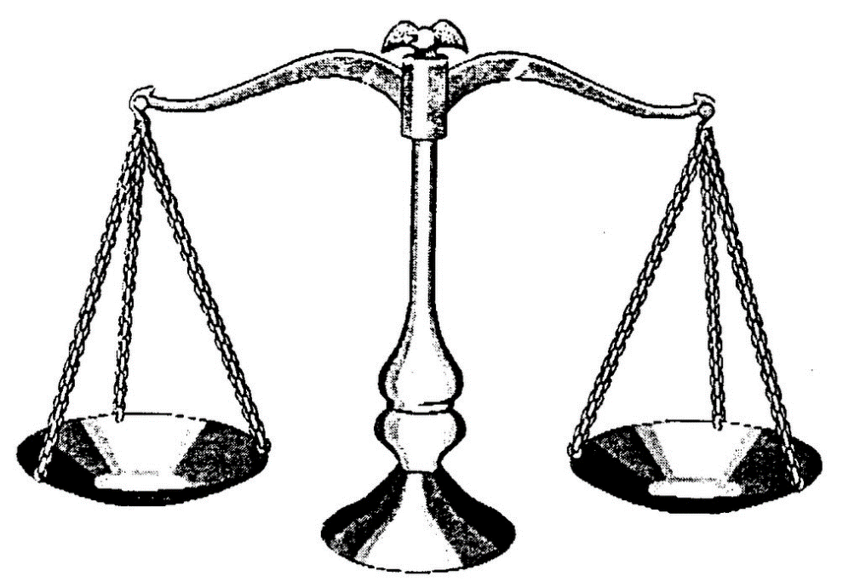
EqTMs={<M_{a}, M_{b}>: L(M_{a})=L(M_{b})}
M
?
Oracle for EqTMs

Slide 8
EqTMs={<M_{a}, M_{b}>: L(M_{a})=L(M_{b})}
A_{ANY} = {<M> : there exists at least one string which TM M
accepts}
R
(Oracle?) EqTMs = {<M_{a}, M_{b}>: L(M_{a})=L(M_{b})}
R(<M>) =
1. Construct the description of M#(x):
  1.1. Accept.
2. Return <M, M#>.
If Oracle exists, then C = Oracle(R(<M>)) decides A_{ANY}:
● C is correct: M# accepts everything. So:
  ● <M> ∈ A_{ANY}: L(M) =? L(M#). Oracle ? Oops.
  ● <M> ∉ A_{ANY}: L(M) ≠ L(M#). Oracle rejects.
Notes:
Note that this attempt at reduction fails!
Correct reduction on next slide.

Slide 9
EqTMs={<M_{a}, M_{b}>: L(M_{a})=L(M_{b})}
A_{ALL} = {<M> : L(M) = Σ*}
R
(Oracle) EqTMs = {<M_{a}, M_{b}>: L(M_{a})=L(M_{b})}
R(<M>) =
1. Construct the description of M#(x):
  1.1. Accept.
2. Return <M, M#>.
If Oracle exists, then C = Oracle(R(<M>)) decides A_{ALL}:
● C is correct: M# accepts everything. So if L(M) = L(M#), M must
also accept everything. So:
● <M> ∈ A_{ALL}: L(M) = L(M#). Oracle accepts.
● <M> ∉ A_{ALL}: L(M) ≠ L(M#). Oracle rejects.
But no machine to decide A_{ALL} can exist, so neither does Oracle.

Slide 10
A Practical Consequence
Consider the problem of virus detection. Suppose that a
new virus V is discovered and its code is <V>.
● Is it sufficient for antivirus software to check solely for
occurrences of <V>?
● Is it possible for it to check for equivalence to V?

Slide 11
Sometimes Mapping Reducibility Isn’t Right
Recall that a mapping reduction from L₁ to L₂ is a computable function f where:
∀x∈Σ* (x ∈ L₁ ↔ f(x) ∈ L₂).
When we use a mapping reduction, we return:
Oracle(f(x))
Sometimes we need a more general ability to use Oracle
as a subroutine and then to do other computations after it
returns.

Slide 12
{<M> : M accepts no even length strings}
H = {< M, w> : TM M halts on input string w}
R
(?Oracle) L₂ = {<M> : M accepts no even length strings}
R(<M, w>) =
1. Construct the description <M#>, where M#(x) operates as follows:
  1.1. Erase the tape.
  1.2. Write w on the tape.
  1.3. Run M on w.
  1.4. Accept.
2. Return <M#>.
If Oracle exists, then C = Oracle(R(<M, w>)) decides H:
● C is correct: M# ignores its own input. It accepts everything or nothing,
depending on whether it makes it to step 1.4. So:
● <M, w> ∈ H: M halts on w. Oracle: __________
● <M, w> ∉ H: M does not halt on w. Oracle : __________
Problem:
Notes:
M halts → M# Accepts all strings. So Oracle rejects
M does not halt on w→ M# accepts nothing, So Oracle accepts.
So a strict Mapping reduction does not apply. By the Reduction R coupled with ¬, works fine.

Slide 13
{<M> : M accepts no even length strings}
H = {< M, w> : TM M halts on input string w}
R
(?Oracle) L₂ = {<M> : M accepts no even length strings}
R(<M, w>) =
1. Construct the description <M#>, where M#(x) operates as follows:
1.1. Erase the tape.
1.2. Write w on the tape.
  1.3. Run M on w.
  1.4. Accept.
2. Return <M#>.
If Oracle exists, then C = ¬Oracle(R(<M, w>)) decides H:
● R and ¬ can be implemented as Turing machines.
● C is correct:
● <M, w> ∈ H: M halts on w. M# accepts everything, including some
even length strings. Oracle rejects so C accepts.
● <M, w> ∉ H: M does not halt on w. M# gets stuck. So it accepts
nothing, so no even length strings. Oracle accepts. So C rejects.
But no machine to decide H can exist, so neither does Oracle.

Slide 14
Are All Questions about TMs Undecidable?
Let L = {<M> : TM M contains an even number of states}
Let L = {<M, w> : M halts on w within 3 steps}.
Let L_{q} = {<M, q> : there is some configuration
(p, uav) of M, with p ≠ q,
that yields a configuration whose state is q }.
Is L_{q} decidable?
Notes:
Ask students how they would do it?
Can easily determine this one by examining the description of M.
--------------------
Second one: Ask students how they would do it?
Again, we have the description. We can run the UTM to simulate three steps of M on W.
--------------------------
Ask students how they would do it?
Do a breadth-first search of states you can reach from p. If you reach an already-seen one, backtrack. If you reach q, halt and accept. If nothing else to try, halt and reject.

Slide 15
Is There a Pattern?
  ● Does L contain some particular string w?
  ● Does L contain ε?
  ● Does L contain any strings at all?
  ● Does L contain all strings over some alphabet Σ?
  ● A = {<M, w> : TM M accepts w}.
  ● A_{ε} = {<M> : TM M accepts ε}.
  ● A_{ANY} = {<M> : there exists at least one string that
  TM M accepts}.
  ● A_{ALL} = {<M> : TM M accepts all inputs}.
Notes:
We compare decision problems to language membership problems

Slide 16
Rice’s Theorem
  No nontrivial property of the SD languages is decidable.
  or
  Any language that can be described as:
  {<M>: P(L(M)) = True}
  for any nontrivial property P, is not in D.
  A nontrivial property is one that is not simply:
  True for all languages, or
  False for all languages.
Because of time constraints, we will skip the proof of this theorem.

Slide 17
Applying Rice’s Theorem
To use Rice’s Theorem to show that a language L is not in D we must:
● Specify property P.
● Show that the domain of P is the SD languages.
● Show that P is nontrivial:
● P is true of at least one language
● P is false of at least one language

Slide 18
Applying Rice’s Theorem
1. {<M> : L(M) contains only even length strings}.
2. {<M> : L(M) contains an odd number of strings}.
3. {<M> : L(M) contains all strings that start with a}.
4. {<M> : L(M) is infinite}.
5. {<M> : L(M) is regular}.
6. {<M> : M contains an even number of states}.
7. {<M> : M has an odd number of symbols in its tape
alphabet}.
8. {<M> : M accepts ε within 100 steps}.
9. {<M>: M accepts ε}.
10. {<M_{a}, M_{b}> : L(M_{a}) = L(M_{b})}.
Notes:
Cases 1-5. Domain of P is the set of SD languages, and P is non-trivial.
Cases 6-8. Domain is not languages but machines. So Rice's Theorem says nothing. All of these happen to be decidable
9 is stated in terms of M, but it is really about languages. So Rice's Theorem applies.
10. The problem domain is the set of pairs of SD languages, so the theorem does not apply. It turns out to be undecidable, but Rice's theorem does not show it.

Slide 19
Given a TM M, is L(M) Regular?
The problem: Is L(M) regular?
As a language: Is {<M> : L(M) is regular} in D?
No, by Rice’s Theorem:
● P = True if L is regular and False otherwise.
● The domain of P is the set of SD languages since it is
the set of languages accepted by some TM.
● P is nontrivial:
  ♦ P(a*) = True.
  ♦ P(A^{n}B^{n}) = False.
We can also show it directly, using reduction.
(Next slide)

Slide 20
Given a TM encoding <M>, is L(M) Regular?
H = {<M, w> : TM M halts on input string w}
R
(Oracle) L₂ = {<M> : L(M) is regular}
R(<M, w>) =
1. Construct M#(x):
  1.1. Copy its input x to another track for later.
  1.2. Erase the tape.
  1.3. Write w on the tape.
  1.4. Run M on w.
  1.5. Put x back on the tape.
  1.6. If x ∈ A^{n}B^{n} then accept, else reject.
  2. Return <M#>.
Problem:
Notes:
If <M, w> is in H, then M halts on w, so M# makes it to 1.5 So it then accepts x iff x is in A^{n}B^{n}.
So M# accepts A^{n}B^{n}, which is not regular. So Oracle(<M#>) rejects.
If <M, w> is not in H, then M does not halt on w, so M# is stuck in step 1.4, therefore, it accepts nothing.
Thus Oracle(<M#> accepts.
So it is another backwards one. We need NOT also (next slide)

Slide 21
But We Can Flip
R(<M, w>) =
1. Construct the description <M#>, where M#(x) operates as follows:
  1.1. Save x for later.
  1.2. Erase the tape.
  1.3. Write w on the tape.
  1.4. Run M on w.
  1.5. Put x back on the tape.
  1.6. If x ∈ A^{n}B^{n} then accept, else reject.
  2. Return <M#>.
  If Oracle decides L₂, then C = ¬Oracle(R(<M, w>)) decides H:
  ● <M, w> ∈ H: M# makes it to step 1.5. Then it accepts x iff
  x ∈ A^{n}B^{n}. So M# accepts A^{n}B^{n}, which is not regular.
  Oracle rejects. C accepts.
  ● <M, w> ∉ H: M does not halt on w. M# gets stuck in step 1.4.
  It accepts nothing. L(M#) = ∅, which is regular.
  Oracle accepts. C rejects.
  But no machine to decide H can exist, so neither does Oracle.
Notes:
This is the same reduction as on the previous slide, but now we flip.

Slide 22
Or, Doing it Without Flipping
R(<M, w>) =
1. Construct the description <M#>, where M#(x) operates as follows:
  1.1. If x ∈ A^{n}B^{n} then accept, else:
  1.2. Erase the tape.
  1.3. Write w on the tape.
  1.4. Run M on w.
  1.5. Accept
2. Return <M#>.
If Oracle exists, C = Oracle(R(<M, w>)) decides H:
● C is correct: M# immediately accepts all strings in A^{n}B^{n}:
  ● <M, w> ∈ H: M# accepts everything else in step 1.5. So
  L(M#) = Σ*, which is regular. Oracle accepts.
  ● <M, w> ∉ H: M# gets stuck in step 1.4, so it accepts nothing
  else. L(M#) = A^{n}B^{n}, which is not regular. Oracle rejects.
  But no machine to decide H can exist, so neither does Oracle.

Slide 23
Any Nonregular Language Will Work
R(<M, w>) =
1. Construct the description <M#>, where M#(x) operates as follows:
  1.1. If x ∈ WW then accept, else:
  1.2. Erase the tape.
  1.3. Write w on the tape.
  1.4. Run M on w.
  1.5. Accept
2. Return <M#>.
If Oracle exists, C = Oracle(R(<M, w>)) decides H:
● C is correct: M# immediately accepts all strings WW:
  ● <M, w> ∈ H: M# accepts everything else in step 1.5. So
  L(M#) = Σ*, which is regular. Oracle accepts.
  ● <M, w> ∉ H: M# gets stuck in step 1.4, so it accepts nothing
  else. L(M#) = WW, which is not regular. Oracle rejects.
  But no machine to decide H can exist, so neither does Oracle.

Slide 24
How you cannot use Rice's theorem (in this course)
You are not allowed to use Rice's Theorem as a substitute for learning how to do reductions.
There will be exam problem(s) that explicitly disallow use of Rice's Theorem, requiring you to do an explicit reduction instead.

Slide 25
Is L(M) Context-free?
How about: L₃ = {<M> : L(M) is context-free}?
R(<M, w>) =
1. Construct the description <M#>, where M#(x) operates as follows:
  1.1. If x ∈ A^{n}B^{n}C^{n} then accept, else:
  1.2. Erase the tape.
  1.3. Write w on the tape.
  1.4. Run M on w.
  1.5. Accept
2. Return <M#>.

Slide 26
Practical Impact of These Results
1. Does P, when running on x, halt?
2. Might P get into an infinite loop on some input?
3. Does P, when running on x, ever output a 0? Or anything at
all?
4. Are P₁ and P₂ equivalent?
5. Does P, when running on x, ever assign a value to n?
6. Does P ever reach S on any input (in other words, can we
chop it out?
7. Does P reach S on every input (in other words, can we
guarantee that S happens)?
● Can the Patent Office check prior art?
● Can the CSSE department buy the definitive grading program?

Slide 27
Turing Machine Questions Can be Reduced to Program Questions
EqPrograms =
{<P_{a}, P_{b}> : P_{a} and P_{b} are PL programs and L(P_{a}) = L(P_{b})}.
We can build, in any programming language PL, SimUM:
  that is a PL program
  that implements the Universal TM U and so can simulate an arbitrary TM.

Slide 28
{<M, q> : M reaches q on some input}
H_{ANY} = {<M> : there exists some string on which TM M halts}
R
(?Oracle) L₂ = {<M, q> : M reaches q on some input}
R(<M>) =
1. Build <M#> so that M# is identical to M except that, if M has a transition
((q₁, c₁), (q₂, c₂, d)) and q₂ is a halting state other than h, replace that
transition with:
((q₁, c₁), (h, c₂, d)).
2. Return <M#, h>.
If Oracle exists, then C = Oracle(R(<M>)) decides H_{ANY}:
● R can be implemented as a Turing machine.
● C is correct: M# will reach the halting state h iff M would reach some
halting state. So:
● <M> ∈ H_{ANY}: There is some string on which M halts. So there is some
string on which M# reaches state h. Oracle accepts.
● <M> ∉ H_{ANY}: There is no string on which M halts. So there is no string
on which M# reaches state h. Oracle rejects.
But no machine to decide H_{ANY} can exist, so neither does Oracle.
A good example, but the term is flying by, so we may skip it for now.

Slide 29
Side Road with a purpose: obtainSelf
From Section 25.3:
In section 25.3, the author proves the existence of a very useful computable function: obtainSelf. When called as a subroutine by any Turing machine M, obtainSelf writes <M> onto M's tape.
Related to quines

Slide 30
Some quines
main(){char q=34, n=10,*a="main() {char q=34,n=10,*a=%c%s%c; printf(a,q,a,q,n);}%c";printf(a,q,a,q,n);}
((lambda (x) (list x (list 'quote x)))
(quote (lambda (x) (list x (list 'quote x)))))
Quine's paradox and a related sentence:
"Yields falsehood when preceded by its quotation" yields falsehood when preceded by its quotation.
"quoted and followed by itself is a quine." quoted and followed by itself is a quine.

Slide 31
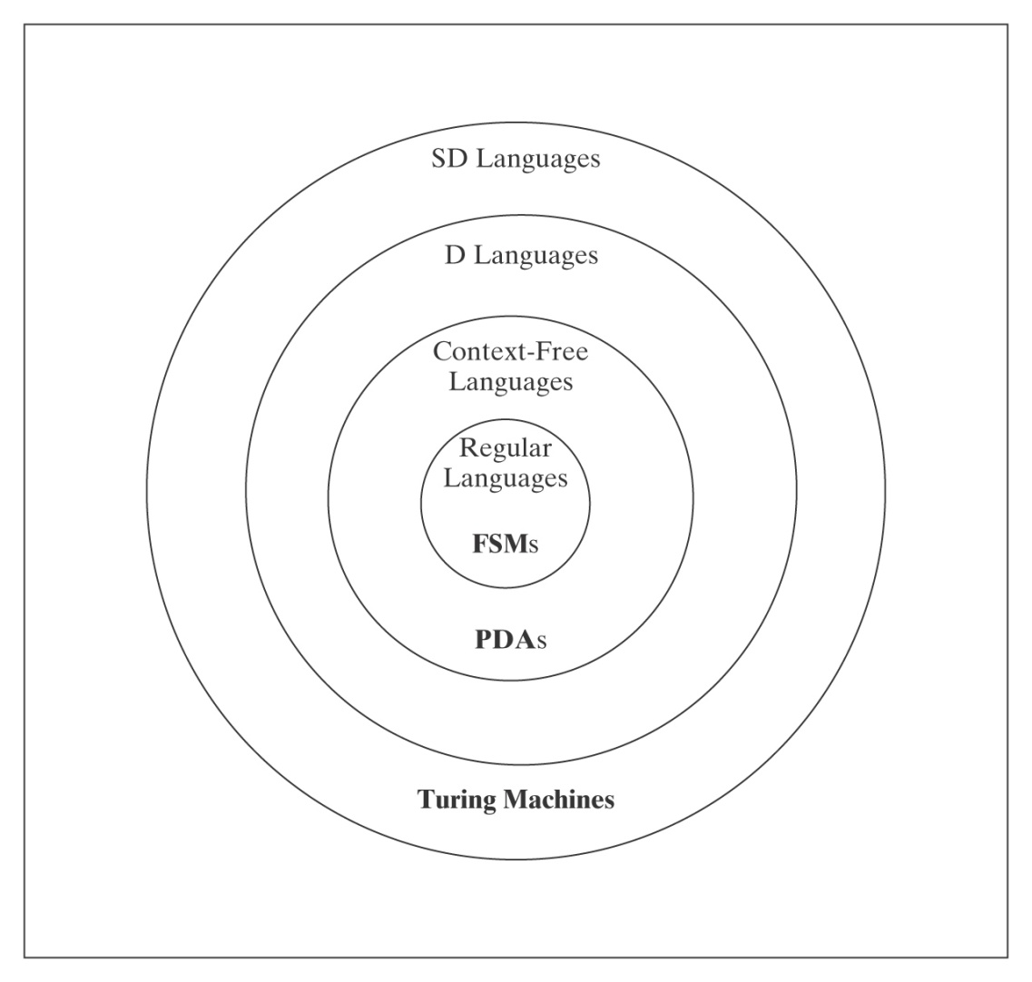
Non-SD Languages
There is an uncountable number of non-SD languages, but only a
countably infinite number of TM’s (hence SD languages). ∴The class
of non-SD languages is much bigger than that of SD languages!

Slide 32
Non-SD Languages
Intuition: Non-SD languages usually involve either infinite
search (where testing each potential member could loop forever) or determining whether the a TM will infinitely loop.
Examples:
¬H = {<M, w> : TM M does not halt on w}.
{<M> : L(M) = Σ*}.
{<M> : TM M halts on nothing}.
Notes:
If M does halt on W, we'll eventually discover it. But how can we discover that it does not halt on w?

Slide 33
Proving Languages are not SD
● Contradiction
● L is the complement of an SD/D Language.
● Reduction from a known non-SD language

Slide 34
Contradiction
Theorem: TM_{MIN} =
{<M>: Turing machine M is minimal} is not in SD.
Proof: If TM_{MIN} were in SD, then there would exist some Turing
machine ENUM that enumerates its elements. Define the following
Turing machine:
M#(x) =
1. Invoke obtainSelf to produce <M#>.
2. Run ENUM until it generates the description of some Turing
machine M′ whose description is longer than |<M#>|.
3. Invoke U on the string <M′, x>.
Since TM_{MIN} is infinite, ENUM must eventually generate a string that
is longer than |<M#>|. So M# makes it to step 3 and thus M# is
equivalent to M′ since it simulates M′. But, since |<M#>| < |<M′>|, M′
cannot be minimal.
But M#'s description was generated by ENUM. Contradiction.
We'll probably skip this one in class
Notes:
Obtainself exists (Recursion Theorem, chapter 25, something we won't get to in this course).
Basically it says that given any TM, there is an equivalent TM that can write its own description on one of its tape.
It is equivalent to a "Program that prints itself"

Slide 35
The Complement of L is in SD/D
Suppose we want to know whether L is in SD and we know:
● ¬L is in SD, and
● At least one of L or ¬L is not in D.
Then we can conclude that L is not in SD, because, if it were,
it would force both itself and its complement into D, which we
know cannot be true.
Example:
● ¬H (since ¬(¬H) = H is in SD and not in D)

Slide 36
A_{anbn} = {<M> : L(M) = A^{n}B^{n}}
A_{anbn} contains strings that look like:
(q00,a00,q01,a00,→),
(q00,a01,q00,a10,→),
(q00,a10,q01,a01,←),
(q00,a11,q01,a10,←),
(q01,a00,q00,a01,→),
(q01,a01,q01,a10,→),
(q01,a10,q01,a11,←),
(q01,a11,q11,a01,←)
It does not contain strings like aaabbb.
But A^{n}B^{n} does.

Slide 37
A_{anbn} = {<M> : L(M) = A^{n}B^{n}}
What’s wrong with this proof that A_{anbn} is not in SD?
¬H = {<M, w> : TM M does not halt on w}
R
(?Oracle) A_{anbn} = {<M> : L(M) = A^{n}B^{n}}
R(<M, w>) =
1. Construct the description <M#>, where M#(x) operates as follows:
1.1. Erase the tape.
1.2. Write w on the tape.
1.3. Run M on w.
  1.4. Accept.
2. Return <M#>.
If Oracle exists, C = Oracle(R(<M, w>)) semidecides ¬H:
Notes:
If <M, w> is in ¬H, L(M#) = ∅.
If <M, w> is not in ¬H, L(M#) is Σ*.
In neither case either is L(M#) = A^{n}B^{n}.
So Oracle makes no distinction between the two cases.

Slide 38
A_{anbn} = {<M> : L(M) = A^{n}B^{n}} is not SD
What about: ¬H = {<M, w> : TM M does not halt on w}
R
(?Oracle) A_{anbn} = {<M> : L(M) = A^{n}B^{n}}
R(<M, w>) =
1. Construct the description <M#>, where M#(x) operates as follows:
  1.1 Copy the input x to another track for later.
  1.2. Erase the tape.
  1.3. Write w on the tape.
  1.4. Run M on w.
  1.5. Put x back on the tape.
  1.6. If x ∈ A^{n}B^{n} then accept, else loop.
2. Return <M#>.
If Oracle exists, C = Oracle(R(<M, w>)) semidecides ¬H:
Notes:
If <M, w> is in ¬H, L(M#) = ∅.
If <M, w> is not in ¬H, L(M#) is A^{n}B^{n}. So Oracle gets it backwards.
Can we just use NOT? No because SD languages are not closed under complement!

Slide 39
A_{anbn} = {<M> : L(M) = A^{n}B^{n}} is not SD
R(<M, w>) reduces ¬H to A_{anbn}:
1. Construct the description <M#>:
  1.1. If x ∈ A^{n}B^{n} then accept. Else:
  1.2. Erase the tape.
  1.3. Write w on the tape.
  1.4. Run M on w.
  1.5. Accept.
  2. Return <M#>.
If Oracle exists, then C = Oracle(R(<M, w>)) semidecides ¬H:
M# immediately accepts all strings in A^{n}B^{n}. If M does not halt on
w, those are the only strings M# accepts. If M halts on w,
M# accepts everything:
● <M, w> ∈ ¬H: M does not halt on w, so M# accepts strings in
A^{n}B^{n} in step 1.1. Then it gets stuck in step 1.4, so it accepts
nothing else. It is an A^{n}B^{n} acceptor. Oracle accepts.
● <M, w> ∉ ¬H: M halts on w, so M# accepts everything.
Oracle does not accept.
But no machine to semidecide ¬H can exist, so neither does Oracle.

