Slide 1

MA/CSSE 474
Theory of Computation
Reduction and Undecidabiluity

Slide 2

Your Questions?
Previous class days' material
Reading Assignments
HW problems
Anything else
In honor of the week's big events:
The Beatles' Ed Sullivan 52^{tnd} anniversary, and Valentine's Day

Slide 3
Last time
A language L is in SD iff L is Turing enumerable

Slide 4
Lexicographic Enumeration
M lexicographically enumerates L iff M enumerates the elements of L in lexicographic order.
A language L is lexicographically Turing-enumerable iff there is a Turing machine that lexicographically enumerates it.
Example: A^{n}B^{n}C^{n} = {a^{n}b^{n}c^{n} : n ≥ 0}
Lexicographic enumeration:
Notes:
Ask how a TM would do this?
A second tape that starts blank.
Repeat:
if n 1's on second tape:
write n a's, then n b's, then n c's.
enter state p
erase first tape and add a 1 to the end of the second tape.

Slide 5
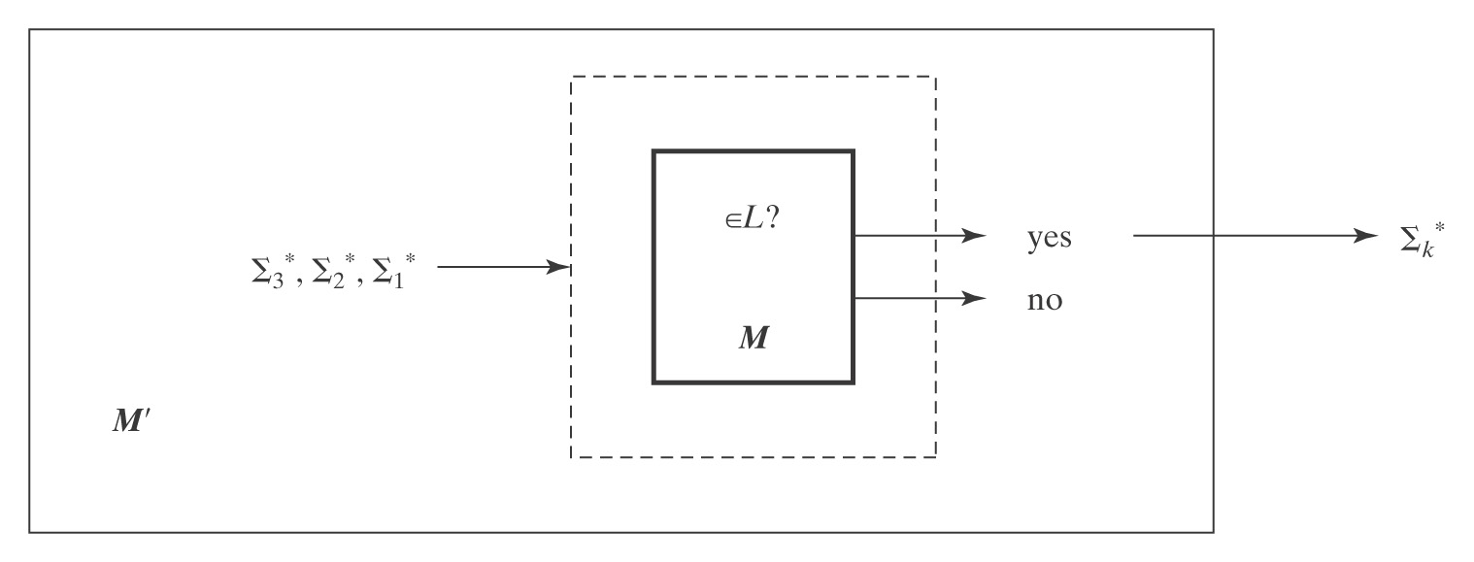
Lexicographically Enumerable = D
Theorem: A language is in D iff it is lexicographically Turing-enumerable.
Proof that D implies lexicographically TE: Let M be a Turing machine that decides L. M' lexicographically generates the strings in Σ* and tests each using M. It outputs those that are accepted by M. Thus M' lexicographically enumerates L.

Slide 6
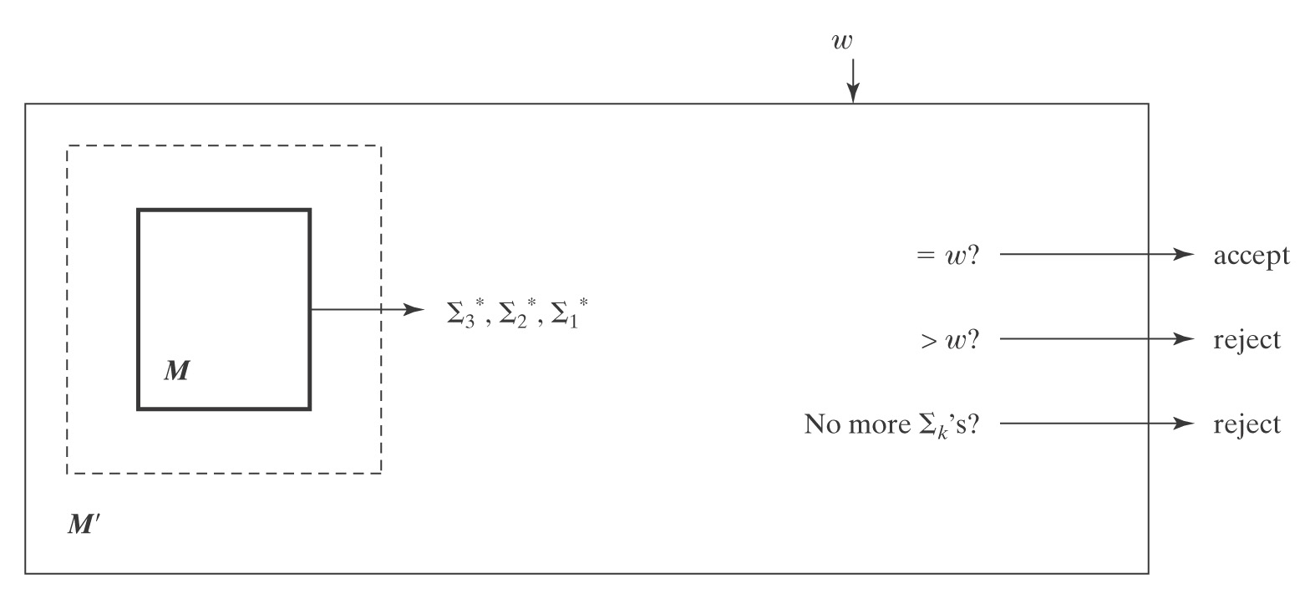
Proof, Continued
Proof that lexicographically Turing Enumerable implies D: Let M be a Turing machine that lexicographically enumerates L. Then, on input w, M' starts up M and waits until:
● M generates w (so M' accepts),
● M generates a string that comes after w (so M' rejects), or
● M halts (so M' rejects).
Thus M' decides L.

Slide 7
Language Summary
IN SD OUT
Semideciding TM H Reduction
Enumerable
Unrestricted grammar
D
Deciding TM A^{n}B^{n}C^{n} Diagonalize
Lexic. enum Reduction
L and ¬L in SD
Context-Free
CF grammar A^{n}B^{n} Pumping
PDA Closure
Closure
Regular
Regular Expression a*b* Pumping
FSM Closure

Slide 8
Overview of Reduction

Slide 9
Reducing Decision Problem P₁ to another Decision Problem P₂
We say that P1 is reducible to P₂ (written P₁ ≤ P₂) if
there is a Turing-computable function f that finds, for an arbitrary instance I of P₁, an instance f(I) of P₂, and
f is defined such that for every instance I of P₁,
I is a yes-instance of P₁ if and only if
f(I) is a yes-instance of P₂.
So P₁ ≤ P₂ means "if there is a TM that decides P₂, then there is a TM that decides P₁."
In some sense, P1 is "at least as easy as" P2.

Slide 10
Example of Turing Reducibility
Let
P₁(n) = "Is the decimal integer n divisible by 4?"
P₂(n) = "Is the decimal integer n divisible by 2?"
f(n) = n/2 (integer division, which is clearly
Turing computable)
Then P₁(n) is "yes" iff
P₂(n) is "yes" and P₂(f(n)) is "yes" .
Thus P₁ is reducible to P₂, and we write P₁ ≤ P₂.
P₂ is clearly decidable (is the last digit an element of {0, 2, 4, 6, 8} ?), so P₁ is decidable

Slide 11
Reducing Language L₁ to L₂
Language L₁ (over alphabet Σ₁) is reducible to language L₂ (over alphabet Σ₂) and we write L₁ ≤ L₂ if
there is a Turing-computable function
f : Σ₁* → Σ₂* such that
∀x ∈ Σ₁*, x ∈ L₁ if and only if f(x) ∈ L₂

Slide 12
Using reducibility
If P₁ is reducible to P₂, then
  If P₂ is decidable, so is P₁.
  If P₁ is not decidable, neither is P₂.
The second part is the one that we will use most.

Slide 13
Another Example of Reduction
● Computing a function (where x and y are unary representations of integers)
multiply(x, y) =
1. answer := ε.
2. For i := 1 to |y| do:
answer = concat (answer, x) .
3. Return answer.
So we reduce multiplication to addition. (concatenation)

Slide 14
Reduction example: Nim
At each turn, a player chooses one pile and removes some sticks from it.
The player who takes the last stick wins.
Problem: Is there a move that guarantees a win for the current
player?

Slide 15
Nim
  ● Obvious approach: search the space of possible moves.
  ● Reduction to an XOR computation problem:
100 1 10
101 1 01
010 0 11
011
  ● XOR them together:
    ♦ 0⁺ means state is losing for current player
    ♦ otherwise current player can win by making a move that makes the XOR 0.

Slide 16
Mapping Reductions
L₁ is mapping reducible to L₂ (L₁ ≤_{M} L₂) iff there exists
some computable function f such that:
∀x∈Σ* (x ∈ L₁ ↔ f(x) ∈ L₂).
To decide whether x is in L₁, we transform it, using f,
into a new object and ask whether that object is in L₂.
Example:
DecideNIM(x) = XOR-solve(transform(x))

Slide 17
Using Reduction for Undecidability
(R is a reduction from L₁ to L₂) ∧ (L₂ is in D) → (L₁ is in D)
If (L₁ is in D) is false, then at least one of the two antecedents of that implication must be false. So:
If (R is a reduction from L₁ to L₂) is true
and (L1 is in D) is false,
then (L₂ is in D) must be false.
Application: If L1 is a language that is known to not be in D, and we can find a reduction from L1 to L2, then L2 is also not in D.

Slide 18
Reduction and (Un)decidability
Showing that L₂ is not in D:
L₁ (known not to be in D) L₁ in D But L₁ not in D
R
L₂ (a new language whose if L₂ in D So L₂ not in D
decidability we are
trying to determine)

Slide 19
To Show L2 undecidable
Choose a language L₁ that is already known not to be in D,
  Assume existence of a TM Oracle that decides L₂
  show that L₁ can be reduced to L₂
Details:
2. Define the reduction R.
3. Describe the composition C of R with Oracle.
4. Show that C correctly decides L₁ iff Oracle exists. We
do this by showing:
● R can be implemented by Turing machines,
● C is correct:
● If x ∈ L₁, then C(x) accepts, and
● If x ∉ L₁, then C(x) rejects.
Follow this outline in proofs that you submit.. We will see many examples in the next few sessions.
First Reduction Example:
H_{ε} = {<M> : TM M halts on ε}

Slide 20
Hidden: show H_{ε} in SD but not in D
1. H_{ε} is in SD: Turing machine T semidecides it:
T(<M>) =
1. Run M on ε.
2. Accept.
T accepts <M> iff M halts on ε, so T semidecides H_{ε}.
* Recall: "M halts on w" is a short way of saying "M, when started with input w, eventually halts"
First Reduction Example:
H_{ε} = {<M> : TM M halts on ε}

Slide 21
Hidden: H_{ε} = {<M> : TM M halts on ε}
2. Theorem: H_{ε} = {<M> : TM M halts on ε} is not in D.
Proof: by reduction from H:
H = {<M, w> : TM M halts on input string w}
R
(?Oracle) H_{ε}= {<M> : TM M halts on ε}
R is a mapping reduction from H to H_{ε}:
R(<M, w>) =
1. Construct <M#>, where M#(x) operates as follows:
  1.1. Erase the tape.
  1.2. Write w on the tape and move the head to the left end.
  1.3. Run M on w.
2. Return <M#>.
H_{ε} ≤ H is intuitive, the other way not so obvious.
Note that such a reduction takes something of the form <M.w> as input, and produces <M#> as output
We saw the details of this construction on a slide last week
*
Notes:
R will transform any input of the form <M, w> into a new string, <M#>, suitable for input to Oracle.
We build a new TM M# such that M# halts on ε iff M halts on w.
To simplify the construction, we make M# ignore its own input, so it either always halts or never halts.
So M# erases its tape, writes w on the tape, moves the tape head left, then acts like M on w.

Slide 22
Hidden: Construction is a reduction
R(<M, w>) =
1. Construct <M#>, where M#(x) operates as follows:
  1.1. Erase the tape.
  1.2. Write w on the tape and move the head to the left end.
  1.3. Run M on w.
2. Return <M#>.
Now, suppose there is an Oracle that decides H_{ε}
If Oracle exists, then C = Oracle(R(<M, w>)) = Oracle(<M#) decides H:
● C is correct: M# ignores its own input. It halts on everything or
nothing. So:
● <M, w> ∈ H: M halts on w, so M# halts on everything. In
particular, it halts on ε. Oracle accepts.
● <M, w> ∉ H: M does not halt on w, so M# halts on nothing and
thus not on ε. Oracle rejects.
Conclusion: Since H is undecidable, Oracle for H_{ε} cannot exist

Slide 23
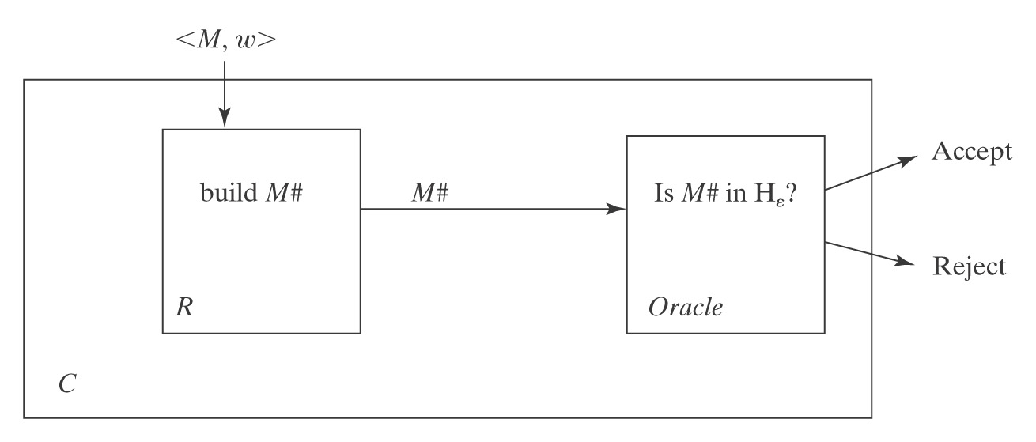
Hidden: A Block Diagram of C
Note: In all three places where M# appears in this diagram, it should be <M#>

Slide 24
Different Languages We Are Dealing With?
H = {<M, w> : TM M halts on input string w}
R
(?Oracle) H_{ε} {<M> : TM M halts on ε}
H contains strings of the form:
(q00,a00,q01,a10,←),(q00,a00,q01,a10,→),…,aaa
H_{ε} contains strings of the form:
(q00,a00,q01,a10,←),(q00,a00,q01,a10,→),…
The language on which some M halts contains strings of some arbitrary form, for example,
(letting Σ = {a, b}): aaaba
This slide comes after the proof, which was done on the board.

Slide 25
Different Machines We Are Dealing With?
H = {<M, w> : TM M halts on input string w}
R
(?Oracle) H_{ε} {<M> : TM M halts on ε}
R is a reduction from H to Hε:
R(<M, w>) =
1. Construct <M#>, where M#(x) operates as follows:
  1.1. Erase the tape.
  1.2. Write w on the tape.
  1.3. Run M on w.
2. Return <M#>.
● Oracle (the hypothesized machine to decide H_{ε}).
● R (the machine that builds M#. Actually exists).
● C (the composition of R with Oracle).
● M# (the machine we will pass as input to Oracle). Note that we never run it.
● M (the machine whose membership in H we are interested in determining;
thus also an input to R).

Slide 26
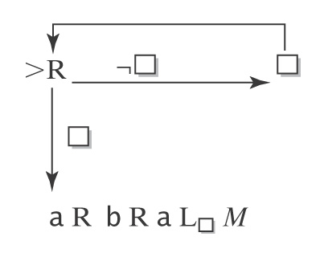
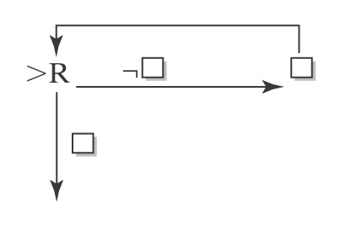
R Can Be Implemented as a Turing Machine
R must construct <M#> from <M, w>. Suppose w = aba.
M# will be:
So the procedure for constructing M# is:
1. Write:
2. For each character x in w do:
  2.1. Write x.
  2.2. If x is not the last character in w, write R.
3. Write L_{q} M.

Slide 27
Conclusion
R can be implemented as a Turing machine.
C is correct.
So, if Oracle exists:
C = Oracle(R(<M, w>)) decides H.
But no machine to decide H can exist.
So neither does Oracle.

Slide 28
This Result is Somewhat Surprising
If we could decide whether M halts on the specific string ε, we
could solve the more general problem of deciding whether M
halts on an arbitrary input.
Clearly, the other way around is true: If we could solve H we
could decide whether M halts on any one particular string.
But we have used reduction to show that (H undecidable implies
H_{ε} undecidable); this is not at all obvious.

Slide 29
Another Way to View the Reduction
// let L = {<M> | M is a TM that halts when its input is epsilon}
// if L is decidable, let the following function decide L:
boolean haltsOnEpsilon(TM M); // defined in magic.h
// HaltsOn decides H using HaltsOnEpsilon
// .: HaltsOn reduces to HaltsOnEpsilon:
bool haltsOn(TM M, string w) {
void wrapper(string iDontCare) {// a nested TM
M(w);
} {// end of nested TM
return haltsOnEpsilon(wrapper);
}
If HaltsOnEpsilon is a decision procedure, so is HaltsOn.
But of course HaltsOn is not, so neither is HaltsOnEpslipn

Slide 30
Important Elements in a Reduction Proof
A clear declaration of the reduction “from” and “to” languages.
A clear description of R.
If R is doing anything nontrivial, argue that it can be implemented as a TM.
Note that machine diagrams are not necessary or even sufficient in these proofs. Use them as thought devices, where needed.
Run through the logic that demonstrates how the “from” language is being decided by the composition of R and Oracle. You must do both accepting and rejecting cases.
Declare that the reduction proves that your “to” language is not in D.

Slide 31
The Most Common Mistake:
Doing the Reduction Backwards
The right way to use reduction to show that L₂ is not in D:
1. Given that L₁ is not in D, L₁
2. Reduce L₁ to L₂, i.e., show how to solve L₁
(the known one) in terms of L₂ (the unknown one) L₂
Doing it wrong by reducing L₂ (the unknown one) to L₁:
If there exists a machine M₁ that solves H, then we could build a
machine that solves L₂ as follows:
1. Return (M₁(<M, ε>)).
This proves nothing. It’s an argument of the form:
If False then …

Slide 32
H_{ANY} = {<M> : there exists at least one string on which TM M halts}
Theorem: H_{ANY} is in SD.
Proof: by exhibiting a TM T that semidecides it.
What about simply trying all the strings in Σ* one at a time
until one halts?

Slide 33
H_{ANY} is in SD
T(<M>) =
1. Use dovetailing* to try M on all of the elements of Σ*:
ε [1]
ε [2] a [1]
ε [3] a [2] b [1]
ε [4] a [3] b [2] aa [1]
ε [5] a [4] b [3] aa [2] ab [1]
2. If any instance of M halts, halt and accept.
T will accept iff M halts on at least one string. So T
semidecides H_{ANY.}
* http://en.wikipedia.org/wiki/Dovetailing_(computer_science)

Slide 34
H_{ANY} is not in D
Notes:
Slides 23-24 were originally hidden, intended to be done on the whiteboard, but we were out of time, so I unhid them and showed them quickly.

Slide 35
Hidden: H_{ANY} is not in D
H = {<M, w> : TM M halts on input string w}
R
(?Oracle) H_{ANY} = {<M> : there exists at least one string on which TM M halts}
R(<M, w>) =
1. Construct <M#>, where M#(x) operates as follows:
  1.1. Examine x.
  1.2. If x = w, run M on w, else loop.
2. Return <M#>.
If Oracle exists, then C = Oracle(R(<M, w>)) decides H:
● R can be implemented as a Turing machine.
● C is correct: The only string on which M# can halt is w. So:
● <M, w> ∈ H: M halts on w. So M# halts on w. There exists at least one
string on which M# halts. Oracle accepts.
● <M, w> ∉ H: M does not halt on w, so neither does M#. So there exists
no string on which M# halts. Oracle rejects.
But no machine to decide H can exist, so neither does Oracle.

Slide 36
Hidden: (Another R That Works)
Proof: We show that H_{ANY} is not in D by reduction from H:
H = {<M, w> : TM M halts on input string w}
R
(?Oracle) H_{ANY} = {<M> : there exists at least one string on which TM M
halts}
R(<M, w>) =
1. Construct the description <M#>, where M#(x) operates as follows:
  1.1. Erase the tape.
  1.2. Write w on the tape.
  1.3. Run M on w.
2. Return <M#>.
If Oracle exists, then C = Oracle(R(<M, w>)) decides H:
● C is correct: M# ignores its own input. It halts on everything or nothing. So:
● <M, w> ∈ H: M halts on w, so M# halts on everything. So it halts on at
least one string. Oracle accepts.
● <M, w> ∉ H: M does not halt on w, so M# halts on nothing. So it does not
halt on at least one string. Oracle rejects.
But no machine to decide H can exist, so neither does Oracle.

Slide 37
The Steps in a Reduction Proof
1.  Choose an undecidable language to reduce from.
2.  Define the reduction R.
3. Show that C (the composition of R with Oracle) is
correct.
✪ indicates where we make choices.

Slide 38
Undecidable Problems
(Languages That Aren’t In D)
The Problem View | The Language View
Does TM M halt on w? | H = {<M, w> : M halts on w}
Does TM M not halt on w? | ¬H = {<M, w> : M does not halt on w}
Does TM M halt on the empty tape? | H_{ε} = {<M> : M halts on ε}
Is there any string on which TM M halts? | H_{ANY} = {<M> : there exists at least one string on which TM M halts }
Does TM M accept all strings? | A_{ALL} = {<M> : L(M) = Σ*}
Do TMs M_{a} and M_{b} accept the same languages? | EqTMs = {<M_{a}, M_{b}> : L(M_{a}) = L(M_{b})}
Is the language that TM M accepts regular? | TMreg = {<M>:L(M) is regular}
Next: We examine proofs of some of these (some are also done in the book)
Notes:
We will prove some of these (most are done in the book)

Slide 39
H_{ALL} = {<M> : TM M halts on all inputs}
We show that H_{ALL} is not in D by reduction from H_{ε}.
H_{ε} = {<M> : TM M halts on ε}
R
(?Oracle) H_{ALL} = {<M> : TM M halts on all inputs }
R(<M>) =
1. Construct the description <M#>, where M#(x) operates as follows:
  1.1. Erase the tape.
  1.2. Run M.
2. Return <M#>.
If Oracle exists, then C = Oracle(R(<M>)) decides H_{ε}:
● R can be implemented as a Turing machine.
● C is correct: M# halts on everything or nothing, depending on whether M
halts on ε. So:
● <M> ∈ H_{ε}: M halts on ε, so M# halts on all inputs. Oracle accepts.
● <M> ∉ H_{ε}: M does not halt on ε, so M# halts on nothing. Oracle rejects.
But no machine to decide H_{ε} can exist, so neither does Oracle.

Slide 40
The Membership Question for TMs
We next define a new language:
A = {<M, w> : M accepts w}.
Note that A is different from H since it is possible that M
halts but does not accept. An alternative definition of A is:
A = {<M, w> : w ∈ L(M)}.

Slide 41
A = {<M, w> : w ∈ L(M)}
We show that A is not in D by reduction from H.
H = {<M, w> : TM M halts on input string w}
R
(?Oracle) A = {<M, w > : w ∈ L(M) }
R(<M, w>) =
1. Construct the description <M#>, where M#(x) operates as follows:
  1.1. Erase the tape.
  1.2. Write w on the tape.
  1.3. Run M on w.
  1.4. Accept
2. Return <M#, w>.
If Oracle exists, then C = Oracle(R(<M, w>)) decides H:
● R can be implemented as a Turing machine.
● C is correct: M# accepts everything or nothing. So:
● <M, w> ∈ H: M halts on w, so M# accepts everything. In particular, it
accepts w. Oracle accepts.
● <M, w > ∉ H: M does not halt on w. M# gets stuck in step 1.3 and so
accepts nothing. Oracle rejects.
But no machine to decide H can exist, so neither does Oracle.

Slide 42
A_{ε}, A_{ANY}, and A_{ALL}
Theorem: A_{ε} = {<M> : TM M accepts ε} is not in D.
Proof: Analogous to that for H_{ε}.
Theorem:
A_{ANY} = {<M> : TM M accepts at least one string}
is not in D.
Proof: Analogous to that for H_{ANY}.
Theorem: A_{ALL} = {<M> : = L(M) = Σ*} is not in D.
Proof: Analogous to that for H_{ALL}.

Slide 43
Are Security Properties Decidable?
 | process₁ | process₂ | process₃ | process₄ | file₁ | file₂
process₁ | execute |  | execute |  | own | read
process₂ |  | execute | execute |  |  | read
process₃ |  |  | execute |  |  | own
process₄ |  |  | execute | execute |  | read
Suppose we could show that rights don’t “leak”.
Then we could encode configurations of TMs in this framework:
q a b b q ...
q₅
 | s₁ | s₂ | s₃ | s₄
s₁ | q | own
s₂ |  | a | own
s₃ |  |  | b, q₅ | own
s₄ |  |  |  | b, end

Slide 44
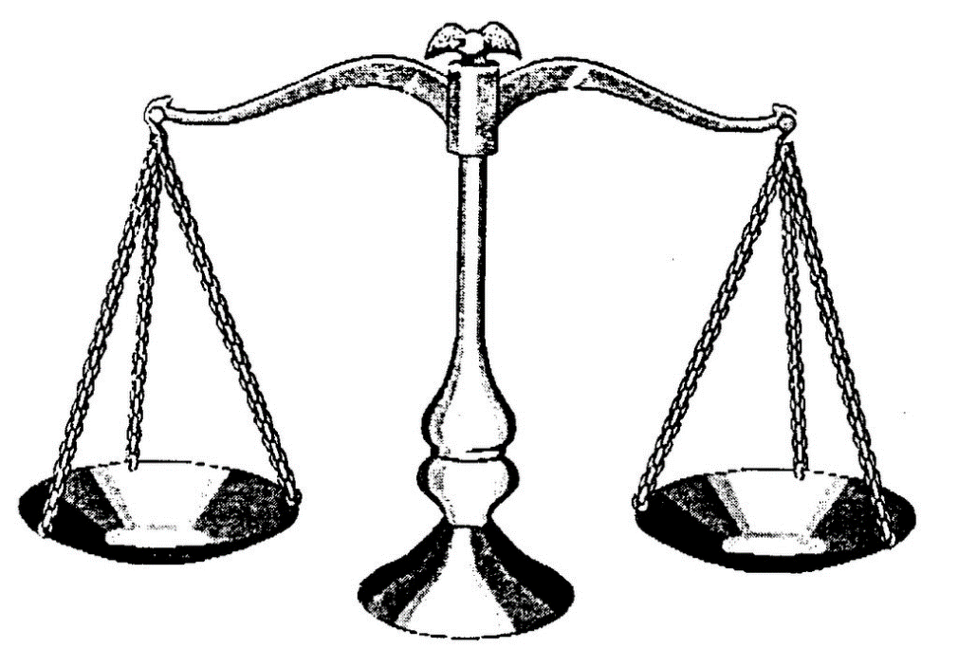
EqTMs={<M_{a}, M_{b}>: L(M_{a})=L(M_{b})}
M
?
Oracle for EqTMs

Slide 45
EqTMs={<M_{a}, M_{b}>: L(M_{a})=L(M_{b})}
A_{ANY} = {<M> : there exists at least one string on which TM M
halts}
R
(Oracle) EqTMs = {<M_{a}, M_{b}>: L(M_{a})=L(M_{b})}
R(<M>) =
1. Construct the description of M#(x):
  1.1. Accept.
2. Return <M, M#>.
If Oracle exists, then C = Oracle(R(<M>)) decides A_{ANY}:
● C is correct: M# accepts everything. So:
  ● <M> ∈ A_{ANY}: L(M) =? L(M#). Oracle ? Oops.
  ● <M> ∉ A_{ANY}: L(M) ≠ L(M#). Oracle rejects.
Notes:
Note that this attempt at reduction fails!
Correct reduction on next slide.

Slide 46
EqTMs={<M_{a}, M_{b}>: L(M_{a})=L(M_{b})}
A_{ALL} = {<M> : L(M) = Σ*}
R
(Oracle) EqTMs = {<M_{a}, M_{b}>: L(M_{a})=L(M_{b})}
R(<M>) =
1. Construct the description of M#(x):
  1.1. Accept.
2. Return <M, M#>.
If Oracle exists, then C = Oracle(R(<M>)) decides A_{ALL}:
● C is correct: M# accepts everything. So if L(M) = L(M#), M must
also accept everything. So:
● <M> ∈ A_{ALL}: L(M) = L(M#). Oracle accepts.
● <M> ∉ A_{ALL}: L(M) ≠ L(M#). Oracle rejects.
But no machine to decide A_{ALL} can exist, so neither does Oracle.

Slide 47
A Practical Consequence
Consider the problem of virus detection. Suppose that a
new virus V is discovered and its code is <V>.
● Is it sufficient for antivirus software to check solely for
occurrences of <V>?
● Is it possible for it to check for equivalence to V?

Slide 48
Sometimes Mapping Reducibility Isn’t Right
Recall that a mapping reduction from L₁ to L₂ is a computable function f where:
∀x∈Σ* (x ∈ L₁ ↔ f(x) ∈ L₂).
When we use a mapping reduction, we return:
Oracle(f(x))
Sometimes we need a more general ability to use Oracle
as a subroutine and then to do other computations after it
returns.

Slide 49
{<M> : M accepts no even length strings}
H = {< M, w> : TM M halts on input string w}
R
(?Oracle) L₂ = {<M> : M accepts no even length strings}
R(<M, w>) =
1. Construct the description <M#>, where M#(x) operates as follows:
  1.1. Erase the tape.
  1.2. Write w on the tape.
  1.3. Run M on w.
  1.4. Accept.
2. Return <M#>.
If Oracle exists, then C = Oracle(R(<M, w>)) decides H:
● C is correct: M# ignores its own input. It accepts everything or nothing,
depending on whether it makes it to step 1.4. So:
● <M, w> ∈ H: M halts on w. Oracle:
● <M, w> ∉ H: M does not halt on w. Oracle:
Problem:
Notes:
M halts → M# Accepts all strings. So Oracle rejects
M does not halt on w→ M# accepts nothing, So Oracle accepts.
So a strict Mapping reduction does not apply. By the Reduction R coupled with ¬, works fine.

Slide 50
{<M> : M accepts no even length strings}
H = {< M, w> : TM M halts on input string w}
R
(?Oracle) L₂ = {<M> : M accepts no even length strings}
R(<M, w>) =
1. Construct the description <M#>, where M#(x) operates as follows:
1.1. Erase the tape.
1.2. Write w on the tape.
  1.3. Run M on w.
  1.4. Accept.
2. Return <M#>.
If Oracle exists, then C = ¬Oracle(R(<M, w>)) decides H:
● R and ¬ can be implemented as Turing machines.
● C is correct:
● <M, w> ∈ H: M halts on w. M# accepts everything, including some
even length strings. Oracle rejects so C accepts.
● <M, w> ∉ H: M does not halt on w. M# gets stuck. So it accepts
nothing, so no even length strings. Oracle accepts. So C rejects.
But no machine to decide H can exist, so neither does Oracle.

Slide 51
Are All Questions about TMs Undecidable?
Let L = {<M> : TM M contains an even number of states}
Let L = {<M, w> : M halts on w within 3 steps}.
Let L_{q} = {<M, q> : there is some configuration
(p, uav) of M, with p ≠ q,
that yields a configuration whose state is q }.
Is L_{q} decidable?
Notes:
Ask students how they would do it?
Can easily determine this one by examining the description of M.
--------------------
Second one: Ask students how they would do it?
Again, we have the description. We can run the UTM to simulate three steps of M on W.
--------------------------
Ask students how they would do it?
Do a breadth-first search of states you can reach from p. If you reach an already-seen one, backtrack. If you reach q, halt and accept. If nothing else to try, halt and reject.

Slide 52
Is There a Pattern?
  ● Does L contain some particular string w?
  ● Does L contain ε?
  ● Does L contain any strings at all?
  ● Does L contain all strings over some alphabet Σ?
  ● A = {<M, w> : TM M accepts w}.
  ● A_{ε} = {<M> : TM M accepts ε}.
  ● A_{ANY} = {<M> : there exists at least one string that
  TM M accepts}.
  ● A_{ALL} = {<M> : TM M accepts all inputs}.
Notes:
We compare decision problems to language membership problems

Slide 53
Rice’s Theorem
  No nontrivial property of the SD languages is decidable.
  or
  Any language that can be described as:
  {<M>: P(L(M)) = True}
  for any nontrivial property P, is not in D.
  A nontrivial property is one that is not simply:
  True for all languages, or
  False for all languages.
Because of time constraints, we will skip the proof of this theorem.

Slide 54
Applying Rice’s Theorem
To use Rice’s Theorem to show that a language L is not in D we must:
● Specify property P.
● Show that the domain of P is the SD languages.
● Show that P is nontrivial:
● P is true of at least one language
● P is false of at least one language

Slide 55
Applying Rice’s Theorem
1. {<M> : L(M) contains only even length strings}.
2. {<M> : L(M) contains an odd number of strings}.
3. {<M> : L(M) contains all strings that start with a}.
4. {<M> : L(M) is infinite}.
5. {<M> : L(M) is regular}.
6. {<M> : M contains an even number of states}.
7. {<M> : M has an odd number of symbols in its tape
alphabet}.
8. {<M> : M accepts ε within 100 steps}.
9. {<M>: M accepts ε}.
10. {<M_{a}, M_{b}> : L(M_{a}) = L(M_{b})}.
Notes:
Cases 1-5. Domain of P is the set of SD languages, and P is non-trivial.
Cases 6-8. Domain is not languages but machines. So Rice's Theorem says nothing. All of these happen to be decidable
9 is stated in terms of M, but it is really about languages. So Rice's Theorem applies.
10. The problem domain is the set of pairs of SD languages, so the theorem does not apply. It turns out to be undecidable, but Rice's theorem does not show it.

Slide 56
Given a TM M, is L(M) Regular?
The problem: Is L(M) regular?
As a language: Is {<M> : L(M) is regular} in D?
No, by Rice’s Theorem:
● P = True if L is regular and False otherwise.
● The domain of P is the set of SD languages since it is
the set of languages accepted by some TM.
● P is nontrivial:
  ♦ P(a*) = True.
  ♦ P(A^{n}B^{n}) = False.
We can also show it directly, using reduction.
(Next slide)

Slide 57
Given a Turing Machine M, is L(M) Regular?
H = {<M, w> : TM M halts on input string w}
R
(Oracle) L₂ = {<M> : L(M) is regular}
R(<M, w>) =
1. Construct M#(x):
  1.1. Copy its input x to another track for later.
  1.2. Erase the tape.
  1.3. Write w on the tape.
  1.4. Run M on w.
  1.5. Put x back on the tape.
  1.6. If x ∈ A^{n}B^{n} then accept, else reject.
  2. Return <M#>.
Problem:
Notes:
If <M, w> is in H, then M halts on w, so M# makes it to 1.5 So it then accepts x iff x is in A^{n}B^{n}.
So M# accepts A^{n}B^{n}, which is not regular. So Oracle(<M#>) rejects.
If <M, w> is not in H, then M does not halt on w, so M# is stuck in step 1.4, therefore, it accepts nothing.
Thus Oracle(<M#> accepts.
So it is another backwards one. We need NOT also (next slide)

Slide 58
But We Can Flip
R(<M, w>) =
1. Construct the description <M#>, where M#(x) operates as follows:
  1.1. Save x for later.
  1.2. Erase the tape.
  1.3. Write w on the tape.
  1.4. Run M on w.
  1.5. Put x back on the tape.
  1.6. If x ∈ A^{n}B^{n} then accept, else reject.
  2. Return <M#>.
  If Oracle decides L₂, then C = ¬Oracle(R(<M, w>)) decides H:
  ● <M, w> ∈ H: M# makes it to step 1.5. Then it accepts x iff
  x ∈ A^{n}B^{n}. So M# accepts A^{n}B^{n}, which is not regular.
  Oracle rejects. C accepts.
  ● <M, w> ∉ H: M does not halt on w. M# gets stuck in step 1.4.
  It accepts nothing. L(M#) = ∅, which is regular.
  Oracle accepts. C rejects.
  But no machine to decide H can exist, so neither does Oracle.
Notes:
This is the same reduction as on the previous slide, but now we flip.

Slide 59
Or, Doing it Without Flipping
R(<M, w>) =
1. Construct the description <M#>, where M#(x) operates as follows:
  1.1. If x ∈ A^{n}B^{n} then accept, else:
  1.2. Erase the tape.
  1.3. Write w on the tape.
  1.4. Run M on w.
  1.5. Accept
2. Return <M#>.
If Oracle exists, C = Oracle(R(<M, w>)) decides H:
● C is correct: M# immediately accepts all strings in A^{n}B^{n}:
  ● <M, w> ∈ H: M# accepts everything else in step 1.5. So
  L(M#) = Σ*, which is regular. Oracle accepts.
  ● <M, w> ∉ H: M# gets stuck in step 1.4, so it accepts nothing
  else. L(M#) = A^{n}B^{n}, which is not regular. Oracle rejects.
  But no machine to decide H can exist, so neither does Oracle.

Slide 60
Any Nonregular Language Will Work
R(<M, w>) =
1. Construct the description <M#>, where M#(x) operates as follows:
  1.1. If x ∈ WW then accept, else:
  1.2. Erase the tape.
  1.3. Write w on the tape.
  1.4. Run M on w.
  1.5. Accept
2. Return <M#>.
If Oracle exists, C = Oracle(R(<M, w>)) decides H:
● C is correct: M# immediately accepts all strings WW:
  ● <M, w> ∈ H: M# accepts everything else in step 1.5. So
  L(M#) = Σ*, which is regular. Oracle accepts.
  ● <M, w> ∉ H: M# gets stuck in step 1.4, so it accepts nothing
  else. L(M#) = WW, which is not regular. Oracle rejects.
  But no machine to decide H can exist, so neither does Oracle.

Slide 61
Is L(M) Context-free?
How about: L₃ = {<M> : L(M) is context-free}?
R(<M, w>) =
1. Construct the description <M#>, where M#(x) operates as follows:
  1.1. If x ∈ A^{n}B^{n}C^{n} then accept, else:
  1.2. Erase the tape.
  1.3. Write w on the tape.
  1.4. Run M on w.
  1.5. Accept
2. Return <M#>.

Slide 62
Practical Impact of These Results
1. Does P, when running on x, halt?
2. Might P get into an infinite loop on some input?
3. Does P, when running on x, ever output a 0? Or anything at
all?
4. Are P₁ and P₂ equivalent?
5. Does P, when running on x, ever assign a value to n?
6. Does P ever reach S on any input (in other words, can we
chop it out?
7. Does P reach S on every input (in other words, can we
guarantee that S happens)?
● Can the Patent Office check prior art?
● Can the CS department buy the definitive grading program?

Slide 63
Turing Machine Questions Can be Reduced to Program Questions
EqPrograms =
{<P_{a}, P_{b}> : P_{a} and P_{b} are PL programs and L(P_{a}) = L(P_{b})}.
We can build, in any programming language PL, SimUM:
  that is a PL program
  that implements the Universal TM U and so can simulate an arbitrary TM.

Slide 64
{<M, q> : M reaches q on some input}
H_{ANY} = {<M> : there exists some string on which TM M halts}
R
(?Oracle) L₂ = {<M, q> : M reaches q on some input}
R(<M>) =
1. Build <M#> so that M# is identical to M except that, if M has a transition
((q₁, c₁), (q₂, c₂, d)) and q₂ is a halting state other than h, replace that
transition with:
((q₁, c₁), (h, c₂, d)).
2. Return <M#, h>.
If Oracle exists, then C = Oracle(R(<M>)) decides H_{ANY}:
● R can be implemented as a Turing machine.
● C is correct: M# will reach the halting state h iff M would reach some
halting state. So:
● <M> ∈ H_{ANY}: There is some string on which M halts. So there is some
string on which M# reaches state h. Oracle accepts.
● <M> ∉ H_{ANY}: There is no string on which M halts. So there is no string
on which M# reaches state h. Oracle rejects.
But no machine to decide H_{ANY} can exist, so neither does Oracle.
A good example, but the term is flying by, so we will skip it for now.

Slide 65

How many Turing machines does it take to change a light bulb?
One.
How can you tell whether your Turing machine is the one?
You can’t.
- Tim Nodine

Slide 66
Side Road with a purpose: obtainSelf
From Section 25.3:
In section 25.3, the author proves the existence of a very useful computable function: obtainSelf. When called as a subroutine by any Turing machine M, obtainSelf writes <M> onto M's tape.
Related to quines

Slide 67
Some quines
main(){char q=34, n=10,*a="main() {char q=34,n=10,*a=%c%s%c; printf(a,q,a,q,n);}%c";printf(a,q,a,q,n);}
((lambda (x) (list x (list 'quote x)))
(quote (lambda (x) (list x (list 'quote x)))))
Quine's paradox and a related sentence:
"Yields falsehood when preceded by its quotation" yields falsehood when preceded by its quotation.
"quoted and followed by itself is a quine." quoted and followed by itself is a quine.

Slide 68
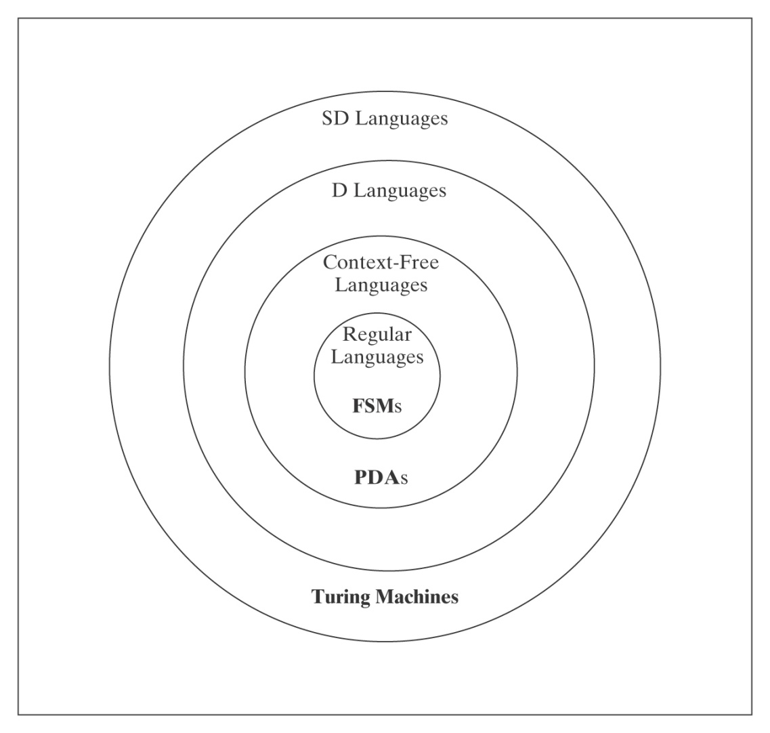
Non-SD Languages
There is an uncountable number of non-SD languages, but only a
countably infinite number of TM’s (hence SD languages). ∴The class
of non-SD languages is much bigger than that of SD languages!

Slide 69
Non-SD Languages
Intuition: Non-SD languages usually involve either infinite
search (where testing each potential member could loop forever) or determining whether the a TM will infinite loop.
Examples:
¬H = {<M, w> : TM M does not halt on w}.
{<M> : L(M) = Σ*}.
{<M> : TM M halts on nothing}.
Notes:
If M does halt on W, we'll eventually discover it. But how can we discover that it does not halt on w?

Slide 70
Proving Languages are not SD
● Contradiction
● L is the complement of an SD/D Language.
● Reduction from a known non-SD language

Slide 71
Contradiction
Theorem: TM_{MIN} =
{<M>: Turing machine M is minimal} is not in SD.
Proof: If TM_{MIN} were in SD, then there would exist some Turing
machine ENUM that enumerates its elements. Define the following
Turing machine:
M#(x) =
1. Invoke obtainSelf to produce <M#>.
2. Run ENUM until it generates the description of some Turing
machine M′ whose description is longer than |<M#>|.
3. Invoke U on the string <M′, x>.
Since TM_{MIN} is infinite, ENUM must eventually generate a string that
is longer than |<M#>|. So M# makes it to step 3 and thus M# is
Equivalent to M′ since it simulates M′. But, since |<M#>| < |<M′>|, M′
cannot be minimal.
But M#'s description was generated by ENUM. Contradiction.
Notes:
Obtainself exists (Recursion Theorem, chapter 25, something we won't get to in this course).
Basically it says that given any TM, there is an equivalent TM that can write its own description on one of its tape.
It is equivalent to a "Program that prints itself"

Slide 72
The Complement of L is in SD/D
Suppose we want to know whether L is in SD and we know:
● ¬L is in SD, and
● At least one of L or ¬L is not in D.
Then we can conclude that L is not in SD, because, if it were,
it would force both itself and its complement into D, which we
know cannot be true.
Example:
● ¬H (since ¬(¬H) = H is in SD and not in D)

Slide 73
A_{anbn} = {<M> : L(M) = A^{n}B^{n}}
A_{anbn} contains strings that look like:
(q00,a00,q01,a00,→),
(q00,a01,q00,a10,→),
(q00,a10,q01,a01,←),
(q00,a11,q01,a10,←),
(q01,a00,q00,a01,→),
(q01,a01,q01,a10,→),
(q01,a10,q01,a11,←),
(q01,a11,q11,a01,←)
It does not contain strings like aaabbb.
But A^{n}B^{n} does.

Slide 74
A_{anbn} = {<M> : L(M) = A^{n}B^{n}}
What’s wrong with this proof that A_{anbn} is not in SD?
¬H = {<M, w> : TM M does not halt on w}
R
(?Oracle) A_{anbn} = {<M> : L(M) = A^{n}B^{n}}
R(<M, w>) =
1. Construct the description <M#>, where M#(x) operates as follows:
1.1. Erase the tape.
1.2. Write w on the tape.
1.3. Run M on w.
  1.4. Accept.
2. Return <M#>.
If Oracle exists, C = Oracle(R(<M, w>)) semidecides ¬H:
Notes:
If <M, w> is in ¬H, L(M#) = ∅.
If <M, w> is not in ¬H, L(M#) is Σ*.
In neither case either is L(M#) = A^{n}B^{n}.
So Oracle makes no distinction between the two cases.

Slide 75
A_{anbn} = {<M> : L(M) = A^{n}B^{n}} is not SD
What about: ¬H = {<M, w> : TM M does not halt on w}
R
(?Oracle) A_{anbn} = {<M> : L(M) = A^{n}B^{n}}
R(<M, w>) =
1. Construct the description <M#>, where M#(x) operates as follows:
  1.1 Copy the input x to another track for later.
  1.2. Erase the tape.
  1.3. Write w on the tape.
  1.4. Run M on w.
  1.5. Put x back on the tape.
  1.6. If x ∈ A^{n}B^{n} then accept, else loop.
2. Return <M#>.
If Oracle exists, C = Oracle(R(<M, w>)) semidecides ¬H:
Notes:
If <M, w> is in ¬H, L(M#) = ∅.
If <M, w> is not in ¬H, L(M#) is A^{n}B^{n}. So Oracle gets it backwards.
Can we just use NOT? No because SD languages are not closed under complement!

Slide 76
A_{anbn} = {<M> : L(M) = A^{n}B^{n}} is not SD
R(<M, w>) reduces ¬H to A_{anbn}:
1. Construct the description <M#>:
  1.1. If x ∈ A^{n}B^{n} then accept. Else:
  1.2. Erase the tape.
  1.3. Write w on the tape.
  1.4. Run M on w.
  1.5. Accept.
  2. Return <M#>.
If Oracle exists, then C = Oracle(R(<M, w>)) semidecides ¬H:
M# immediately accepts all strings in A^{n}B^{n}. If M does not halt on
w, those are the only strings M# accepts. If M halts on w,
M# accepts everything:
● <M, w> ∈ ¬H: M does not halt on w, so M# accepts strings in
A^{n}B^{n} in step 1.1. Then it gets stuck in step 1.4, so it accepts
nothing else. It is an A^{n}B^{n} acceptor. Oracle accepts.
● <M, w> ∉ ¬H: M halts on w, so M# accepts everything.
Oracle does not accept.
But no machine to semidecide ¬H can exist, so neither does Oracle.

