Slide 1

MA/CSSE 474
Theory of Computation
Enumerability
Reduction

Slide 2
More on Dovetailing
Dovetailing: Run multiple (possibly an infinite number) of computations "in parallel".
S[i, j] represents step j of computation i.
  S[1, 1]
  S[2, 1] S[1, 2]
  S[3, 1] S[2, 2] S[1, 3]
  S[4, 1] S[3, 2] S[2, 3] S[1, 4 ]
  . . .
  For every i and j, step S[i, j] will eventually happen.

Slide 3
Enumeration
Enumerate means "list, in such a way that for any element, it appears in the list within a finite amount of time."
We say that Turing machine M enumerates the language L iff, for some fixed state p of M:
L = {w : (s, ε) |-_{M}* (p, w)}.
"p" stands for "print"
A language is Turing-enumerable iff there is a Turing machine that enumerates it.
Another term that is often used is recursively enumerable.
Notes:
Note that the machine is started with empty input. Whenever it gets to state p, it adds the string that is its tape contents to the list, then keeps running.

Slide 4
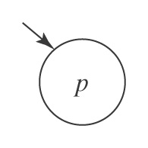
A Printing Subroutine
Let P be a Turing machine that enters state p and then halts:

Slide 5
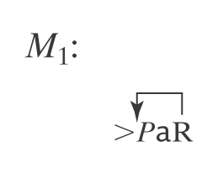
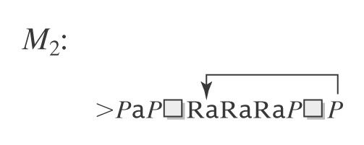
Examples of Enumeration
What languages do M₁ and M₂ enumerate?
Notes:
First Machine: a*
Second machine also A* : {epsilon, a, aaa, aa, aaaaa, aaaa, …}

Slide 6
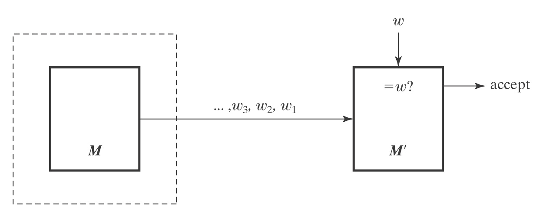
SD and Turing Enumerable
Theorem: A language is SD iff it is Turing-enumerable.
Proof that Turing-enumerable implies SD: Let M be the Turing machine that enumerates L. We convert M to a machine M' that semidecides L:
1. Save input w on another tape.
2. Begin enumerating L. Each time an element of L is
enumerated, compare it to w. If they match, accept.

Slide 7
The Other Way
Proof that SD implies Turing-enumerable:
If L ⊆ Σ* is in SD, then there is a Turing machine M that semidecides L.
A procedure E to enumerate all elements of L:
  1. Enumerate all w ∈ Σ* lexicographically.
  e.g., ε, a, b, aa, ab, ba, bb, …
  2. As each is enumerated, use M to check it.
w₃, w₂, w₁ ∈L? yes w
E
M
M'
Problem with this?

Slide 8
The Other Way
Proof that SD implies Turing-enumerable:
If L ⊆ Σ* is in SD, then there is a Turing machine M that semidecides L.
A procedure to enumerate all elements of L:
1. Enumerate all w ∈ Σ* lexicographically.
2. As each string w_{i} is enumerated:
  1. Start up a copy of M with w_{i} as its input.
  2. Execute one step of each M_{i} initiated so far, excluding those that have previously halted.
  3. Whenever an M_{i} accepts, output w_{i}.

Slide 9
Lexicographic Enumeration
M lexicographically enumerates L iff M enumerates the elements of L in lexicographic order.
A language L is lexicographically Turing-enumerable iff there is a Turing machine that lexicographically enumerates it.
Example: A^{n}B^{n}C^{n} = {a^{n}b^{n}c^{n} : n ≥ 0}
Lexicographic enumeration:
Notes:
Ask how a TM would do this?
A second tape that starts blank.
Repeat:
if n 1's on second tape:
write n a's, then n b's, then n c's.
enter state p
erase first tape and add a 1 to the end of the second tape.

Slide 10
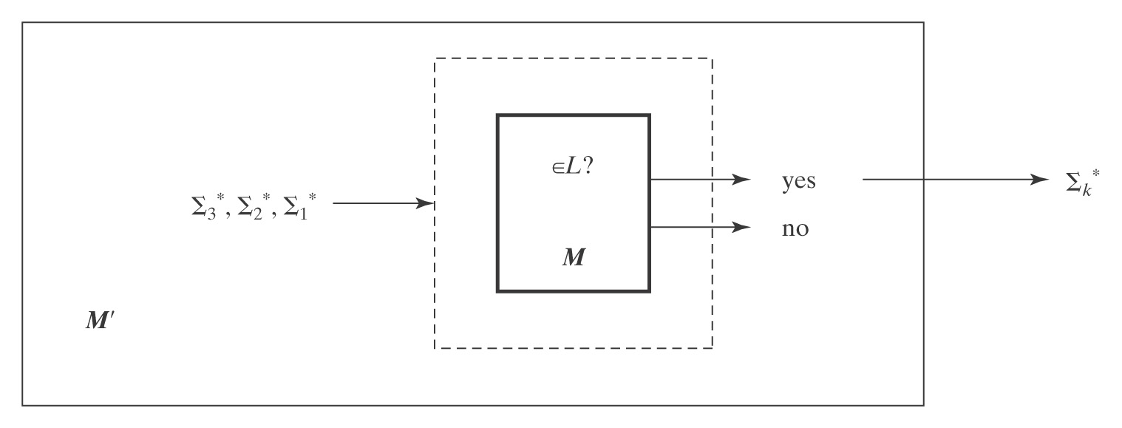
Lexicographically Enumerable = D
Theorem: A language is in D iff it is lexicographically Turing-enumerable.
Proof that D implies lexicographically TE: Let M be a Turing machine that decides L. M' lexicographically generates the strings in Σ* and tests each using M. It outputs those that are accepted by M. Thus M' lexicographically enumerates L.

Slide 11
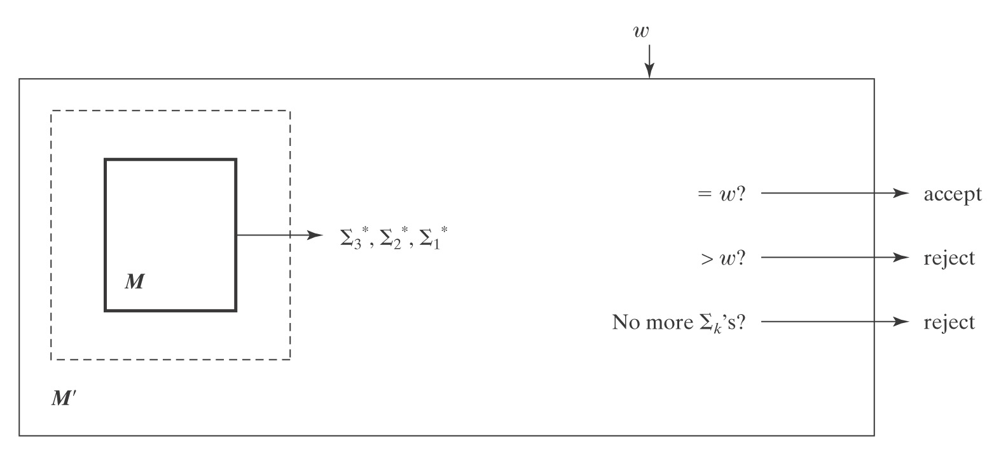
Proof, Continued
Proof that lexicographically Turing Enumerable implies D: Let M be a Turing machine that lexicographically enumerates L. Then, on input w, M' starts up M and waits until:
● M generates w (so M' accepts),
● M generates a string that comes after w (so M' rejects), or
● M halts (so M' rejects).
Thus M' decides L.

Slide 12
Language Summary
IN SD OUT
Semideciding TM H Reduction
Enumerable
Unrestricted grammar
D
Deciding TM A^{n}B^{n}C^{n} Diagonalize
Lexic. enum Reduction
L and ¬L in SD
Context-Free
CF grammar A^{n}B^{n} Pumping
PDA Closure
Closure
Regular
Regular Expression a*b* Pumping
FSM Closure

Slide 13
Overview of Reduction

Slide 14
Reducing Decision Problem P₁ to another Decision Problem P₂
We say that P1 is reducible to P₂ (written P₁ ≤ P₂) if
there is a Turing-computable function f that finds, for an arbitrary instance I of P₁, an instance f(I) of P₂, and
f is defined such that for every instance I of P₁,
I is a yes-instance of P₁ if and only if
f(I) is a yes-instance of P₂.
So P₁ ≤ P₂ means "if we have a TM that decides P₂, then there is a TM that decides P₁.

Slide 15
Example of Turing Reducibility
Let
P₁(n) = "Is the decimal integer n divisible by 4?"
P₂(n) = "Is the decimal integer n divisible by 2?"
f(n) = n/2 (integer division, which is clearly
Turing computable)
Then P₁(n) is "yes" iff
P₂(n) is "yes" and P₂(f(n)) is "yes" .
Thus P₁ is reducible to P₂, and we write P₁ ≤ P₂.
P₂ is clearly decidable (is the last digit an element of {0, 2, 4, 6, 8} ?), so P₁ is decidable

Slide 16
Reducing Language L₁ to L₂
Language L₁ (over alphabet Σ₁) is mapping reducible to language L₂
(over alphabet Σ₂) and we write L₁ ≤ L₂ if
there is a Turing-computable function
f : Σ₁* → Σ₂* such that
∀x ∈ Σ₁*, x ∈ L₁ if and only if f(x) ∈ L₂

Slide 17
Using reducibility
If P₁ is reducible to P₂, then
  If P₂ is decidable, so is P₁.
  If P₁ is not decidable, neither is P₂.
The second part is the one that we will use most.

Slide 18
Example of Reduction
● Compute a function (where x and y are unary representations of integers)
multiply(x, y) =
1. answer := ε.
2. For i := 1 to |y| do:
answer = concat (answer, x) .
3. Return answer.
So we reduce multiplication to addition. (concatenation)

Slide 19
Using Reduction for Undecidability
A reduction R from language L₁ to language L₂ is one or more Turing machines such that:
If there exists a Turing machine Oracle that decides (or
semidecides) L₂,
then the TMs in R can be composed with Oracle
to build a deciding (or semideciding) TM for L₁.
P ≤ P′ means that P is reducible to P′.

Slide 20
Using Reduction for Undecidability
(R is a reduction from L₁ to L₂) ∧ (L₂ is in D) → (L₁ is in D)
If (L₁ is in D) is false, then at least one of the two antecedents of that implication must be false. So:
If (R is a reduction from L₁ to L₂) is true
and (L1 is in D) is false,
then (L₂ is in D) must be false.
Application: If L1 is a language that is known to not be in D, and we can find a reduction from L1 to L2, then L2 is also not in D.

Slide 21
Using Reduction for Undecidability
Showing that L₂ is not in D:
L₁ (known not to be in D) L₁ in D But L₁ not in D
R
L₂ (a new language whose if L₂ in D L₂ not in D
decidability we are
trying to determine)

Slide 22
To Use Reduction for Undecidability
1. Choose a language L₁:
  ● that is already known not to be in D, and
  ● show that L₁ can be reduced to L₂.
2. Define the reduction R.
3. Describe the composition C of R with Oracle.
4. Show that C does correctly decide L₁ iff Oracle exists. We
do this by showing:
● R can be implemented by Turing machines,
● C is correct:
● If x ∈ L₁, then C(x) accepts, and
● If x ∉ L₁, then C(x) rejects.
Follow this outline in proofs that you submit.. We will see many examples in the next few sessions.
Example: H_{ε} = {<M> : TM M halts on ε}

Slide 23
Mapping Reductions
L₁ is mapping reducible to L₂ (L₁ ≤_{M} L₂) iff there exists
some computable function f such that:
∀x∈Σ* (x ∈ L₁ ↔ f(x) ∈ L₂).
To decide whether x is in L₁, we transform it, using f,
into a new object and ask whether that object is in L₂.
Example:
DecideNIM(x) = XOR-solve(transform(x))

Slide 24
show H_{ε} in SD but not in D
1. H_{ε} is in SD. T semidecides it:
T(<M>) =
1. Run M on ε.
2. Accept.
T accepts <M> iff M halts on ε, so T semidecides H_{ε}.
* Recall: "M halts on w" is a short way of saying "M, when started with input w, eventually halts"

Slide 25
H_{ε} = {<M> : TM M halts on ε}
2. Theorem: H_{ε} = {<M> : TM M halts on ε} is not in D.
Proof: by reduction from H:
H = {<M, w> : TM M halts on input string w}
R
(?Oracle) H_{ε} {<M> : TM M halts on ε}
R is a mapping reduction from H to H_{ε}:
R(<M, w>) =
1. Construct <M#>, where M#(x) operates as follows:
  1.1. Erase the tape.
  1.2. Write w on the tape and move the head to the left end.
  1.3. Run M on w.
2. Return <M#>.
H_{ε} ≤ H is intuitive, the other direction is not so obvious.
*
Notes:
R will transform any input of the form <M, w> into a new string, <M#>, suitable for input to Oracle.
We build a new TM M# such that M# halts on ε iff M halts on w.
To simplify the construction, we make M# ignore its own input, so it either always halts or never halts.
So M# erases its tape, writes w on the tape, moves the tape head left, then acts like M on w.

Slide 26
Proof, Continued
R(<M, w>) =
1. Construct <M#>, where M#(x) operates as follows:
  1.1. Erase the tape.
  1.2. Write w on the tape and move the head to the left end.
  1.3. Run M on w.
2. Return <M#>.
If Oracle exists, C = Oracle(R(<M, w>)) decides H:
● C is correct: M# ignores its own input. It halts on everything or
nothing. So:
● <M, w> ∈ H: M halts on w, so M# halts on everything. In
particular, it halts on ε. Oracle accepts.
● <M, w> ∉ H: M does not halt on w, so M# halts on nothing and
thus not on ε. Oracle rejects.

