Slide 1

MA/CSSE 474
Theory of Computation
Halting Problem

Slide 2
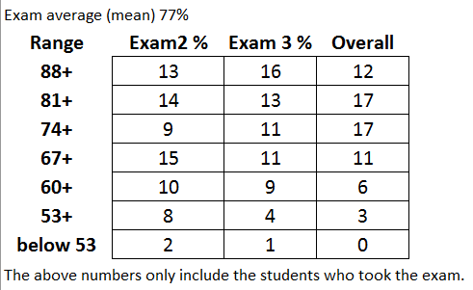
Your Questions?
Previous class days' material
Reading Assignments
HW 15 problems
Anything else

Slide 3
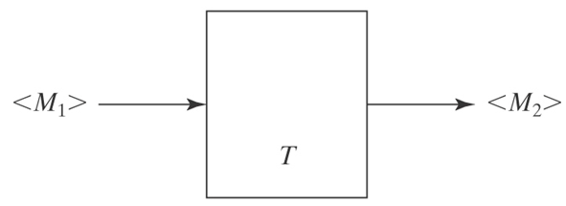
Key ideas so far
Let Σ_{U} be
{(, ), a, q, y, n, h, 0, 1, comma, →, ←}, ordered as listed
Any TM M may be encoded as a string <M> over alphabet Σ_{U}
We can design a TM T to take as input <M₁>, an encoding of TM M₁, and produce as output <M₂>, an encoding of TM M₂

Slide 4
Key ideas so far 2
We can lexicographically enumerate:
  All TM encodings
  All TM encodings with a given input alphabet
  All TM encodings with a given input alphabet and a given tape alphabet
For any TM M and any string w over M's input alphabet, we can encode the pair
M, w as a single string <M, w>

Slide 5
Key ideas so far 3
There is a universal TM U whose input alphabet is Σ_{U.}
If U is started with input <M,w>, it simulates the behavior of M, started with input w:
  If M does not halt, U does not halt
  If M halts and accepts, so does U
  If M halts and rejects, so does U
  If M is a "function computing" TM, then
  U leaves the same string on the tape that M would leave, so that U(<M, w>) = M(w)
Church-Turing Thesis (brief version):
"Computable" is equivalent to "computable by a Turing machine"

Slide 6
Recap: D and SD
  ● A TM M with input alphabet Σ decides a language L ⊆ Σ* iff,
  for any string w ∈ Σ*,
    ● if w ∈ L then M accepts w, and
    ● if w ∉ L then M rejects w.
  A language L is decidable (an element of D) iff there is a Turing machine M that decides it.
  ● A TM M with input alphabet Σ semidecides L iff for any string
  w ∈ Σ*,
    ● if w ∈ L then M accepts w
    ● if w ∉ L then M does not accept w.
    M may reject or loop.
  A language L is semidecidable (an element of SD) iff there is a Turing machine that semidecides it.

Slide 7
Defining the Universe
What is the complement of:
A^{n}B^{n} = {a^{n}b^{n} : n ≥ 0} ?
Depends on the universe:
That universe may be {a, b}*, or even {a, b, c, d}*, or could be {a^{k}b^{m}}
{<M, w> : TM M halts on input string w}
Universe may be Σ_{U}*, or could be
{<M, w> : M is a TM and w is a string over M's input alphabet}
Notes:
In both cases, depends on what the universe is.
1. Could be {a, b}*, or even {a, b, c, d}*, or could be {a^{k}b^{m}}
2. Could be everything in the language, or could be {<M, w> : M is a TM and w is a string over M's input alphabet.}

Slide 8
Defining the Universe
L₁ = {<M, w> : TM M halts on input string w}.
L₂ = {<M> : M doesn't halt on any input string}.
L₃ = {<M_{a}, M_{b}> : M_{a} and M_{b} halt on the same strings}.
For a string w to be in L₁, it must:
● be syntactically well-formed.
● encode a machine M and a string w such that M halts
when started on w.
Define the universe from which we are drawing strings to contain only those strings that meet the syntactic requirements of the language definition.
This convention has no impact on the decidability of any of these languages since the set of all syntactically valid strings is clearly in D.

Slide 9
A Different Definition of Complement
Our earlier definition:
¬L₁ = {x: x is not a syntactically well formed <M, w> pair}
∪
{<M, w> : TM M does not halt on input string w}.
We will use a different definition:
Define the complement of any language L whose member strings include at least one Turing machine description to be with respect to a universe of strings that are of the same syntactic form as L.
Now we have:
¬L₁ = {<M, w> : TM M does not halt on input string w}.

Slide 10
The Language H
Theorem: The language:
H = {<M, w> : TM M halts on input string w}
● is semidecidable, but
● is not decidable.
Proof soon! via two lemmas ..
We know that we can decide the halting question for specific simple TMs.
Or can we … ?

Slide 11
Does This Program Always Halt?
times3(x: positive integer) =
while x ≠ 1 do:
if x is even then x = x/2.
else x = 3x + 1
max = 100000
maxCount = 0
for i in range(1, max+1):
current = i
count = 0
while current != 1:
count += 1
if current % 2 == 0:
current /= 2
else:
current = 3 * current + 1
print "%7d %7d" % (i, count)
if count > maxCount:
maxCount = count
print "maxCount = ", maxCount
times3(25) …
Lothar Collatz, 1937, conjectured that times3 halts for all positive integers n. Still an open problem.
Paul Erdős: "Mathematics is not yet ready for such confusing, troubling, and hard problems."
http://mathworld.wolfram.com/CollatzProblem.html
Notes:
Slide is animated.
times3(25): 25 76 38 19 58 29 88 44 22 11 34 17 52 26 13 40 20 10 5 16 8 4 2 1
It is conjectured that this will halt for all x, but no one has been able to prove it yet.
I wrote a program to count the number of steps before halting for all numbers <= 100,000. The maximum number of steps was 350.
Look at the Word document that contains the output (in SlidesPPT folder). Notice the long string of 48's starting at i = 2987.
In 2008, Oliveira e Silva showed that it always halts for values of x that are ≤ 19 2⁵⁸.

Slide 12
Collatz function example
27, 82, 41, 124, 62, 31, 94, 47, 142, 71, 214, 107, 322, 161, 484, 242, 121, 364, 182, 91, 274, 137, 412, 206, 103, 310, 155, 466, 233, 700, 350, 175, 526, 263, 790, 395, 1186, 593, 1780, 890, 445, 1336, 668, 334, 167, 502, 251, 754, 377, 1132, 566, 283, 850, 425, 1276, 638, 319, 958, 479, 1438, 719, 2158, 1079, 3238, 1619, 4858, 2429, 7288, 3644, 1822, 911, 2734, 1367, 4102, 2051, 6154, 3077, 9232, 4616, 2308, 1154, 577, 1732, 866, 433, 1300, 650, 325, 976, 488, 244, 122, 61, 184, 92, 46, 23, 70, 35, 106, 53, 160, 80, 40, 20, 10, 5, 16, 8, 4, 2, 1
Notes:
Slide is animated.
times3(25): 25 76 38 19 58 29 88 44 22 11 34 17 52 26 13 40 20 10 5 16 8 4 2 1
It is conjectured that this will halt for all x, but no one has been able to prove it yet.
I wrote a program to count the number of steps before halting for all numbers <= 100,000. The maximum number of steps was 350.
Look at the Word document that contains the output (in SlidesPPT folder). Notice the long string of 48's starting at i = 2987.
In 2008, Oliveira e Silva showed that it always halts for values of x that are ≤ 19 2⁵⁸.

Slide 13
H is Semidecidable
Lemma: The language:
H = {<M, w> : TM M halts on input string w}
is semidecidable.
Proof: The TM M'_{H} semidecides H:
M'_{H}(<M, w>) =
1. Run M on w.
2. Accept.
M'_{H} accepts <M, w> iff M halts on w.
Thus M'_{H} semidecides H.
Notes:
Basis: Universal Turing machine

Slide 14
The Undecidability of the Halting Problem
Lemma: The language:
H = {<M, w> : TM M halts on input string w}
is not decidable.
Contradiction
Specification of halts
Trouble [in (Wabash) River City)]
halts(<Trouble, Trouble>) - what happens?

Slide 15
The Undecidability of the Halting Problem
Lemma: The language:
H = {<M, w> : TM M halts on input string w}
is not decidable.
Proof (by contradiction): Assume that H is decidable.
Then some TM M_{H} would decide it. M_{H} would implement the specification:
halts(<M, w>) =
if <M> is a Turing machine description
and M halts when given input w
then accept.
else reject.

Slide 16
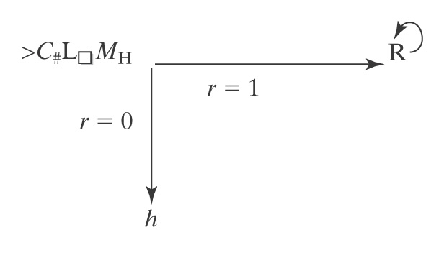
Trouble [in (Wabash) River City)]
Trouble(x: string) =
if halts(<x, x>) then loop forever, else halt.
If there is an M_{H} that computes the function halts, Trouble exists:
Consider halts(<Trouble, Trouble>):
● If M_{H} reports that Trouble(<Trouble>) halts, Trouble loops.
● But if M_{H} reports that Trouble(<Trouble>) does not halt, then
Trouble halts.
C# is the machine from several class sessions ago that makes a copy of the non-blank characters on the tape.
Note that it is important to this proof that Trouble be constructible from M_{H}
Notes:
http://www.youtube.com/watch?v=qam1fbQmA_s Trouble (from the Music Man)
3:05 is the place in the video to show
MH always halts, because it implements halts.
So here is an example for which MH gives the wrong answer. A contradiction, so a deciding MH does not exist.

Slide 17
Viewing the Halting Problem as Diagonalization
● Lexicographically enumerate Turing machine encodings and input strings.
● Let 1 mean halting, blank mean non halting.
 | i₁ | i₂ | i₃ | … | <Trouble> | …
<machine₁> | 1
machine₂> |  | 1
machine₃> |  |  |  |  | 1
… |  |  |  | 1
<Trouble> |  |  | 1 |  |  | 1
… | 1 | 1 | 1
… |  |  |  | 1
If M_{H} exists and decides membership in H, it must be able to correctly fill in any cell in this table.
What about the shaded square?
Notes:
Since the table enumerates all TMs, some row must be an encoding of Trouble.
If Trouble halts on input <Trouble>, then M_{H} puts a 1 in the cell. But then Trouble loops forever.
If Trouble doesn't halt on input Trouble, then M_{H} leaves the cell blank. So Trouble halts.

Slide 18
If H were in D, then SD would equal D
Recall: H = {<M, w> : TM M halts on input string w}
We know that H∈SD. If H were also in D, then there would exist a TM O that decides it.
Theorem: If H were in D then every SD language would be in D.
Proof: Let L be any SD language. There exists a TM M_{L} that semidecides it. The following machine M' decides whether w is in L(M_{L}):
M'(w: string) =
1. Run O on <M_{L}, w>. (O will always halt)
2. If O accepts (i.e., M_{L} will halt on input w), then:
  2.1. Run M_{L} on w.
  2.2. If it accepts, accept.
  2.3 Else reject.
3. Else reject.

Slide 19
Recap: The Entscheidungsproblem
  From Wikipedia: The Entscheidungsproblem ("decision problem", David Hilbert 1928) asks for an algorithm that will take as input a description of a formal language and a mathematical statement in the language, and produce as output either "True" or "False" according to whether the statement is true or false.
  The algorithm need not justify its answer, nor provide a proof, so long as it is always correct.

Slide 20
Back to the Entscheidungsproblem
Theorem: The Entscheidungsproblem is unsolvable.
Proof: (Due to Turing)
1. If we could solve the problem of determining whether a given Turing
machine ever prints the symbol 0, then we could solve the problem of
determining whether a given Turing machine halts.
2. But we can’t solve the problem of determining whether a given Turing
machine halts, so neither can we solve the problem of determining
whether it ever prints 0.
3. Given a Turing machine M, we can construct a logical formula F that is
true iff M ever prints the symbol 0.
4. If there were a solution to the Entscheidungsproblem, then we would
be able to determine the truth of any logical sentence, including F, and
thus be able to decide whether M ever prints the symbol 0.
5. But we know that there is no procedure for determining whether M
ever prints 0.
6. So there is no solution to the Entscheidungsproblem.

Slide 21
Decidable and Semidecidable Languages

Slide 22
Every CF Language is in D
  Theorem: The set of context-free languages is a proper subset of D.
  Proof:
  ● Every context-free language is decidable, so the context-
  free languages are a subset of D.
  ● There is at least one language, A^{n}B^{n}C^{n}, that is decidable
  but not context-free.
  So the context-free languages are a proper subset of D.

Slide 23
Decidable and Semidecidable Languages
Almost every obvious language that is in SD is also in D:
● A^{n}B^{n}C^{n} = {a^{n}b^{n}c^{n}, n ≥ 0}
● {wcw, w ∈ {a, b}*}
● {ww, w ∈ {a, b}*}
● {x∗y=z: x,y,z ∈ {0, 1}* and, when x, y, and z are viewed
as binary numbers, xy = z}
But there are languages that are in SD but not in D:
● H = {<M, w> : M halts on input w}

Slide 24
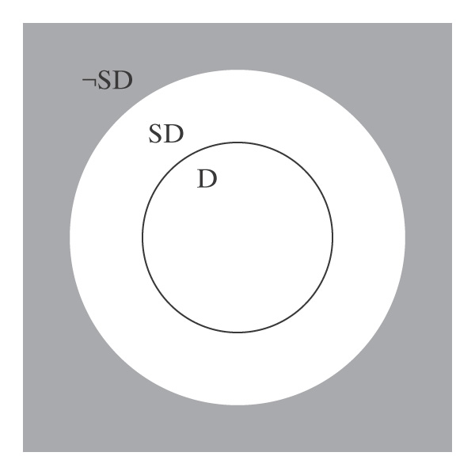
D and SD
D is a subset of SD. In other words, every decidable language is also semidecidable.
There exists at least one language that is in SD-D, the donut in the picture.
What about languages that are not in SD? Is the gray area of the figure empty?

Slide 25
Subset Relationships between D and SD
1. There exists at least one SD language that is not D.
2. Every language that is in D is also in SD: If L is in D, then there is a Turing machine M that decides it (by definition).
But M also semidecides it.

Slide 26
Languages That Are Not in SD
Theorem: There are languages that are not in SD.
Proof: Assume any nonempty alphabet Σ.
Lemma: There is a countably infinite number of SD languages over Σ.
Lemma: There is an uncountably infinite number of languages over Σ.
So there are more languages than there are languages in SD. Thus there must exist at least one language that is in ¬SD.

Slide 27
Closure of D Under Complement
Theorem: The set D is closed under complement.
Proof: (by construction) If L is in D, then there is a deterministic Turing machine M that decides it.
M:
y n
From M, we construct M′ to decide ¬L:

Slide 28
Closure of D Under Complement
Theorem: The set D is closed under complement.
Proof: (by construction)
M: M':
This works because, by definition, M is:
● deterministic
● complete
Since M' decides ¬L, ¬L is in D.
y
n
n
y

Slide 29
SD is Not Closed Under Complement
Can we use the same technique?
M: M':
y

Slide 30
SD is Not Closed Under Complement
Suppose we had:
M_{L}: M_{¬L}:
Accepts if input is in L. Accepts if input not in L.
Then we could decide L. How?
So every language in SD would also be in D.
But we know that there is at least one language (H) that is in SD but not in D. Contradiction.
Notes:
Run both machines. One of them will eventually halt.

Slide 31
D and SD Languages
Theorem: A language is in D iff both it and its complement are in SD.
Proof:
● L in D implies L and ¬L are in SD:
● L is in SD because D ⊂ SD.
● D is closed under complement
● So ¬L is also in D and thus in SD.
● L and ¬L are in SD implies L is in D:
● M₁ semidecides L.
● M₂ semidecides ¬L.
● To decide L:
● Run M₁ and M₂ in parallel on w.
● Exactly one of them will eventually accept.

Slide 32
A Particular Language that is Not in SD
Theorem: The language ¬H =
{<M, w> : TM M does not halt on input string w}
is not in SD.
Proof:
● H is in SD.
● If ¬H were also in SD then H would be in D.
● But H is not in D.
● So ¬H is not in SD.

Slide 33
Enumeration
Enumerate means "list, in such a way that for any element, it appears in the list within a finite amount of time."
We say that Turing machine M enumerates the language L iff, for some fixed state p of M:
L = {w : (s, ε) |-_{M}* (p, w)}.
"p" stands for "print"
A language is Turing-enumerable iff there is a Turing machine that enumerates it.
Another term that is often used is recursively enumerable.
Notes:
Note that the machine is started with empty input. Whenever it gets to state p, it adds the string that is its tape contents to the list, then keeps running.

Slide 34
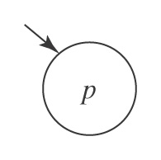
A Printing Subroutine
Let P be a Turing machine that enters state p and then halts:

Slide 35
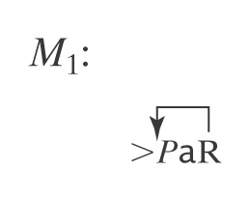
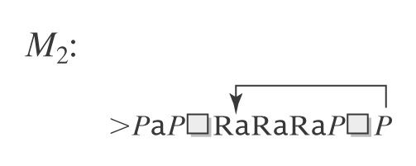
Example of Enumeration
Let L = a*.
Q11
Notes:
Second machine : {epsilon, a, aaa, aa, aaaaa, aaaa, …}

Slide 36
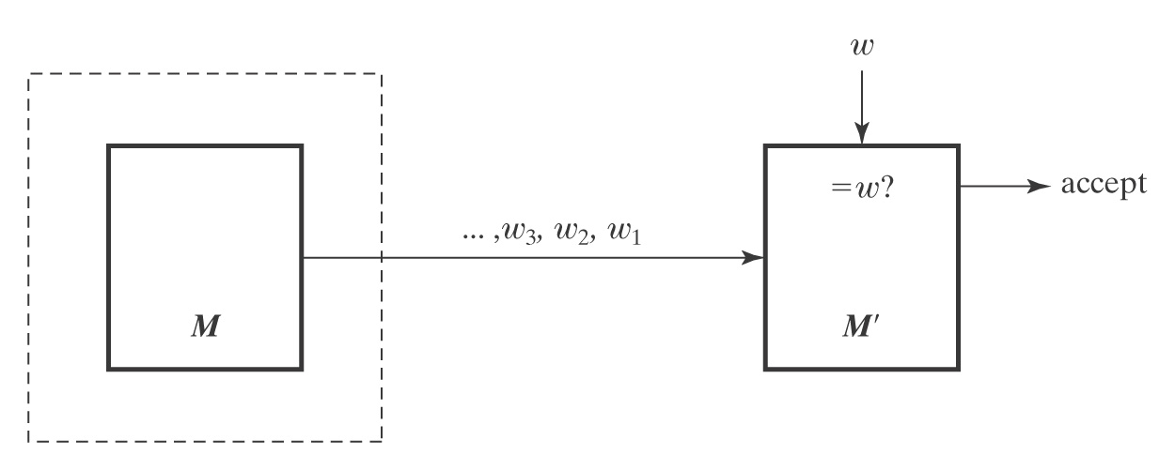
SD and Turing Enumerable
Theorem: A language is SD iff it is Turing-enumerable.
Proof that Turing-enumerable implies SD: Let M be the Turing machine that enumerates L. We convert M to a machine M' that semidecides L:
1. Save input w on another tape.
2. Begin enumerating L. Each time an element of L is
enumerated, compare it to w. If they match, accept.

Slide 37
The Other Way
Proof that SD implies Turing-enumerable:
If L ⊆ Σ* is in SD, then there is a Turing machine M that semidecides L.
A procedure E to enumerate all elements of L:
  1. Enumerate all w ∈ Σ* lexicographically.
  e.g., ε, a, b, aa, ab, ba, bb, …
  2. As each is enumerated, use M to check it.
w₃, w₂, w₁ ∈L? yes w
E
M
M'
Problem?

Slide 38
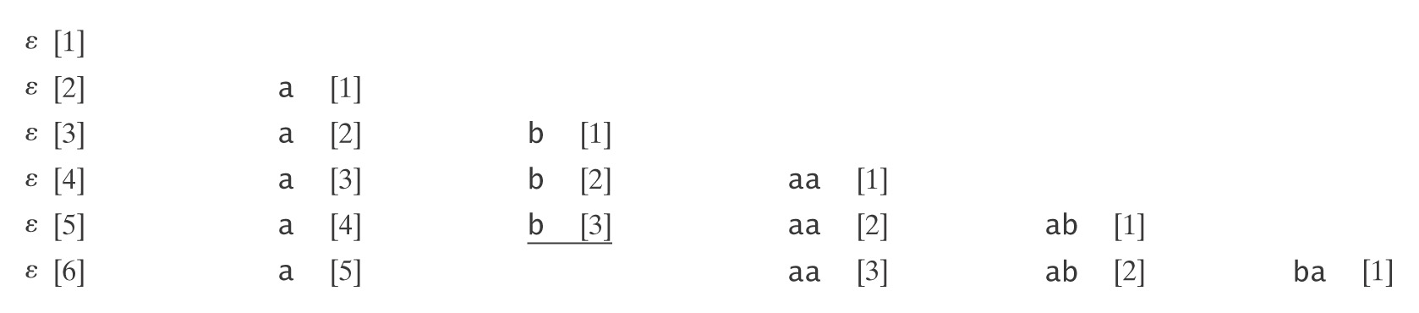
Dovetailing

Slide 39
The Other Way
Proof that SD implies Turing-enumerable:
If L ⊆ Σ* is in SD, then there is a Turing machine M that semidecides L.
A procedure to enumerate all elements of L:
1. Enumerate all w ∈ Σ* lexicographically.
2. As each string w_{i} is enumerated:
  1. Start up a copy of M with w_{i} as its input.
  2. Execute one step of each M_{i} initiated so far, excluding only those that have previously halted.
  3. Whenever an M_{i} accepts, output w_{i}.

Slide 40
Lexicographic Enumeration
M lexicographically enumerates L iff M enumerates the elements of L in lexicographic order.
A language L is lexicographically Turing-enumerable iff there is a Turing machine that lexicographically enumerates it.
Example: A^{n}B^{n}C^{n} = {a^{n}b^{n}c^{n} : n ≥ 0}
Lexicographic enumeration:
Notes:
Ask how a TM would do this?
A second tape that starts blank.
Repeat:
if n 1's on second tape:
write n a's, then n b's, then n c's.
enter state p
erase first tape and add a 1 to the end of the second tape.

Slide 41
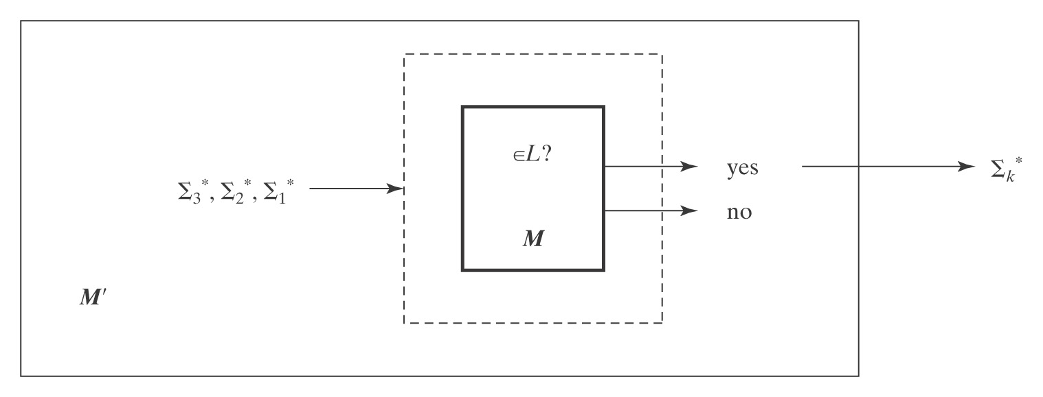
Lexicographically Enumerable = D
Theorem: A language is in D iff it is lexicographically Turing-enumerable.
Proof that D implies lexicographically TE: Let M be a Turing machine that decides L. Then M' lexicographically generates the strings in Σ* and tests each using M. It outputs those that are accepted by M. Thus M' lexicographically enumerates L.

Slide 42
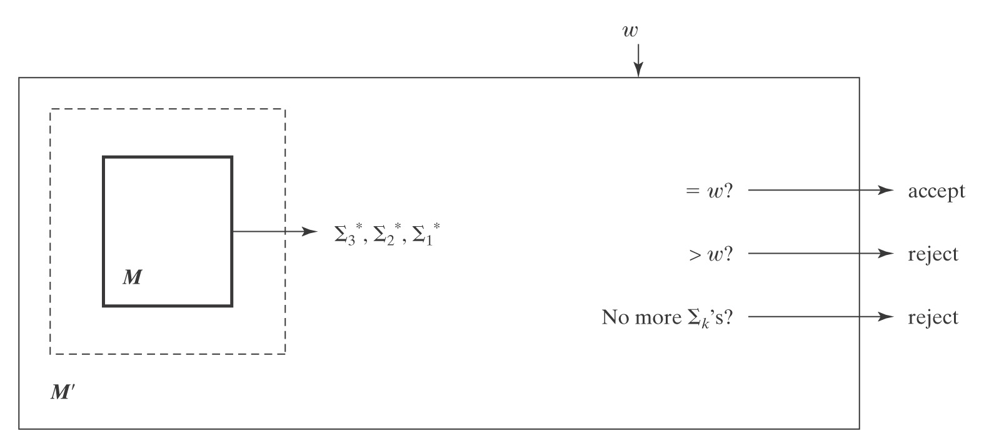
Proof, Continued
Proof that lexicographically Turing Enumerable implies D: Let M be a Turing machine that lexicographically enumerates L. Then, on input w, M' starts up M and waits until:
● M generates w (so M' accepts),
● M generates a string that comes after w (so M' rejects), or
● M halts (so M' rejects).
Thus M' decides L.

Slide 43
Language Summary
IN SD OUT
Semideciding TM H Reduction
Enumerable
Unrestricted grammar
D
Deciding TM A^{n}B^{n}C^{n} Diagonalize
Lexic. enum Reduction
L and ¬L in SD
Context-Free
CF grammar A^{n}B^{n} Pumping
PDA Closure
Closure
Regular
Regular Expression a*b* Pumping
FSM Closure

