Slide 1
Universal Turing Machine
Church-Turing Thesis
The Halting Problem
Variations:
Multiple tracks
Multiple tapes
Non-deterministic

Slide 2
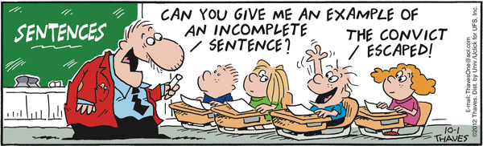
Your Questions?
Previous class days' material
Reading Assignments
HW 14b problems
Exam 3
Anything else

Slide 3
An Encoding Example
Consider M = ( { s, q, h }, { a, b, c }, { q, a, b, c }, δ, s, { h } ):
<M> = (q00,a00,q01,a00,→), (q00,a01,q00,a10,→),
(q00,a10,q01,a01, ←), (q00,a11,q01,a10,←),
(q01,a00,q00,a01,→), (q01,a01,q01,a10,→),
(q01,a10,q01,a11,←), (q01,a11,h10,a01,←)
state | symbol | δ
s | q | (q, q, →)
s | a | (s, b, →)
s | b | (q, a, ←)
s | c | (q, b, ←)
q | q | (s, a,→)
q | a | (q, b, →)
q | b | (q, b, ←)
q | c | (h, a, ←)
state/symbol | representation
s | q00
q | q01
h | h10
q | a00
a | a01
b | a10
c | a11
Decision problem: Given a string w, is there a TM M such that w=<M> ?
Is this problem decidable?
Notes:
Is the language of TM encodings regular, CF?
No in both cases, because we need to make sure that the encodings of all state representations have the same number of bits

Slide 4
Encoding Multiple Inputs
Let:
<x₁, x₂, …x_{n}>
represent a single string that encodes the sequence of individual values:
x₁, x₂, …x_{n}.

Slide 5
The Specification of the Universal TM
On input <M, w>, U must:
● Halt iff M halts on w.
● If M is a deciding or semideciding machine, then:
  ● If M accepts, accept.
  ● If M rejects, reject.
● If M computes a function, then U(<M, w>) must equal M(w).

Slide 6
How U Works
U will use 3 tapes:
● Tape 1: M’s tape.
● Tape 2: <M>, the “program” that U is running.
● Tape 3: M’s state.

Slide 7
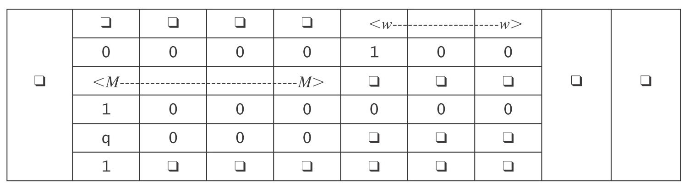
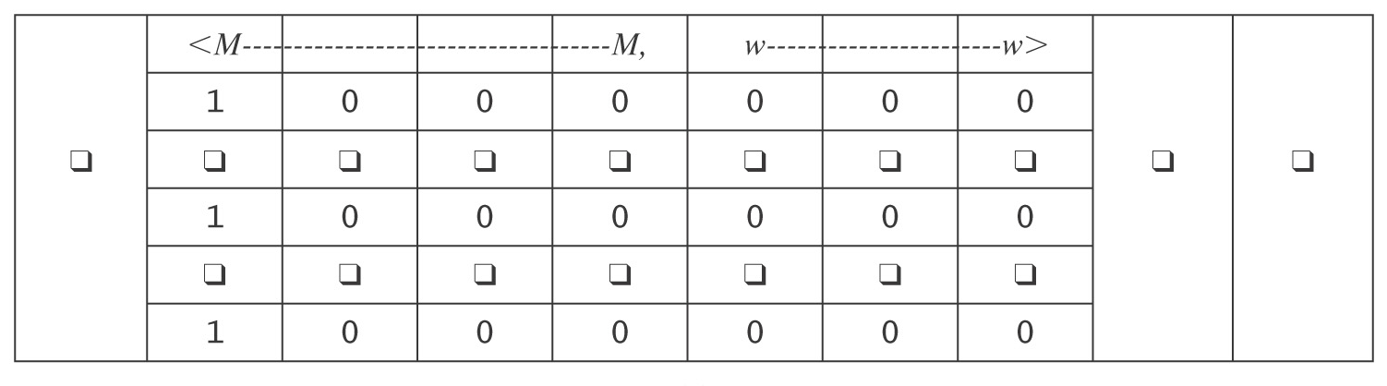
The Universal TM
Initialization of U:
1. Copy <M> onto tape 2.
2. Look at <M>, figure out what i is, and write the encoding of state
s on tape 3.
After initialization:

Slide 8
The Operation of U
Simulate the steps of M :
1. Until M would halt do:
  1.1 Scan tape 2 for a quintuple that matches the current state,
  input pair.
  1.2 Perform the associated action, by changing tapes 1 and 3. If
  necessary, extend the tape.
  1.3 If no matching quintuple found, halt. Else loop.
2. Report the same result M would report.
How long does U take?
Notes:
If M would halt in k steps, U must go through this loop k times.
Each time through the loop it must scan <M> to decide what to do. So k(|<M>|).
But it's worse because of the squaring in the simulation of a Multitape TM by a multitrack TM.

Slide 9
If A Universal Machine is Such a Good Idea …
Could we define a Universal Finite State Machine?
Such a FSM would accept the language:
L = {<F, w> : F is a FSM, and w ∈ L(F) }

Slide 10
Enumerating Turing Machines
Theorem: There exists an infinite lexicographic enumeration of:
(a) All syntactically valid TMs.
(b) All syntactically valid TMs with specific input alphabet Σ.
(c) All syntactically valid TMs with specific input alphabet Σ and specific tape alphabet Γ.

Slide 11
Enumerating Turing Machines
Proof: Fix Σ = {(, ), a, q, y, n, 0, 1, comma, →, ←}, ordered as listed. Then:
1. Lexicographically enumerate the strings in Σ*.
2. As each string s is generated, check to see whether
it is a syntactically valid Turing machine description.
If it is, output it.
To restrict the enumeration to symbols in sets Σ and Γ, check, in step 2, that only alphabets of the appropriate sizes are allowed.
We can now talk about the i^{th} Turing machine.

Slide 12
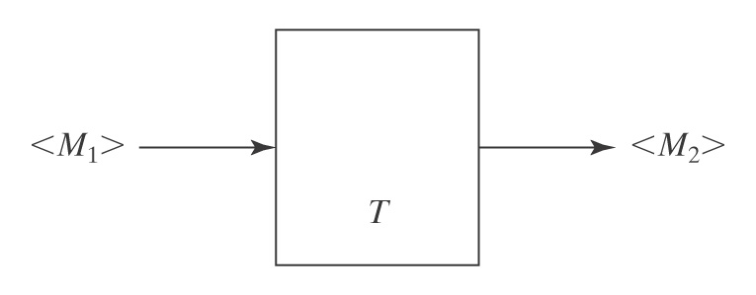
Another Benefit of Encoding
Benefit of defining a way to encode any Turing machine M:
● We can talk about operations on programs (TMs).

Slide 13
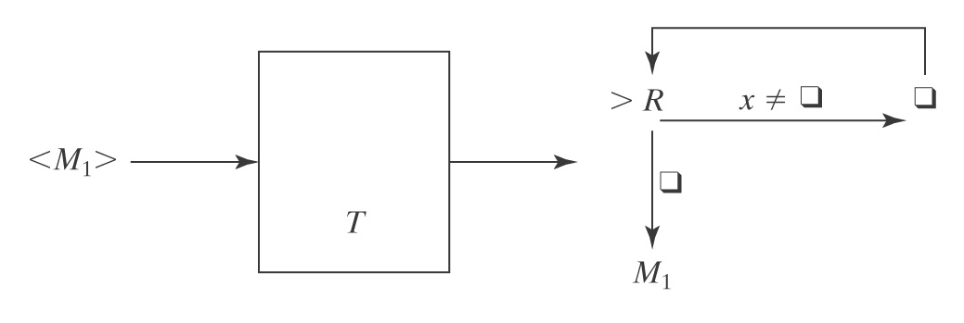
Example of a Transforming TM T:
Input: a TM M₁ that reads its input tape and performs
some operation P on it.
Output: a TM M₂ that performs P on an empty input tape.
The machine M₂ (output of T) empties its tape, then runs M₁.

Slide 14
The Church-Turing Thesis

Slide 15
Are We Done?
In this course: FSM ⇒ PDA ⇒ Turing machine
Is this the end of the line?
There are still problems that we cannot solve with a TM:
● There is a countably infinite number of Turing machines
since we can lexicographically enumerate all the strings
that correspond to syntactically legal Turing machines.
● There is an uncountably infinite number of languages over
any nonempty alphabet.
● So there are more languages than there are Turing
machines.
Notes:
So should we keep going, looking for a more powerful computational model?
Any model where a machine is describable by a finite string is going to suffer the counting constraint listed on this slide.
Is there some COMPUTATIONAL problem that can't be implemented by a TM?

Slide 16
What Can Algorithms Do?
Can we come up with a system of axioms that makes all true statements be theorems (I.e. provable from the axioms)?
The set of axioms can be infinite, but it must be decidable
Can we always decide whether, given a set of axioms, a statement is a theorem or not?
In the early 20th century, it was widely believed that the answer to both questions was "yes."
Notes:
In the early 20th century, mathematicians, led by David Hilbert, laid out plans to solve the major mathematical problems of the day. See "Hilbert's problems." There were 23 of them. About 2/3 are resolved; a few were stated in a way that is too vague for us to determine whether they are resolved.

Slide 17
Gödel’s Incompleteness Theorem
Kurt Gödel showed, in the proof of his Incompleteness Theorem [Gödel 1931], that the answer to question 1 is no. In particular, he showed that there exists no decidable axiomaitization of Peano arithmetic that is both consistent and complete.
Complete: All true statements in the language of the theory are theorems
Notes:
Godel showed that if a decidable set of axioms is consistent, then there must be true statements that are not provable form the axioms.

Slide 18
The Entscheidungsproblem
  From Wikipedia: The Entscheidungsproblem ("decision problem", David Hilbert 1928) asks for an algorithm that will take as input a description of a formal language and a mathematical statement in the language, and produce as output either "True" or "False" according to whether the statement is true or false. The algorithm need not justify its answer, nor provide a proof, so long as it is always correct.
  Three equivalent formulations:
  Does there exist an algorithm to decide, given an arbitrary sentence w in first order logic, whether w is valid?
  Given a set of axioms A and a sentence w, does there exist an algorithm to decide whether w is entailed by A?
  Given a set of axioms, A, and a sentence, w, does there exist an algorithm to decide whether w can be proved from A?

Slide 19
The Entscheidungsproblem
To answer the question, in any of these forms, requires formalizing the definition of an algorithm:
● Turing: Turing machines.
● Church: lambda calculus.
Turing proved that Turing machines and the lambda calculus are equivalent.

Slide 20
Church's Thesis
(Church-Turing Thesis)
All formalisms powerful enough to describe everything we think of as a computational algorithm are equivalent.
This isn’t a formal statement, so we can’t prove it. But many different computational models have been proposed and they all turn out to be equivalent.

Slide 21
The Church-Turing Thesis
Examples of equivalent formalisms:
● Modern computers (with unbounded memory)
● Lambda calculus
● Partial recursive functions
● Tag systems (FSM plus FIFO queue)
● Unrestricted grammars:
aSa → B
● Post production systems
● Markov algorithms
● Conway’s Game of Life
● One dimensional cellular automata
● DNA-based computing
● Lindenmayer systems

Slide 22
The Lambda Calculus
The successor function:
(λ x. x + 1) 3 = 4
Addition: (λ x. λ y. x + y) 3 4
This expression is evaluated by binding 3 to x to create the new function (λ y. 3 + y), which is applied to 4 to return 7.
In the pure lambda calculus, there is no built in number data type. All expressions are functions. But the natural numbers can be defined as lambda calculus functions. So the lambda calculus can effectively describe numeric functions.
Notes:
As most of you know, Lisp (and its cousin Scheme) was invented partially as an implementation of the lambda calculus.

Slide 23
The Lambda Calculus
> (define Y
(lambda (f)
((lambda (x) (f (lambda (y) ((x x) y))))
(lambda (x) (f (lambda (y) ((x x) y)))))))
> (define H
(lambda (g)
(lambda (n)
(if (zero? n)
1
(* n (g (- n 1)))))))
> ((Y H) 5)
120
>

Slide 24

Λ-Calculus in Scheme
> (((lambda (f)
((lambda (x) (f (lambda (y) ((x x) y))))
(lambda (x) (f (lambda (y) ((x x) y))))))
(lambda (g)
(lambda (n)
(if (zero? n)
1
(* n (g (- n 1)))))))
5)
120
The Applicative Y Combinator
Notes:
As most of you know, Lisp was invented partially as am implementation of the lambda calculus.
John McCarthy, its inventor died two years ago (January 2012)
Knights of the Lambda Calculus emblem.

Slide 25
Tag Systems
A tag system (or a Post machine) is an FSM augmented with a FIFO queue.
Simple for WW:
Not so simple for PalEven

Slide 26
The Power of Tag Systems
Tag systems are equivalent in power to Turing machines because the TM’s tape can be simulated with the FIFO queue.
Suppose that we put abcde into the queue:
a b c d e
To read the queue, we must remove the a first.
But suppose we want to remove e first:

Slide 27
The Power of Tag Systems
Tag systems are equivalent in power to Turing machines because the TM’s tape can be simulated with the FIFO queue.
Suppose that we push abcde onto the queue:
a b c d e
To read the queue, we must remove the a first.
But suppose we want to remove e first:
Treat the queue as a loop.

Slide 28

The Game of Life
At each step of the computation, the value for each cell is determined by computing the number of neighbors (up to a max of 8) it currently has, according to the following rules:
● A dead cell with exactly three live neighbors becomes a live cell
(birth).
● A live cell with two or three live neighbors stays alive (survival).
● In all other cases, a cell dies or remains dead (overcrowding or
loneliness).
We’ll say that a game halts iff it reaches some stable configuration.

Slide 29


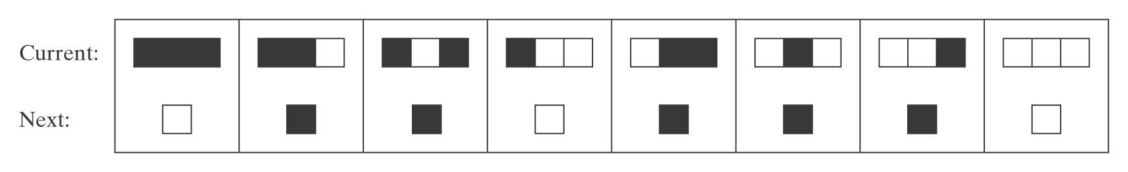
Elementary Cellular Automata
Wolfram’s Rule 110 is a universal
computer, if you can figure out how to encode the
program and the input in the initial configuration:
For some fascinating pictures, look up Rule 110.
Conjectured in 1985 to be Turing complete, proved in 2000 by Matthew Cook.
Also: http://en.wikipedia.org/wiki/A_New_Kind_of_Science
Notes:
Talk about the Wolfram-Cook controversy.

Slide 30
Background for The Halting Problem

Slide 31
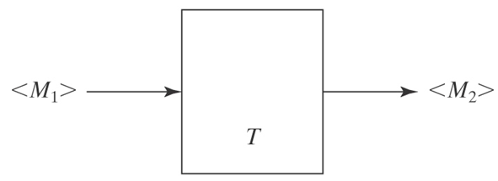
Key ideas so far
Let Σ_{U} be
{(, ), a, q, y, n, h, 0, 1, comma, →, ←}, ordered as listed
Any TM M may be encoded as a string <M> over alphabet Σ_{U}
We can design a TM T to take as input <M₁>, an encoding of TM M₁, and produce as output <M₂>, an encoding of TM M₂

Slide 32
Key ideas so far 2
We can lexicographically enumerate:
  All TM encodings
  All TM encodings with a given input alphabet
  All TM encodings with a given input alphabet and a given tape alphabet
For any TM M and any string w over M's input alphabet, we can encode the pair
M, w as a single string <M, w>

Slide 33
Key ideas so far 3
There is a universal TM U whose input alphabet is Σ_{U.}
If U is started with input <M,w>, it simulates the behavior of M, started with input w:
  If M does not halt, U does not halt
  If M halts and accepts, so does U
  If M halts and rejects, so does U
  If M is a "function computing" TM, then
  U leaves the same string on the tape that M would leave, so that U(<M, w>) = M(w)
Church-Turing Thesis (brief version):
"Computable" is equivalent to "computable by a Turing machine"

Slide 34
Recap: D and SD
  ● A TM M with input alphabet Σ decides a language L ⊆ Σ* iff,
  for any string w ∈ Σ*,
    ● if w ∈ L then M accepts w, and
    ● if w ∉ L then M rejects w.
  A language L is decidable (an element of D) iff there is a Turing machine M that decides it.
  ● A TM M with input alphabet Σ semidecides L iff for any string
  w ∈ Σ*,
    ● if w ∈ L then M accepts w
    ● if w ∉ L then M does not accept w.
    M may reject or loop.
  A language L is semidecidable (an element of SD) iff there is a Turing machine that semidecides it.

Slide 35
Defining the Universe
What is the complement of:
A^{n}B^{n} = {a^{n}b^{n} : n ≥ 0} ?
Depends on the universe:
That universe may be {a, b}*, or even {a, b, c, d}*, or could be {a^{k}b^{m}}
{<M, w> : TM M halts on input string w}
Universe may be Σ_{U}*, or could be
{<M, w> : M is a TM and w is a string over M's input alphabet}
Notes:
In both cases, depends on what the universe is.
1. Could be {a, b}*, or even {a, b, c, d}*, or could be {a^{k}b^{m}}
2. Could be everything in the language, or could be {<M, w> : M is a TM and w is a string over M's input alphabet.}

Slide 36
Defining the Universe
L₁ = {<M, w> : TM M halts on input string w}.
L₂ = {<M> : M doesn't halt on any input string}.
L₃ = {<M_{a}, M_{b}> : M_{a} and M_{b} halt on the same strings}.
For a string w to be in L₁, it must:
● be syntactically well-formed.
● encode a machine M and a string w such that M halts
when started on w.
Define the universe from which we are drawing strings to contain only those strings that meet the syntactic requirements of the language definition.
This convention has no impact on the decidability of any of these languages since the set of all syntactically valid strings is clearly in D.

Slide 37
A Different Definition of Complement
Our earlier definition:
¬L₁ = {x: x is not a syntactically well formed <M, w> pair}
∪
{<M, w> : TM M does not halt on input string w}.
We will use a different definition:
Define the complement of any language L whose member strings include at least one Turing machine description to be with respect to a universe of strings that are of the same syntactic form as L.
Now we have:
¬L₁ = {<M, w> : TM M does not halt on input string w}.

Slide 38
Does This Program Always Halt?
times3(x: positive integer) =
while x ≠ 1 do:
if x is even then x = x/2.
else x = 3x + 1
max = 100000
maxCount = 0
for i in range(1, max+1):
current = i
count = 0
while current != 1:
count += 1
if current % 2 == 0:
current /= 2
else:
current = 3 * current + 1
print "%7d %7d" % (i, count)
if count > maxCount:
maxCount = count
print "maxCount = ", maxCount
times3(25) …
Lothar Collatz, 1937, conjectured that times3 halts for all positive integers n. Still an open problem.
Paul Erdős: "Mathematics is not yet ready for such confusing, troubling, and hard problems."
http://mathworld.wolfram.com/CollatzProblem.html
Notes:
Slide is animated.
times3(25): 25 76 38 19 58 29 88 44 22 11 34 17 52 26 13 40 20 10 5 16 8 4 2 1
It is conjectured that this will halt for all x, but no one has been able to prove it yet.
I wrote a program to count the number of steps before halting for all numbers <= 100,000. The maximum number of steps was 350.
Look at the Word document that contains the output (in SlidesPPT folder). Notice the long string of 48's starting at i = 2987.
In 2008, Oliveira e Silva showed that it always halts for values of x that are ≤ 19 2⁵⁸.

Slide 39
Collatz function example
27, 82, 41, 124, 62, 31, 94, 47, 142, 71, 214, 107, 322, 161, 484, 242, 121, 364, 182, 91, 274, 137, 412, 206, 103, 310, 155, 466, 233, 700, 350, 175, 526, 263, 790, 395, 1186, 593, 1780, 890, 445, 1336, 668, 334, 167, 502, 251, 754, 377, 1132, 566, 283, 850, 425, 1276, 638, 319, 958, 479, 1438, 719, 2158, 1079, 3238, 1619, 4858, 2429, 7288, 3644, 1822, 911, 2734, 1367, 4102, 2051, 6154, 3077, 9232, 4616, 2308, 1154, 577, 1732, 866, 433, 1300, 650, 325, 976, 488, 244, 122, 61, 184, 92, 46, 23, 70, 35, 106, 53, 160, 80, 40, 20, 10, 5, 16, 8, 4, 2, 1
Notes:
Slide is animated.
times3(25): 25 76 38 19 58 29 88 44 22 11 34 17 52 26 13 40 20 10 5 16 8 4 2 1
It is conjectured that this will halt for all x, but no one has been able to prove it yet.
I wrote a program to count the number of steps before halting for all numbers <= 100,000. The maximum number of steps was 350.
Look at the Word document that contains the output (in SlidesPPT folder). Notice the long string of 48's starting at i = 2987.
In 2008, Oliveira e Silva showed that it always halts for values of x that are ≤ 19 2⁵⁸.

Slide 40
The Halting Problem
(Expressed as The Halting Language)

Slide 41
The Language H
Theorem: The language:
H = {<M, w> : TM M halts on input string w}
● is semidecidable, but
● is not decidable.
Proof soon! via two lemmas ..
We know that we can decide the halting question for specific simple TMs.
Or can we … ?

Slide 42
H is Semidecidable
Lemma: The language:
H = {<M, w> : TM M halts on input string w}
is semidecidable.
Proof: The TM M'_{H} semidecides H:
M'_{H}(<M, w>) =
1. Use U to run M on w
2. Accept.
M'_{H} accepts <M, w> iff M halts on w.
Thus M'_{H} semidecides H.
Notes:
Basis: Universal Turing machine

Slide 43
H is Not Decidable
Lemma: The language:
H = {<M, w> : TM M halts on input string w}
is not decidable.
Contradiction
Specification of halts
Trouble [in (Wabash) River City)]
halts(<Trouble, Trouble>) - what happens?

