Slide 1
TUring Machine Variations
Encoding Turing Machines
Universal Turing Machine
Variations:
Multiple tracks
Multiple tapes
Non-deterministic

Slide 2
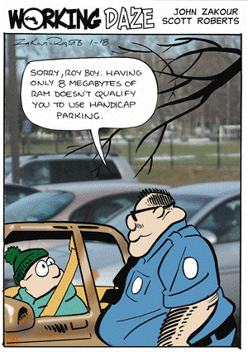
Your Questions?
Previous class days' material
Reading Assignments
HW 14b problems
Exam 3
Anything else

Slide 3
Turing Machine Variations
There are many extensions we might like to make to our basic Turing machine model. We can do this because:
We can show that every extended machine
has an equivalent* basic machine.
We can also place a bound on any change in the complexity of a solution when we go from an extended machine to a basic machine.
Some possible extensions:
● Multi-track tape.
● Multi-tape TM
● Nondeterministic TM
Equivalent means "accepts the same language," or "computes the same function."

Slide 4
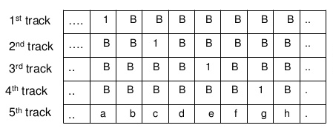
Multiple-track tape
We would like to be able to have TM with a multiple-track tape. On an n-track tape, Track i has input alphabet Σ_{i} and tape alphabet Γ_{i}.

Slide 5
Multiple-track tape
On an n-track tape, track i has input alphabet Σ_{i}
and tape alphabet Γ_{i}.
We can simulate this with an ordinary TM.
A transition is based on the current state and the combination of all of the symbols on all of the tracks of the current "column".
Γ is the set of n-tuples of the form [ γ₁, …, γ_{n}], where γ₁ ∈ Γ_{i}. Σ is similar. The "blank" symbol is the n-tuple [, …, ]. Each transition reads an n-tuple from Γ, and then writes an n-tuple from Γ on the same "square" before the head moves right or left.

Slide 6
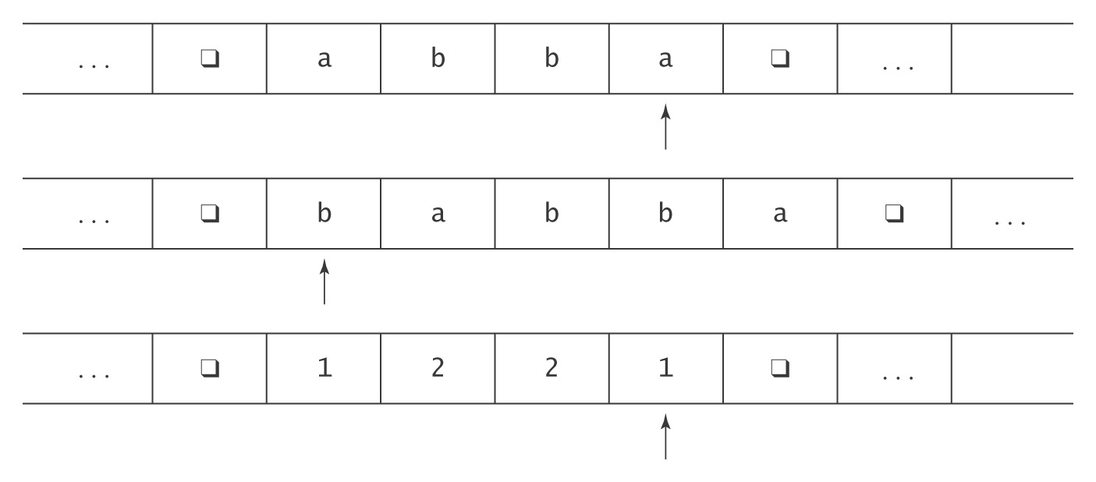
Multiple Tapes

Slide 7
Multiple Tapes
The transition function for a k-tape Turing machine:
  ((K-H) , Γ₁ to (K , Γ_{1′}, {←, →, ↑}
  , Γ₂ , Γ_{2′}, {←, →, ↑}
  , . , .
  , . , .
  , Γ_{k}) , Γ_{k′}, {←, →, ↑})
  Input: initially all on tape 1, other tapes blank.
  Output: what's left on tape 1, other tapes ignored.
  Note: On each transition, any tape head is allowed to stay where it is.

Slide 8
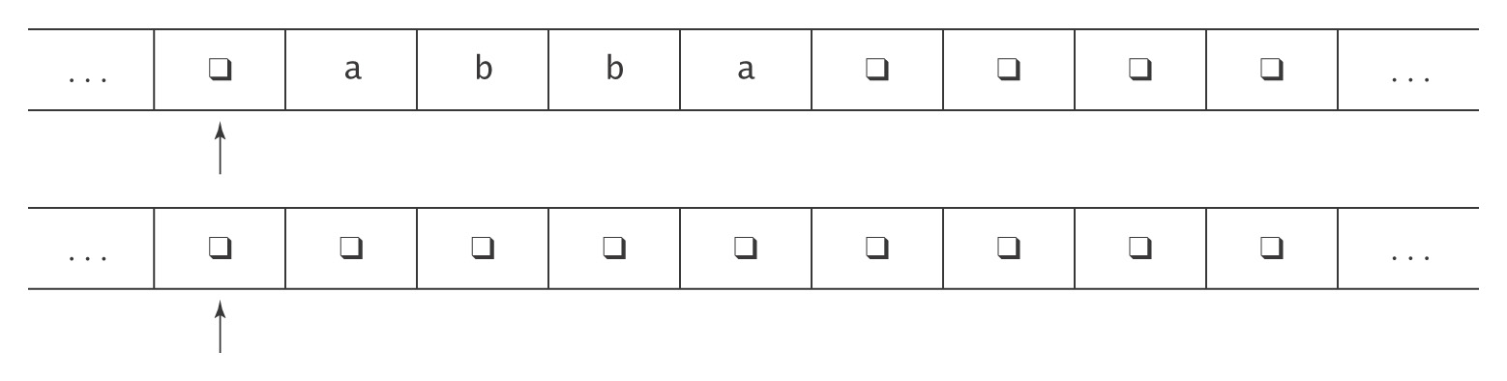
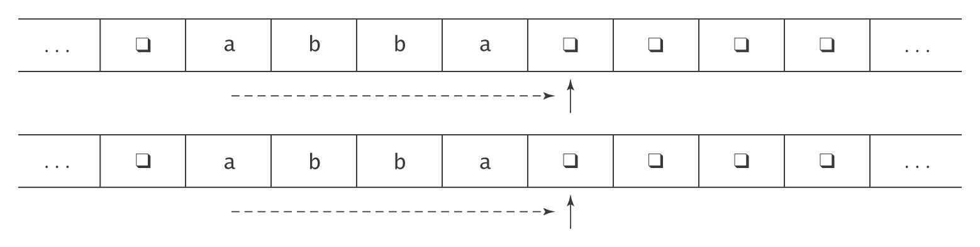
Example: Copying a String

Slide 9
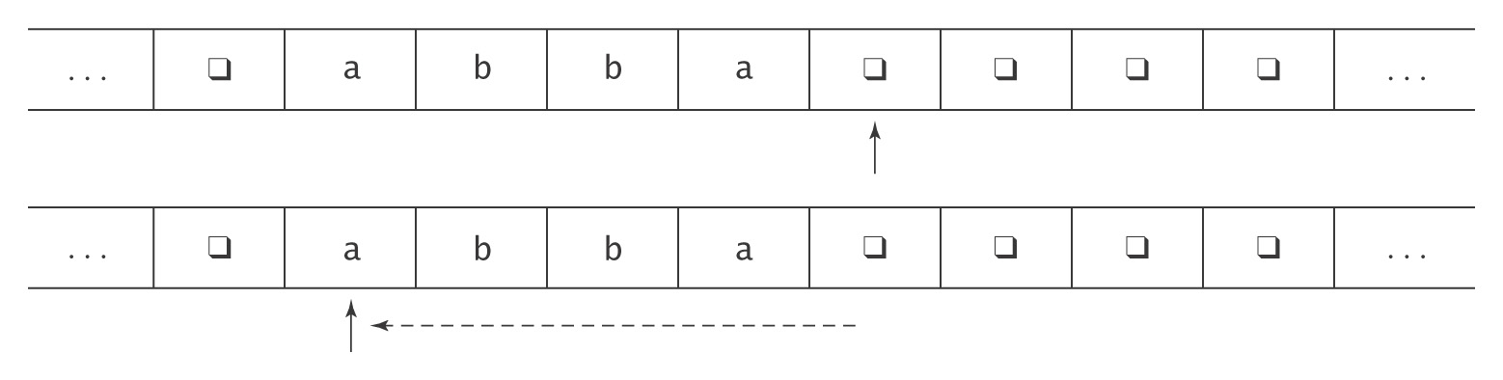
Example: Copying a String

Slide 10
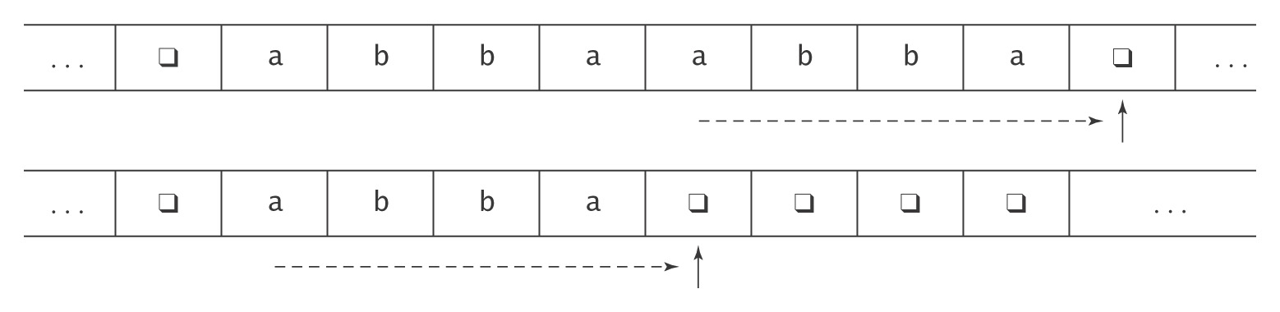
Example: Copying a String

Slide 11
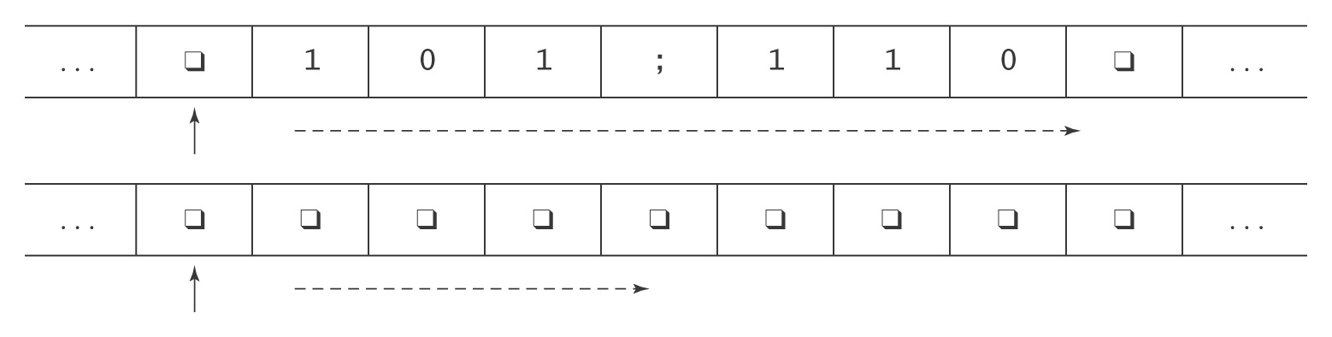
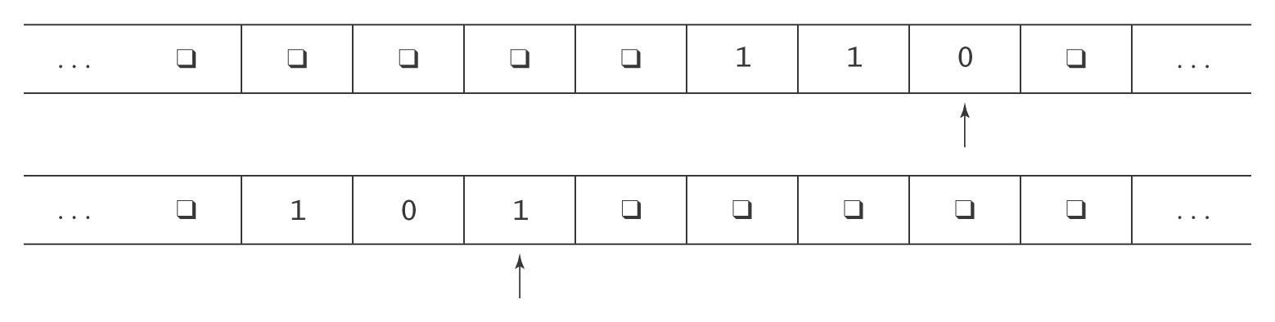
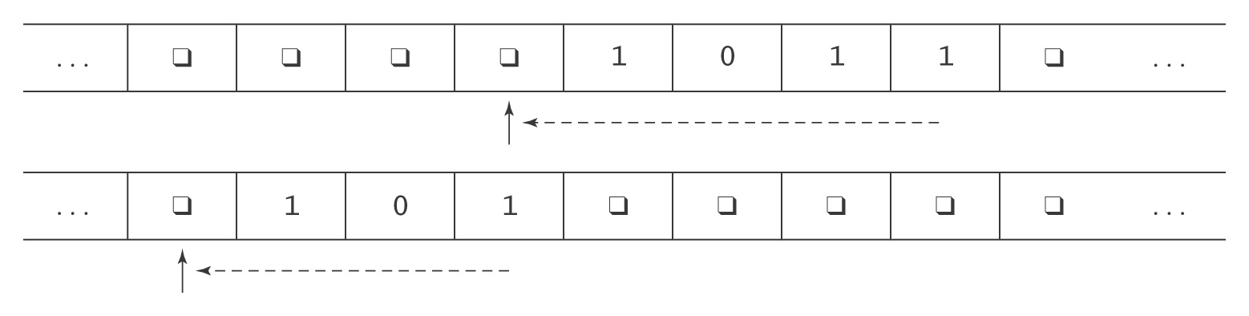
Another Two Tape Example: Addition
Notes:
Ask students how they would use multiple tapes to do multiplication of unary numbers.
Give them a few minutes.

Slide 12
Adding Tapes Does Not Add Power
Theorem: Let M = (K, Σ, Γ, δ, s, H) be a k-tape Turing machine for some k > 1. Then there is a standard TM M'= (K', Σ', Γ', δ', s', H') where Σ ⊆ Σ', and:
● On input x, M halts with output z on the first tape iff
M' halts in the same state with z on its tape.
● On input x, if M halts in n steps, M' halts in O(n²) steps.
Proof: By construction.

Slide 13
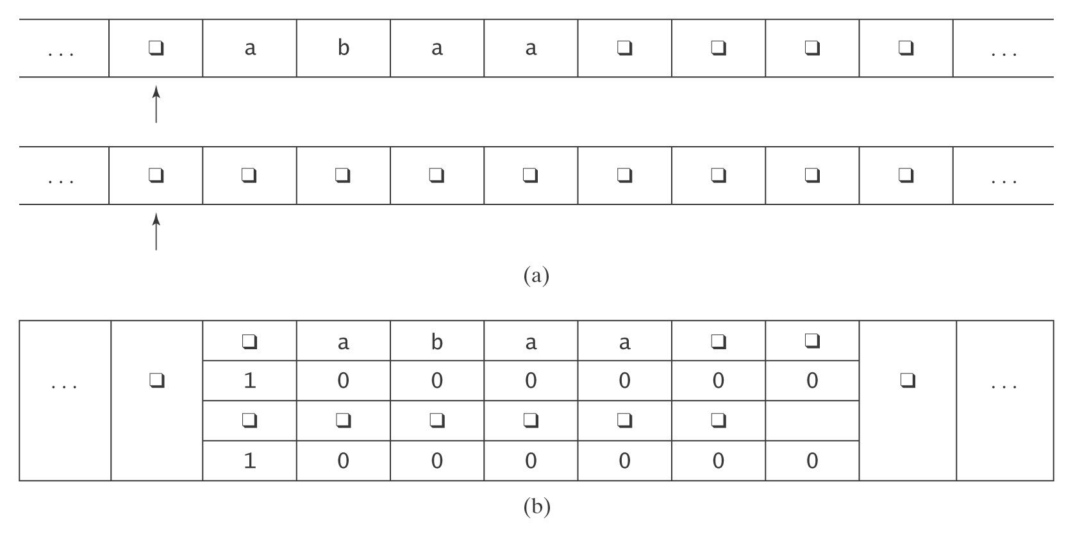
Representation of k-tape machine
by a 2k-track machine
Alphabet (Γ ') of M' = Γ ∪ (Γ × {0, 1})^{k}:
q, a, b, (q, 1, q, 1), (a, 0, q ,0), (b, 0, q, 0), …
Notes:
We treat the single tape as if it is divided into tracks. For each track we need to know the symbols, and the position of the read/write head. 1 indicates "this tape's head is here" and 0 represents "this tape's head is not here".
Total number of symbols in tape alphabet for M' : (3 x 2 x 3 x 2) + 3 = 39

Slide 14
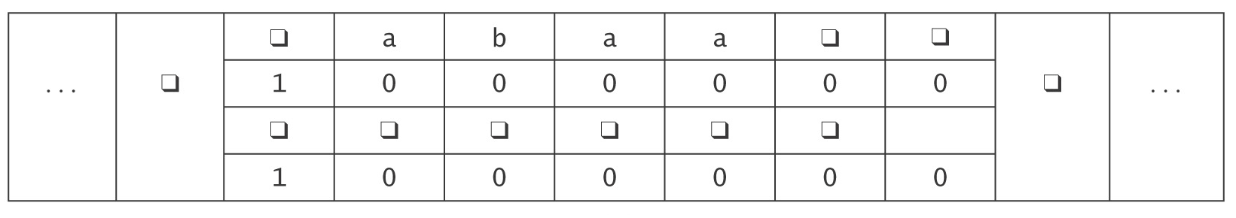
The Operation of M'
1. Set up the multitrack tape.
2. Simulate the computation of M until (if) M would halt:
  2.1 Scan left and store in the state the k-tuple of characters
  under the read heads.
  Move back right.
  2.2 Scan left and update each track as required by the
  transitions of M. If necessary, subdivide a new (formerly
  blank) square into tracks.
  Move back right.
3. When M would halt, reformat the tape to throw away all but track 1,
position the head correctly, then go to M’s halt state.

Slide 15
How Many Steps Does M' Take?
Let: w be the input string, and
n be the number of steps it takes M to execute.
Step 1 (initialization): O(|w|).
Step 2 ( computation):
Number of passes = n.
Work at each pass: 2.1 = 2 ⋅ (length of tape).
= 2 ⋅ (|w| + n).
2.2 = 2 ⋅ (|w| + n).
Total: O(n ⋅ (|w| + n)).
Step 3 (clean up): O(length of tape).
Total: O(n ⋅ (|w| + n)).
= O(n²). *
* assuming that n ≥ w

Slide 16
Universal Turing Machine

Slide 17
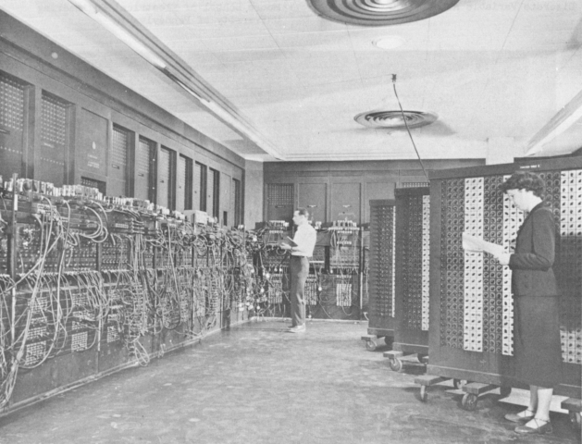
The Universal Turing Machine
Problem: All our machines so far are hardwired.
ENIAC - 1945
Notes:
We have seen that TMs seem to be able to do any algorithm that a real computer can do.
Can there be a programmable TM?

Slide 18
Programmable TM?
Problem: All our machines so far are hardwired.
Question: Can we build a programmable TM that accepts as input:
program input string
executes the program on that input, and outputs:
output string

Slide 19
The Universal Turing Machine
Yes, the Universal Turing Machine.
To define the Universal Turing Machine U we need to:
1. Define an encoding scheme for TMs.
2. Describe the operation of U when it is given input
<M, w>, the encoding of:
  ● a TM M, and
  ● an input string w.
Notes:
One issue.
There is no limit on the number of states or tape symbols that a TM can have.
But we want to be able to encode any TM with a finite number of symbols.

Slide 20
Encoding the States
Let i be ⎡log₂(|K|)⎤.
Each state is encoded by a letter and a string of i binary digits.
Number the states from 0 to |K|-1 in binary:
  ⋅ The start state, s, is numbered 0.
  ⋅ Number the other states in any order.
If t′ is the binary number assigned to state t, then:
  ⋅ If t is the halting state y, assign it the string yt′.
  ⋅ If t is the halting state n, assign it the string nt′.
  ⋅ If t is the halting state h, assign it the string ht′.
  ⋅ If t is any other state, assign it the string qt′.

Slide 21
Example of Encoding the States
Suppose M has 9 states.
i = 4
s = q0000,
The other states (suppose that y is 3 and n is 4):
  q0001 q0010 y0011 n0100
  q0101 q0110 q0111 q1000

Slide 22
Encoding the Tape Alphabet
The tape alphabet is Γ
Let j be ⎡log₂(| Γ |)⎤.
Each tape alphabet symbol is encoded as
ay for some y ∈ {0, 1}⁺, |y| = j
The blank symbol is always encoded as
the j-bit representation of 0
Example: Γ = { q, b, c, d }. j = 2.
q = a00
b = a01
c = a10
d = a11

Slide 23
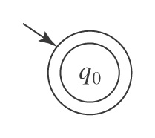
A Special Case
We will treat this as a special case:
Notes:
Represent this as (q0)

Slide 24
Encoding other Turing Machines
The transitions: (state, input, state, output, move)
Example: (q000, a000, q110, a000, →)
A TM encoding is a sequence of transitions, in any order

Slide 25
An Encoding Example
Consider M = ( { s, q, h }, { a, b, c }, { q, a, b, c }, δ, s, { h } ):
<M> = (q00,a00,q01,a00,→), (q00,a01,q00,a10,→),
(q00,a10,q01,a01, ←), (q00,a11,q01,a10,←),
(q01,a00,q00,a01,→), (q01,a01,q01,a10,→),
(q01,a10,q01,a11,←), (q01,a11,h10,a01,←)
state | symbol | δ
s | q | (q, q, →)
s | a | (s, b, →)
s | b | (q, a, ←)
s | c | (q, b, ←)
q | q | (s, a,→)
q | a | (q, b, →)
q | b | (q, b, ←)
q | c | (h, a, ←)
state/symbol | representation
s | q00
q | q01
h | h10
q | a00
a | a01
b | a10
c | a11
Decision problem: Given a string w, is there a TM M such that w=<M> ?
Is this problem decidable?
Notes:
Is the language of TM encodings regular, CF?
No in both cases, because we need to make sure that the encodings of all state representations have the same number of bits

Slide 26
Enumerating Turing Machines
Theorem: There exists an infinite lexicographic enumeration of:
(a) All syntactically valid TMs.
(b) All syntactically valid TMs with specific input alphabet Σ.
(c) All syntactically valid TMs with specific input alphabet Σ and specific tape alphabet Γ.

Slide 27
Enumerating Turing Machines
Proof: Fix Σ = {(, ), a, q, y, n, 0, 1, comma, →, ←}, ordered as listed. Then:
1. Lexicographically enumerate the strings in Σ*.
2. As each string s is generated, check to see whether
it is a syntactically valid Turing machine description.
If it is, output it.
To restrict the enumeration to symbols in sets Σ and Γ, check, in step 2, that only alphabets of the appropriate sizes are allowed.
We can now talk about the i^{th} Turing machine.

Slide 28
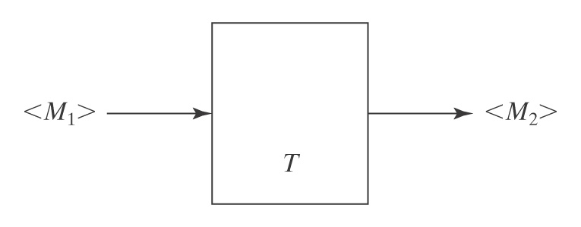
Another Benefit of Encoding
Benefit of defining a way to encode any Turing machine M:
● We can talk about operations on programs (TMs).

Slide 29
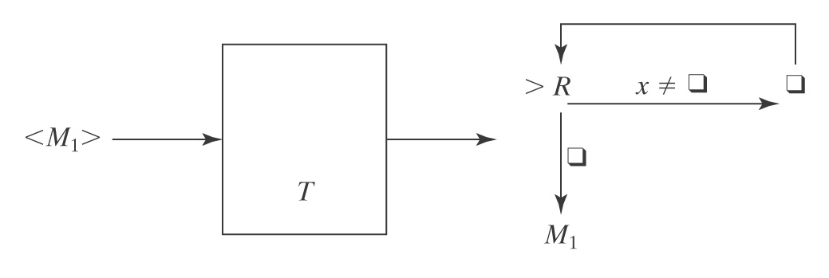
Example of a Transforming TM T:
Input: a TM M₁ that reads its input tape and performs
some operation P on it.
Output: a TM M₂ that performs P on an empty input tape.
The machine M₂ (output of T) empties its tape, then runs M₁.

Slide 30
Encoding Multiple Inputs
Let:
<x₁, x₂, …x_{n}>
represent a single string that encodes the sequence of individual values:
x₁, x₂, …x_{n}.

Slide 31
The Specification of the Universal TM
On input <M, w>, U must:
● Halt iff M halts on w.
● If M is a deciding or semideciding machine, then:
  ● If M accepts, accept.
  ● If M rejects, reject.
● If M computes a function, then U(<M, w>) must equal M(w).

Slide 32
How U Works
U will use 3 tapes:
● Tape 1: M’s tape.
● Tape 2: <M>, the “program” that U is running.
● Tape 3: M’s state.

Slide 33
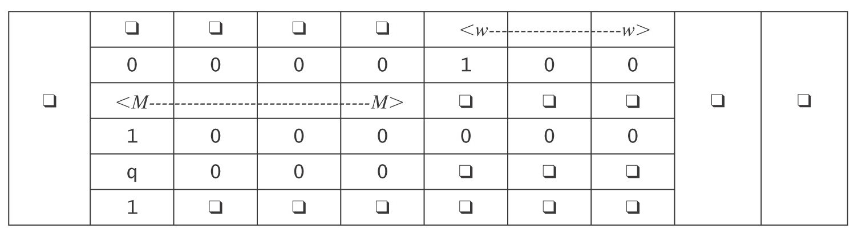
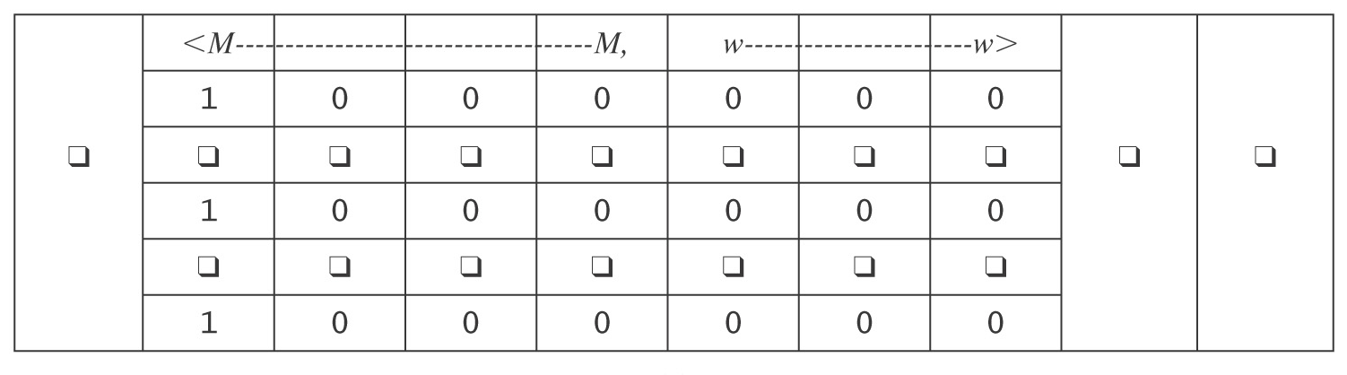
The Universal TM
Initialization of U:
1. Copy <M> onto tape 2.
2. Look at <M>, figure out what i is, and write the encoding of state
s on tape 3.
After initialization:

Slide 34
The Operation of U
Simulate the steps of M :
1. Until M would halt do:
  1.1 Scan tape 2 for a quintuple that matches the current state,
  input pair.
  1.2 Perform the associated action, by changing tapes 1 and 3. If
  necessary, extend the tape.
  1.3 If no matching quintuple found, halt. Else loop.
2. Report the same result M would report.
How long does U take?
Notes:
If M would halt in k steps, U must go through this loop k times.
Each time through the loop it must scan <M> to decide what to do. So k(|<M>|).
But it's worse because of the squaring in the simulation of a Multitape TM by a multitrack TM.

Slide 35
If A Universal Machine is Such a Good Idea …
Could we define a Universal Finite State Machine?
Such a FSM would accept the language:
L = {<F, w> : F is a FSM, and w ∈ L(F) }

Slide 36
The Church-Turing Thesis

Slide 37
Are We Done?
FSM ⇒ PDA ⇒ Turing machine
Is this the end of the line?
There are still problems we cannot solve with a TM:
● There is a countably infinite number of Turing machines
since we can lexicographically enumerate all the strings
that correspond to syntactically legal Turing machines.
● There is an uncountably infinite number of languages over
any nonempty alphabet.
● So there are more languages than there are Turing
machines.
Notes:
So should we keep going, looking for a more powerful computational model?
Any model where a machine is describable by a finite string is going to suffer the counting constraint listed on this slide.
Is there some COMPUTATIONAL problem that can't be implemented by a TM?

Slide 38
What Can Algorithms Do?
Can we come up with a system of axioms that makes all true statements be theorems (I.e. provable from the axioms)?
    The set of axioms can be infinite, but it must be decidable
Can we always decide whether, given a set of axioms, a statement is a theorem or not?
In the early 20th century, it was widely believed that the answer to both questions was "yes."
Notes:
In the early 20th century, mathematicians, led by David Hilbert, laid out plans to solve the major mathematical problems of the day. See "Hilbert's problems." There were 23 of them. About 2/3 are resolved; a few were stated in a way that is to vague to determine whether they are resolved.

Slide 39
Gödel’s Incompleteness Theorem
Kurt Gödel showed, in the proof of his Incompleteness Theorem [Gödel 1931], that the answer to question 1 is no. In particular, he showed that there exists no decidable axiomatization of Peano arithmetic that is both consistent and complete.
Complete: All true statements in the language of the theory are theorems
Notes:
Godel showed that if a decidable set of axioms is consistent, then there must be true statements that are not provable form the axioms.

Slide 40
The Entscheidungsproblem
  From Wikipedia: The Entscheidungsproblem ("decision problem", David Hilbert 1928) asks for an algorithm that will take as input a description of a formal language and a mathematical statement in the language, and produce as output either "True" or "False" according to whether the statement is true or false. The algorithm need not justify its answer, nor provide a proof, so long as it is always correct.
  Three equivalent formulations:
  Does there exist an algorithm to decide, given an arbitrary sentence w in first order logic, whether w is valid?
  Given a set of axioms A and a sentence w, does there exist an algorithm to decide whether w is entailed by A?
  Given a set of axioms, A, and a sentence, w, does there exist an algorithm to decide whether w can be proved from A?

Slide 41
The Entscheidungsproblem
To answer the question, in any of these forms, requires formalizing the definition of an algorithm:
● Turing: Turing machines.
● Church: lambda calculus.
Turing proved that Turing machines and the lambda calculus are equivalent.

Slide 42
Church's Thesis
(Church-Turing Thesis)
All formalisms powerful enough to describe everything we think of as a computational algorithm are equivalent.
This isn’t a formal statement, so we can’t prove it. But many different computational models have been proposed and they all turn out to be equivalent.

Slide 43
The Church-Turing Thesis
Examples of equivalent formalisms:
● Modern computers (with unbounded memory)
● Lambda calculus
● Partial recursive functions
● Tag systems (FSM plus FIFO queue)
● Unrestricted grammars:
aSa → B
● Post production systems
● Markov algorithms
● Conway’s Game of Life
● One dimensional cellular automata
● DNA-based computing
● Lindenmayer systems

Slide 44
The Lambda Calculus
The successor function:
(λ x. x + 1) 3 = 4
Addition: (λ x. λ y. x + y) 3 4
This expression is evaluated by binding 3 to x to create the new function (λ y. 3 + y), which is applied to 4 to return 7.
In the pure lambda calculus, there is no built in number data type. All expressions are functions. But the natural numbers can be defined as lambda calculus functions. So the lambda calculus can effectively describe numeric functions.
Notes:
As most of you know, Lisp (and its cousin Scheme) was invented partially as an implementation of the lambda calculus.

Slide 45
The Lambda Calculus
> (define Y
(lambda (f)
((lambda (x) (f (lambda (y) ((x x) y))))
(lambda (x) (f (lambda (y) ((x x) y)))))))
> (define H
(lambda (g)
(lambda (n)
(if (zero? n)
1
(* n (g (- n 1)))))))
> ((Y H) 5)
120
>

Slide 46

Λ-Calculus in Scheme
> (((lambda (f)
((lambda (x) (f (lambda (y) ((x x) y))))
(lambda (x) (f (lambda (y) ((x x) y))))))
(lambda (g)
(lambda (n)
(if (zero? n)
1
(* n (g (- n 1)))))))
5)
120
The Applicative Y Combinator
Notes:
As most of you know, Lisp was invented partially as am implementation of the lambda calculus.
John McCarthy, its inventor died two years ago (January 2012)
Knights of the Lambda Calculus emblem.

Slide 47
Tag Systems
A tag system (or a Post machine) is an FSM augmented with a FIFO queue.
Simple for WW:
Not so simple for PalEven

Slide 48
The Power of Tag Systems
Tag systems are equivalent in power to Turing machines because the TM’s tape can be simulated with the FIFO queue.
Suppose that we put abcde into the queue:
a b c d e
To read the queue, we must remove the a first.
But suppose we want to remove e first:

Slide 49
The Power of Tag Systems
Tag systems are equivalent in power to Turing machines because the TM’s tape can be simulated with the FIFO queue.
Suppose that we push abcde onto the queue:
a b c d e
To read the queue, we must remove the a first.
But suppose we want to remove e first:
Treat the queue as a loop.

Slide 50
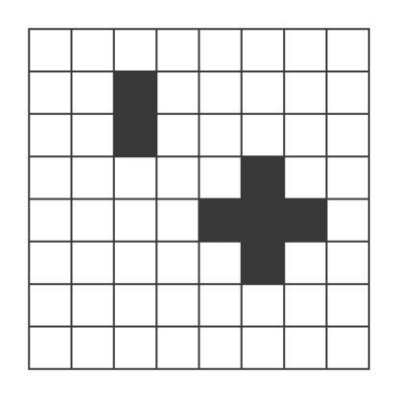
The Game of Life
Playing the game
At each step of the computation, the value for each cell is determined by computing the number of neighbors (up to a max of 8) it currently has, according to the following rules:
● A dead cell with exactly three live neighbors becomes a live cell
(birth).
● A live cell with two or three live neighbors stays alive (survival).
● In all other cases, a cell dies or remains dead (overcrowding or
loneliness).
We’ll say that a game halts iff it reaches some stable configuration.

Slide 51


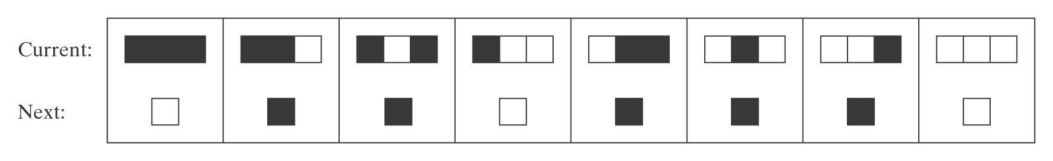
Elementary Cellular Automata
Wolfram’s Rule 110 is a universal
computer, if you can figure out how to encode the
program and the input in the initial configuration:
For some fascinating pictures, look up Rule 110.
Conjectured in 1985 to be Turing complete, proved in 2000 by Matthew Cook.
Also: http://en.wikipedia.org/wiki/A_New_Kind_of_Science
Notes:
Talk about the Wolfram-Cook controversy.

