Slide 1

MA/CSSE 474
Theory of Computation
TM Variations
Encoding a TM
(Universal Turing Machine)

Slide 2
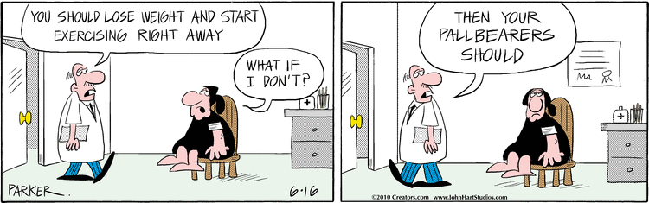
Your Questions?
Previous class days' material
Reading Assignments
HW 14 or 15 problems
Next week's exam
Anything else

Slide 3
Two Flavors of TMs
Recognize a language
Compute a function

Slide 4
Turing Machines as Language Recognizers
Let M = (K, Σ, Γ, δ, s, {y, n}).
● M accepts a string w iff (s, qw) |-_{M}* (y, w′) for some string w′ (that includes an underlined character).
● M rejects a string w iff (s, qw) |-_{M}* (n, w′) for some string w′.
M decides a language L ⊆ Σ* iff:
For any string w ∈ Σ* it is true that:
if w ∈ L then M accepts w, and
if w ∉ L then M rejects w.
A language L is decidable iff there is a Turing machine M that decides it. In this case, we will say that L is in D.

Slide 5
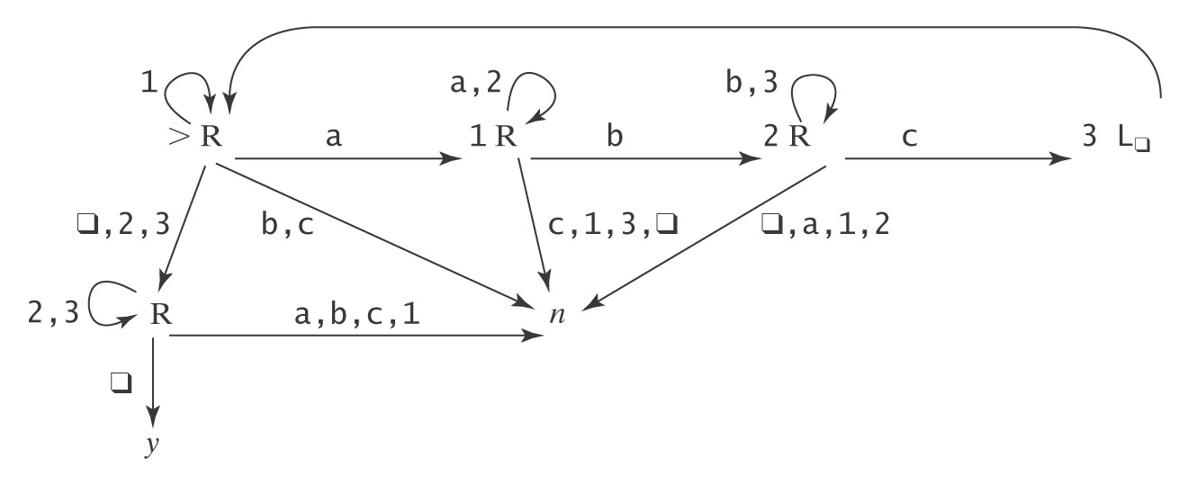
A Deciding Example
A^{n}B^{n}C^{n} = {a^{n}b^{n}c^{n} : n ≥ 0}
Example: qaabbccqqqqqqqqq
Example: qaaccbqqqqqqqqq

Slide 6
Semideciding a Language
Let Σ_{M} be the input alphabet to a TM M. Let L ⊆ Σ_{M}*.
M semidecides L iff, for any string w ∈ Σ_{M}*:
● w ∈ L → M accepts w
● w ∉ L → M does not accept w. M may either:
reject or
fail to halt.
A language L is semidecidable iff there is a Turing machine that semidecides it. We define the set SD to be the set of all semidecidable languages.
Notes:
Another term that is sometimes used tfor this concept is "recursively enumerable"

Slide 7
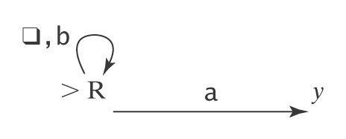
Example of Semideciding
Let L = b*a(a ∪ b)*
We can build M to semidecide L:
1. Loop
  1.1 Move one square to the right. If the character under
  the read head is an a, halt and accept.
In our macro language, M is:

Slide 8
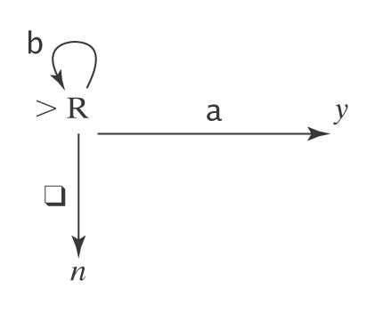
Example of Deciding the same Language
L = b*a(a ∪ b)*. We can also decide L:
  Loop:
    1.1 Move one square to the right.
    1.2 If the character under the read/write head is
    an a, halt and accept.
    1.3 If it is q, halt and reject.
In our macro language, M is:

Slide 9
TM that Computes a Function
Let M = (K, Σ, Γ, δ, s, {h}).
Define M(w) = z iff (s, qw) |-_{M}* (h, qz).
Let Σ′ ⊆ Σ be M’s output alphabet.
Let f be any function from Σ* to Σ′*.
M computes f iff, for all w ∈ Σ*:
● If w is an input on which f is defined: M(w) = f(w).
● Otherwise M(w) does not halt.
A function f is recursive or computable iff there is a Turing machine M that computes it and that always halts.
Note that this is different than our common use of recursive.
Notice that the TM's function computes with strings (Σ* to Σ′*), not directly with numbers.

Slide 10
Example of Computing a Function
Let Σ = {a, b}. Let f(w) = ww.
Input: qwqqqqqq Output: qwwq
Define the copy machine C:
qwqqqqqq → qwqwq
Also use the S← machine:
quqwq → quwq
Then the machine to compute f is just >C S← L_{q}
More details next slide

Slide 11
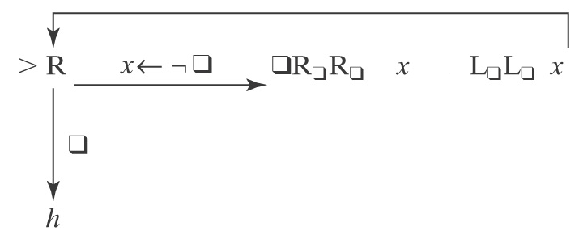
Example of Computing a Function
Let Σ = {a, b}. Let f(w) = ww.
Input: qwqqqqqq Output: qwwq
Define the copy machine C:
qwqqqqqq → qwqwq
Then use the S← machine:
quqwq → quwq
Then the machine to compute f is just >C S← L_{q}

Slide 12
Computing Numeric Functions
For any positive integer k, value_{k}(n) returns the nonnegative integer that is encoded, base k, by the string n.
For example:
● value₂(101) = 5.
● value₈(101) = 65.
TM M computes a function f from ℕ^{m} to ℕ iff, for some k:
value_{k}(M(n₁;n₂;…n_{m})) = f(value_{k}(n₁), … value_{k}(n_{m}))
Note that the semicolon serves to separate the representations of the arguments

Slide 13
Why Are We Working with Our Hands Tied Behind Our Backs?
Turing machines Are more powerful than any of
the other formalisms we have
studied so far. ☺
Turing machines Are a lot harder to work with than
all the real computers that are
available to us.
☹
Why bother?
The very simplicity that makes it hard to program Turing machines makes it possible to reason formally about what they can do. If we can, once, show that everything a real computer can do can be done (albeit clumsily) on a Turing machine, then we have a way to reason about what real computers can do.

Slide 14
TUring Machine Variations
Multiple tracks
Multiple tapes
Non-deterministic

Slide 15
Turing Machine Variations
There are many extensions we might like to make to our basic Turing machine model. We can do this because:
We can show that every extended machine
has an equivalent* basic machine.
We can also place a bound on any change in the complexity of a solution when we go from an extended machine to a basic machine.
Some possible extensions:
● Multi-track tape.
● Multi-tape TM
● Nondeterministic TM
Recall that equivalent means "accepts the same language," or "computes the same function."

Slide 16
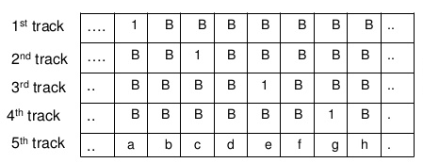
Multiple-track tape
We would like to be able to have TM with a multiple-track tape. On an n-track tape, Track i has input alphabet Σ_{i} and tape alphabet Γ_{i}.

Slide 17
Multiple-track tape
We would like to be able to have a TM with a multiple-track tape. On an n-track tape, Track i has input alphabet Σ_{i} and tape alphabet Γ_{i}.
We can simulate this with an ordinary TM.
A transition is based on the current state and the combination of all of the symbols on all of the tracks of the current "column".
Then Γ is the set of n-tuples of the form [ γ₁, …, γ_{n}], where γ₁ ∈ Γ_{i}. Σ is similar. The "blank" symbol is the n-tuple [, …, ]. Each transition reads an n-tuple from Γ, and then writes an n-tuple from Γ on the same "square" before the head moves right or left.

Slide 18
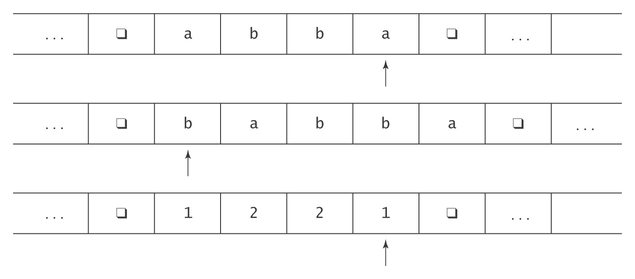
Multiple Tapes

Slide 19
Multiple Tapes
The transition function for a k-tape Turing machine:
  ((K-H) , Γ₁ to (K , Γ_{1′}, {←, →, ↑}
  , Γ₂ , Γ_{2′}, {←, →, ↑}
  , . , .
  , . , .
  , Γ_{k}) , Γ_{k′}, {←, →, ↑})
  Input: initially all on tape 1, other tapes blank.
  Output: what's left on tape 1, other tapes ignored.
  Note: On each transition, any tape head is allowed to stay where it is.

Slide 20
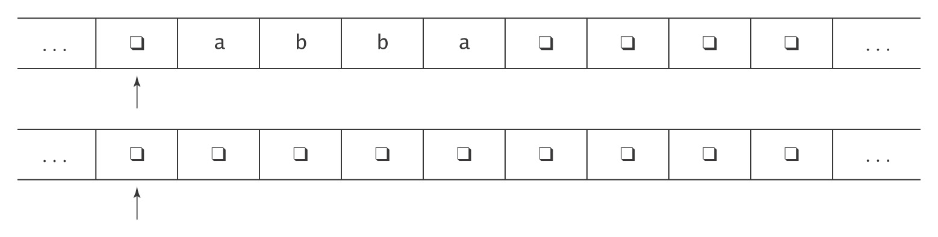
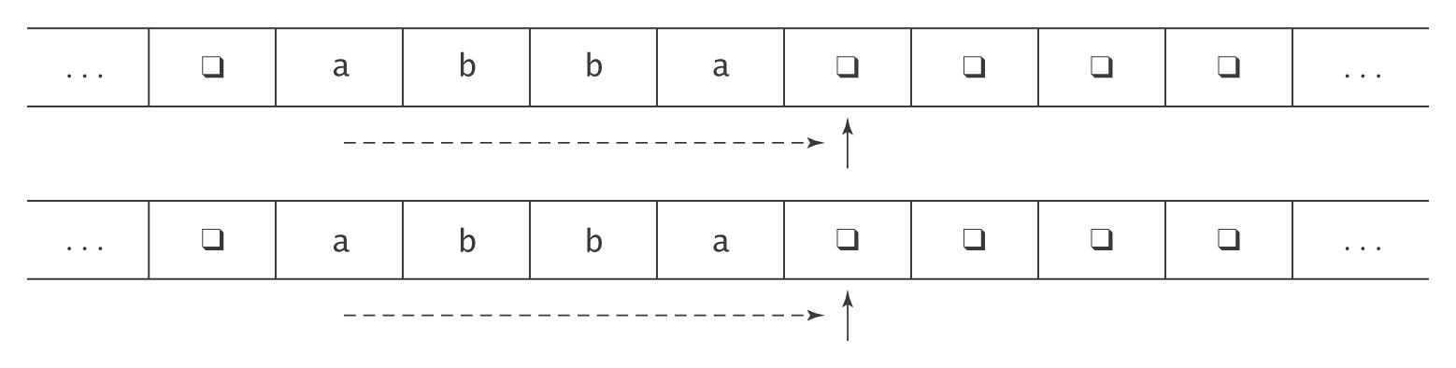
Example: Copying a String

Slide 21
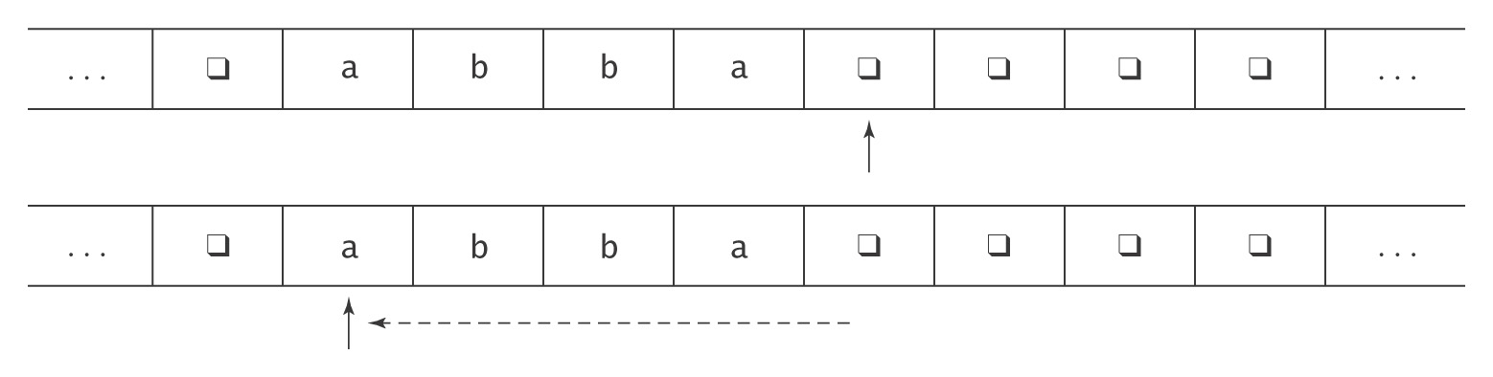
Example: Copying a String

Slide 22
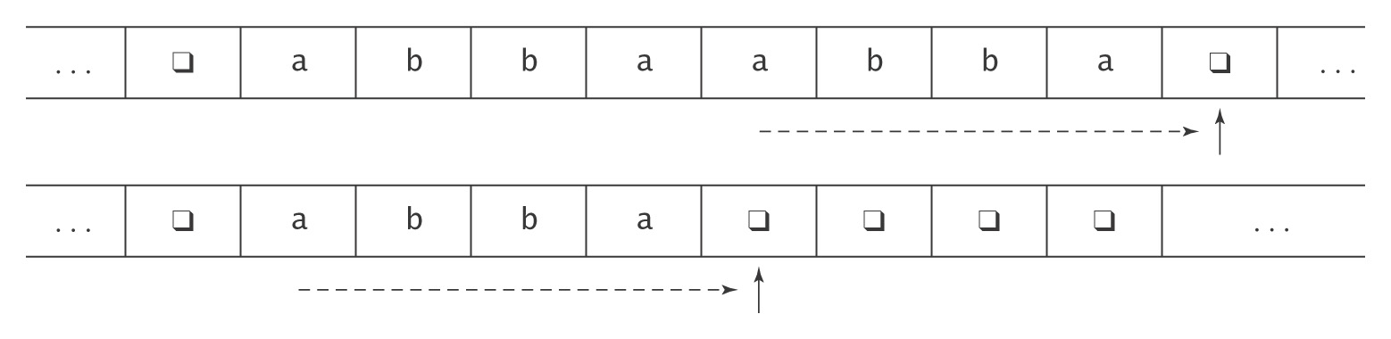
Example: Copying a String

Slide 23
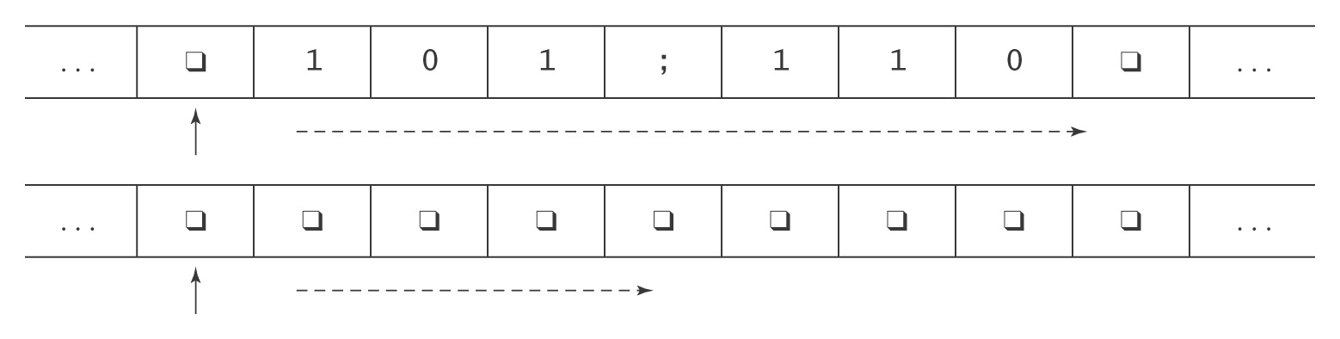
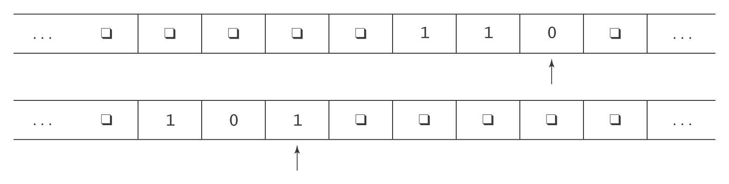
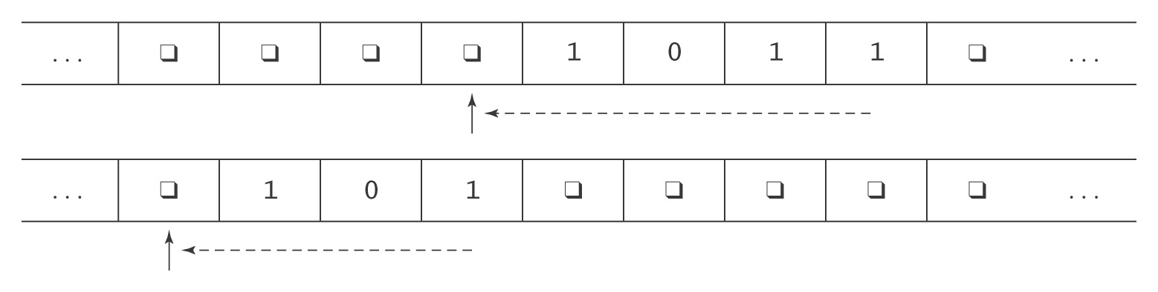
Another Two Tape Example: Addition
Notes:
Ask students how they would use multiple tapes to do multiplication of unary numbers.
Give them a few minutes.

Slide 24
Adding Tapes Does Not Add Power
Theorem: Let M = (K, Σ, Γ, δ, s, H) be a k-tape Turing machine for some k > 1. Then there is a standard TM M'= (K', Σ', Γ', δ', s', H') where Σ ⊆ Σ', and:
● On input x, M halts with output z on the first tape iff
M' halts in the same state with z on its tape.
● On input x, if M halts in n steps, M' halts in O(n²) steps.
Proof: By construction.

Slide 25
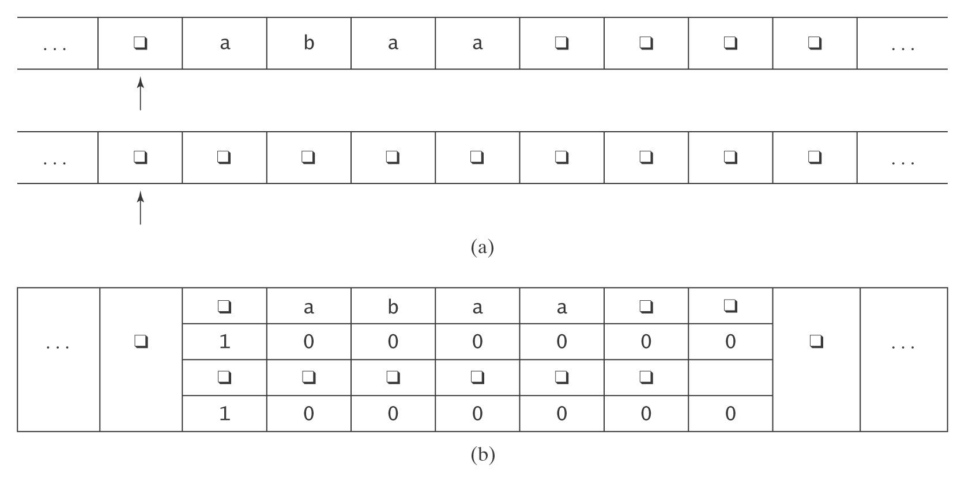
The Representation
Alphabet (Γ ') of M' = Γ ∪ (Γ × {0, 1})^{k}:
q, a, b, (q, 1, q, 1), (a, 0, q ,0), (b, 0, q, 0), …
Notes:
We treat the single tape as if it is divided into tracks. For each track we need to know the symbols, and the position of the read/write head. 1 indicates "this tape's head is here" and 0 represents "this tape's head is not here".
Total number of symbols in tape alphabet for M' : (3 x 2 x 3 x 2) + 3 = 39

Slide 26
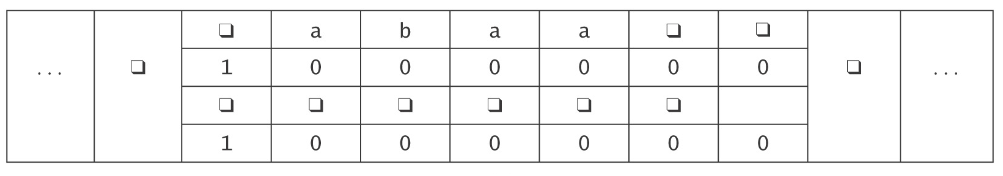
The Operation of M'
1. Set up the multitrack tape.
2. Simulate the computation of M until (if) M would halt:
  2.1 Scan left and store in the state the k-tuple of characters
  under the read heads.
  Move back right.
  2.2 Scan left and update each track as required by the
  transitions of M. If necessary, subdivide a new (formerly
  blank) square into tracks.
  Move back right.
3. When M would halt, reformat the tape to throw away all but track 1,
position the head correctly, then go to M’s halt state.

Slide 27
How Many Steps Does M' Take?
Let: w be the input string, and
n be the number of steps it takes M to execute.
Step 1 (initialization): O(|w|).
Step 2 ( computation):
Number of passes = n.
Work at each pass: 2.1 = 2 ⋅ (length of tape).
= 2 ⋅ (|w| + n).
2.2 = 2 ⋅ (|w| + n).
Total: O(n ⋅ (|w| + n)).
Step 3 (clean up): O(length of tape).
Total: O(n ⋅ (|w| + n)).
= O(n²). *
* assuming that n ≥ w

Slide 28
Universal Turing Machine

Slide 29
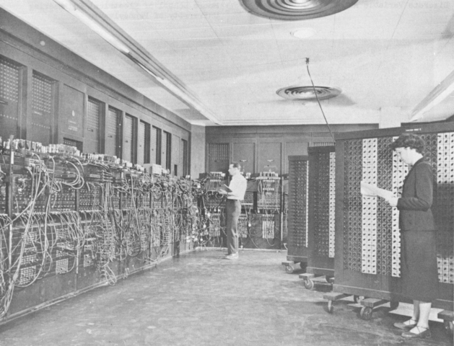
The Universal Turing Machine
Problem: All our machines so far are hardwired.
ENIAC - 1945
Notes:
We have seen that TMs seem to be able to do any algorithm that a real computer can do.
Can there be a programmable TM?

Slide 30
The Universal Turing Machine
Problem: All our machines so far are hardwired.
Question: Can we build a programmable TM that accepts
as input:
program input string
executes the program on that input, and outputs:
output string

Slide 31
The Universal Turing Machine
Yes, it’s called the Universal Turing Machine.
To define the Universal Turing Machine U we need to:
1. Define an encoding scheme for TMs.
2. Describe the operation of U when it is given input
<M, w>, the encoding of:
  ● a TM M, and
  ● an input string w.
Notes:
One issue.
There is no limit on the number of states or tape symbols that a TM can have.
But we want to be able to encode any TM with a finite number of symbols.

