Slide 1

MA/CSSE 474
Theory of Computation
TM Macro Language

Slide 2

Your Questions?
Previous class days' material
Reading Assignments
HW 14 problems
Next week's exam
Anything else

Slide 3
The Macro Language slides from yesterday
They are here for reference and in case you have questions about them.

Slide 4
A Macro language for Turing Machines
(1) Define some basic machines
● Symbol writing machines
For each x ∈ Γ, define M_{x}, written as just x, to be a machine that writes x. Read-write head ends up in original position.
● Head moving machines
R: for each x ∈ Γ, δ(s, x) = (h, x, →)
L: for each x ∈ Γ, δ(s, x) = (h, x, ←)
● Machines that simply halt:
h, which simply halts (don't care whether it accepts).
n, which halts and rejects.
y, which halts and accepts.
You need to learn this simple language. I will use it and I expect you to use it on HW and tests.
Notes:
There is an Mx for each x∈Γ. To implement M_{x} requires two TM moves. δ(s, y) = (s', x, →), δ(s', z) = (s, z, ←)

Slide 5
Checking Inputs and Combining Machines
Next we need to describe how to:
● Check the tape and branch based on what character
we see, and
● Combine the basic machines to form larger ones.
To do this, we need two forms:
● M₁ M₂
● M₁ <condition> M₂
Notes:
Run M1 then M2. If either fails to halt, so does the composite machine.
Run M1; if it halts, check condition (usually look for a specific character under the tape head). If true, run M2. If M1 does not halt or if condition is true and M2 does not halt, composite machine does not halt.

Slide 6
Turing Machines Macros Cont'd
Example:
>M₁ a M₂
b
M₃
● Start in the start state of M₁.
● Compute until M₁ reaches a halt state.
● Examine the tape and take the appropriate transition.
● Start in the start state of the next machine, etc.
● Halt if any component reaches a halt state and has no place
to go.
● If any component fails to halt, then the entire machine may fail
to halt.

Slide 7
More macros
a
M₁ M₂ becomes M₁ a, b M₂
b
M₁ all elems of Γ M₂ becomes M₁ M₂
or
M₁M₂
Variables
M₁ all elems of Γ M₂ becomes M₁ x ← ¬a M₂
except a and x takes on the value of
the current square
M₁ a, b M₂ becomes M₁ x ← a, b M₂
and x takes on the value of
the current square
M₁ x = y M₂
if x = y then take the transition
e.g., > x ← ¬q Rx if the current square is not blank, go right and copy it.
Notes:
Two ways to implement "variable assignment:
Use an area of the tape at the left or right end as a "scratchpad".
Have a bunch of duplicate sets of states, each representing "holding" a different tape symbol (usually an input symbol).

Slide 8
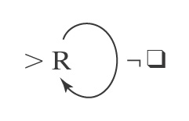
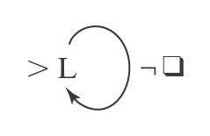
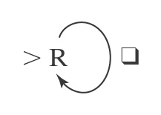
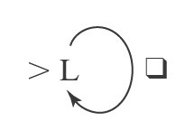
Blank/Non-blank Search Machines
Find the first blank square to
the right of the current square.
Find the first blank square to
the left of the current square.
Find the first nonblank square to
the right of the current square.
Find the first nonblank square to
the left of the current square
R_{q}
L_{q}
R_{¬q}
L_{¬q}

Slide 9
More Search Machines
L_{a} Find the first occurrence of a to
the left of the current square.
R_{a,b} Find the first occurrence of a or b
to the right of the current square.
L_{a,b} a M₁ Find the first occurrence of a or b
to the left of the current square,
b then go to M₁ if the detected
character is a; go to M₂ if the
M₂ detected character is b.
L_{x←a,b} Find the first occurrence of a or b
to the left of the current square
and set x to the value found.
L_{x←a,b}Rx Find the first occurrence of a or b
to the left of the current square,
set x to the value found, move one
square to the right, and write x (a or b).

Slide 10
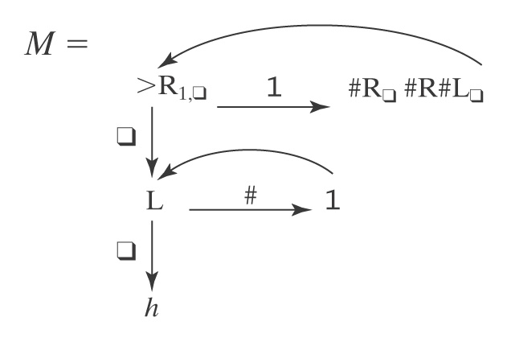
An Example
Input: qw w ∈ {1}*
Output: qw³
Example: q111qqqqqqqqqqqqqq

Slide 11
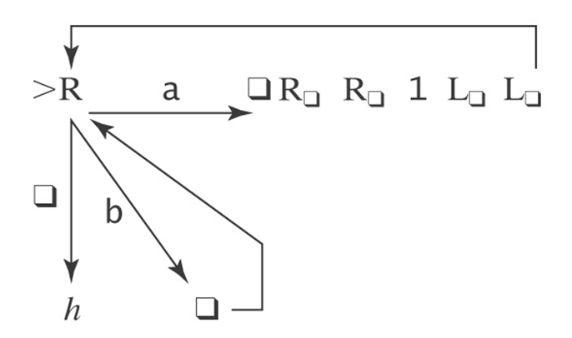
What does this machine do?

Slide 12
Exercise
Initial input on the tape is an integer written in binary, most significant bit first (110 represents 6).
Design a TM that replaces the binary representation of n by the binary representation of n+1.

