Slide 1

MA/CSSE 474
Theory of Computation
TM Macro Language

Slide 2
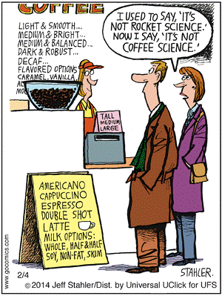
Your Questions?
Previous class days' material
Reading Assignments
HW 14 problems
Exam 3
Anything else

Slide 3
TMs are complicated
… and very low-level!
We need higher-level "abbreviations".
  Macros
Notes:
Let's look at the difference between a macro and a subroutine.
In C, #define vs. function definition.
In Scheme, lambda vs define-syntax.
Many assemblers are macro-assemblers, allowing the user to create macros.
In MIPS assembly language, I believe move is a macro
(out of my league here)

Slide 4
A Macro language for Turing Machines
You need to learn this simple language. I will use it and I expect you to use it on HW and tests (for exams I'll give you a handout with the details).
(1) Define some basic machines
● Symbol writing machines
For each x ∈ Γ, define M_{x}, written as just x, to be a machine that writes x. Read-write head ends up in original position.
● Head moving machines
R: for each x ∈ Γ, δ(s, x) = (h, x, →)
L: for each x ∈ Γ, δ(s, x) = (h, x, ←)
● Machines that simply halt:
h, which simply halts (don't care whether it accepts).
n, which halts and rejects.
y, which halts and accepts.
Notes:
There is an Mx for each x∈Γ.
To implement M_{x} requires two TM moves.
δ(s, y) = (s', x, →), δ(s', z) = (s, z, ←)

Slide 5
Checking Inputs and Combining Machines
Machines to:
● Check the tape and branch based on what character
we see, and
● Combine the basic machines to form larger ones.
To do this, we need two forms:
● M₁ M₂
● M₁ <condition> M₂
Notes:
Run M1 then M2. If either fails to halt, so does the composite machine.
Run M1; if it halts, check condition (usually look for a specific character under the tape head). If true, run M2. If M1 does not halt or if condition is true and M2 does not halt, composite machine does not halt.

Slide 6
Turing Machines Macros Cont'd
Example:
>M₁ a M₂
b
M₃
● Start in the start state of M₁.
● Compute until M₁ reaches one of its halt states, which are not halt states in the combined machine.
● Examine the tape and take the appropriate transition.
● Start in the start state of the next machine, etc.
● Halt if any component reaches a halt state and has no place
to go.
● If any component fails to halt, then the entire machine may fail
to halt.

Slide 7
More macros
a
M₁ M₂ becomes M₁ a, b M₂
b
M₁ all elems of Γ M₂ becomes M₁ M₂
or
M₁M₂
Variables
M₁ all elems of Γ M₂ becomes M₁ x ← ¬a M₂
except a and x takes on the value of
the current square
M₁ a, b M₂ becomes M₁ x ← a, b M₂
and x takes on the value of
the current square
M₁ x = y M₂
if x = y then take the transition
e.g., > x ← ¬q Rx if the current square is not blank, go right and copy it.
Notes:
Two ways to implement "variable assignment:
Use an area of the tape at the left or right end as a "scratchpad".
Have a bunch of duplicate sets of states, each representing "holding" a different tape symbol (usually an input symbol).

Slide 8
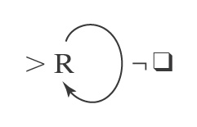
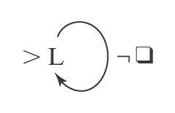
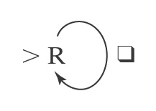
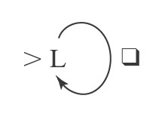
Blank/Non-blank Search Machines
Find the first blank square to
the right of the current square.
Find the first blank square to
the left of the current square.
Find the first nonblank square to
the right of the current square.
Find the first nonblank square to
the left of the current square
R_{q}
L_{q}
R_{¬q}
L_{¬q}

Slide 9
More Search Machines
L_{a} Find the first occurrence of a to
the left of the current square.
R_{a,b} Find the first occurrence of a or b
to the right of the current square.
L_{a,b} a M₁ Find the first occurrence of a or b
to the left of the current square,
b then go to M₁ if the detected
character is a; go to M₂ if the
M₂ detected character is b.
L_{x←a,b} Find the first occurrence of a or b
to the left of the current square
and set x to the value found.
L_{x←a,b}Rx Find the first occurrence of a or b
to the left of the current square,
set x to the value found, move one
square to the right, and write x (a or b).

Slide 10
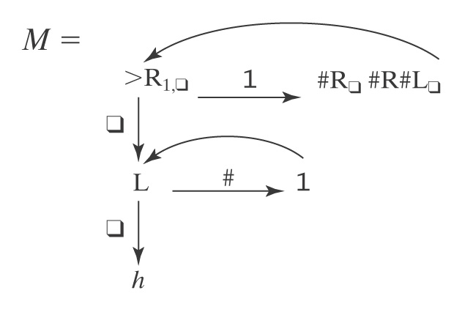
An Example
Input: qw w ∈ {1}*
Output: qw³
Example: q111qqqqqqqqqqqqqq

Slide 11
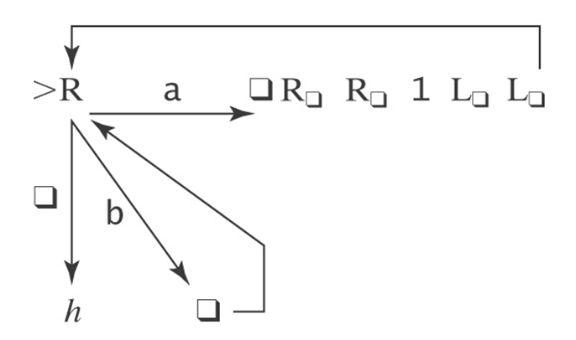
What does this machine do?

Slide 12
Exercise
Initial input on the tape is an integer written in binary, most significant bit first (110 represents 6).
Design a TM that replaces the binary representation of n by the binary representation of n+1.

Slide 13
Two Flavors of TMs
Recognize a language
Compute a function

Slide 14
Turing Machines as Language Recognizers
Let M = (K, Σ, Γ, δ, s, {y, n}).
● M accepts a string w iff (s, qw) |-_{M}* (y, w′) for some string w′ (that includes an underlined character).
● M rejects a string w iff (s, qw) |-_{M}* (n, w′) for some string w′.
M decides a language L ⊆ Σ* iff:
For any string w ∈ Σ* it is true that:
if w ∈ L then M accepts w, and
if w ∉ L then M rejects w.
A language L is decidable iff there is a Turing machine M that decides it. In this case, we will say that L is in D.

Slide 15
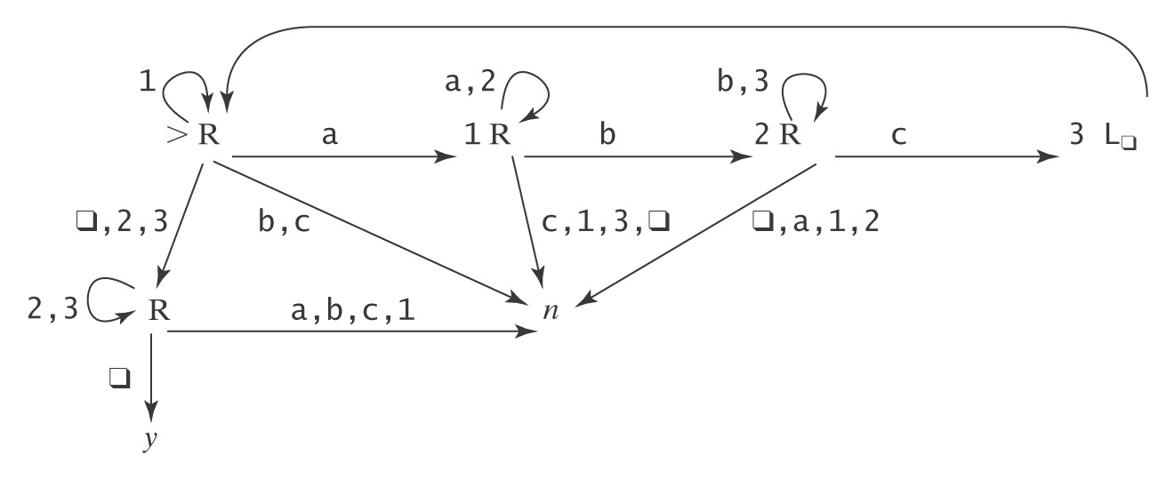
A Deciding Example
A^{n}B^{n}C^{n} = {a^{n}b^{n}c^{n} : n ≥ 0}
Example: qaabbccqqqqqqqqq
Example: qaaccbqqqqqqqqq

Slide 16
Semideciding a Language
Let Σ_{M} be the input alphabet to a TM M. Let L ⊆ Σ_{M}*.
M semidecides L iff, for any string w ∈ Σ_{M}*:
● w ∈ L → M accepts w
● w ∉ L → M does not accept w. M may either:
reject or
fail to halt.
A language L is semidecidable iff there is a Turing machine that semidecides it. We define the set SD to be the set of all semidecidable languages.
Notes:
Another term that is sometimes used tfor this concept is "recursively enumerable"

Slide 17
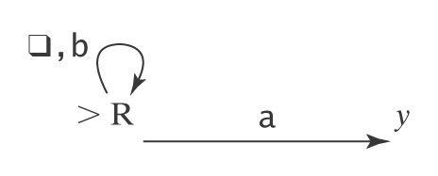
Example of Semideciding
Let L = b*a(a ∪ b)*
We can build M to semidecide L:
1. Loop
  1.1 Move one square to the right. If the character under
  the read head is an a, halt and accept.
In our macro language, M is:

Slide 18
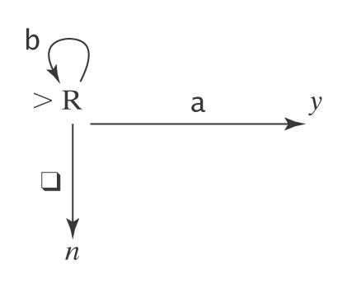
Example of Deciding the same Language
L = b*a(a ∪ b)*. We can also decide L:
  Loop:
    1.1 Move one square to the right.
    1.2 If the character under the read/write head is
    an a, halt and accept.
    1.3 If it is q, halt and reject.
In our macro language, M is:

Slide 19
TM that Computes a Function
Let M = (K, Σ, Γ, δ, s, {h}).
Define M(w) = z iff (s, qw) |-_{M}* (h, qz).
Let Σ′ ⊆ Σ be M’s output alphabet.
Let f be any function from Σ* to Σ′*.
M computes f iff, for all w ∈ Σ*:
● If w is an input on which f is defined: M(w) = f(w).
● Otherwise M(w) does not halt.
A function f is recursive or computable iff there is a Turing machine M that computes it and that always halts.
Note that this is different than our common use of recursive.
Notice that the TM's function computes with strings (Σ* to Σ′*), not directly with numbers.

Slide 20
Example of Computing a Function
Let Σ = {a, b}. Let f(w) = ww.
Input: qwqqqqqq Output: qwwq
Define the copy machine C:
qwqqqqqq → qwqwq
Also use the S← machine:
quqwq → quwq
Then the machine to compute f is just >C S← L_{q}
More details next slide

Slide 21
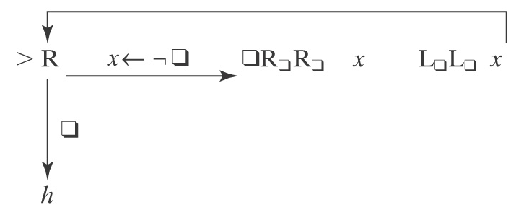
Example of Computing a Function
Let Σ = {a, b}. Let f(w) = ww.
Input: qwqqqqqq Output: qwwq
Define the copy machine C:
qwqqqqqq → qwqwq
Then use the S← machine:
quqwq → quwq
Then the machine to compute f is just >C S← L_{q}

Slide 22
Computing Numeric Functions
For any positive integer k, value_{k}(n) returns the nonnegative integer that is encoded, base k, by the string n.
For example:
● value₂(101) = 5.
● value₈(101) = 65.
TM M computes a function f from ℕ^{m} to ℕ iff, for some k:
value_{k}(M(n₁;n₂;…n_{m})) = f(value_{k}(n₁), … value_{k}(n_{m}))
Note that the semicolon serves to separate the representations of the arguments

Slide 23
Why Are We Working with Our Hands Tied Behind Our Backs?
Turing machines Are more powerful than any of
the other formalisms we have
studied so far. ☺
Turing machines Are a lot harder to work with than
all the real computers that are
available to us.
☹
Why bother?
The very simplicity that makes it hard to program Turing machines makes it possible to reason formally about what they can do. If we can, once, show that everything a real computer can do can be done (albeit clumsily) on a Turing machine, then we have a way to reason about what real computers can do.

