Slide 1

MA/CSSE 474
Theory of Computation
Remove Useless Nonterminals
Ambiguity
Normal forms
Notes:
Exam next Friday!

Slide 2
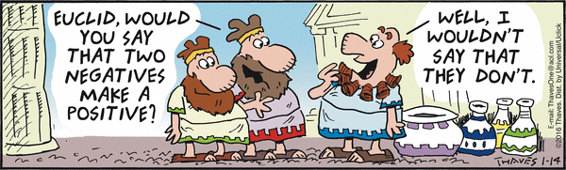
Your Questions?
Previous class days' material
Reading Assignments
This is quite a "complement" to Euclid!
HW 9, 10 problems
Anything else

Slide 3
Prove the Correctness of a Grammar
A^{n}B^{n} = {a^{n}b^{n} : n ≥ 0}
G = ({S, a, b}, {a, b}, R, S),
R = { S → a S b
S → ε
}
● Prove that G generates only strings in L.
● Prove that G generates all the strings in L.
Notes:
If S ⇒* w, then w is in L.
By Induction on number of steps:
1. If alpha can be derived from S, then alpha has 0 or 1 S.
2. If alpha can be derived from S and contains S, then for some n , alpha is anSbn.
3. If w is derived from S, the the S was removed in the last step.
Let w = anbn. Show by induction that w is derived from S.

Slide 4
Simplify Context-Free Grammars
Remove non-productive and unreachable non-terminals.

Slide 5
Remove Unproductive Nonterminals
removeunproductive(G: CFG) =
G′ = G.
Mark every nonterminal symbol in G′ as unproductive.
Mark every terminal symbol in G′ as productive.
Until one entire pass has been made without any new nonterminal symbol being marked do:
For each rule X → α in R do:
If every symbol in α has been marked as productive and X has not yet been marked as productive then:
Mark X as productive.
Remove from G′ every unproductive symbol.
Remove from G′ every rule that contains an unproductive symbol.
Return G′.

Slide 6
Remove Unreachable Nonterminals
removeunreachable(G: CFG) =
G′ = G.
Mark S as reachable.
Mark every other nonterminal symbol as unreachable.
Until one entire pass has been made without any new symbol being marked do:
For each rule X → αAβ (where A ∈ V - Σ) in R do:
If X has been marked as reachable and A has not, then:
Mark A as reachable.
Remove from G′ every unreachable symbol.
Remove from G′ every rule with an unreachable symbol on the left-hand side.
Return G′.

Slide 7
Derivations and parse trees
Parse trees capture essential structure:
1 2 3 4 5 6
S ⇒ SS ⇒ (S)S ⇒ ((S))S ⇒ (())S ⇒ (())(S) ⇒ (())()
S ⇒ SS ⇒ (S)S ⇒ ((S))S ⇒ ((S))(S) ⇒ (())(S) ⇒ (())()
1 2 3 5 4 6
S
S S
( S ) ( S )
( S ) ε
ε

Slide 8
Parse Trees
A parse tree, (derivation tree) derived from a grammar G = (V, Σ, R, S), is a rooted, ordered tree in which:
● Every leaf node is labeled with an element of Σ ∪ {ε},
● The root node is labeled S,
● Every other node is labeled with an element
of N = V - Σ and
● If m is a non-leaf node labeled X and the (ordered) children of m are labeled x₁, x₂, …, x_{n}, then R contains the rule
X → x₁ x₂ … x_{n}.

Slide 9
Structure in English
S
NP VP
Nominal V NP
Adjs N Nominal
Adj N
the smart cat smells chocolate

Slide 10
Generative Capacity
Because parse trees matter, it makes sense, given a grammar G, to distinguish between:
● G’s weak generative capacity, defined to be the
set of strings, L(G), that G generates, and
● G’s strong generative capacity, defined to be the
set of parse trees that G generates.

Slide 11
Algorithms Care How We Search or Derive
S
S S
( S ) ( S )
( S ) ε
ε
Algorithms for generation and recognition must be systematic. They typically use either the leftmost derivation or the rightmost derivation.
Notes:
Leftmost: Always replace leftmost nonterminal in a sentential form.

Slide 12
Derivations of The Smart Cat
A left-most derivation is:
S ⇒ NP VP ⇒ the Nominal VP ⇒ the Adjs N VP ⇒
the Adj N VP ⇒ the smart N VP ⇒ the smart cat VP ⇒
the smart cat V NP ⇒ the smart cat smells NP ⇒
the smart cat smells Nominal ⇒ the smart cat smells N ⇒
the smart cat smells chocolate
A right-most derivation is:
S ⇒ NP VP ⇒ NP V NP ⇒ NP V Nominal ⇒ NP V N ⇒
NP V chocolate ⇒ NP smells chocolate ⇒
the Nominal smells chocolate ⇒
the Adjs N smells chocolate ⇒
the Adjs cat smells chocolate ⇒
the Adj cat smells chocolate ⇒
the smart cat smells chocolate

Slide 13
Ambiguity
A grammar is ambiguous iff there is at least one string in L(G) for which G produces more than one parse tree*.
For many applications of context-free grammars, this is a problem.
Example: A programming language.
If there can be two different structures for a string in the language, there can be two different meanings.
Not good!
* Equivalently, more than one leftmost derivation, or more
than one rightmost derivation.
Notes:
I removed the previous slide:
Derivation is Not Necessarily Unique
Which is About regular languages.

Slide 14
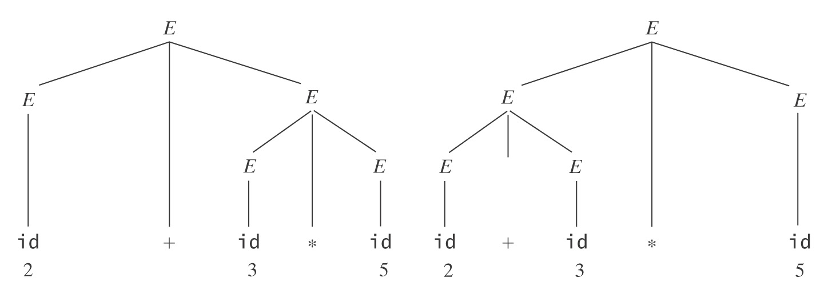
An Arithmetic Expression Grammar
E → E + E
E → E ∗ E
E → (E)
E → id

Slide 15
Inherent Ambiguity
Some CF languages have the property that every grammar for them is ambiguous. We call such languages inherently ambiguous.
Example:
L = {a^{n}b^{n}c^{m}: n, m ≥ 0} ∪ {a^{n}b^{m}c^{m}: n, m ≥ 0}.

Slide 16
Inherent Ambiguity
L = {a^{n}b^{n}c^{m}: n, m ≥ 0} ∪ {a^{n}b^{m}c^{m}: n, m ≥ 0}.
One grammar for L has these rules:
S → S₁ | S₂
S₁ → S₁c | A /* Generate all strings in {a^{n}b^{n}c^{m}}.
A → aAb | ε
S₂ → aS₂ | B /* Generate all strings in {a^{n}b^{m}c^{m}}.
B → bBc | ε
Consider any string of the form a^{n}b^{n}c^{n}.
It turns out that L is inherently ambiguous.

Slide 17
Ambiguity and undecidability
Both of the following problems are undecidable*:
Given a context-free grammar G, is G ambiguous?
Given a context-free language L, is L inherently
ambiguous?
Informal definition of undecidable for the first problem:
There is no algorithm (procedure that is guaranteed to always halt) that, given a grammar G, determines whether G is ambiguous.

