Slide 1

MA/CSSE 474
Theory of Computation
Context-Free Grammars, Part 2
Notes:
Exam next Friday!

Slide 2
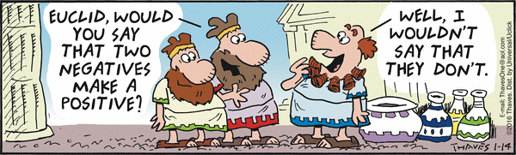
Your Questions?
Previous class days' material
Reading Assignments
This is quite a "complement" to Euclid!
HW 9 problems
Exam 2
Anything else

Slide 3
CFG for Simple Arithmetic Expressions
G = (V, Σ, R, E), where
V = {+, *, (, ), id, E},
Σ = {+, *, (, ), id},
R = {
E → E + E
E → E ∗ E
E → (E)
E → id
}
Derive id + id * id
Notes:
WE saw this one in PLC.

Slide 4
Recursive Grammar Rules
A rule is recursive iff it is X → w₁Yw₂, where:
Y ⇒* w₃Xw₄ for some w₁, w₂, w₃, and w₄ in V*.
A grammar G is recursive iff G contains at least one recursive rule.
Examples: S → (S) S → (T)
T → (S)
In general, non-recursive grammars are boring!
Notes:
A brief foray into Chapter 7

Slide 5
Self-Embedding Grammar Rules
A rule in a grammar G is self-embedding iff it is :
X → w₁Yw₂, where Y ⇒* w₃Xw₄ and
both w₁w₃ and w₄w₂ are in Σ⁺.
A grammar is self-embedding iff it contains at least one self-embedding rule.
Examples: S → aSa self-embedding
S → aS recursive but not self-embedding
S → aT
T → Sa self-embedding
What is the difference between self-embedding and recursive?

Slide 6
Where Context-Free Grammars Get Their Power
If a CFG G is not self-embedding then L(G) is regular.
If a language L has the property that every grammar that defines it is self-embedding, then L is not regular.

Slide 7
Equal Numbers of a’s and b’s
Let L = {w ∈ {a, b}*: #_{a}(w) = #_{b}(w)}.
Find a CFG G such that L = L(G)
Notes:
G = {{S, a, b}, {a, b}, R, S}, where:
R = { S → aSb
S → bSa
S → SS
S → ε }.

Slide 8
BNF
A notation for writing practical context-free grammars
The symbol | should be read as “or”.
Example: S → aSb | bSa | SS | ε
Allow a nonterminal symbol to be any sequence of characters surrounded by angle brackets.
Examples of nonterminals:
<program>
<variable>

Slide 9
BNF for a Java Fragment
<block> ::= {<stmt-list>} |
{}
<stmt-list> ::= <stmt> |
<stmt-list> <stmt>
<stmt> ::= <block> |
while (<cond>) <stmt> |
if (<cond>) <stmt> |
do <stmt> while (<cond>); |
<assignment-stmt>; |
return |
return <expression> |
<method-invocation>;

Slide 10
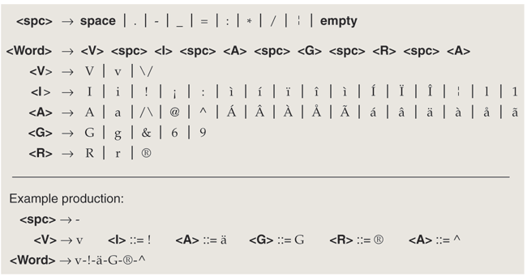
Spam Generation
These production rules yield 1,843,200 possible spellings.
How Many Ways Can You Spell V1@gra? By Brian Hayes
American Scientist, July-August 2007
http://www.americanscientist.org/template/AssetDetail/assetid/55592

Slide 11
HTML
<ul>
<li>Item 1, which will include a sublist</li>
<ul>
<li>First item in sublist</li>
<li>Second item in sublist</li>
</ul>
<li>Item 2</li>
</ul>
A grammar:
/* Text is a sequence of elements.
HTMLtext → Element HTMLtext | ε
Element → UL | LI | … (and other kinds of elements that
are allowed in the body of an HTML document)
/* The <ul> and </ul> tags must match.
UL → <ul> HTMLtext </ul>
/* The <li> and </li> tags must match.
LI → <li> HTMLtext </li>

Slide 12
English
S → NP VP
NP → the Nominal | a Nominal | Nominal |
ProperNoun | NP PP
Nominal → N | Adjs N
N → cat | dogs | bear | girl | chocolate | rifle
ProperNoun → Chris | Fluffy
Adjs → Adj Adjs | Adj
Adj → young | older | smart
VP → V | V NP | VP PP
V → like | likes | thinks | shoots | smells
PP → Prep NP
Prep → with
Notes:
But of course, English grammar is not entirely context-free.

Slide 13
Designing Context-Free Grammars
● Generate related regions together.
A^{n}B^{n}
● Generate concatenated regions:
A → BC
● Generate outside in:
A → aAb

Slide 14
Concatenating Independent Languages
Let L = {a^{n}b^{n}c^{m} : n, m ≥ 0}.
The c^{m} portion of any string in L is completely independent of the a^{n}b^{n} portion, so we should generate the two portions separately and concatenate them together.
G = ({S, N, C, a, b, c}, {a, b, c}, R, S} where:
R = { S → NC
N → aNb
N → ε
C → cC
C → ε
}.

Slide 15
L = { : k ≥ 0 and ∀i (n_{i} ≥ 0)}
Examples of strings in L: ε, abab, aabbaaabbbabab
Note that L = {a^{n}b^{n} : n ≥ 0}*.
G = ({S, M, a, b}, {a, b}, R, S} where:
R = { S → MS
S → ε
M → aMb
M → ε
}.

Slide 16
Another Example: Unequal a’s and b’s
L = {a^{n}b^{m} : n ≠ m}
G = (V, Σ, R, S), where
V = {a, b, S, },
Σ = {a, b},
R =
Notes:
S → A /* more a’s than b’s
S → B /* more b’s than a’s
A → a /* at least one extra a generated
A → aA
A → aAb
B → b /* at least one extra b generated
B → Bb
B → aBb

Slide 17
Prove the Correctness of a Grammar
A^{n}B^{n} = {a^{n}b^{n} : n ≥ 0}
G = ({S, a, b}, {a, b}, R, S),
R = { S → a S b
S → ε
}
● Prove that G generates only strings in L.
● Prove that G generates all the strings in L.
Notes:
If S ⇒* w, then w is in L.
By Induction on number of grammar symbols:
1. If alpha can be derived from S, then alpha has 0 or 1 S.
2. If alpha can be derived form S and contains S, then for some n , alpha is anSbn.
3. If w is derived from S, the the S was removed in the last step.
Let w = anbn. Show by induction that w is derived from S.

Slide 18
Structure
Context free languages:
We care about structure.
E
E + E
id E * E
3 id id
5 7

Slide 19
Simplifying Context-Free Grammars
Remove non-productive and unreachable non-terminals.

Slide 20
Remove Unproductive Nonterminals
removeunproductive(G: CFG) =
G′ = G.
Mark every nonterminal symbol in G′ as unproductive.
Mark every terminal symbol in G′ as productive.
Until one entire pass has been made without any new nonterminal symbol being marked do:
For each rule X → α in R do:
If every symbol in α has been marked as productive and X has not yet been marked as productive then:
Mark X as productive.
Remove from G′ every unproductive symbol.
Remove from G′ every rule that contains an unproductive symbol.
Return G′.

Slide 21
Remove Unreachable Nonterminals
removeunreachable(G: CFG) =
G′ = G.
Mark S as reachable.
Mark every other nonterminal symbol as unreachable.
Until one entire pass has been made without any new symbol being marked do:
For each rule X → αAβ (where A ∈ V - Σ) in R do:
If X has been marked as reachable and A has not then:
Mark A as reachable.
Remove from G′ every unreachable symbol.
Remove from G′ every rule with an unreachable symbol on the left-hand side.
Return G′.

