Slide 1
MA/CSSE 474
Theory of Computation
DFSM Canonical Form
Proof of NDFSM→DFSM ALGORITHM (as much as we have time for)

Slide 2

Your Questions?
Previous class days' material
Reading Assignments
HW5 problems
Tuesday's Exam
Anything else

Slide 3
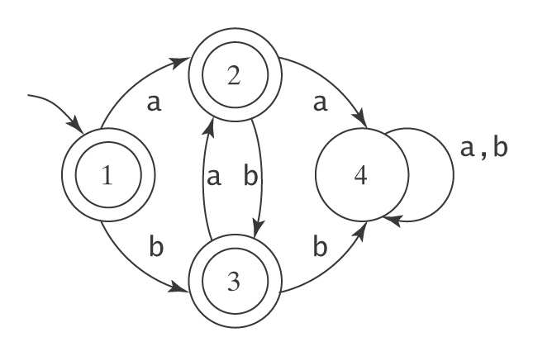
Example (continued)
L = { w∈{a, b}* : no two adjacent characters are the same }
Equivalence classes of ≈_{L}:
[1] [ε]
[2] [a, aba, ababa,
[3] [b, ab, bab, abab, …]
[4] [aa, abaa, ababb…]

Slide 4
The Myhill-Nerode Theorem
Theorem: A language is regular iff the number of equivalence classes of ≈_{L} is finite.
Proof: Show the two directions of the implication:
L regular → the number of equivalence classes of ≈_{L} is finite: If L is regular, then
The number of equivalence classes of ≈_{L} is finite → L regular: If the cardinality of ≈_{L} is finite, then
Notes:
Proof: Show the two directions of the implication:
L regular → the number of equivalence classes of ≈_{L} is finite: If L is regular, then there exists some FSM M that accepts L. M has some finite number of states m. The cardinality of ≈_{L} ≤ m. So the cardinality of ≈_{L} is finite.
The number of equivalence classes of ≈_{L} is finite → L regular: If the cardinality of ≈_{L} is finite, then the construction that was described in the proof of the previous theorem will build an FSM that accepts L. So L must be regular.

Slide 5
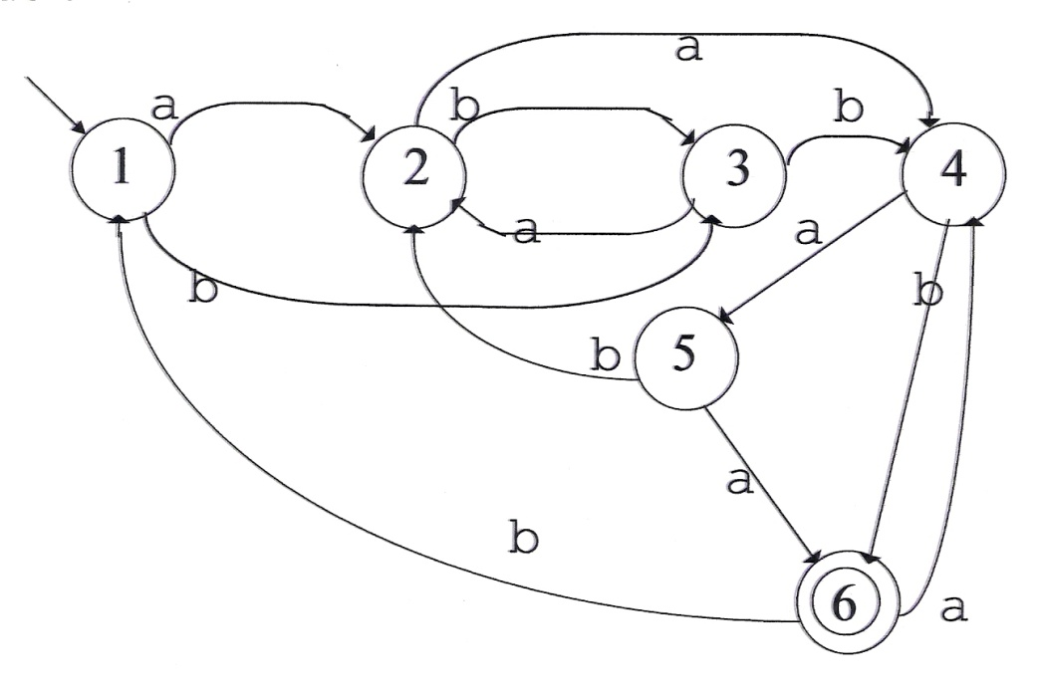
So Where Do We Stand?
1. We know that for any regular language L there exists a minimal
accepting machine M_{L}.
2. We know that |K| of M_{L} equals the number of equivalence
classes of ≈_{L}.
3. We know how to construct M_{L} from ≈_{L}.
4. We know that M_{L} is unique up to the naming of its states.
But is this good enough?
Consider:
Notes:
It's not so easy to determine the equivalence classes, since we don't know the language. And this is a fairly small machine.

Slide 6
Minimizing an Existing DFSM
(Without Knowing ≈L)
Two approaches:
Begin with M and collapse redundant states, getting rid of one at a time until the resulting machine is minimal.
Begin by overclustering the states of M into just two groups, accepting and nonaccepting. Then iteratively split those groups apart until all the distinguishable states have been distinguished.

Slide 7
The Overclustering Approach
We need a definition for “equivalent”, i.e., mergeable states.
Define p ≡ q iff for every string w ∈ Σ*, either w takes M to an accepting state from both q and p or it takes M to a rejecting state from both q and p.
Is ≡ an equivalence relation?
Notes:
∀ w ∊ Σ* (∃ p', q' ∊ K ( ((p, w) ⊦* (p', ε ) ^ (q, w) ⊦* (q', ε ) ) → ((p'∊ A) ↔ (q' ∊ A))))

Slide 8
Construct ≡ as the Limit of a Sequence of Approximating Equivalence Relations ≡^{n}
(Where n is the length of the input strings that have been considered so far)
Consider input strings, starting with ε, and increasing in length by 1 at each iteration. Start by overclustering the states. Then split them apart as it becomes apparent (with longer and longer strings) that they are not equivalent

Slide 9
Constructing ≡^{n}
p ≡⁰ q iff they behave equivalently when they read ε. In other words, if they are both accepting or both rejecting states.
p ≡¹ q iff p ≡⁰ q and they behave equivalently when they read any string of length 1, i.e., if any single character sends both of them to an accepting state or both of them to a rejecting state. Note that this is equivalent to saying that any single character sends them to states that are ≡⁰ to each other.
p ≡² q iff p ≡¹ q and they behave equivalently when they read any string of length 2, which they will do if, when they read the first character they land in states that are ≡¹ to each other. By the definition of ≡¹, they will then yield the same outcome when they read the single remaining character.
And so forth.

Slide 10
Constructing ≡, Continued
More precisely, ∀p,q ∈ K and any n ≥ 1, q ≡^{n} p iff:
1. q ≡^{n-1} p, and
2. ∀a ∈ Σ (δ(p, a) ≡^{n-1} δ(q, a))

Slide 11
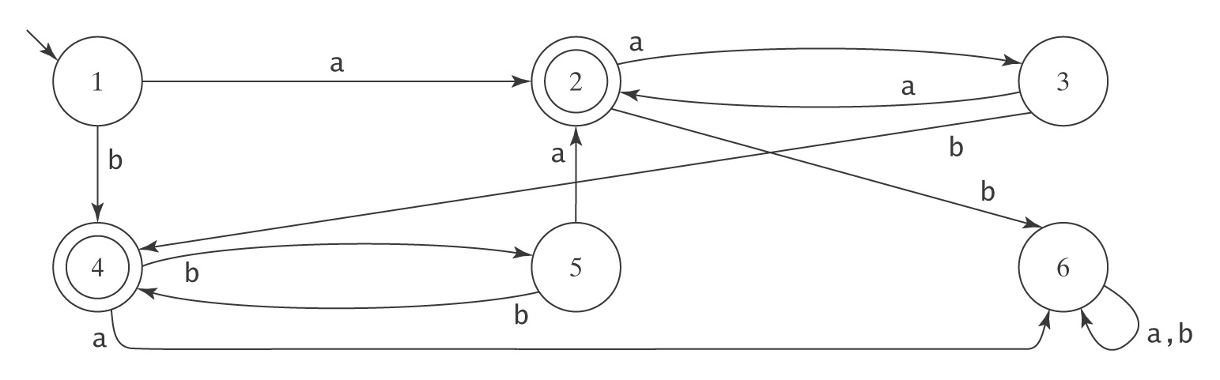
An Example
Σ = {a, b}
Equivalence classes:
≡⁰ =
≡¹ =
≡² =

Slide 12
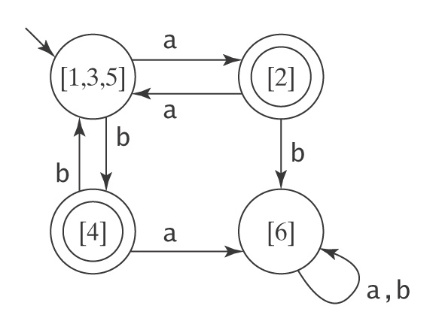
The Result

Slide 13
MinDFSM
MinDFSM(M: DFSM) =
1. classes := {A, K-A};
2. Repeat until no changes are made
  2.1. newclasses := ∅;
  2.2. For each equivalence class e in classes, if e contains
  more than one state do
    For each state q in e do
      For each character c in Σ do
        Determine which element of classes q
        goes to if c is read
    If there are any two states p and q that need to be
    split, split them. Create as many new
    equivalence classes as are necessary. Insert
    those classes into newclasses.
    If there are no states whose behavior differs, no
    splitting is necessary. Insert e into
    newclasses.
  2.3. classes := newclasses;
3. Return M* = (classes, Σ, δ, [s_{M}], {[q: the elements of q are in A_{M}]}),
where δ_{M*} is constructed as follows:
if δ_{M}(q, c) = p, then δ_{M*}([q], c) = [p]

Slide 14
Summary
● Given any regular language L, there exists a
minimal DFSM M that accepts L.
● M is unique up to the naming of its states.
● Given any DFSM M, there exists an algorithm
minDFSM that constructs a minimal DFSM
that also accepts L(M).

Slide 15
Canonical Forms
A canonical form for some set of objects C assigns exactly one representative to each class of “equivalent” objects in C.
Further, each such representative is distinct, so two objects in C share the same representation iff they are “equivalent” in the sense for which we define the form.
In order for a canonical form to be useful, there must be a procedure which, given an object from the set, computes its canonical form.

Slide 16
A Canonical Form for FSMs
buildFSMcanonicalform(M: FSM) =
1. M′ = ndfsmtodfsm(M).
2. M* = minDFSM(M′).
3. Create a unique assignment of names to the
states of M*.
4. Return M*.
Given two FSMs M₁ and M₂:
buildFSMcanonicalform(M₁)
=
buildFSMcanonicalform(M₂)
iff L(M₁) = L(M₂).
The simple algorithm for unique name assignment is in the textbook; we will illustrate it here by doing an example.

Slide 17
NDFSMtoDFSM Correctness

Slide 18
The Algorithm ndfsmtodfsm
ndfsmtodfsm(M: NDFSM) =
1. For each state q in K_{M} do:
  1.1 Compute eps(q).
2. s' = eps(s)
3. Compute δ':
  3.1 active-states = {s'}.
  3.2 δ' = ∅.
  3.3 While there exists some element Q of active-states for
  which δ' has not yet been computed do:
For each character c in Σ_{M} do:
new-state = ∅.
For each state q in Q do:
For each state p such that (q, c, p) ∈ Δ do:
new-state = new-state ∪ eps(p).
Add the transition (q, c, new-state) to δ'.
If new-state ∉ active-states then insert it.
4. K' = active-states.
5. A' = {Q ∈ K' : Q ∩ A ≠ ∅ }.

Slide 19
Correctness Proof of ndfsmtodfsm
To prove:
From any NDFSM M = (K, Σ, Δ, s, A), ndfsmtodfsm constructs a DFSM M'= (K', Σ, δ', s', A'), which is equivalent to M.
K' ⊆ P(K) (a.k.a. 2^{K})
s' = eps(s)
A' = {Q ⊆ K : Q ∩ A ≠ ∅}
δ'(Q, a) = ∪ {eps(p): p ∈ K and
(q, a, p)∈Δ for some q∈Q}

Slide 20
Correctness Proof of ndfsmtodfsm
From any NDFSM M, ndfsmtodfsm constructs a DFSM M', which is:
M' is Deterministic: By the definition in step 3 of δ', we are guaranteed that δ' is defined for all reachable elements of K' and all possible input characters. Further, step 3 inserts a single value into δ' for each state-input pair, so M' is deterministic.
(2) M' is Equivalent to M: We constructed δ' so that M' mimics an “all paths” simulation of M. We must now prove that that simulation returns the same result that M would.

Slide 21
A Useful Lemma
Lemma: Let w be any string in Σ*, let p and q be any states in K, and let P be any state in K'. Then:
(q, w) |-_{M}* (p, ε) iff ((eps(q), w) |-_{M}' * (P, ε) and p ∈ P) .
  INFORMAL RESTATEMENT OF LEMMA: In other words, if the original NDFSM M starts in state q and, after reading the string w, can land in state p ( along at least one of its paths), then the new DFSM M' must behave as follows:
  Furthermore, the only-if part implies:
Notes:
It turns out that we will only need this lemma for the case where q = s, but the more general thing is easier to porve by induction. This is common in induction proofs.
INFORMAL RESTATEMENT OF LEMMA: If the original NDFSM M starts in state q and, after reading the string w, can land in state p (along at least one of its paths), then the new DFSM M' must behave as follows:
When started in the state that corresponds to the set of states the original machine M could get to from q without consuming any input, M' reads the string w and lands in a state P (which is a set of M's states) that contains p.
Furthermore, The only-if part implies: M' (starting from q and reading w) must end up in a "set state" that contains only states that M could get to from q after reading w and following any available epsilon-transitions.

Slide 22
A Useful Lemma
Lemma: Let w be any string in Σ*, let p and q be any states in K, and let P be any state in K'. Then:
(q, w) |-_{M}* (p, ε) iff ((eps(q), w) |-_{M}' * (P, ε) and p ∈ P) .
It turns out that we will only need this lemma for the case where q = s, but the more general form is easier to prove by induction. This is common in induction proofs.
Proof: We must show that δ' has been defined so that the individual steps of M', when taken together, do the right thing for an input string w of any length. Since the definitions describe one step at a time, we will prove the lemma by induction on |w|.
Recall: NDFSM M = (K, Σ, Δ, s, A), DFSM M'= (K', Σ, δ', s', A'),
Notes:
It turns out that we will only need this lemma for the case where q = s, but the more general thing is easier to prve by induction. This is common in induction proofs.

Slide 23
Base Case: |w| = 0, so w = ε
if part: Prove:
(eps(q), ε) |-_{M}' * (P, ε) ∧ p ∈ P → (q, ε) |-_{M}*(p, ε)
Notes:
Since w = ε and M' (being deterministic) contains no ε-transitions, M' makes no moves. So M' must end in the same state it started in, namely eps(q). So P = eps(q).
Now, since P contains p, then p ∈ eps(q). But, given the definition of eps, this means that, in the original NDFSM M, p is reachable from q just by following ε-transitions. So (q, ε) |-_{M}*(p, ε) .

Slide 24
Base Case
only if part: We need to show:
(q, ε) |-_{M}* (p, ε) → [ (eps(q), ε) |-_{M}'* (P, ε) and p ∈ P ]
Notes:
If |w| = 0 and the original machine M goes from q to p with only w as input, it must go from q to p following just ε-transitions. So p ∈ eps(q).
M' starts in eps(q). Since M' contains no ε-transitions, it will make no moves at all if its input is ε. So it will halt in exactly the same state it started in, namely eps(q). So P = eps(q) and thus contains p.
So M' halts in a state that includes p.

Slide 25
Induction Step
Let w have length k + 1. Then w = zc where z∈Σ* has length k, and c∈Σ.
Induction assumption. The lemma is true for z.
So we show that, assuming that M and M' behave identically for the first k characters, they behave identically for the last character also and thus for the entire string of length k + 1.
The Definition of δ′
δ'(Q, a) = ∪{eps(p) : ∃q∈Q ((q, a, p) ∈ Δ)}

Slide 26
What We Need to Prove
The relationship between:
The computation of the NDFSM M:
(q, w) |-_{M}* (p, ε)
and
The computation of the DFSM M':
(eps(q), w) |-_{M'}* (P, ε) and p ∈ P

Slide 27
What We Need to Prove
Rewriting w as zc:
The computation of the NDFSM M:
(q, zc) |-_{M}* (p, ε)
and
The computation of the DFSM M':
(eps(q), zc) |-_{M'}* (P, ε) and p ∈ P

Slide 28
What We Need to Prove
Breaking w into two pieces:
The computation of the NDFSM M:
(q, zc) |-_{M}* (s_{i}, c) |-_{M}* (p, ε)
and
The computation of the DFSM M':
(eps(q), zc) |-_{M'}* (Q, c) |-_{M'} (P, ε) and p ∈ P
In other words, after processing z, M will be in some set of states S, whose elements we write as s_{i}. M' will be in some "set" state that we call Q. Again, well split the proof into two parts:
In the M derivation above, the second |-_{M} has a * due to the possibility of epsilon moves. In the M' derivation there is no * because of no epsilon moves in a deterministic machine.
Notes:
In other words, after processing z, M will be in some set of states S, whose elements well write as s_{i}. M' will be in some "set" state that we call Q. Again, well split the proof into two parts:

Slide 29
If Part
We must prove:
(eps(q), zc) |-_{M'}* (Q, c) |-_{M'} (P, ε) and p ∈ P →
(q, zc) |-_{M}* (s_{i}, c) |-_{M}* (p, ε)
Notes:
If, after reading z, M' is in state Q, we know, from the induction hypothesis, that the original machine M, after reading z, must be in some set of states S and that Q is precisely that set.
If we have that M', starting in Q and reading x lands in P, then, from the definition of δ', P contains precisely the states that M could land in after starting in any state in S and reading x. Thus if p ∈ P, p must be a state that M could land in if started in s_{i} on reading x.

Slide 30
Only If Part
We must prove:
(q, zc) |-_{M}* (s_{i}, c) |-_{M}* (p, ε) →
(eps(q), zc) |-_{M'}* (Q, c) |-_{M'} (P, ε) and p ∈ P
Notes:
By the induction hypothesis, if M, after processing z, can reach some set of states S, then Q (the state M' is in after processing z) must contain precisely all the states in S. So, from Q, reading x, M' must be in some set state P that contains precisely the states that M can reach starting in any of the states in S, reading x, and then following all ε transitions. So, after consuming zc, M', when started in eps(q), must end up in a state P that contains all and only the states p that M, when started in q, could end up in.

Slide 31
Back to the Theorem
If w ∈ L(M) then:
The original machine M, when started in its start state, can consume w and end up in an accepting state.
(eps(s), w) |-_{M'}* (Q, ε) for some Q containing some state r ∈ A.
  In the statement of the lemma, let q equal s and p = r for some r ∈ A.
  Then M', when started in its start state, eps(s), will consume w and end in a state that contains r.
  But if M' does that, then it has ended up in one of its accepting states (by the definition of A' in step 5 of the algorithm).
  So M' accepts w (by the definition of what it means for a machine to accept a string).
Notes:
After first sentence of second bullet: In other words, the new machine, when started in its start state, can consume w and end up in one of its accepting states. This follows from the lemma, which is more general and describes a computation from any state to any other.

Slide 32
Back to the Theorem
If w ∉ L(M) (i.e. the original NDFSM does not accept w):
The original machine M, when started in its start state, will not be able to end up in an accepting state after reading w.
If (eps(s), w) |-_{M'}* (Q, ε), then Q contains no state
r ∈ A. This follows directly from the lemma.
The two cases, taken together, show that M' accepts exactly the same strings that M accepts.

