Slide 1

MA/CSSE 474
Theory of Computation
TM Design
Macro Language
D and SD
Notes:
Exam next Friday!

Slide 2
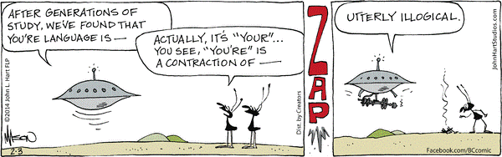
Your Questions?
Previous class days' material
Reading Assignments
I have included some slides online that we will not have time to do in class, but may be helpful to you anyway.
HW 13 problems
Anything else

Slide 3
Turing MachineS

Slide 4
Languages and Machines
SD
D
Context-Free
Languages
Regular
Languages
reg exps
FSMs
cfgs
PDAs
unrestricted grammars
Turing Machines

Slide 5
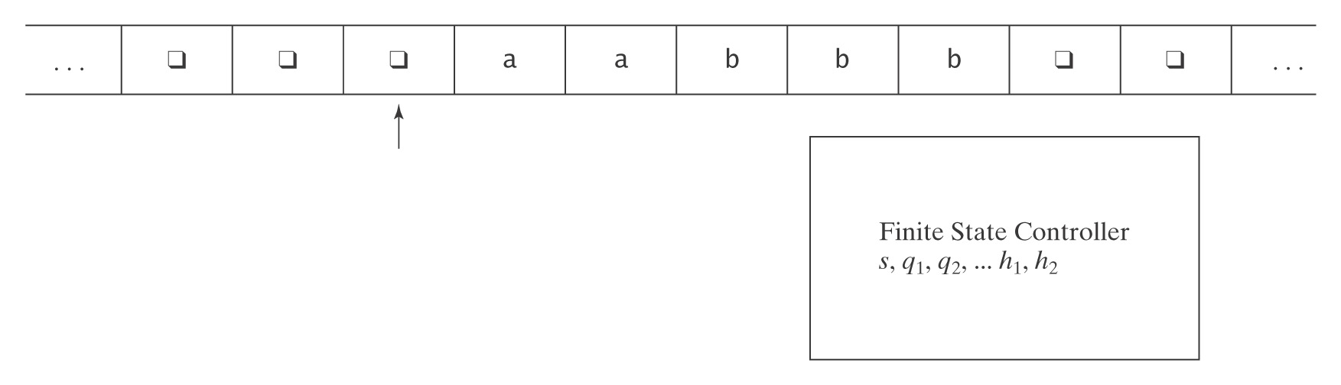
Turing Machines
  At each step, the machine must:
  ● choose its next state,
  ● write on the current square, and
  ● move left or right.

Slide 6
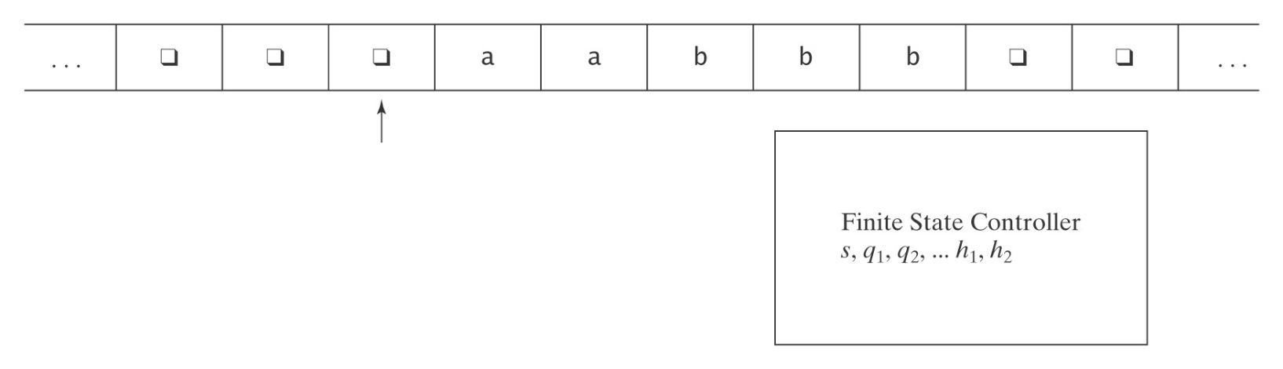
TM Formal Definition
A (deterministic) Turing machine M is (K, Σ, Γ, δ, s, H), where
● K is a finite set of states;
● Σ is the input alphabet, which does not contain q;
● Γ is the tape alphabet,
which must contain q and have Σ as a subset.
● s ∈ K is the initial state;
● H ⊆ K is the set of halting states;
● δ is the transition function:
(K - H) × Γ to K × Γ × {→, ←}
non-halting × tape → state × tape × direction to move
state char char (R or L)

Slide 7
Turing Machines
  At each step, the machine must:
  ● choose its next state,
  ● write on the current square, and
  ● move left or right.

Slide 8
Notes on the Definition
1. The input tape is infinite in both directions.
2. δ is a function, not a relation. So this is a definition for
deterministic Turing machines.
3. δ must be defined for all (state, tape symbol) pairs unless the state is a halting state.
4. Turing machines do not necessarily halt (unlike FSM's and
most PDAs). Why? To halt, they must enter a halting state.
Otherwise they loop.
5. Turing machines generate output, so they can compute
functions.

Slide 9
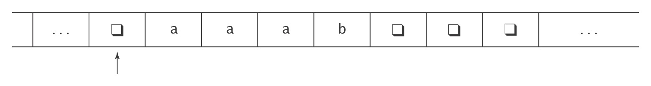
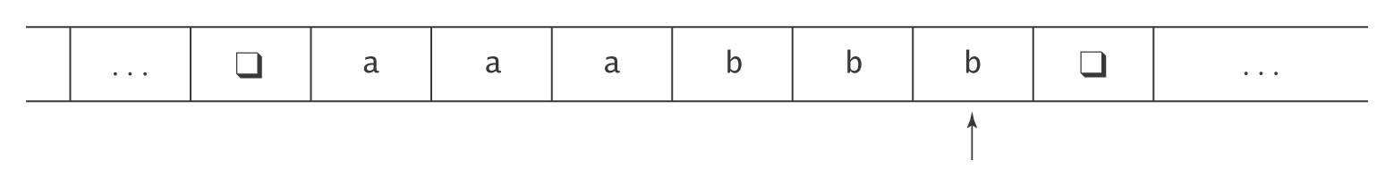
An Example
M takes as input a string in the language:
{a^{i}b^{j}, 0 ≤ j ≤ i},
and adds b’s as required to make the number of b’s equal the number of a’s.
The input to M will look like this:
The output should be:

Slide 10
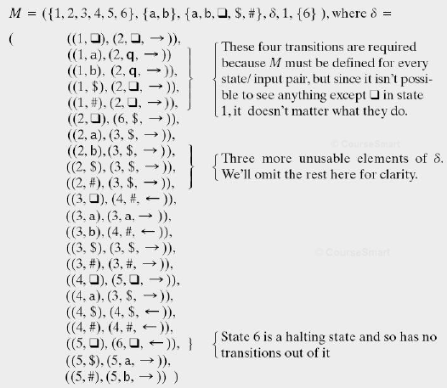
Formal Definition of M

Slide 11
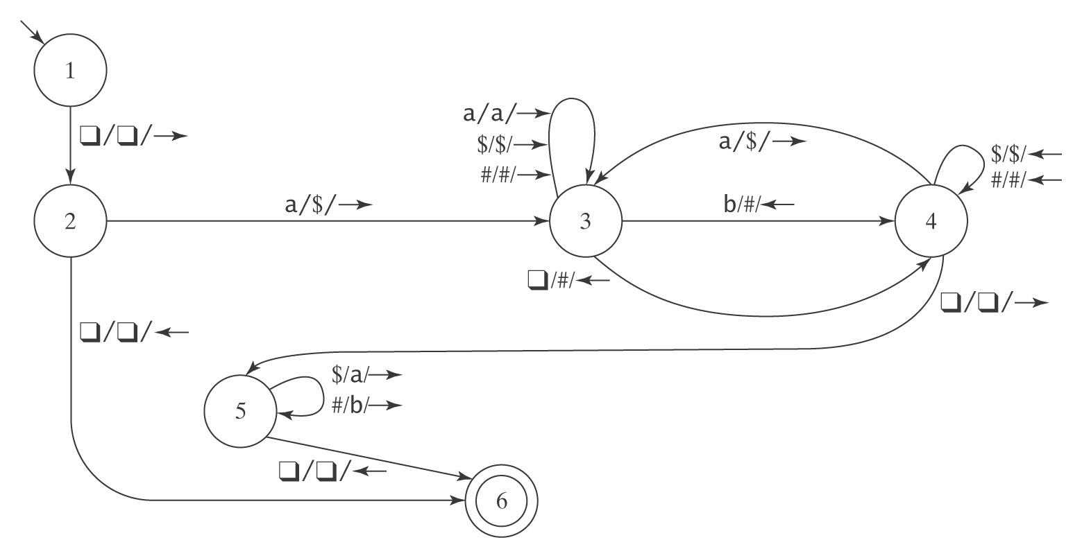
The Details (ε)
K = {1, 2, 3, 4, 5, 6}, Σ = {a, b}, Γ = {a, b, q, $, #},
s = 1, H = {6}, δ =
Show what happens for strings:
ε, aa, aabb, aab, b
❑
❑
❑
❑
❑
❑
❑
❑
1
Notes:
Show what happens with some strings. It's okay to spend some time on this.
Empty string
aa
aabb
a
aab
b

Slide 12
The Details (ε)
K = {1, 2, 3, 4, 5, 6}, Σ = {a, b}, Γ = {a, b, q, $, #},
s = 1, H = {6}, δ =
Show what happens for strings:
ε, aa, aabb, aab, b
❑
❑
❑
❑
❑
❑
❑
❑
2
Notes:
Show what happens with some strings. It's okay to spend some time on this.
Empty string
aa
aabb
a
aab
b

Slide 13
The Details (ε)
K = {1, 2, 3, 4, 5, 6}, Σ = {a, b}, Γ = {a, b, q, $, #},
s = 1, H = {6}, δ =
Show what happens for strings:
ε, aa, aabb, aab, b
❑
❑
❑
❑
❑
❑
❑
❑
6
Notes:
Show what happens with some strings. It's okay to spend some time on this.
Empty string
aa
aabb
a
aab
b

Slide 14
The Details(aa)
K = {1, 2, 3, 4, 5, 6}, Σ = {a, b}, Γ = {a, b, q, $, #},
s = 1, H = {6}, δ =
Show what happens for strings:
ε, aa, aabb, aab, b
❑
❑
❑
a
a
❑
❑
❑
1
Notes:
Show what happens with some strings. It's okay to spend some time on this.
Empty string
aa
aabb
a
aab
b

Slide 15
The Details(aa)
K = {1, 2, 3, 4, 5, 6}, Σ = {a, b}, Γ = {a, b, q, $, #},
s = 1, H = {6}, δ =
Show what happens for strings:
ε, aa, aabb, aab, b
❑
❑
❑
a
a
❑
❑
❑
2
Notes:
Show what happens with some strings. It's okay to spend some time on this.
Empty string
aa
aabb
a
aab
b

Slide 16
The Details(aa)
K = {1, 2, 3, 4, 5, 6}, Σ = {a, b}, Γ = {a, b, q, $, #},
s = 1, H = {6}, δ =
Show what happens for strings:
ε, aa, aabb, aab, b
❑
❑
❑
$
a
❑
❑
❑
3
Notes:
Show what happens with some strings. It's okay to spend some time on this.
Empty string
aa
aabb
a
aab
b

Slide 17
The Details(aa)
K = {1, 2, 3, 4, 5, 6}, Σ = {a, b}, Γ = {a, b, q, $, #},
s = 1, H = {6}, δ =
Show what happens for strings:
ε, aa, aabb, aab, b
❑
❑
❑
$
a
❑
❑
❑
3
Notes:
Show what happens with some strings. It's okay to spend some time on this.
Empty string
aa
aabb
a
aab
b

Slide 18
The Details(aa)
K = {1, 2, 3, 4, 5, 6}, Σ = {a, b}, Γ = {a, b, q, $, #},
s = 1, H = {6}, δ =
Show what happens for strings:
ε, aa, aabb, aab, b
❑
❑
❑
$
a
#
❑
❑
4
Notes:
Show what happens with some strings. It's okay to spend some time on this.
Empty string
aa
aabb
a
aab
b

Slide 19
The Details(aa)
K = {1, 2, 3, 4, 5, 6}, Σ = {a, b}, Γ = {a, b, q, $, #},
s = 1, H = {6}, δ =
Show what happens for strings:
ε, aa, aabb, aab, b
❑
❑
❑
$
$
#
❑
❑
3
Notes:
Show what happens with some strings. It's okay to spend some time on this.
Empty string
aa
aabb
a
aab
b

Slide 20
The Details(aa)
K = {1, 2, 3, 4, 5, 6}, Σ = {a, b}, Γ = {a, b, q, $, #},
s = 1, H = {6}, δ =
Show what happens for strings:
ε, aa, aabb, aab, b
❑
❑
❑
$
$
#
❑
❑
3
Notes:
Show what happens with some strings. It's okay to spend some time on this.
Empty string
aa
aabb
a
aab
b

Slide 21
The Details(aa)
K = {1, 2, 3, 4, 5, 6}, Σ = {a, b}, Γ = {a, b, q, $, #},
s = 1, H = {6}, δ =
Show what happens for strings:
ε, aa, aabb, aab, b
❑
❑
❑
$
$
#
❑
❑
3
Notes:
Show what happens with some strings. It's okay to spend some time on this.
Empty string
aa
aabb
a
aab
b

Slide 22
The Details(aa)
K = {1, 2, 3, 4, 5, 6}, Σ = {a, b}, Γ = {a, b, q, $, #},
s = 1, H = {6}, δ =
Show what happens for strings:
ε, aa, aabb, aab, b
❑
❑
❑
$
$
#
#
❑
4
Notes:
Show what happens with some strings. It's okay to spend some time on this.
Empty string
aa
aabb
a
aab
b

Slide 23
The Details(aa)
K = {1, 2, 3, 4, 5, 6}, Σ = {a, b}, Γ = {a, b, q, $, #},
s = 1, H = {6}, δ =
Show what happens for strings:
ε, aa, aabb, aab, b
❑
❑
❑
$
$
#
#
❑
4
Notes:
Show what happens with some strings. It's okay to spend some time on this.
Empty string
aa
aabb
a
aab
b

Slide 24
The Details(aa)
K = {1, 2, 3, 4, 5, 6}, Σ = {a, b}, Γ = {a, b, q, $, #},
s = 1, H = {6}, δ =
Show what happens for strings:
ε, aa, aabb, aab, b
❑
❑
❑
$
$
#
#
❑
4
Notes:
Show what happens with some strings. It's okay to spend some time on this.
Empty string
aa
aabb
a
aab
b

Slide 25
The Details(aa)
K = {1, 2, 3, 4, 5, 6}, Σ = {a, b}, Γ = {a, b, q, $, #},
s = 1, H = {6}, δ =
Show what happens for strings:
ε, aa, aabb, aab, b
❑
❑
❑
$
$
#
#
❑
4
Notes:
Show what happens with some strings. It's okay to spend some time on this.
Empty string
aa
aabb
a
aab
b

Slide 26
The Details(aa)
K = {1, 2, 3, 4, 5, 6}, Σ = {a, b}, Γ = {a, b, q, $, #},
s = 1, H = {6}, δ =
Show what happens for strings:
ε, aa, aabb, aab, b
❑
❑
❑
$
$
#
#
❑
5
Notes:
Show what happens with some strings. It's okay to spend some time on this.
Empty string
aa
aabb
a
aab
b

Slide 27
The Details(aa)
K = {1, 2, 3, 4, 5, 6}, Σ = {a, b}, Γ = {a, b, q, $, #},
s = 1, H = {6}, δ =
Show what happens for strings:
ε, aa, aabb, aab, b
❑
❑
❑
a
$
#
#
❑
5
Notes:
Show what happens with some strings. It's okay to spend some time on this.
Empty string
aa
aabb
a
aab
b

Slide 28
The Details(aa)
K = {1, 2, 3, 4, 5, 6}, Σ = {a, b}, Γ = {a, b, q, $, #},
s = 1, H = {6}, δ =
Show what happens for strings:
ε, aa, aabb, aab, b
❑
❑
❑
a
a
#
#
❑
5
Notes:
Show what happens with some strings. It's okay to spend some time on this.
Empty string
aa
aabb
a
aab
b

Slide 29
The Details(aa)
K = {1, 2, 3, 4, 5, 6}, Σ = {a, b}, Γ = {a, b, q, $, #},
s = 1, H = {6}, δ =
Show what happens for strings:
ε, aa, aabb, aab, b
❑
❑
❑
a
a
b
#
❑
5
Notes:
Show what happens with some strings. It's okay to spend some time on this.
Empty string
aa
aabb
a
aab
b

Slide 30
The Details(aa)
K = {1, 2, 3, 4, 5, 6}, Σ = {a, b}, Γ = {a, b, q, $, #},
s = 1, H = {6}, δ =
Show what happens for strings:
ε, aa, aabb, aab, b
❑
❑
❑
a
a
b
b
❑
5
Notes:
Show what happens with some strings. It's okay to spend some time on this.
Empty string
aa
aabb
a
aab
b

Slide 31
The Details(aa)
K = {1, 2, 3, 4, 5, 6}, Σ = {a, b}, Γ = {a, b, q, $, #},
s = 1, H = {6}, δ =
Show what happens for strings:
ε, aa, aabb, aab, b
❑
❑
❑
a
a
b
b
❑
6
Notes:
Show what happens with some strings. It's okay to spend some time on this.
Empty string
aa
aabb
a
aab
b

Slide 32
The Details (aabb)
K = {1, 2, 3, 4, 5, 6}, Σ = {a, b}, Γ = {a, b, q, $, #},
s = 1, H = {6}, δ =
Show what happens for strings:
ε, aa, aabb, aab, b
❑
❑
❑
a
a
b
b
❑
The steps are the same as previous example until we read the b; skip to there
1
Notes:
Show what happens with some strings. It's okay to spend some time on this.
Empty string
aa
aabb
a
aab
b

Slide 33
The Details (aabb)
K = {1, 2, 3, 4, 5, 6}, Σ = {a, b}, Γ = {a, b, q, $, #},
s = 1, H = {6}, δ =
Show what happens for strings:
ε, aa, aabb, a, aab, b
❑
❑
❑
$
a
b
b
❑
3
Notes:
Show what happens with some strings. It's okay to spend some time on this.
Empty string
aa
aabb
a
aab
b

Slide 34
The Details (aabb)
K = {1, 2, 3, 4, 5, 6}, Σ = {a, b}, Γ = {a, b, q, $, #},
s = 1, H = {6}, δ =
Show what happens for strings:
ε, aa, aabb, aab, b
❑
❑
❑
$
a
#
b
❑
4
Notes:
Show what happens with some strings. It's okay to spend some time on this.
Empty string
aa
aabb
a
aab
b

Slide 35
The Details (aabb)
K = {1, 2, 3, 4, 5, 6}, Σ = {a, b}, Γ = {a, b, q, $, #},
s = 1, H = {6}, δ =
Show what happens for strings:
ε, aa, aabb, aab, b
❑
❑
❑
$
$
#
b
❑
3
Notes:
Show what happens with some strings. It's okay to spend some time on this.
Empty string
aa
aabb
a
aab
b

Slide 36
The Details (aabb)
K = {1, 2, 3, 4, 5, 6}, Σ = {a, b}, Γ = {a, b, q, $, #},
s = 1, H = {6}, δ =
Show what happens for strings:
ε, aa, aabb, aab, b
❑
❑
❑
$
$
#
b
❑
3
Notes:
Show what happens with some strings. It's okay to spend some time on this.
Empty string
aa
aabb
a
aab
b

Slide 37
The Details (aabb)
K = {1, 2, 3, 4, 5, 6}, Σ = {a, b}, Γ = {a, b, q, $, #},
s = 1, H = {6}, δ =
Show what happens for strings:
ε, aa, aabb, aab, b
❑
❑
❑
$
$
#
#
❑
In state 4, go left until we hit a blank
4
Notes:
Show what happens with some strings. It's okay to spend some time on this.
Empty string
aa
aabb
a
aab
b

Slide 38
The Details (aabb)
K = {1, 2, 3, 4, 5, 6}, Σ = {a, b}, Γ = {a, b, q, $, #},
s = 1, H = {6}, δ =
Show what happens for strings:
ε, aa, aabb, a, aab, b
❑
❑
❑
$
$
#
#
❑
4
Notes:
Show what happens with some strings. It's okay to spend some time on this.
Empty string
aa
aabb
a
aab
b

Slide 39
The Details (aabb)
K = {1, 2, 3, 4, 5, 6}, Σ = {a, b}, Γ = {a, b, q, $, #},
s = 1, H = {6}, δ =
Show what happens for strings:
ε, aa, aabb, aab, b
❑
❑
❑
$
$
#
#
❑
4
Notes:
Show what happens with some strings. It's okay to spend some time on this.
Empty string
aa
aabb
a
aab
b

Slide 40
The Details (aabb)
K = {1, 2, 3, 4, 5, 6}, Σ = {a, b}, Γ = {a, b, q, $, #},
s = 1, H = {6}, δ =
Show what happens for strings:
ε, aa, aabb, aab, b
❑
❑
❑
$
$
#
#
❑
5
Notes:
Show what happens with some strings. It's okay to spend some time on this.
Empty string
aa
aabb
a
aab
b

Slide 41
The Details (aabb)
K = {1, 2, 3, 4, 5, 6}, Σ = {a, b}, Γ = {a, b, q, $, #},
s = 1, H = {6}, δ =
Show what happens for strings:
ε, aa, aabb, aab, b
❑
❑
❑
$
$
#
#
❑
Go right, replacing $ with a and # with b, then move left, as in the last part of the previous example.
5
Notes:
Show what happens with some strings. It's okay to spend some time on this.
Empty string
aa
aabb
a
aab
b

Slide 42
The Details(aabb)
K = {1, 2, 3, 4, 5, 6}, Σ = {a, b}, Γ = {a, b, q, $, #},
s = 1, H = {6}, δ =
Show what happens for strings:
ε, aa, aabb, aab, b
❑
❑
❑
a
a
b
b
❑
6
Notes:
Show what happens with some strings. It's okay to spend some time on this.
Empty string
aa
aabb
a
aab
b

Slide 43
The Details (aab)
K = {1, 2, 3, 4, 5, 6}, Σ = {a, b}, Γ = {a, b, q, $, #},
s = 1, H = {6}, δ =
Show what happens for strings:
ε, aa, aabb, aab, b
❑
❑
❑
a
a
b
❑
❑
You should try this one.
1
Notes:
Show what happens with some strings. It's okay to spend some time on this.
Empty string
aa
aabb
a
aab
b

Slide 44
The Details (b)
K = {1, 2, 3, 4, 5, 6}, Σ = {a, b}, Γ = {a, b, q, $, #},
s = 1, H = {6}, δ =
Show what happens for strings:
ε, aa, aabb, aab, b
❑
❑
❑
b
❑
❑
❑
❑
In the first step, move right. Then there is no transition in the diagram. But there is an implied transition to a dead state, i.e. a new halting state that does not accept.
1
Notes:
Show what happens with some strings. It's okay to spend some time on this.
Empty string
aa
aabb
a
aab
b

Slide 45
Notes on Programming
Turing machinesa strong procedural feel, with one phase coming after another.
There are common idioms, such as
"scan left until you find a blank"
There are some common ways to scan back and forth marking things off.
Often there is a final phase to fix up the output.
Even a very simple machine can be a nuisance to write.

Slide 46
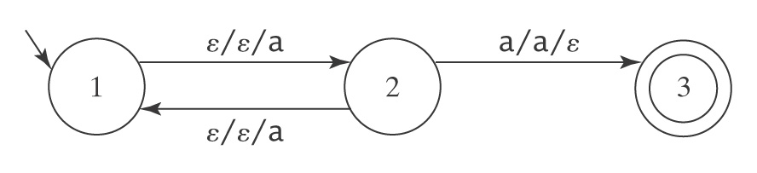
Halting
● A DFSM M, on input w, is guaranteed to halt in |w| steps.
● A PDA M, on input w, is not guaranteed to halt. To see
why, consider again M =
But there exists an algorithm to construct an equivalent PDA
M′ that is guaranteed to halt.
● A TM M, on input w, is not guaranteed to halt. And there is no algorithm to construct an equivalent TM that is guaranteed to halt.

Slide 47
Formalize TM computations
A configuration of TM M = (K, Σ, Γ, s, H) is an element of:
K × ((Γ- {q}) Γ*) ∪ {ε} × Γ × (Γ* (Γ- {q})) ∪ {ε}
state before current after
current tape current
tape square square tape square

Slide 48
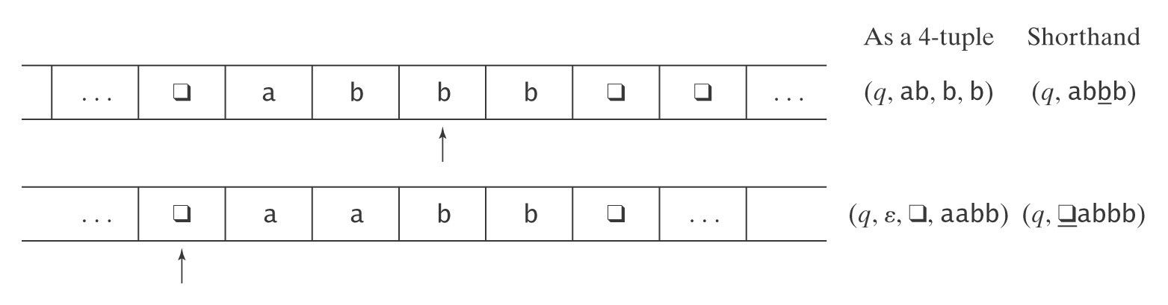
Example Configurations
b
Second a should be b
(1) (q, ab, b, b) written more simply as (q, abbb)
(2) (q, ε, q, abbb) written more simply as (q, qabbb)
Initial configuration is always (s, qw)
Notes:
There is an error in this slide but it is a picture that is hard to fix.
At the top, second line, should be (q, epsilon, blank, abbb), not aabb.

Slide 49
Yields and Computations
(q₁, w₁) ⊢_{M} (q₂, w₂) iff (q₂, w₂) is derivable via δ in one step.
For any TM M, let ⊢_{M} * be the reflexive, transitive closure of |-_{M}.
Configuration C₁ yields configuration C₂ if: C₁ ⊢_{M} * C₂.
A path through M is a sequence of configurations C₀, C₁, …, C_{n} for some n ≥ 0 such that C₀ is the initial configuration and:
C₀ ⊢_{M} C₁ ⊢_{M} C₂ ⊢_{M} … ⊢_{M} C_{n}.
A computation by M is a path that halts.
If a computation is of length n (has n steps), we can also write:
C₀ ⊢_{M} ^{n} C_{n}

Slide 50
Exercise
If n and m are non-negative integers, monus(n, m) is defined to be n – m
if n > m, and 0 if n ≤ m.
Draw the diagram for a TM M whose input is 1^{n};1^{m} and whose output is 1^{monus(n, m)} . When M halts, the read/write head should be positioned on the blank before the first 1.
Notes:
One approach:
repeat
Go to right end; replace a 1 with a blank,
checking to make sure there is a 1 on left end as we go.
back to left end, replace 1 with a blank
until no more 1's on one side or the other.
If extra 1's on left, eliminate the ;
If extra 1's on right, eliminate all of them.

Slide 51
(not used in class 2018)Exercise
A TM to recognize { ww^{R} : w ∈ {a, b}* }.
If the input string is in the language, the machine should halt with y as its current tape symbol
If not, it should halt with n as its current tape symbol.
The final symbols on the rest of the tape may be anything.

Slide 52
Solution to this Exercise
Look at this after you try it.
A TM to recognize ww^{R}, where w ∈ {a, b}* (beginning of a solution)
New tape symbols: A, B:
(1, q) → (2, q, →)
(2, q) → (3, q, →) 3 is a halting state
(2, a) → (4, A, →)
(4, a) → (4, a, →)
(4, b) → (4, b, →)
(4, q) → (5, q, ←)
(4, A) → (5, A, ←)
Notes:
This is a start. If there is time, fill in more before class.

Slide 53
TMs are complicated
… and very low-level!
We need higher-level "abbreviations".
  Macros
  Subroutines
Notes:
Let's look at the difference between a macro and a subroutine.
In C, #define vs. function definition.
In Scheme, lambda vs define-syntax.
Many assemblers are macro-assemblers, allowing the user to create macros.
In MIPS assembly language, I believe move is a macro
(out of my league here)

Slide 54
A Macro language for Turing Machines
(1) Define some basic machines
● Symbol writing machines
For each x ∈ Γ, define M_{x}, written as just x, to be a machine that writes x. Read-write head ends up in original position.
● Head-moving machines
R: for each x ∈ Γ, δ(s, x) = (h, x, →)
L: for each x ∈ Γ, δ(s, x) = (h, x, ←)
● Machines that simply halt:
h, which simply halts (don't care whether it accepts).
n, which halts and rejects.
y, which halts and accepts.
You need to learn (but not memorize) this simple language. I will use it and I expect you to use it on HW and tests.
Notes:
There is an Mx for each x∈Γ. To implement M_{x} requires two TM moves. δ(s, y) = (s', x, →), δ(s', z) = (s, z, ←)

Slide 55
Checking Inputs and Combining Machines
Next we need to describe how to:
● Check the tape and branch based on what character
we see, and
● Combine the basic machines to form larger ones.
To do this, we need two forms:
● M₁ M₂
● M₁ <condition> M₂
Notes:
Run M1 then M2. If either fails to halt, so does the composite machine.
Run M1; if it halts, check condition (usually look for a specific character under the tape head). If true, run M2. If M1 does not halt or if condition is true and M2 does not halt, composite machine does not halt.

Slide 56
Turing Machines Macros Cont'd
Example:
>M₁ a M₂
b
M₃
● Start in the start state of M₁.
● Compute until M₁ reaches a halt state.
● Examine the tape and take the appropriate transition.
● Start in the start state of the next machine, etc.
● Halt if any component reaches a halt state and has no place
to go.
● If any component fails to halt, then the entire machine may fail
to halt.

Slide 57
More macros
a
M₁ M₂ becomes M₁ a, b M₂
b
M₁ all elems of Γ M₂ becomes M₁ M₂
or
M₁M₂
Variables
M₁ all elems of Γ M₂ becomes M₁ x ← ¬a M₂
except a and x takes on the value of
the current square
M₁ a, b M₂ becomes M₁ x ← a, b M₂
and x takes on the value of
the current square
M₁ x = y M₂
if x = y then take the transition
e.g., > x ← ¬q Rx if the current square is not blank, go right and copy it.
Notes:
Two ways to implement "variable assignment":
Use an area of the tape at the left or right end as a "scratchpad".
Have a bunch of duplicate sets of states, each representing "holding" a different tape symbol (usually an input symbol).

Slide 58
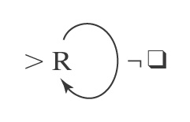
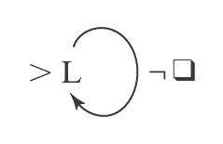
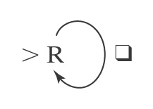
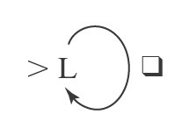
Blank/Non-blank Search Machines
Find the first blank square to
the right of the current square.
Find the first blank square to
the left of the current square.
Find the first nonblank square to
the right of the current square.
Find the first nonblank square to
the left of the current square
R_{q}
L_{q}
R_{¬q}
L_{¬q}

Slide 59
More Search Machines
L_{a} Find the first occurrence of a to
the left of the current square.
R_{a,b} Find the first occurrence of a or b
to the right of the current square.
L_{a,b} a M₁ Find the first occurrence of a or b
to the left of the current square,
b then go to M₁ if the detected
character is a; go to M₂ if the
M₂ detected character is b.
L_{x←a,b} Find the first occurrence of a or b
to the left of the current square
and set x to the value found.
L_{x←a,b}Rx Find the first occurrence of a or b
to the left of the current square,
set x to the value found, move one
square to the right, and write x (a or b).

Slide 60
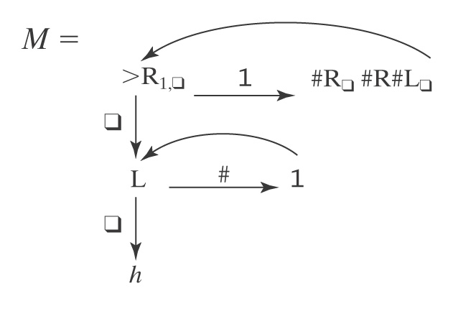
An Example
Input: qw w ∈ {1}*
Output: qw³
Example: q111qqqqqqqqqqqqqq

Slide 61
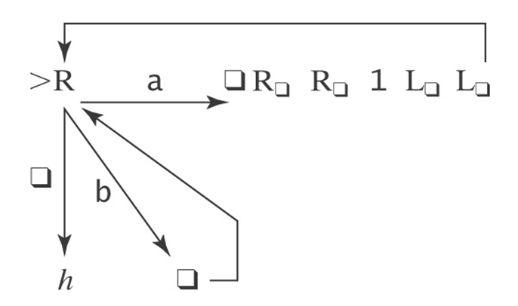
What does this machine do?

Slide 62
Exercise
Initial input on the tape is a non-negative integer written in binary, most significant bit first (110 represents 6).
Design a TM that replaces the binary representation of n by the binary representation of n+1.
Notes:
0 This is not correct, but kind of on the right track
R_{b}L------→ 1
| \
| 1 \
| |
V /
0 ---/ L_{0,b}1

Slide 63
Two Flavors of TMs
Recognize a language
Compute a function

Slide 64
Turing Machines as Language Recognizers
Let M = (K, Σ, Γ, δ, s, {y, n}).
● M accepts a string w iff (s, qw) |-_{M}* (y, w′) for some string w′.
● M rejects a string w iff (s, qw) |-_{M}* (n, w′) for some string w′.
M decides a language L ⊆ Σ* iff:
For any string w ∈ Σ* it is true that:
if w ∈ L then M accepts w, and
if w ∉ L then M rejects w.
A language L is decidable iff there is a Turing machine M that decides it. In this case, we will say that L is in D.

Slide 65
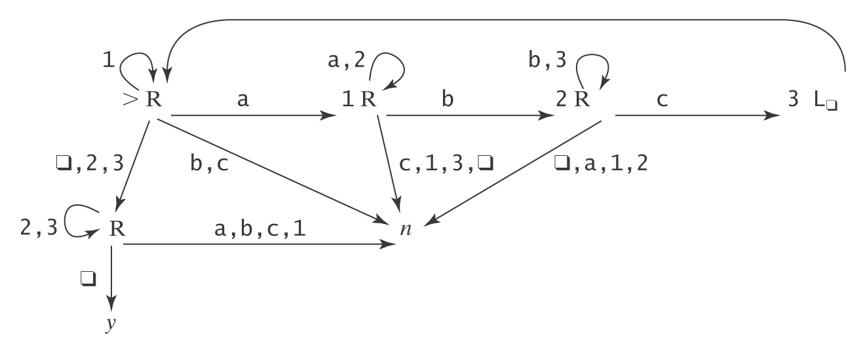
A Deciding Example
A^{n}B^{n}C^{n} = {a^{n}b^{n}c^{n} : n ≥ 0}
Example: qaabbccqqqqqqqqq
Example: qaaccbqqqqqqqqq

Slide 66
Semideciding a Language
Let Σ_{M} be the input alphabet to a TM M. Let L ⊆ Σ_{M}*.
M semidecides L iff, for any string w ∈ Σ_{M}*:
● w ∈ L → M accepts w
● w ∉ L → M does not accept w. M may either:
reject or
fail to halt.
A language L is semidecidable iff there is a Turing machine that semidecides it. We define the set SD to be the set of all semidecidable languages.
Notes:
Another term that is sometimes used tfor this concept is "recursively enumerable"

Slide 67
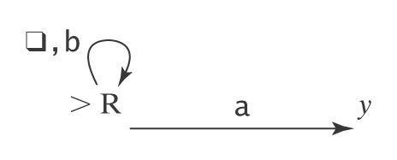
Example of Semideciding
Let L = b*a(a ∪ b)*
We can build M to semidecide L:
1. Loop
  1.1 Move one square to the right. If the character under
  the read head is an a, halt and accept.
In our macro language, M is:

Slide 68
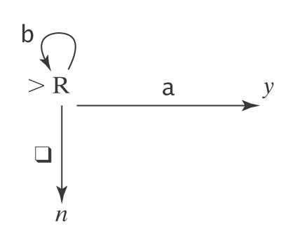
Example of Semideciding
L = b*a(a ∪ b)*. We can also decide L:
  Loop:
    1.1 Move one square to the right.
    1.2 If the character under the read/write head is
    an a, halt and accept.
    1.3 If it is q, halt and reject.
In our macro language, M is:

