Slide 1
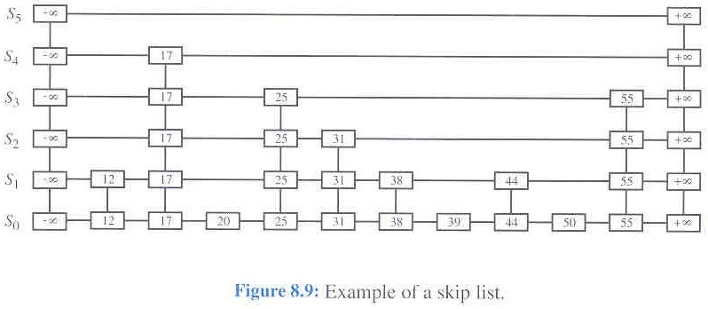
CSSE 230 Day 25
Skip Lists

Slide 2
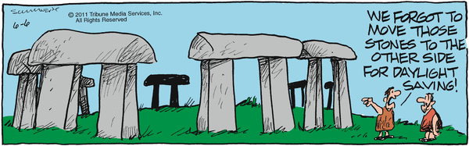
Reminders/Announcements

Slide 3
Skip Lists
An alternative to balanced trees
Sorted data.
Random.
Expected times are O(log n).

Slide 4
An alternative to balanced trees
Indexed lists
  One-level index.
  2nd-level index.
  3rd-level index
  log-n-level index.
Problem: insertion and deletion.
Solution: Randomized node height: Skip lists.
  Pugh, 1990 CACM.
https://people.ok.ubc.ca/ylucet/DS/SkipList.html
Remember the problem with keeping trees completely balanced”?
Note that we can iterate through the list easily and in increasing order, like a threaded BST”
Notes:
Bottom bullet used to say: Notice that skip lists do not share with binary trees the problem that threads are designed to solve. This is a real tongue-twister.
Also, the old applet disappeared from the Univ of Bern: http://iamwww.unibe.ch/~wenger/DA/SkipList/. Replced with one above.

Slide 5
A slightly different skip list representation
Uses a bit more space, makes the code simpler.
Michael Goodrich and Roberto Tamassia.

Slide 6
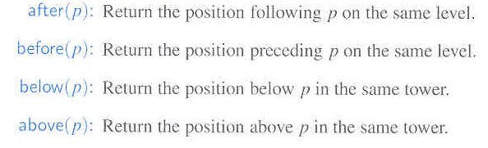
Methods in SkipListNode class

Slide 7
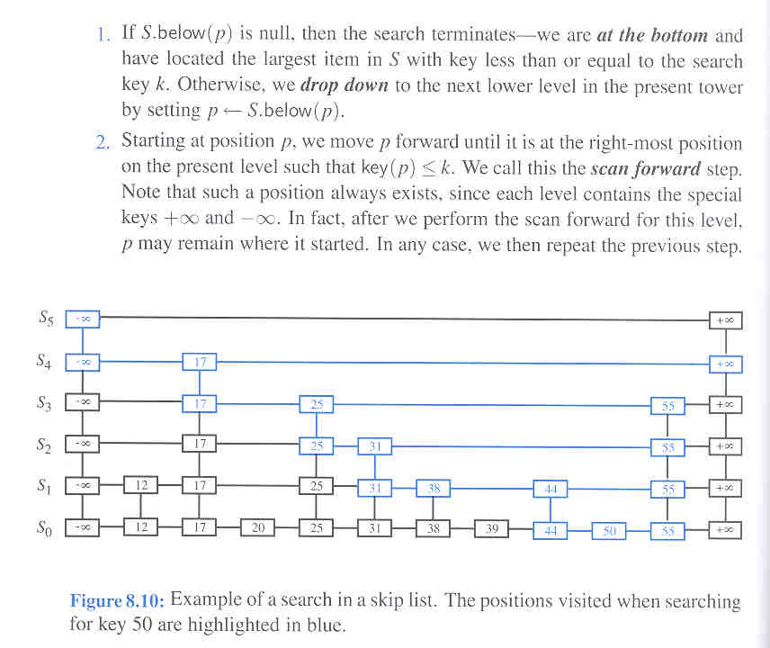
Search algorithm

Slide 8
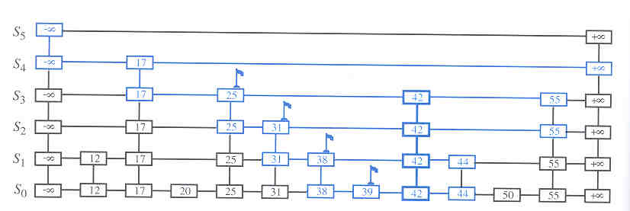
Insertion diagram

Slide 9
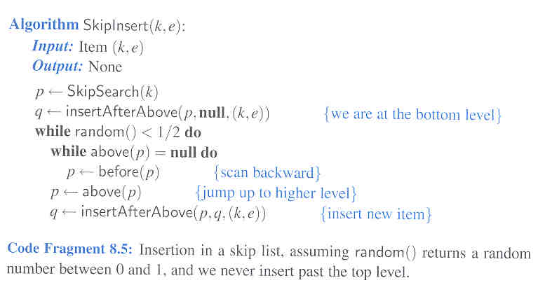
Insertion algorithm

Slide 10
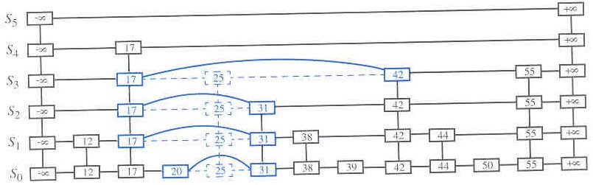
Remove algorithm

Slide 11
(sort of) Analysis of Skip Lists
No guarantees that we won't get O(N) behavior.
  The interaction of the random number generator and the order in which things are inserted/deleted could lead to a long chain of nodes with the same height.
  But this is very unlikely.
  Expected time for search, insert, and remove are O(log n).

Slide 12
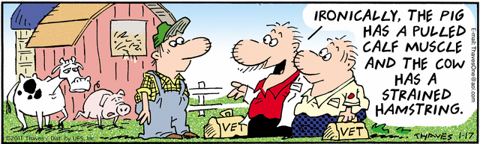
Questions

Slide 13
Exhaustive Search and Backtracking
A taste of artificial intelligence

Slide 14
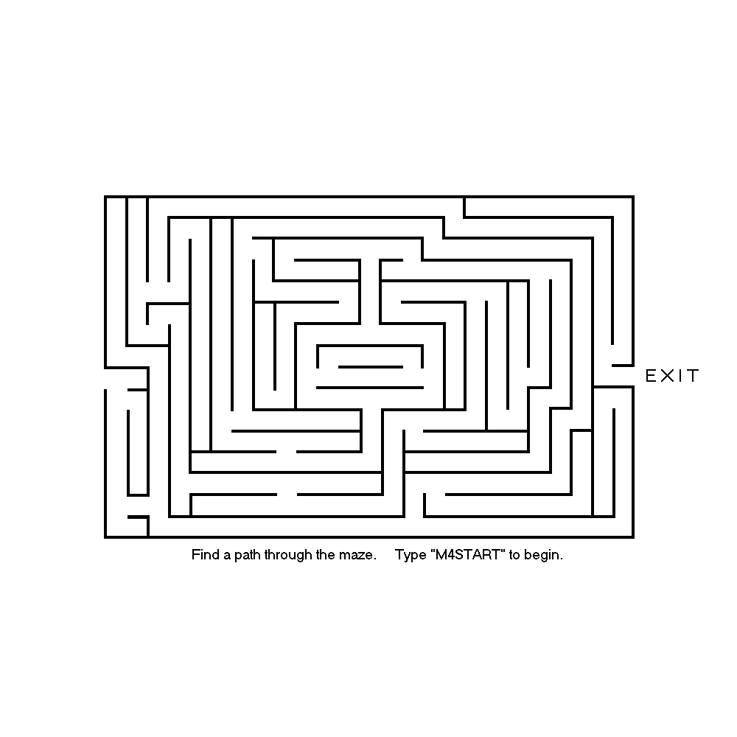
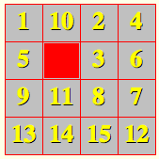
Exhaustive search
Given: a large set of possible solutions to a problem
Goal: Find all solutions (or an optimal solution) from that set
Questions we ask:
  How do we represent the possible solutions?
  How do we organize the search?
  Can we avoid checking some obvious non-solutions?
Examples:
  Mazes The “15” puzzle
The “search space”
http://www.numeracysoftware.com/maze4.bmp

Slide 15
In backtracking, we always try to extend a partial solution
dead end
?
dead end
dead end
?
start
?
?
dead end
dead end
http://www.cis.upenn.edu/~matuszek/cit594-2004/Lectures/38-backtracking.ppt
?
success!
Note: the search is a tree and we explore it using a pre-order traversal
Notes:
How do we represent the possible solutions? series of moves on the call stack
How do we organize the search? depth-first, recursive calls
Can we eliminate subsets of the possible solution set without checking each one? not in this case

Slide 16
In backtracking, we always try to extend a partial solution
Notes:
How do we represent the possible solutions? series of moves on the call stack
How do we organize the search? depth-first, recursive calls
Can we eliminate subsets of the possible solution set without checking each one? not in this case

Slide 17
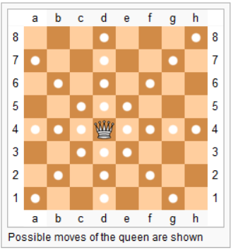
The non-attacking chess queens problem is a famous example
  In how many ways can N chess queens be placed on an NxN grid, so that none of the queens can attack any other queen?
  I.e. there are not two queens on the same row, same column, or same diagonal.
There is no "formula"
for generating a solution.
The famous computer scientist Niklaus Wirth described his approach to the problem in 1971: Program Development by Stepwise Refinement http://sunnyday.mit.edu/16.355/wirth-refinement.html#3
http://en.wikipedia.org/wiki/Queen_(chess)
Notes:
Ask who needs a refresher on the moves the queens can make.
Draw 4x4 solution on board.

Slide 18
With a partner, discuss "possible solution" search strategies
In how many ways can N chess queens be placed on an NxN grid, so that none of the queens can attack any other queen?
  I.e. no two queens on the same row, same column, or same diagonal.
Two minutes
No Peeking!
Notes:
In the next few slides we explore various possibilities for the search space and count the number of potential solutions that must be tried in each case.

Slide 19
Search Space Possibilities 1/5
1
Very naive approach. Perhaps stupid is a better word!
There are N queens, N² squares.
For each queen, try every possible square, allowing the possibility of multiple queens in the same square.
  Represent each potential solution as an N-item array of pairs of integers (a row and a column for each queen).
  Generate all such arrays (you should be able to write code that would do this) and check to see which ones are solutions.
  Number of possibilities to try in the NxN case:
  Specific number for N=8:
281,474,976,710,656
Notes:
(n^2)^n = n^(2n)
Number on slide = 64^8

Slide 20
Search Space Possibilities 2/5
Slight improvement. There are N queens, N² squares. For each queen, try every possible square, notice that we can't have multiple queens on the same square.
  Represent each potential solution as an N-item array of pairs of integers (a row and a column for each queen).
  Generate all such arrays and check to see which ones are solutions.
  Number of possibilities to try in NxN case:
  Specific number for N=8:
178,462,987,637,760
(vs. 281,474,976,710,656)
Notes:
Number on slide = 64! / 56! = 64x63x62x61x60x59x58x57

Slide 21
Search Space Possibilities 3/5
Slightly better approach. There are N queens, N columns. If two queens are in the same column, they will attack each other. Thus there must be exactly one queen per column.
Represent a potential solution as an N-item array of integers.
  Each array position represents the queen in one column.
  The number stored in an array position represents the row of that column's queen.
  Show array for 4x4 solution.
    Generate all such arrays and check to see which ones are solutions.
    Number of possibilities to try in NxN case:
    Specific number for N=8:
16,777,216
Notes:
This is 8^8

Slide 22
Search Space Possibilities 4/5
Still better approach There must also be exactly one queen per row.
Represent the data just as before, but notice that the data in the array is a set!
  Generate each of these and check to see which ones are solutions.
  How to generate? A good thing to think about.
  Number of possibilities to try in NxN case:
  Specific number for N=8:
40,320
Notes:
This is 8!

Slide 23
Search Space Possibilities 5/5
Backtracking solution
Instead of generating all permutations of N queens and checking to see if each is a solution, we generate "partial placements" by placing one queen at a time on the board
Once we have successfully placed k<N queens, we try to extend the partial solution by placing a queen in the next column.
When we extend to N queens, we have a solution.
Notes:
Demonstrate the process for the 8x8 case using the applet whose link is on the next slide.

Slide 24
Experimenting with 8 x 8 Case
Play the game:
  http://homepage.tinet.ie/~pdpals/8queens.htm
See the solutions:
  http://www.dcs.ed.ac.uk/home/mlj/demos/queens
  (if you can figure out how to enable Java in your browser)

Slide 25
Program output:
>java RealQueen 5
SOLUTION: 1 3 5 2 4
SOLUTION: 1 4 2 5 3
SOLUTION: 2 4 1 3 5
SOLUTION: 2 5 3 1 4
SOLUTION: 3 1 4 2 5
SOLUTION: 3 5 2 4 1
SOLUTION: 4 1 3 5 2
SOLUTION: 4 2 5 3 1
SOLUTION: 5 2 4 1 3
SOLUTION: 5 3 1 4 2
Tommorrow:
We'll look at details of the algorithm.
Bring your computer, capabl;e of compiling and running Java programs.

