Slide 1
MA/CSSE 473
Day 36
Student Questions
More on Minimal
Spanning Trees
Kruskal
Prim

Slide 2
Algorithms for finding a Minimal Spanning tree
Kruskal and Prim

Slide 3
Kruskal’s algorithm
To find a MST (minimal Spanning Tree):
Start with a graph T containing all n of G’s vertices and none of its edges.
for i = 1 to n – 1:
  Among all of G’s edges that can be added without creating a cycle, add to T an edge that has minimal weight.
  Details of Data Structures later

Slide 4
Prim’s algorithm
Start with T as a single vertex of G (which is a MST for a single-node graph).
for i = 1 to n – 1:
  Among all edges of G that connect a vertex in T to a vertex that is not yet in T, add a minimum-weight edge (and the vertex at the other end of T).
  Details of Data Structures later

Slide 5
MST lemma
Let G be a weighted connected graph,
let T be any MST of G,
let G′ be any nonempty subgraph of T, and
let C be any connected component of G′.
Then:
  If we add to C an edge e=(v,w) that has minimum-weight among all edges that have one vertex in C and the other vertex not in C,
  G has an MST that contains the union of G′ and e.
[WLOG, v is the vertex of e that is in C, and w is not in C]
Summary: If G' is a subgraph of an MST, so is G'∪{e}
Notes:
Consider doing this one on the board, and showing the slides later.
If so, do not include the next two slides in the on-line PDF until after class.
Write on board:
Graph G has MST T
G' is a subgraph of T
C is a connected component of G'
e = (v,w) = minimal-weight-edge from C to G-C.
Then do the steps

Slide 6
MST lemma
Let G be a weighted connected graph with a MST T; let G′ be any subgraph of T, and let C be any connected component of G′.
If we add to C an edge e=(v,w) that has minimum-weight among all edges that have one vertex in C and the other vertex not in C,
then G has an MST that contains the union of G′ and e.
[WLOG v is the vertex of e that is in C, and w is not in C]
Proof:
If e is in T, we are done, so we assume that e is not in T.
Since T does not contain edge e, adding e to T creates a cycle.
Removing any edge of that cycle from T∪{e} gives us another spanning tree.
If we want that tree to be a minimal spanning tree for G that contains G’ and e, we must choose the “removable” edge carefully.
Details on next page…
Notes:
Consider doing this one on the board, and showing the slides later.
Write on board:
Graph G has MST T
G' is a subgraph of T
C is a connected component of G'
e = (v,w) = minimal-weight-edge from C to G-C.
Then do the steps

Slide 7
Choosing the edge to remove
Along the unique simple path in T from v to w, let w′ be the first vertex that is not in C, and let v′ be the vertex immediately before it.
Then e′ = (v′, w′) is also an edge from C to G-C.
Note that by the minimal-weight choice of e, weight(e′) ≥ weight(e) .
Let T′ be the (spanning) tree obtained from T by removing e′ and adding e.
Note that the removed edge is not in G′,
Because e and e′ are the only edges that are different, weight(T) ≥ weight(T′).
Because T is a MST, weight(T) ≤ weight(T′).
Thus the weights are equal, and T’ is an MST containing G′ and e, which is what we wanted.
Notes:
First step: How do we know that such a v and w exist?

Slide 8
Recap: MST lemma
Let G be a weighted connected graph with an MST T;
let G′ be any subgraph of T, and let C be any connected component of G′.
If we add to C an edge e=(v,w) that has minimum-weight among all
edges that have one vertex in C and the other vertex not in C,
then G has an MST that contains the union of G′ and e.
Recall Kruskal’s algorithm
To find a MST for G:
  Start with a connected weighted graph containing all of G’s n vertices and none of its edges.
  for i = 1 to n – 1:
    Among all of G’s edges that can be added without creating a cycle, add one that has minimal weight.
Does this algorithm actually
produce an MST for G?

Slide 9
Does Kruskal produce a MST?
Claim: After every step of Kruskal’s algorithm, we have a set of edges that is part of an MST of G
Proof of claim: Base case …
Induction step:
  Induction Assumption: before adding an edge we have a subgraph of an MST
  We must show that after adding the next edge we have a subgraph of an MST
  Details:
Notes:
Suppose that the most recently added edge is e = (v, w).
Let C be the component (of the “before adding e” MST subgraph) that contains v
Note that there must be such a component and that it is unique.
Exists and is unique: Every vertex is part of some component (Every vertex starts out as its own component.
Are all of the conditions of MST lemma met?
Thus the new graph is a subgraph of some MST of G
Once we have the claim, it is easy to see that once you get N-1 edges, you have a MST.

Slide 10
Does Prim produce an MST?
Proof similar to Kruskal (but slightly simpler)
It's done in the textbook

Slide 11
Recap: Prim’s Algorithm for Minimal Spanning Tree
Start with T as a single vertex of G (which is a MST for a single-node graph).
for i = 1 to n – 1:
  Among all edges of G that connect a vertex in T to a vertex that is not yet in T, add to T a minimum-weight edge.
  At each stage, T is a MST for a connected subgraph of G
  We now examine Prim more closely

Slide 12
Main Data Structures for Prim
Start with adjacency-list representation of G
Let V be all of the vertices of G, and let V_{T} the subset consisting of the vertices that we have placed in the tree so far
We need a way to keep track of "fringe" edges
  i.e. edges that have one vertex in V_{T}
  and the other vertex in V – V_{T}
Fringe edges need to be ordered by edge weight
  E.g., in a priority queue
What is the most efficient way to implement a priority queue?
Notes:
Ask about what is needed before revealing any parts of this slide
A binary heap

Slide 13
Prim detailed algorithm summary
Create a minheap from the adjacency-list representation of G
  Each heap entry contains a vertex and its weight
  The vertices in the heap are those not yet in T
  Weight associated with each vertex v is the minimum weight of an edge that connects v to some vertex in T
  If there is no such edge, v's weight is infinite
    Initially all vertices except start are in heap, have infinite weight
  Vertices in the heap whose weights are not infinite are the fringe vertices
  Fringe vertices are candidates to be the next vertex (with its associated edge) added to the tree
Loop:
  Delete min weight vertex from heap, add it to T
  We may then be able to decrease the weights
  associated with one or vertices that are adjacent
  to v
Notes:
Ask about what is needed before revealing any parts of this slide
A binary heap

Slide 14
MinHeap overview
We need an operation that a standard binary heap doesn't support:
decrease(vertex, newWeight)
  Decreases the value associated with a heap element
Instead of putting vertices and associated edge weights directly in the heap:
  Put them in an array called key[]
  Put references to them in the heap

Slide 15
Min Heap methods
operation | description | run time
init(key) | build a MinHeap from the array of keys | Ѳ(n)
del() | delete and return (the location in key[ ] of ) the minimum element | Ѳ(log n)
isIn(w) | is vertex w currently in the heap? | Ѳ(1)
keyVal(w) | The weight associated with vertex w (minimum weight of an edge from that vertex to some adjacent vertex that is in the tree). | Ѳ(1)
decrease(w, newWeight) | changes the weight associated with vertex w to newWeight (which must be smaller than w's current weight) | Ѳ(log n)

Slide 16
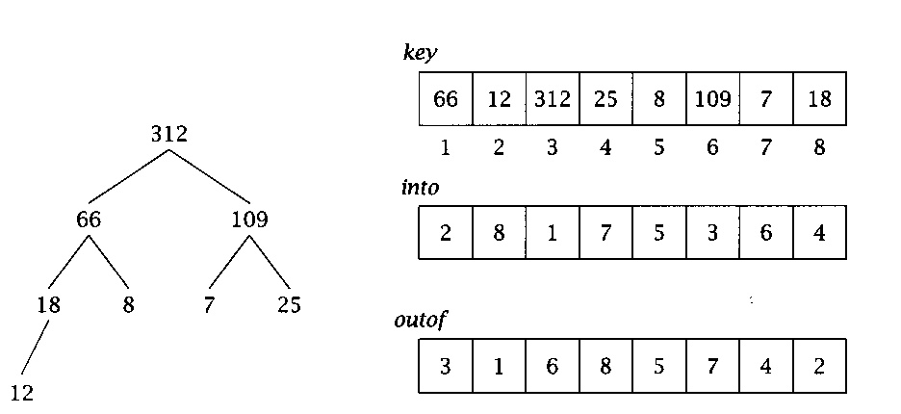
MinHeap implementation
An indirect heap. We keep the keys in place in an array, and use another array, "outof", to hold the positions of these keys within the heap.
To make lookup faster, another array, "into" tells where to find an element in the heap.
i = into[j] iff j = out of[i]
Picture shows it for a maxHeap, but the idea is the same:

Slide 17
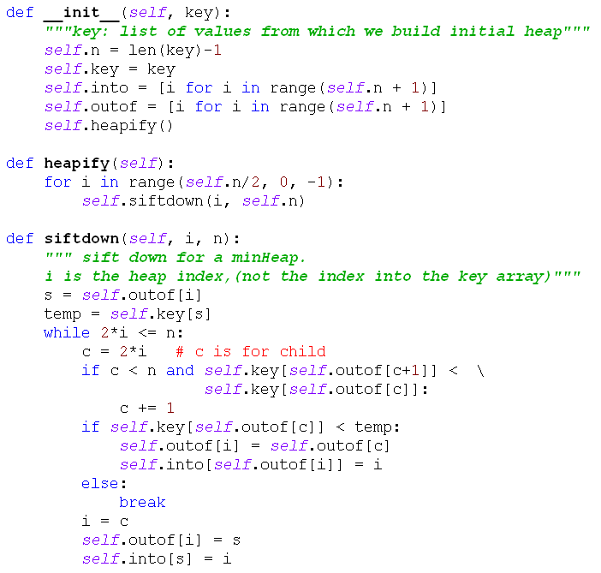
MinHeap code part 1

Slide 18
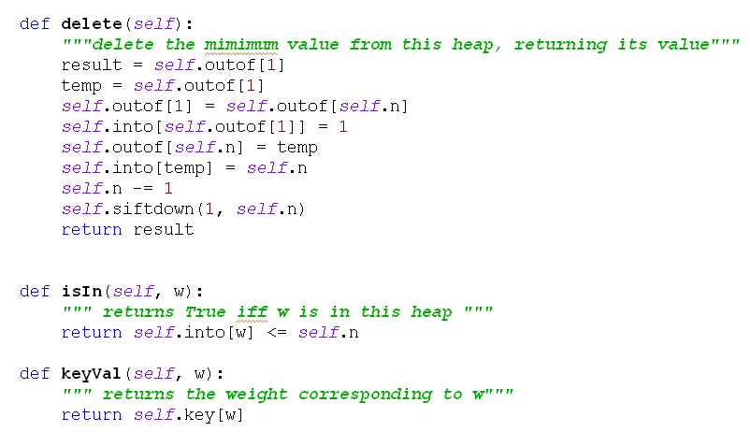
MinHeap code part 2
NOTE: delete could be simpler, but I kept pointers to the deleted nodes around, to make it easy to implement heapsort later. N calls to delete() leave the outof array in indirect reverse sorted order.

Slide 19
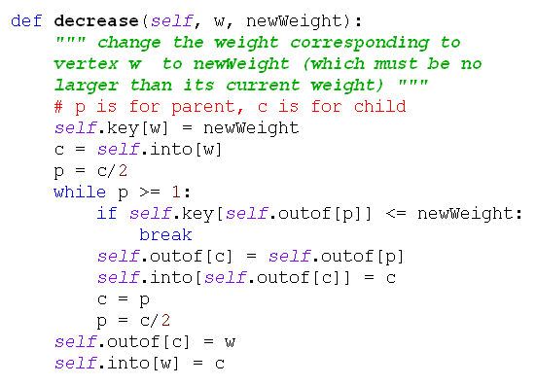
MinHeap code part 3

Slide 20
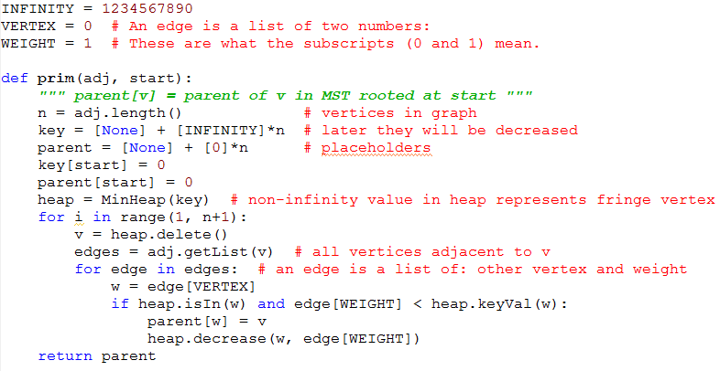
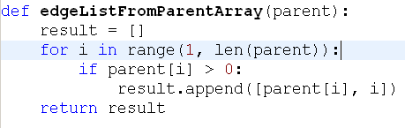
Prim Algorithm
Notes:
g = AdjancencyListGraph(
[[1, [(2, 4),(3, 2), (5, 3)]],
[2, [(1, 4), (4, 5)]],
[3, [(1, 2), (5, 6), (4, 1), (6,3)]],
[4, [(2, 5), (6,6), (3,1)]],
[5, [(1, 3), (3,6), (6,2)]],
[6, [(5, 2), (3, 3), (4, 6)]]
])
Show an example of what the parent array looks like. Draw a rootless tree on the board, number the vertices, pick a start vertex and show parent array contents.
How many total calls to inner loop execute altogether? Answer 2*|E| + |V|.
What is maximum time for a single execution of the inner loop? Answer log V
Total time is Theta((|E| + |V|) log |V|) = Theta(|E| log |V|)

Slide 21
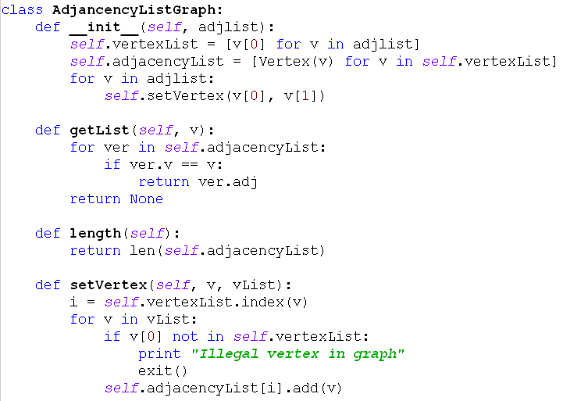
AdjacencyListGraph class

Slide 22
Data Structures for Kruskal
A sorted list of edges (edge list, not adjacency list)
Disjoint subsets of vertices, representing the connected components at each stage.
  Start with n subsets, each containing one vertex.
  End with one subset containing all vertices.
Disjoint Set ADT has 3 operations:
  makeset(i): creates a singleton set containing i.
  findset(i): returns a "canonical" member of its subset.
    I.e., if i and j are elements of the same subset,
    findset(i) == findset(j)
  union(i, j): merges the subsets containing i and j into a single subset.
Q37-1

Slide 23
Example of operations
makeset (1)
makeset (2)
makeset (3)
makeset (4)
makeset (5)
makeset (6)
union(4, 6)
union (1,3)
union(4, 5)
findset(2)
findset(5)
What are the sets after these operations?

Slide 24
Kruskal Algorithm
What can we say about efficiency of this algorithm (in terms of |V| and |E|)?
Assume vertices are numbered 1...n
(n = |V|)
Sort edge list by weight (increasing order)
for i = 1..n: makeset(i)
i, count, tree = 1, 0, []
while count < n-1:
if findset(edgelist[i].v) !=
findset(edgelist[i].w):
tree += [edgelist[i]]
count += 1
union(edgelist[i].v, edgelist[i].w)
i += 1
return tree

Slide 25
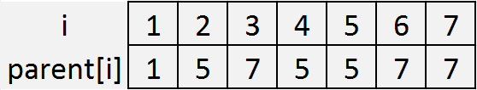
Set Representation
Each disjoint set is a tree, with the "marked" element as its root
Efficient representation of the trees:
  an array called parent
  parent[i] contains the index of i’s parent.
  If i is a root, parent[i]=i
5
1
7
2
4
3
6
8

Slide 26
Using this representation
makeset(i):
findset(i):
mergetrees(i,j):
  assume that i and j are the marked elements from different sets.
union(i,j):
  assume that i and j are elements from different sets
Notes:
Animated slide. Figure each out together before revealing it
def makeset1(i):
parent[i] = i
def findset1(i):
while i != parent[i]:
i = parent[i]
return i
def mergetrees1(i,j):
parent[i] = j
def mergetrees1(i,j):
parent[i] = j

