Slide 1
MA/CSSE 473 Day 27
Dynamic Programming
Binomial Coefficients
Warshall's algorithm
(Optimal BSTs)
Student questions?

Slide 2
Dynamic programming
Used for problems with recursive solutions and overlapping subproblems
Typically, we save (memoize) solutions to the subproblems, to avoid recomputing them.
Previously seen example: Fib(n)

Slide 3
Dynamic Programming Example
Binomial Coefficients:
C(n, k) is the coefficient of x^{k} in the expansion of (1+x)^{n}
C(n,0) = C(n, n) = 1.
If 0 < k < n, C(n, k) = C(n-1, k) + C(n-1, k-1)
Can show by induction that the "usual" factorial formula for C(n, k) follows from this recursive definition.
  An upcoming homework problem.
If we don't cache values as we compute them, this can take a lot of time, because of duplicate (overlapping) computation.
Notes:
We did this in High School when I was in HS.
C(n-1,k) + C(n-1, k-1) = (n-1)! / k! (n-1-k)! + (n-1)! / (k-1)! (n-k)!
= [ (n-1)! (n-k) + (n-1)! k] / k! (n-k) !
= (n-1)! n / k! (n-k)!
= n! / k! (n-k)!

Slide 4
Computing a binomial coefficient
  Binomial coefficients are coefficients of the binomial formula:
  (a + b)^{n} = C(n,0)a^{n}b⁰ + . . . + C(n,k)a^{n-k}b^{k} + . . . + C(n,n)a⁰b^{n}
  Recurrence: C(n,k) = C(n-1,k) + C(n-1,k-1) for n > k > 0
  C(n,0) = 1, C(n,n) = 1 for n ≥ 0
  Value of C(n,k) can be computed by filling in a table:
  0 1 2 . . . k-1 k
  0 1
  1 1 1
  .
  .
  .
  n-1 C(n-1,k-1) C(n-1,k)
  n C(n,k)

Slide 5
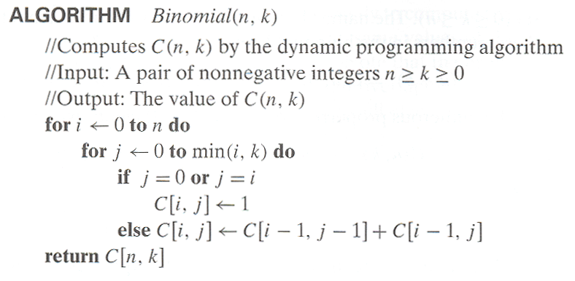
Computing C(n, k):
Time efficiency: Θ(nk)
Space efficiency: Θ(nk)
If we are computing C(n, k) for many different n and k values, we could cache the table between calls.
Notes:
Look at the Multiply/Divide/Multiply/Divide algorithm:
n(n-1)(n-2) (n-i+1) is divisible by i!

Slide 6
Elementary Dyn. Prog. problems
These are in Section 8.1 of Levitin
Simple and straightforward.
I am going to have you read them on your own.
  Coin-row
  Change-making
  Coin Collection

Slide 7
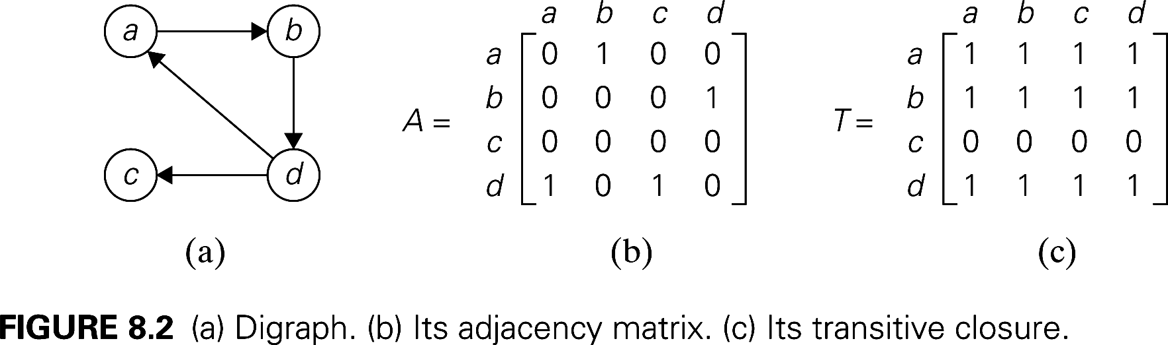
Transitive closure of a directed graph
We ask this question for a given directed graph G: for each of vertices, (A,B), is there a path from A to B in G?
Start with the boolean adjacency matrix A for the n-node graph G. A[i][j] is 1 if and only if G has a directed edge from node i to node j.
The transitive closure of G is the boolean matrix T such that T[i][j] is 1 iff there is a nontrivial directed path from node i to node j in G.
If we use boolean adjacency matrices, what does M² represent? M³?
In boolean matrix multiplication, + stands for or, and * stands for and
Notes:
Show A² as a boolean matrix (ask students to check me as I do it)

Slide 8
Transitive closure via multiplication
Again, using + for or, we get
T = M + M² + M³ + …
Can we limit it to a finite operation?
We can stop at M^{n-1}.
  How do we know this?
Number of boolean multiplications for solving the whole problem?
Notes:
Answer is n⁴ . It is n³ for each matrix multiplication. Additions are n², so all of them together are n³.

Slide 9
Warshall's Algorithm for Transitive Closure
Similar to binomial coefficients algorithm
Assume that the vertices have been numbered
v₁, v₂, …, v_{n}
Graph represented by a boolean adjacency matrix M.
Numbering is arbitrary, but is fixed throughout the algorithm.
Define the boolean matrix R^{(k)} as follows:
  R^{(k)}[i][j] is 1 iff there is a path from v_{i} to v_{j} in the directed graph
  that has the form v_{i} = w₀ → w₁ → … → w_{s} = v_{j}, where
    s >=1, and
    for all t = 1, …, s-1, the w_{t} is v_{m} for some m ≤ k
    i.e, none of the intermediate vertices are numbered higher than k
What is R⁽⁰⁾?
Note that the transitive closure T is R^{(n)}
Notes:
Perhaps computation of R^{(n)} is faster than M^{n}

Slide 10
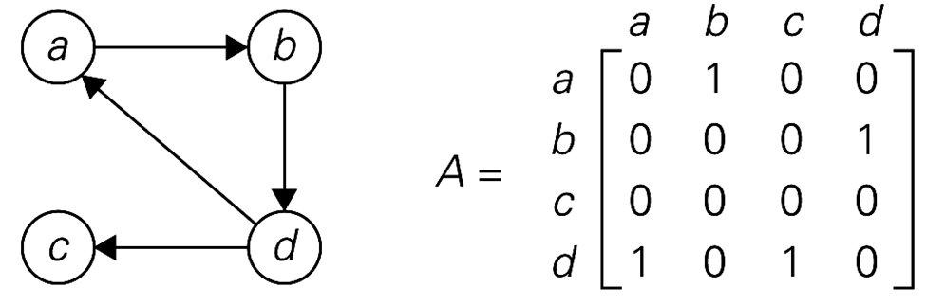
R^{(k)} example
R^{(k)}[i][j] is 1 iff there is a path in the directed graph
v_{i} = w₀ → w₁ → … → w_{s} = v_{j}, where
  s >1, and
  for all t = 2, …, s-1, the w_{t} is v_{m} for some m ≤ k
Example: assuming that the node numbering is in alphabetical order, calculate R⁽⁰⁾, R⁽¹⁾ , and R⁽²⁾
Notes:
Of course R(0) is simply A. For R(1), we add the 1 from d to b.
For R(2), we add a 1 from d to itself.

Slide 11
Quickly Calculating R^{(k)}
Back to the matrix multiplication approach:
  How much time did it take to compute A^{k}[i][j], once we have A^{k-1}?
Can we do better when calculating R^{(k)}[i][j] from R^{(k-1)}?
How can R^{(k)}[i][j] be 1?
  either R^{(k-1)}[i][j] is 1, or
  there is a path from v_{i} to v_{k} that uses no vertices numbered higher than v_{k-1}, and a similar path from v_{k} to v_{j}.
Thus R^{(k)}[i][j] is
R^{(k-1)}[i][j] or ( R^{(k-1)}[i][k] and R^{(k-1)}[k][j] )
Note that this can be calculated in constant time if we already have the three vales from the right-hand side.
Time for calculating R^{(k)} from R^{(k-1)}?
Total time for Warshall's algorithm?
Code and example on next slides
Notes:
Draw the picture

Slide 12
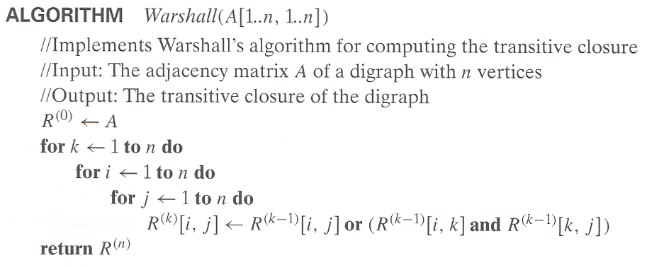
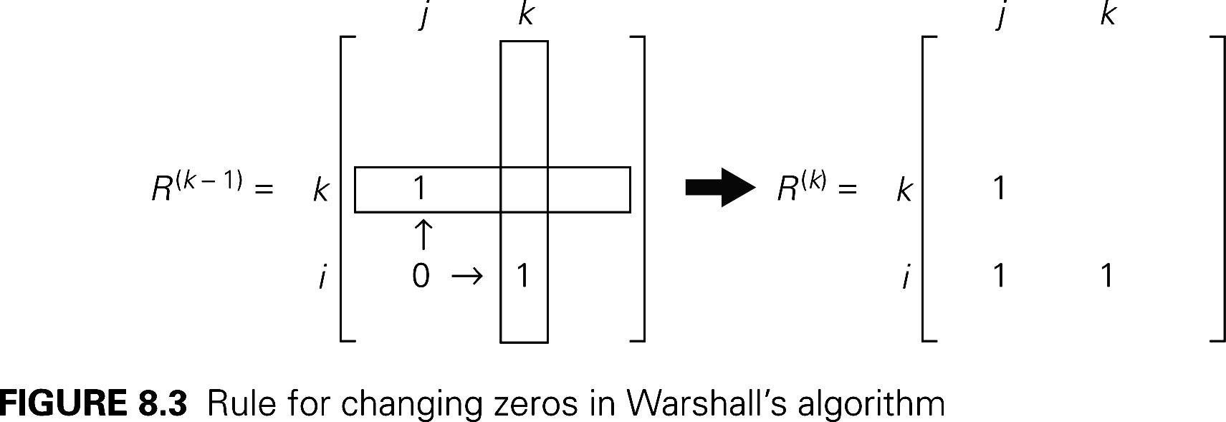
Notes:
Do it for our example.
Ask them: Several of you have already taken 474. There is an algorithm in that course that is almost identical to this one. Can anyone recall which one it is?
[It's the algorithm which, given a DFSM M, produces a regular expression R such that L(R)]= L(M)]

Slide 13
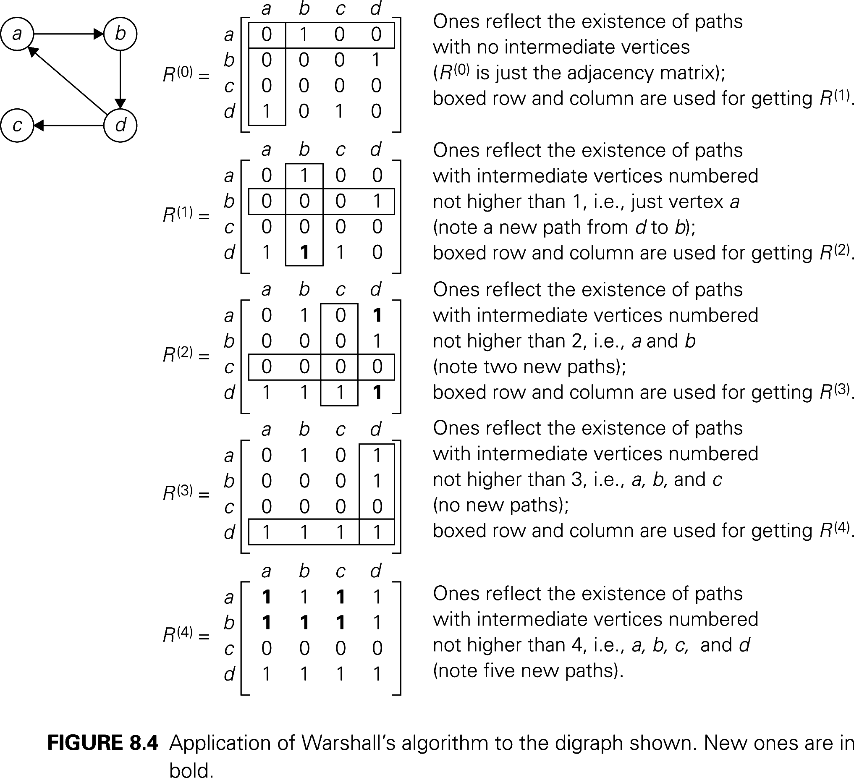

Slide 14
Floyd's algorithm
All-pairs shortest path
A network is a graph whose edges are labeled by (usually) non-negative numbers. We store those edge numbers as the values in the adjacency matrix for the graph
A shortest path from vertex u to vertex v is a path whose edge sum is smallest.
Floyd's algorithm calculates the shortest path from u to v for each pair (u, v) od vertices.
It is so much like Warshall's algorithm, that I am confident you can quickly get the details from the textbook after you understand Warshall's algorithm.

Slide 15
Optimal Binary search trees
Dynamic Programming Example

Slide 16
Warmup: Optimal linked list order
Suppose we have n distinct data items
x₁, x₂, …, x_{n} in a linked list.
Also suppose that we know the probabilities p₁, p₂, …, p_{n} that each of these items is the item we'll be searching for.
Questions we'll attempt to answer:
  What is the expected number of probes before a successful search completes?
  How can we minimize this number?
  What about an unsuccessful search?

Slide 17
Examples
p_{i} = 1/n for each i.
  What is the expected number of probes?
p₁ = ½, p₂ = ¼, …, p_{n-1} = 1/2^{n-1}, p_{n} = 1/2^{n-1}
  expected number of probes:
What if the same items are placed into the list in the opposite order?
The next slide shows the evaluation of the last two summations in Maple.
  Good practice for you? prove them by induction
Notes:
in first case (not on the next slide), the average for successful search is (1/n) (1+2+3+ … + n) = (n+1)/2.

Slide 18
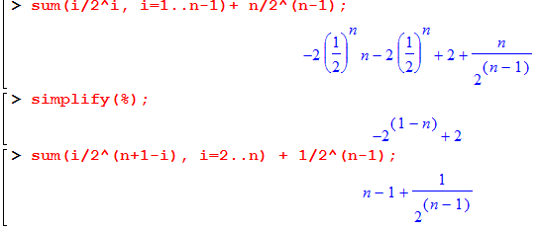
Calculations for previous slide

Slide 19
What if we don't know the probabilities?
Sort the list so we can at least improve the average time for unsuccessful search
Self-organizing list:
  Elements accessed more frequently move toward the front of the list; elements accessed less frequently toward the rear.
  Strategies:
    Move ahead one position (exchange with previous element)
    Exchange with first element
    Move to Front (only efficient if the list is a linked list)
What we are actually likely to know is frequencies in previous searches.
Our best estimate of the probabilities will be proportional to the frequencies, so we can use frequencies instead of probabilities.

Slide 20
Optimal Binary Search Trees
Suppose we have n distinct data keys K₁, K₂, …, K_{n} (in increasing order) that we wish to arrange into a Binary Search Tree
Suppose we know the probabilities that a successful search will end up at K_{i} and the probabilities that the key in an unsuccessful search will be larger than K_{i} and smaller than K_{i+1}
This time the expected number of probes for a successful or unsuccessful search depends on the shape of the tree and where the search ends up
  Formula?
Guiding principle for optimization?

Slide 21
Example
How many different ways to arrange N distinct values into a BST?
For now we consider only successful searches, with probabilities A(0.2), B(0.3), C(0.1), D(0.4).
What would be the worst-case arrangement for the expected number of probes?
  For simplicity, we'll multiply all of the probabilities by 10 so we can deal with integers.
Try some other arrangements:
Opposite, Greedy, Better, Best?
Notes:
Worst: ABCD Opposite: DCBA
27 RRR0 23 LLL0
Greedy: DBAC Better: CBAD
23 L200 21 2L00
Best?: BADC
18 20L0

