Slide 1
MA/CSSE 473 Day 25
Student questions
String search
Horspool
Boyer Moore intro
Notes:
Don't include the second Space-time tradeoffs slide in the on-line slides

Slide 2
String Search
Brute Force, Horspool, Boyer-Moore

Slide 3
Brute Force String Search Example
The problem: Search for the first occurrence of a pattern of length m in a text of length n.
Usually, m is much smaller than n.
What makes brute force so slow?
When we find a mismatch, we can shift the pattern by only one character position in the text.
Text: abracadabtabradabracadabcadaxbrabbracadabraxxxxxxabracadabracadabra
Pattern: abracadabra
abracadabra
abracadabra
abracadabra
abracadabra
abracadabra

Slide 4
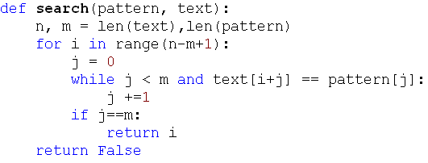
Faster String Searching
Was a HW problem
Brute force: worst case m(n-m+1)
A little better: but still Ѳ(mn) on average
  Short-circuit the inner loop

Slide 5
What we want to do
When we find a character mismatch
  Shift the pattern as far right as we can
  With no possibility of skipping over a match.

Slide 6
Horspool's Algorithm
A simplified version of the Boyer-Moore algorithm
A good bridge to understanding Boyer-Moore
Published in 1980
Recall: What makes brute force so slow?
  When we find a mismatch, we can only shift the pattern to the right by one character position in the text.
  Text: abracadabtabradabracadabcadaxbrabbracadabraxxxxxxabracadabracadabra
  Pattern: abracadabra
  abracadabra
  abracadabra
  abracadabra
Can we sometimes shift farther?
Like Boyer-Moore, Horspool does the comparisons in a counter-intuitive order (moves right-to-left
through the pattern)
Notes:
We mostly look at Horspool as a bridge to understanding Boyer-Moore

Slide 7
Horspool's Main Question
If there is a character mismatch, how far can we shift the pattern, with no possibility of missing a match within the text?
What if the last character in the pattern is compared to a character in the text that does not occur anywhere in the pattern?
Text: ... ABCDEFG ...
Pattern: CSSE473

Slide 8
How Far to Shift?
Look at first (rightmost) character in the part of the text that is compared to the pattern:
The character is not in the pattern
.....C.......... {C not in pattern)
BAOBAB
The character is in the pattern (but not the rightmost)
.....O..........(O occurs once in pattern)
BAOBAB
.....A..........(A occurs twice in pattern)
BAOBAB
The rightmost characters do match
.....B......................
BAOBAB
Notes:
Tell studentshifts to think about how far we can

Slide 9
Shift Table Example
Shift table is indexed by text and pattern alphabet
E.g., for BAOBAB:
EXERCISE: Create the shift table for COCACOLA (on your handout)
A B C D E F G H I J K L M N O P Q R S T U V W X Y Z
1 2 6 6 6 6 6 6 6 6 6 6 6 6 3 6 6 6 6 6 6 6 6 6 6 6

Slide 10
Example of Horspool’s Algorithm
A B C D E F G H I J K L M N O P Q R S T U V W X Y Z
_
BARD LOVED BANANAS (this is the text)
BAOBAB (this is the pattern)
BAOBAB
BAOBAB
BAOBAB (unsuccessful search)
1 2 6 6 6 6 6 6 6 6 6 6 6 6 3 6 6 6 6 6 6 6 6 6 6 6
6

Slide 11

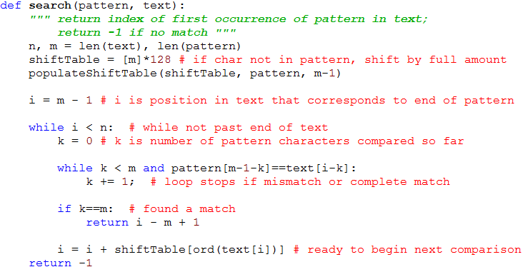
Horspool Code

Slide 12
Horspool Example
pattern = abracadabra
text = abracadabtabradabracadabcadaxbrabbracadabraxxxxxxabracadabracadabra
shiftTable: a3 b2 r1 a3 c6 a3 d4 a3 b2 r1 a3 x11
abracadabtabradabracadabcadaxbrabbracadabraxxxxxxabracadabracadabra
abracadabra
abracadabtabradabracadabcadaxbrabbracadabraxxxxxxabracadabracadabra
abracadabra
abracadabtabradabracadabcadaxbrabbracadabraxxxxxxabracadabracadabra
abracadabra
abracadabtabradabracadabcadaxbrabbracadabraxxxxxxabracadabracadabra
abracadabra
abracadabtabradabracadabcadaxbrabbracadabraxxxxxxabracadabracadabra
abracadabra
abracadabtabradabracadabcadaxbrabbracadabraxxxxxxabracadabracadabra
abracadabra
abracadabtabradabracadabcadaxbrabbracadabraxxxxxxabracadabracadabra
abracadabra
Continued on next slide

Slide 13
Horspool Example Continued
pattern = abracadabra
text = abracadabtabradabracadabcadaxbrabbracadabraxxxxxxabracadabracadabra
shiftTable: a3 b2 r1 a3 c6 a3 d4 a3 b2 r1 a3 x11
abracadabtabradabracadabcadaxbrabbracadabraxxxxxxabracadabracadabra
abracadabra
abracadabtabradabracadabcadaxbrabbracadabraxxxxxxabracadabracadabra
abracadabra
abracadabtabradabracadabcadaxbrabbracadabraxxxxxxabracadabracadabra
abracadabra
abracadabtabradabracadabcadaxbrabbracadabraxxxxxxabracadabracadabra
abracadabra
abracadabtabradabracadabcadaxbrabbracadabraxxxxxxabracadabracadabra
abracadabra
abracadabtabradabracadabcadaxbrabbracadabraxxxxxxabracadabracadabra
abracadabra
49
Using brute force, we would have to compare the pattern to 50 different positions in the text before we find it;
with Horspool, only 13 positions are tried.

Slide 14
Boyer Moore Intro
When determining how far to shift after a mismatch
  Horspool only uses the text character corresponding to the rightmost pattern character
  Can we do better?
Often there is a partial match (on the right end of the pattern) before a mismatch occurs
Boyer-Moore takes into account k, the number of matched characters before a mismatch occurs.
If k=0, same shift as Horspool.

Slide 15
Boyer-Moore Algorithm
Based on two main ideas:
compare pattern characters to text characters from right to left
precompute the shift amounts in two tables
  bad-symbol table indicates how much to shift based on the text’s character that causes a mismatch
  good-suffix table indicates how much to shift based on matched part (suffix) of the pattern

Slide 16

Bad-symbol shift in Boyer-Moore
If the rightmost character of the pattern does not match, Boyer-Moore algorithm acts much like Horspool
If the rightmost character of the pattern does match, BM compares preceding characters right to left until either
  all pattern’s characters match, or
  a mismatch on text’s character c is encountered after k > 0 matches
text
pattern
bad-symbol shift: How much should we shift by?
d₁ = max{t₁(c ) - k, 1} ,
where t₁(c) is the value from the Horspool shift table.
≠
k matches

Slide 17
Boyer-Moore Algorithm
After successfully matching 0 < k < m characters, the algorithm shifts the pattern right by
d = max {d₁, d₂}
where d₁ = max{t₁(c) - k, 1} is the bad-symbol shift
d₂(k) is the good-suffix shift
Remaining question:
How to compute good-suffix shift table?
d₂[k] = ???

Slide 18
Good-suffix Shift in Boyer-Moore
Good-suffix shift d₂ is applied after the k last characters of the pattern are successfully matched
  0 < k < m
How can we take advantage of this?
As in the bad suffix table, we want to pre-compute some information based on the characters in the suffix.
We create a good suffix table whose indices are k = 1...m-1, and whose values are how far we can shift after matching a k-character suffix (from the right).
Spend some time talking with one or two other students. Try to come up with criteria for how far we can shift.
Example patterns: CABABA AWOWWOW
WOWWOW ABRACADABRA
Notes:
First, look (right to left) for a previous substring that matches the suffix.
What if the previous character (before the matching part) is the same as c?
Shifting that much definitely will not be a match.
So we want the rightmost match that is not preceded by c.
What if there isn't one.
We'd think that we could just shift by m?
But what if a prefix of the pattern matches a suffix (length less than k)?

Slide 19
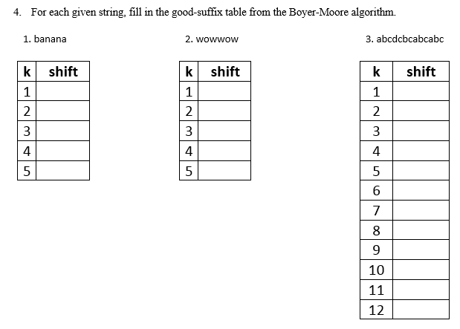
Can you figure these out?

Slide 20
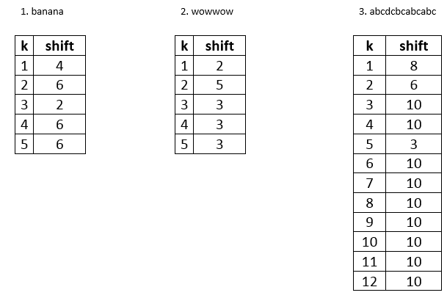
Solution (hide this until after class)

Slide 21
Boyer-Moore example (Levitin)
B E S S _ K N E W _ A B O U T _ B A O B A B S
B A O B A B
d₁ = t₁(K) = 6 B A O B A B
d₁ = t₁(_)-2 = 4
d₂(2) = 5
B A O B A B
d₁ = t₁(_)-1 = 5
d₂(1) = 2
B A O B A B (success)
A B C D E F G H I J K L M N O P Q R S T U V W X Y Z
_
1 2 6 6 6 6 6 6 6 6 6 6 6 6 3 6 6 6 6 6 6 6 6 6 6 6
6
k | pattern | d₂
1 | BAOBAB | 2
2 | BAOBAB | 5
3 | BAOBAB | 5
4 | BAOBAB | 5
5 | BAOBAB | 5

Slide 22
Boyer-Moore Example
On Moore's home page
http://www.cs.utexas.edu/users/moore/best-ideas/string-searching/fstrpos-example.html

