Slide 1
MA/CSSE 473 Day 24
Student questions
Space-time tradeoffs
Hash tables review
String search algorithms intro
Notes:
Don't include the second Space-time tradeoffs slide in the on-line slides

Slide 2
Things we did last time in Section 1
We did not get to them in other sections

Slide 3
Horner's Rule
It involves a representation change.
Instead of a_{n}x^{n} + a_{n-1}x^{n-1} + …. + a₁x + a₀, which requires a lot of multiplications, we write
( … (a_{n}x + a_{n-1})x + … +a₁ )x + a₀
code on next slide
Notes:
It's O(n).
It involves a representation change.
Instead of anx^n + an-1x^n-1 …. + a1x + a0 we write
( … (a_{n}x + a_{n-1})x + … )x + a₀

Slide 4
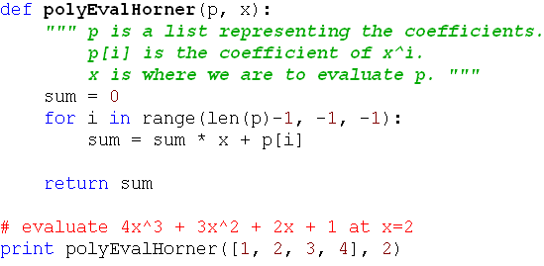
Horner's Rule Code
This is clearly Ѳ(n).
Notes:
It's O(n).
It involves a representation change.
Instead of anx^n + an-1x^n-1 …. + a1x + a0 we write
( … (a_{n}x + a_{n-1})x + … )x + a₀

Slide 5
Problem Reduction
Express an instance of a problem in terms of an instance of another problem that we already know how to solve.
There needs to be a one-to-one mapping between problems in the original domain and problems in the new domain.
Example: In quickhull, we reduced the problem of determining whether a point is to the left of a line to the problem of computing a simple 3x3 determinant.
Example: Moldy chocolate problem in HW 9.
The big question: What problem to reduce it to?
(You'll answer that one in the homework)

Slide 6
Least Common Multiple
Let m and n be integers. Find their LCM.
Factoring is hard.
But we can reduce the LCM problem to the GCD problem, and then use Euclid's algorithm.
Note that lcm(m,n)∙gcd(m,n) = m∙n
This makes it easy to find lcm(m,n)
Notes:
N = 12 = 2 2 3
M = 18 = 2 3 3
GCD = 6
LCM = 36
GCD * LCM = 6 * 36 = 216

Slide 7
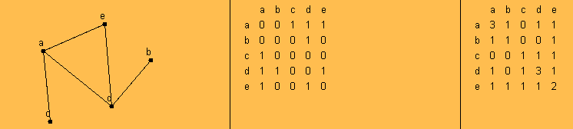
Paths and Adjacency Matrices
We can count paths from A to B in a graph by looking at powers of the graph's adjacency matrix.
For this example, I used the applet from
http://oneweb.utc.edu/~Christopher-Mawata/petersen2/lesson7.htm, which is no longer accessible
Notes:
This should be review fm 230
Take the square of the matrix

Slide 8
Space-time tradeoffs
Sometimes using a little more space saves a lot of time

Slide 9
Space vs time tradeoffs
Often we can find a faster algorithm if we are willing to use additional space.
Give some examples
Examples:

Slide 10
Space vs time tradeoffs
Often we can find a faster algorithm if we are willing to use additional space.
Give some examples (quiz question)
Examples:
  Binary heap vs simple sorted array. Uses one extra array position
  Merge sort
  Sorting by counting
  Radix sort and Bucket Sort
  Anagram finder
  Binary Search Tree (extra space for the pointers)
  AVL Tree (extra space for the balance code)

Slide 11
Hash Table Implementation
A Quick Review

Slide 12
Hash Table Review
Section 7.4 of Levitin
Excellent detailed reference: Weiss Chapter 20.
Covered in 230
  Both versions of the course
  A link to one version: http://www.rose-hulman.edu/class/csse/csse230/201230/Slides/17-Graphs-HashTables.pdf
Three questions on today's handout guide you through a quick review; the above link may be helpful. Do it with two other students. 20 minutes.
Then we will prove a property of quadratic probing that is described in 230 but seldom proved there.
  If you don't understand the effects of clustering, you might find the animation that is linked from this page to be especially helpful.
: http://www.cs.auckland.ac.nz/software/AlgAnim/hash_tables.html
Notes:
Assign them to groups of three to discuss this.
3 main issues:
table size, hash function, collision resolution

Slide 13
Hashing Review
Discuss the following questions in a group of three students
What problem do we try to solve by hashing?
What is the general idea of how hashing works?
Why does it fit into Chapter 7 (space-time tradeoffs)?
What are the main issues to be addressed when discussing hashing implementation?
How to choose between a hash table and a binary search tree?
Notes:
Assign them to groups of three to discuss this.
3 main issues:
table size, hash function, collision resolution

Slide 14
Terminology and analysis
If any of this terminology is unfamiliar, you should look it up
collision
load factor (λ)
perfect hash function
open addressing
  linear probing
  cluster
  quadratic probing
  rehashing
separate chaining
Notes:
Linear probing analysis:
Successful: (1 + 1/(1 – lambda)) / 2
Unsuccessful: (1 + 1/(1-lambda)^2) / 2
Answer student questions on Q1 before going on to Q2

Slide 15
Some Hashing Details …
Can be found on this page:
http://www.rose-hulman.edu/class/csse/csse230/201230/Slides/17-Graphs-HashTables.pdf
Similar to Weiss's presentation
They are linked from here in case you didn't "get it" the first time in CSSE230.
We will not go over all of them in detail in class.

Slide 16
Collision Resolution: Quadratic probing
With linear probing, if there is a collision at H, we try H, H+1, H+2, H+3, ... (all modulo the table size) until we find an empty spot.
  Causes (primary) clustering
With quadratic probing, we try H, H+1². H+2², H+3², ...
  Eliminates primary clustering, but can cause secondary clustering.
  Is it possible that it misses some available array positions?
  I.e it repeats the same positions over and over, while never probing some other positions?

Slide 17
Hints for quadratic probing
Choose a prime number for the array size, then …
  If the array is not more than half full, finding a place to do an insertion is guaranteed , and no cell is probed twice before finding it
  Suppose the array size is P, a prime number greater than 3
  Show by contradiction that if i and j are ≤ ⌊P/2⌋, and if i≠j, then
  H + i² (mod P) ≢ H + j² (mod P).
Use an algebraic trick to calculate next index
  Replaces mod and general multiplication with subtraction and a bit shift
  Difference between successive probes:
    H + (i+1)² ⁼ H + i² + (2i+1) [can use a bit-shift for the multiplication].
    nextProbe = nextProbe + (2i+1);
    if (nextProbe >= P) nextProbe -= P;
Notes:
Suppose i≠j, and H + i² (mod P) ≡ H + j² (mod P).
Then (H + i²) -(H + j²) ≡ 0 (mod P)
(i-j)(i+j) ≡ 0 (mod P). But 0 < (i + j) < P, so i=j, a contradiction.

Slide 18
Quadratic probing analysis
No one has been able to analyze it
Experimental data shows that it works well
  Provided that the array size is prime, and is the table is less than half full

Slide 19
Hashing Highlights (consider this later)
We cover this pretty thoroughly in CSSE 230, and Levitin does a good job of reviewing it concisely, so I'll have you read it on your own (section 7.3).
On the next slides you'll find a list of things you should know (some of them expressed here as questions)
Details in Levitin section 7.3 and Weiss chapter 20.
Outline of what you need to know is on the next slides.
Will not cover them in great detail in class, since they are typically covered well in 230.

Slide 20
Hashing – You should know, part 1
Hash table logically contains key-value pairs.
Represented as an array of size m. H[0..m-1]
Typically m is larger than the number of pairs currently in the table.
Hash function h(K) takes key K to a number in range 0..m
Hash function goals:
  Distribute keys as evenly as possible in the table.
  Easy to compute.
  Does not require m to be a lot larger than the number of keys in the table.

Slide 21
Hashing – You should know, part 2
Load factor: ratio of used table slots to total table slots.
  Smaller → better time efficiency (fewer collisions)
  Larger → better space efficiency
Two main approaches to collision resolution
  Open addressing
  Se
Open addressing basic idea
  When there is a collision during insertion, systematically check later slots (with wraparound) until we find an empty spot.
  When searching, we systematically move through the array in the same way we did upon insertion until
  we find the key we are looking for or an empty
  slot.

Slide 22
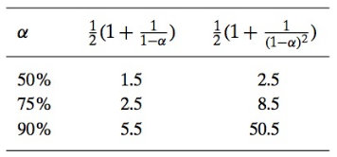
Hashing – You should know, part 3
Open addressing – linear probing
  When there is a collision, check the next cell, then the next one,…, (with wraparound)
  Let α be the load factor, and let S and U be the expected number of probes for successful and unsuccessful searches. Expected values for S and U are

Slide 23
Hashing – You should know, part 4
Open addressing – double hashing
  When there is a collision, use another hash function s(K) to decide how much to increment by when searching for an empty location in the table
  So we look in H(k), H(k) + s(k), H(k) + 2s(k), …, with everything being done mod m.
  If we we want to utilize all possible array positions, gcd(m, s(k)) must be 1. If m is prime, this will happen.

Slide 24

Hashing – You should know, part 5
Separate chaining
  Each of the m positions in the array contains a link ot a structure (perhaps a linked list) that can hold multiple values.
  Does not have the clustering problem that can come from open addressing.
  For more details, including quadratic probing, see Weiss Chapter 20 or my CSSE 230 slides (linked from the schedule page)

Slide 25
String Search
Search for a string within another string

Slide 26
Brute Force String Search Example
The problem: Search for the first occurrence of a pattern of length m in a text of length n.
Usually, m is much smaller than n.
What makes brute force so slow?
When we find a mismatch, we can shift the pattern by only one character position in the text.
Text: abracadabtabradabracadabcadaxbrabbracadabraxxxxxxabracadabracadabra
Pattern: abracadabra
abracadabra
abracadabra
abracadabra
abracadabra
abracadabra

Slide 27
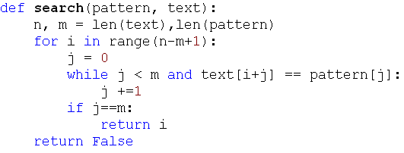
Faster String Searching
Was a HW problem
Brute force: worst case m(n-m+1)
A little better: but still Ѳ(mn) on average
  Short-circuit the inner loop

Slide 28
Horspool's Algorithm Intro
A simplified version of the Boyer-Moore algorithm
A good bridge to understanding Boyer-Moore
Published in 1980
What makes brute force so slow?
  When we find a mismatch, we can only shift the pattern to the right by one character position in the text.
  Text: abracadabtabradabracadabcadaxbrabbracadabraxxxxxxabracadabracadabra
  Pattern: abracadabra
  abracadabra
  abracadabra
  abracadabra
Can we shift farther?
Like Boyer-Moore, Horspool does the comparisons in a counter-intuitive order (moves right-to-left
through the pattern)
Notes:
We mostly look at Horspool as a bridge to understanding Boyer-Moore

Slide 29
Horspool's Main Question
If there is a character mismatch, how far can we shift the pattern, with no possibility of missing a match within the text?
What if the last character in the pattern is compared with a character in the text that does not occur in the pattern at all?
Text: ... ABCDEFG ...
Pattern: CSSE473

Slide 30
How Far to Shift?
Look at first (rightmost) character in the part of the text that is compared to the pattern:
The character is not in the pattern
.....C.......... {C not in pattern)
BAOBAB
The character is in the pattern (but not the rightmost)
.....O..........(O occurs once in pattern)
BAOBAB
.....A..........(A occurs twice in pattern)
BAOBAB
The rightmost characters do match
.....B......................
BAOBAB
Notes:
Tell students to think about how far we can shift.

