Slide 1
MA/CSSE 473 Day 23
Review of Binary Heaps and Heapsort
Overview of what
you should know about hashing
Answers to student questions
Notes:
Don't include the second Space-time tradeoffs slide in the on-line slides

Slide 2
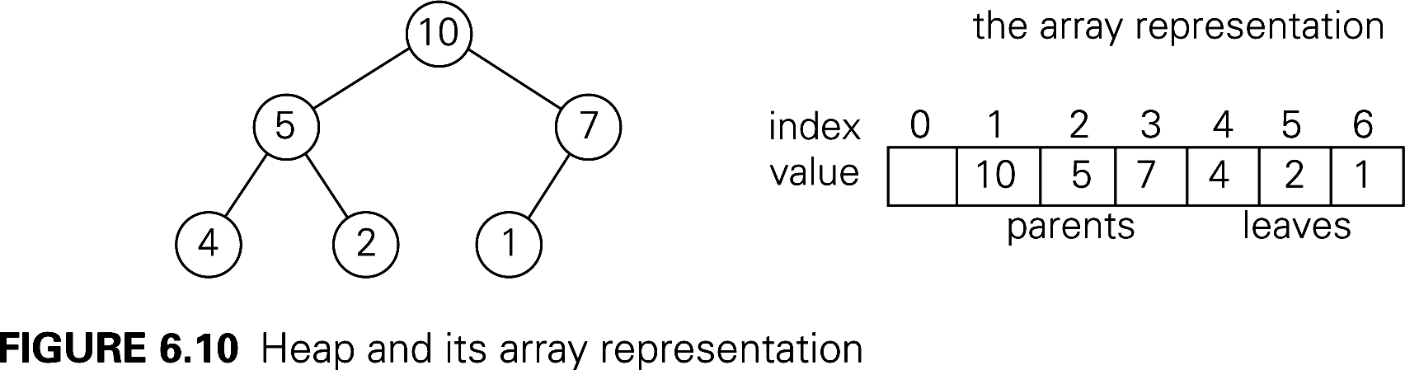
Binary (max) Heap Quick Review
Representation change example
See also Weiss, Chapter 21 (Weiss does min heaps)
An almost-complete Binary Tree
  All levels, except possibly the last, are full
  On the last level all nodes are as far left as possible
  No parent is smaller than either of its children
  A great way to represent a Priority Queue
Representing a binary heap as an array:
Notes:
My guess is that for most of you, you only need a quick refresher on the heap insert and removeMax algorithms, but that a subtle issue relating to heapSort analysis may have gone over your head.

Slide 3
Insertion and RemoveMax
Insert an item:
  Insert at the next position (end of the array) to maintain an almost-complete tree, then "percolate up" within the tree to restore heap property.
RemoveMax:
  Move last element of the heap to replace the root, then "percolate down" to restore heap property.
Both operations are Ѳ(log n).
Many more details (done for min-heaps):
  http://www.rose-hulman.edu/class/csse/csse230/201230/Slides/18-Heaps.pdf
Notes:
Draw the heap rom previous slide on the board, insert 8, then 11; removeMax a couple of times.
Then show code on next slide

Slide 4
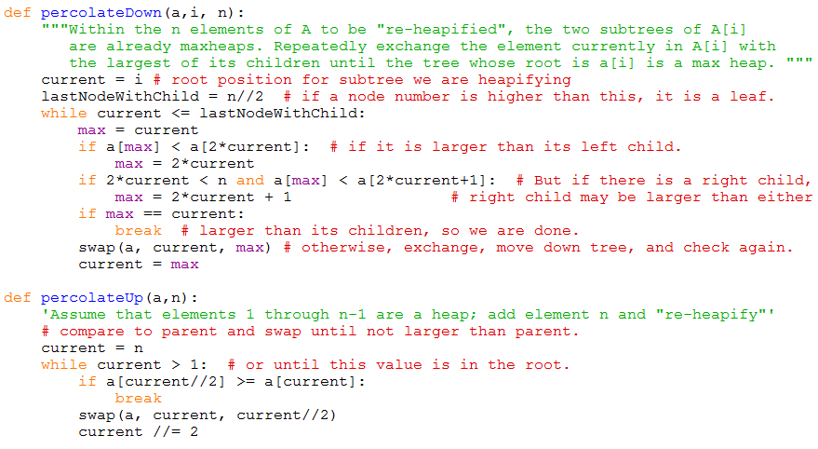
Heap utilitiy functions
Code is on-line, linked from the schedule page

Slide 5
HeapSort
Arrange array into a heap. (details next slide)
for i = n downto 2:
a[1]↔a[i], then "reheapify" a[1]..a[i-1]

Slide 6
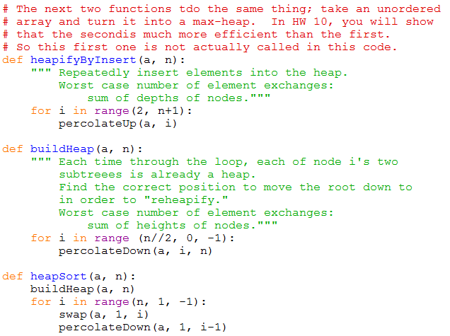
HeapSort Code

Slide 7
HeapSort: Build Initial Heap
Two approaches:
  for i = 2 to n
  percolateUp(i)
  for j = n/2 downto 1
  percolateDown(j)
Which is faster, and why?
What does this say about overall big-theta running time for HeapSort?
Notes:
In a heap, what is the depth of the node in position a[i]? Answer: floor(lg i)
In a full tree, what is the relationship between Height(node[i]) and depth(node[i])?

Slide 8
Transform and conquer
Polynomial Evaluation
Problem Reductiion

Slide 9
Horner's Rule
It involves a representation change.
Instead of a_{n}x^{n} + a_{n-1}x^{n-1} + …. + a₁x + a₀, which requires a lot of multiplications, we write
( … (a_{n}x + a_{n-1})x + … +a₁ )x + a₀
code on next slide
Notes:
It's O(n).
It involves a representation change.
Instead of anx^n + an-1x^n-1 …. + a1x + a0 we write
( … (a_{n}x + a_{n-1})x + … )x + a₀

Slide 10
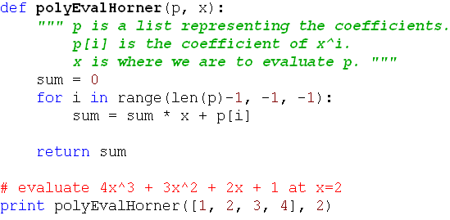
Horner's Rule Code
This is clearly Ѳ(n).
Notes:
It's O(n).
It involves a representation change.
Instead of anx^n + an-1x^n-1 …. + a1x + a0 we write
( … (a_{n}x + a_{n-1})x + … )x + a₀

Slide 11
Problem Reduction
Express an instance of a problem in terms of an instance of another problem that we already know how to solve.
There needs to be a one-to-one mapping between problems in the original domain and problems in the new domain.
Example: In quickhull, we reduced the problem of determining whether a point is to the left of a line to the problem of computing a simple 3x3 determinant.
Example: Moldy chocolate problem in HW 9.
The big question: What problem to reduce it to?
(You'll answer that one in the homework)

Slide 12
Least Common Multiple
Let m and n be integers. Find their LCM.
Factoring is hard.
But we can reduce the LCM problem to the GCD problem, and then use Euclid's algorithm.
Note that lcm(m,n)∙gcd(m,n) = m∙n
This makes it easy to find lcm(m,n)
Notes:
N = 12 = 2 2 3
M = 18 = 2 3 3
GCD = 6
LCM = 36
GCD * LCM = 6 * 36 = 216

Slide 13
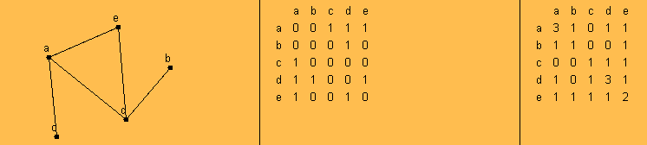
Paths and Adjacency Matrices
We can count paths from A to B in a graph by looking at powers of the graph's adjacency matrix.
For this example, I used the applet from
http://oneweb.utc.edu/~Christopher-Mawata/petersen2/lesson7.htm, which is no longer accessible
Notes:
This should be review fm 230
Take the square of the matrix

Slide 14
Linear programming
We want to maximize/minimize a linear function
, subject to constraints, which are linear equations or inequalities involving the n variables x₁,…,x_{n} .
The constraints define a region, so we seek to maximize the function within that region.
If the function has a maximum or minimum in the region it happens at one of the vertices of the convex hull of the region.
The simplex method is a well-known algorithm for solving linear programming problems. We will not deal with it in this course.
The Operations Research courses cover linear programming in some detail.

Slide 15
Integer Programming
A linear programming problem is called an integer programming problem if the values of the variables must all be integers.
The knapsack problem can be reduced to an integer programming problem:
maximize subject to the constraints
and x_{i} ∈{0, 1} for i=1, …, n

Slide 16
Space-time tradeoffs
Sometimes using a little more space saves a lot of time

Slide 17
Space vs time tradeoffs
Often we can find a faster algorithm if we are willing to use additional space.
Examples:

Slide 18
Space vs time tradeoffs
Often we can find a faster algorithm if we are willing to use additional space.
Give some examples (quiz question)
Examples:
  Binary heap vs simple sorted array. Uses one extra array position
  Merge sort
  Radix sort and Bucket Sort
  Anagram finder
  Binary Search Tree (extra space for the pointers)
  AVL Tree (extra space for the balance code)

Slide 19
Hashing Highlights
We cover this pretty thoroughly in CSSE 230, and Levitin does a good job of reviewing it concisely, so I'll have you read it on your own (section 7.3).
On the next slides you'll find a list of things you should know (some of them expressed here as questions)
Details in Levitin section 7.3 and Weiss chapter 20.
Outline of what you need to know is on the next slides.
Will not cover them in great detail in class, since they are typically covered well in 230.
Today: talk with students near you and answer the last two questions on today's handout.

Slide 20
Hashing – You should know, part 1
Hash table logically contains key-value pairs.
Represented as an array of size m. H[0..m-1]
Typically m is larger than the number of pairs currently in the table.
Hash function h(K) takes key K to a number in range 0..m
Hash function goals:
  Distribute keys as evenly as possible in the table.
  Easy to compute.
  Does not require m to be a lot larger than the number of keys in the table.

Slide 21
Hashing – You should know, part 2
Load factor: ratio of used table slots to total table slots.
  Smaller → better time efficiency (fewer collisions)
  Larger → better space efficiency
Two main approaches to collision resolution
  Open addressing
  Se
Open addressing basic idea
  When there is a collision during insertion, systematically check later slots (with wraparound) until we find an empty spot.
  When searching, we systematically move through the array in the same way we did upon insertion until
  we find the key we are looking for or an empty
  slot.

Slide 22
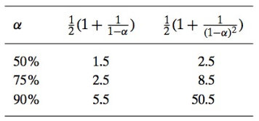
Hashing – You should know, part 3
Open addressing – linear probing
  When there is a collision, check the next cell, then the next one,…, (with wraparound)
  Let α be the load factor, and let S and U be the expected number of probes for successful and unsuccessful searches. Expected values for S and U are

Slide 23
Hashing – You should know, part 4
Open addressing – double hashing
  When there is a collision, use another hash function s(K) to decide how much to increment by when searching for an empty location in the table
  So we look in H(k), H(k) + s(k), H(k) + 2s(k), …, with everything being done mod m.
  If we we want to utilize all possible array positions, gcd(m, s(k)) must be 1. If m is prime, this will happen.

Slide 24

Hashing – You should know, part 5
Separate chaining
  Each of the m positions in the array contains a link ot a structure (perhaps a linked list) that can hold multiple values.
  Does not have the clustering problem that can come from open addressing.
  For more details, including quadratic probing, see Weiss Chapter 20 or my CSSE 230 slides (linked from the schedule page)

